Slide 1
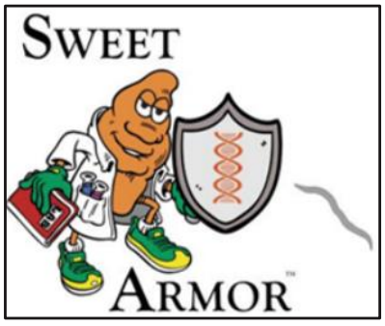
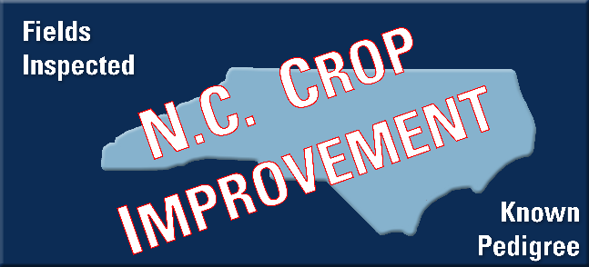
Advances in Marker Assisted and Genomic Selection in the North Carolina State University Sweetpotato Breeding Program
Simon Fraher, MS, PhD student
Simon Fraher, Bonny Oloka, Gabriel de Siqueira Gesteira, Guilherme da Silva Pereira, Zhao-Bang Zeng, Marcelo Mollinari, Adrienne Gorny, G. Craig Yencho. North Carolina State University, Raleigh, NC.
North Carolina State University
Horticulture Science – Sweetpotato Breeding
Tools for Polyploids 2024 Conference
1.11.24 San Diego, CA
With funding from SweetGAINS funded by the Bill and Melinda Gates Foundation OPP1052983 and OPP1213329,
The NC Agricultural Foundation, Inc., the NC Crop Improvement Association and NC Foundation Seed Producers, Inc.,
and Specialty Crop Research Initiative Grant No. 2021-51181-35865 from the USDA National Institute of Food and Agriculture.

Slide 2
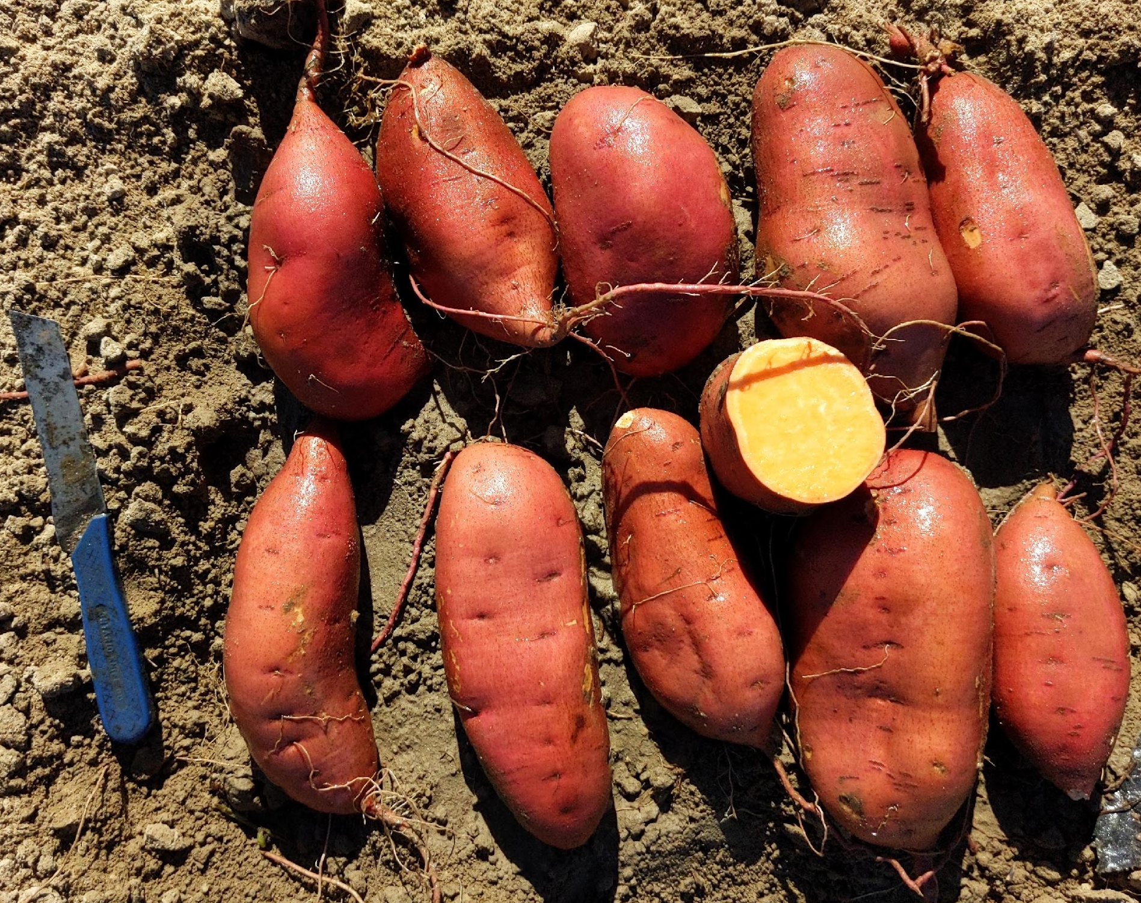
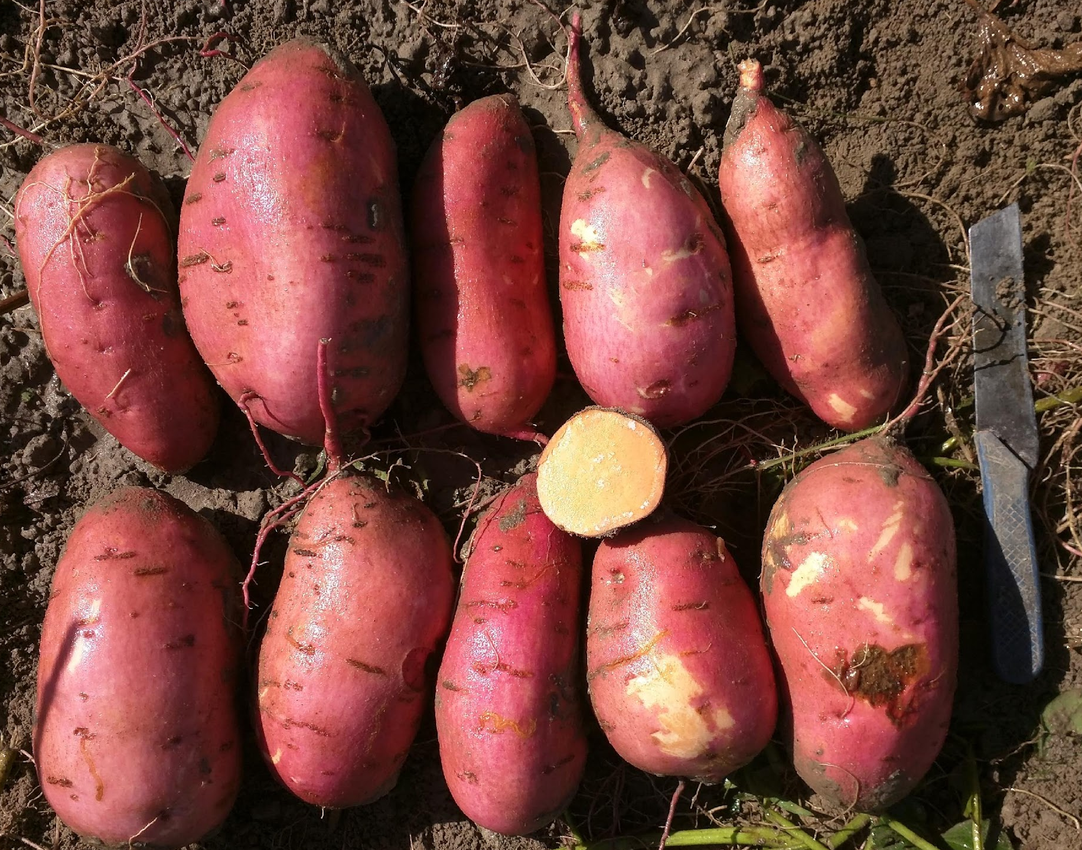
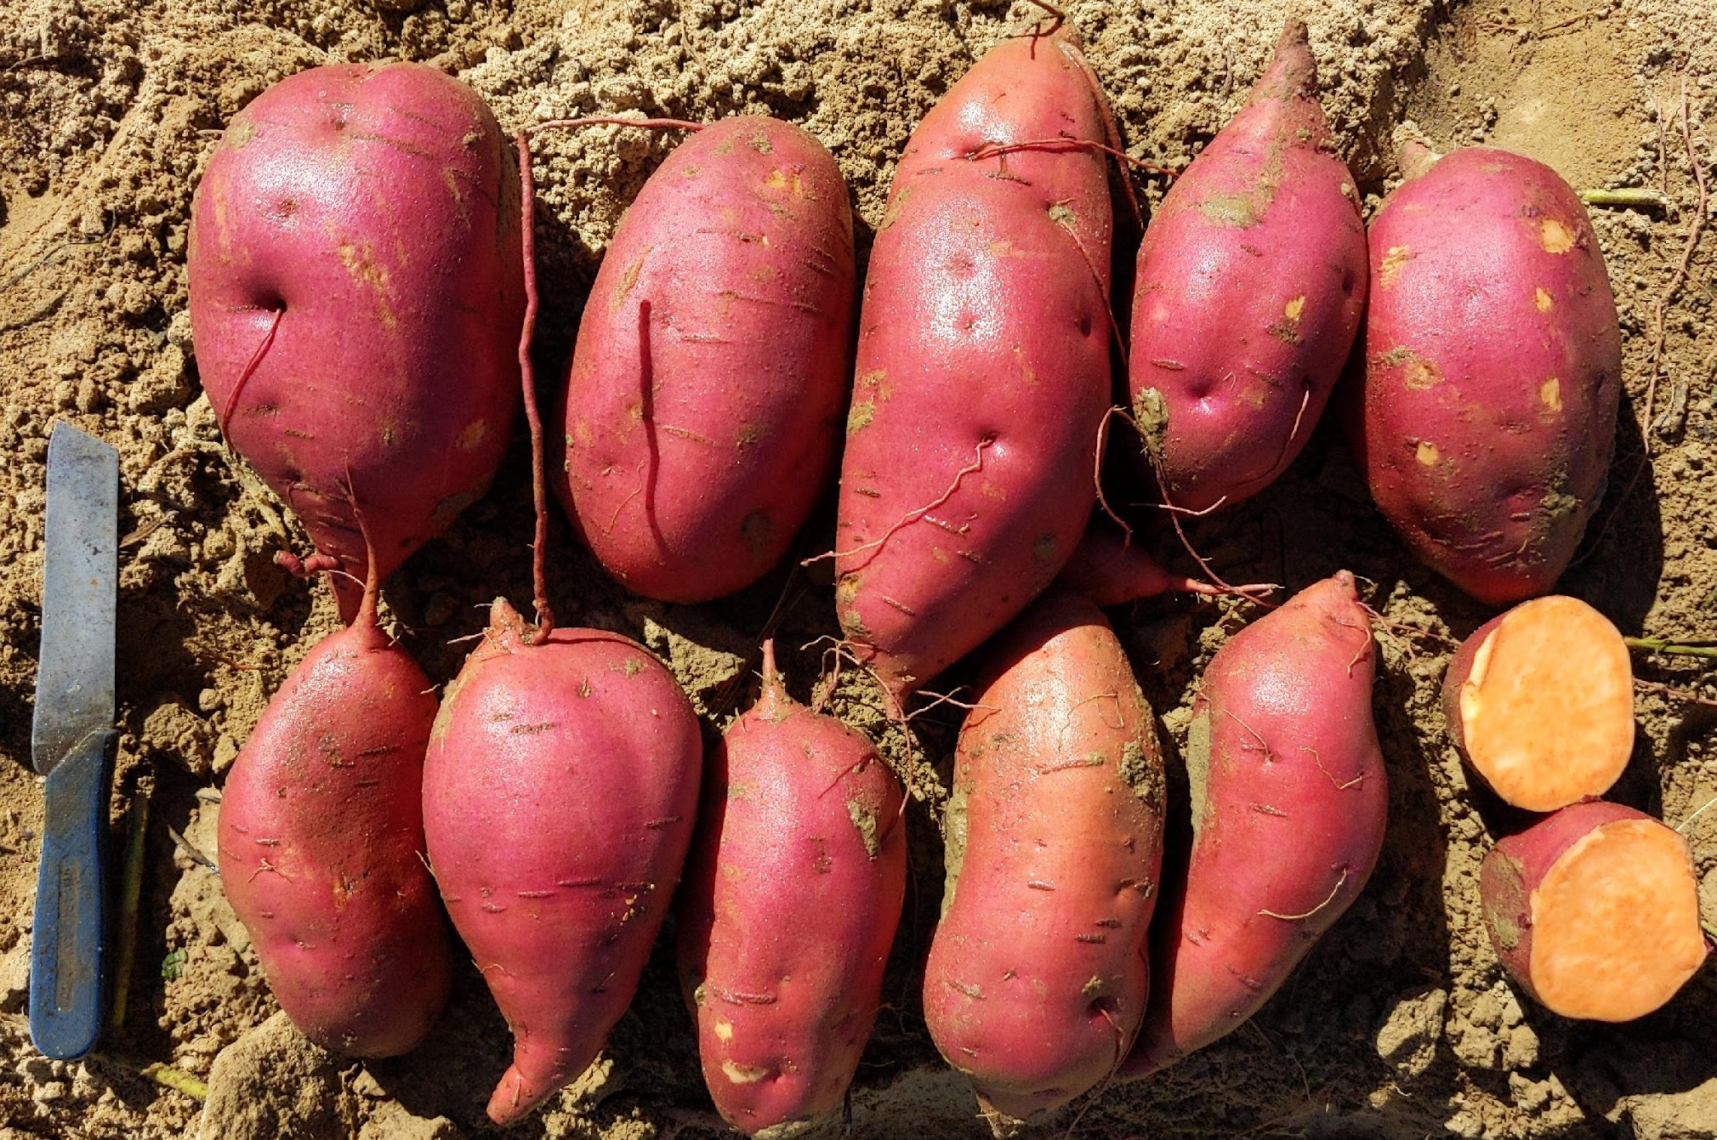
North Carolina Sweetpotato Breeding
Ipomoea batatas (L.) Lam. (2n=6x=90)
North Carolina produces 65% of US crop ($375m)
40% exported to EU
Breeding Considerations
High heterozygosity
F1 segregation
Self incompatibility
Backcrossing not feasible
Strategy: recurrent mass selection
‘Covington’ >90%
‘Beauregard’ ~2.5%
‘Bayou Belle’ ~2.5%

Slide 3
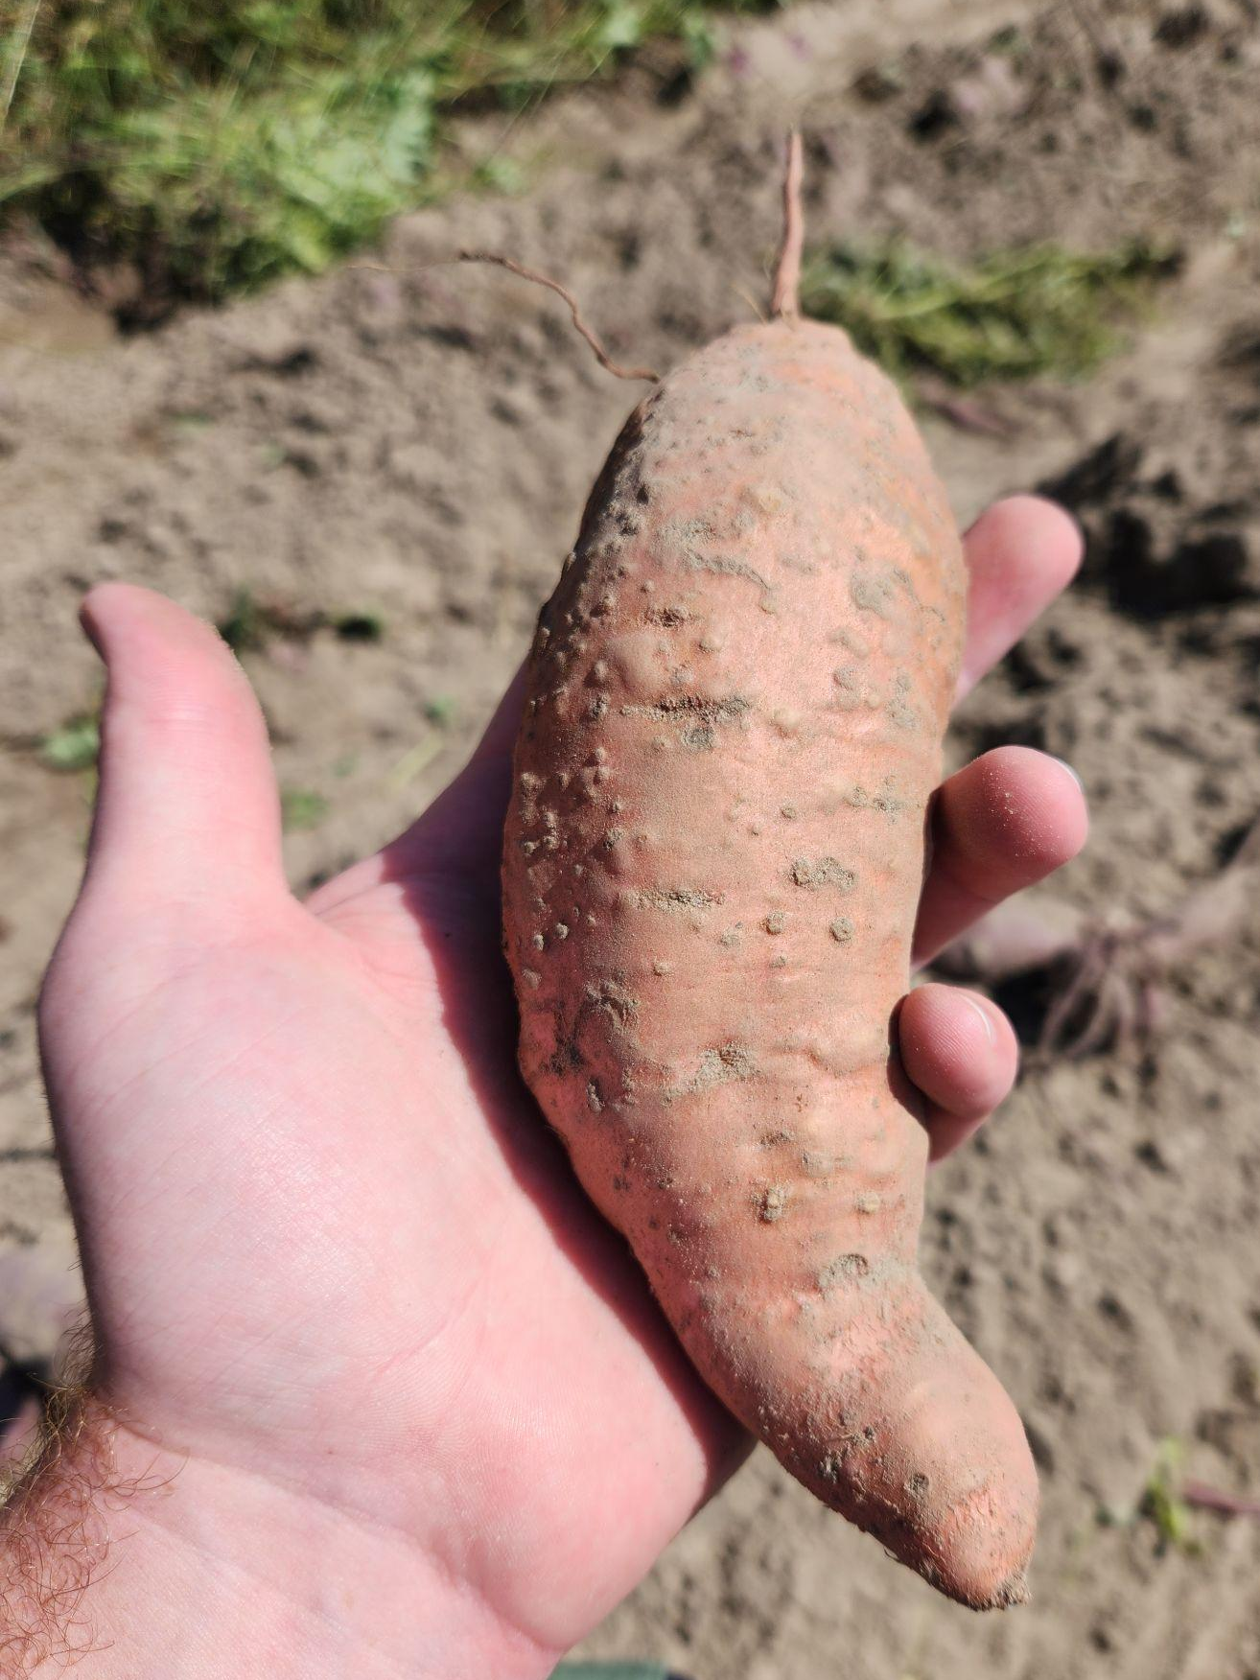
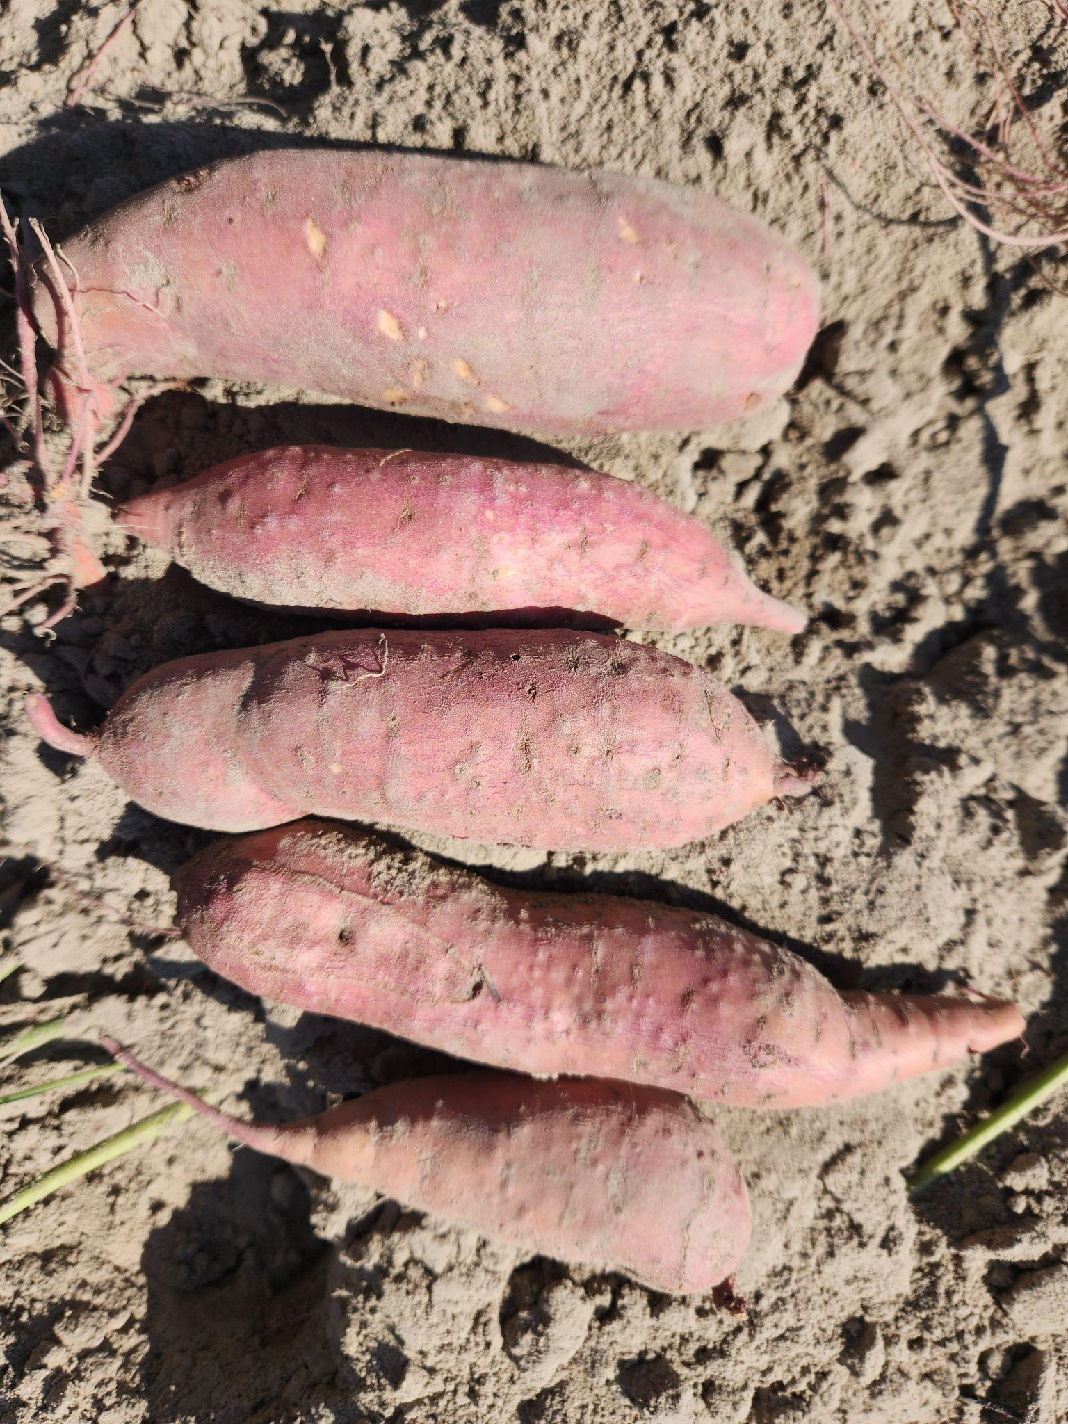
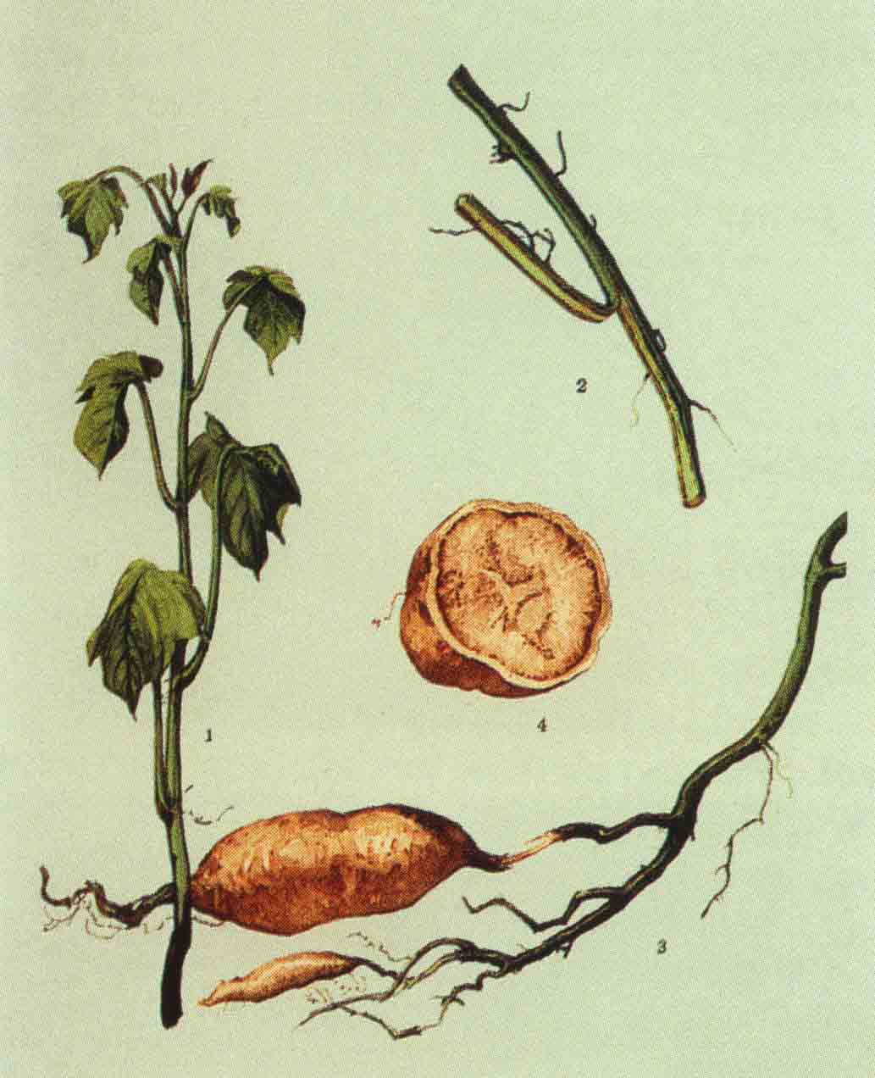
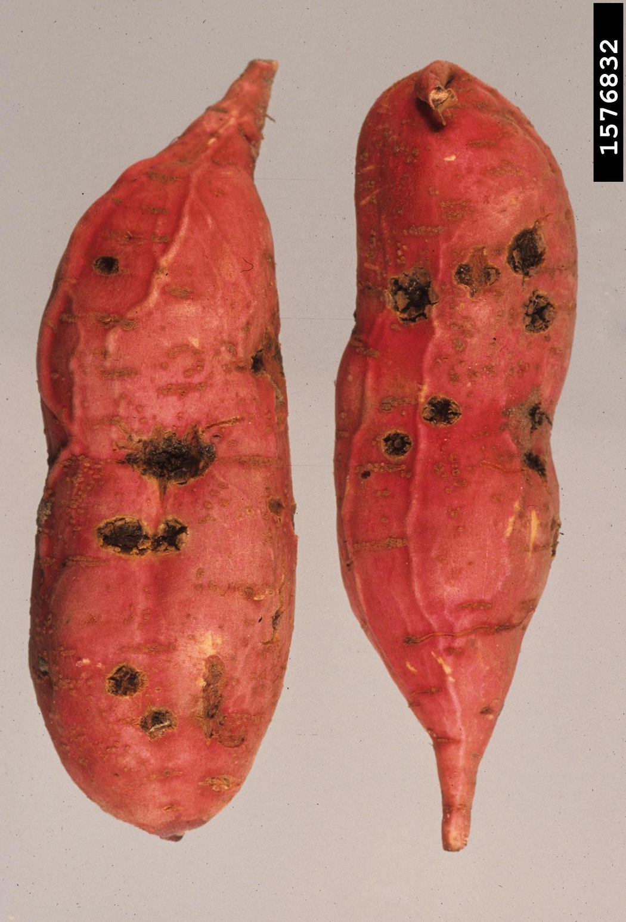
Four Major Sweetpotato Diseases (Southeast)
Guava RKN
Meloidogyne enterolobii
Southern RKN
M. incognita
Fusarium Wilt
F. oxysporum
Soil Pox
Streptomyces ipomoeae

Slide 4
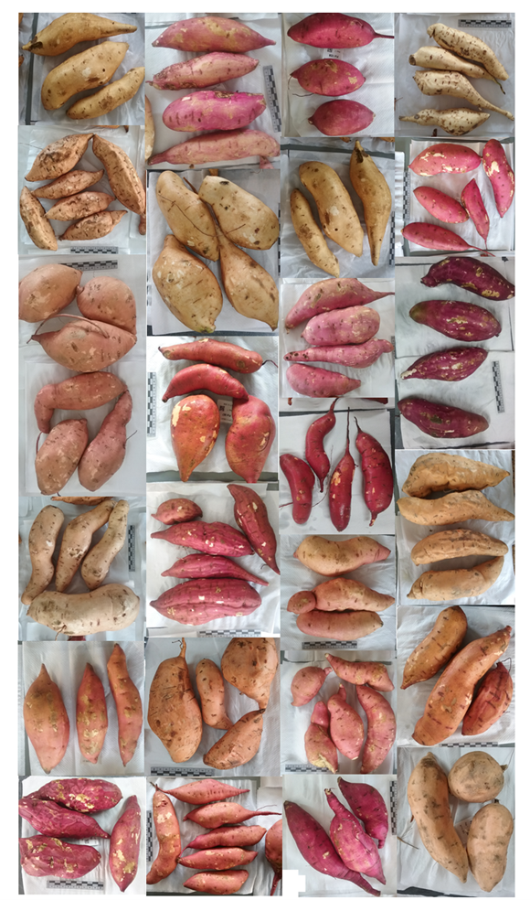
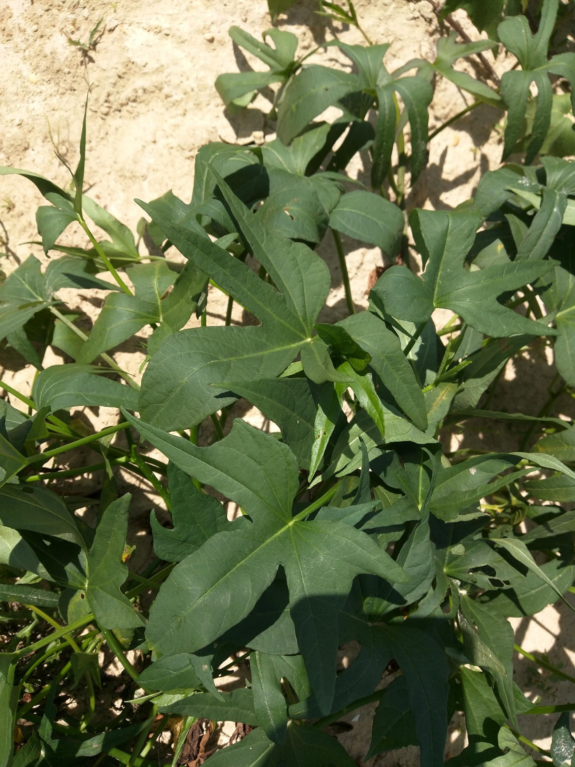
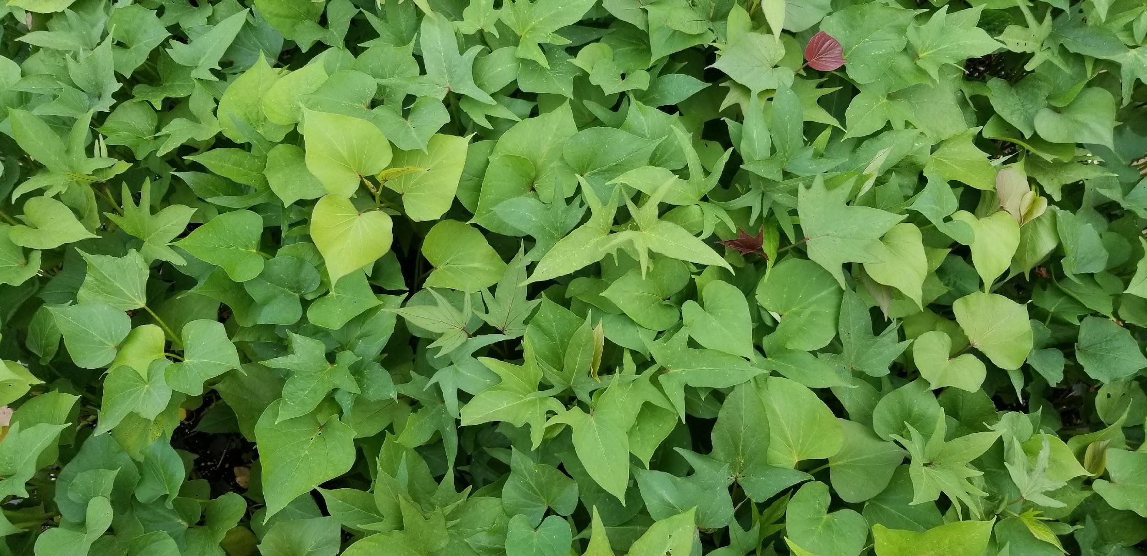
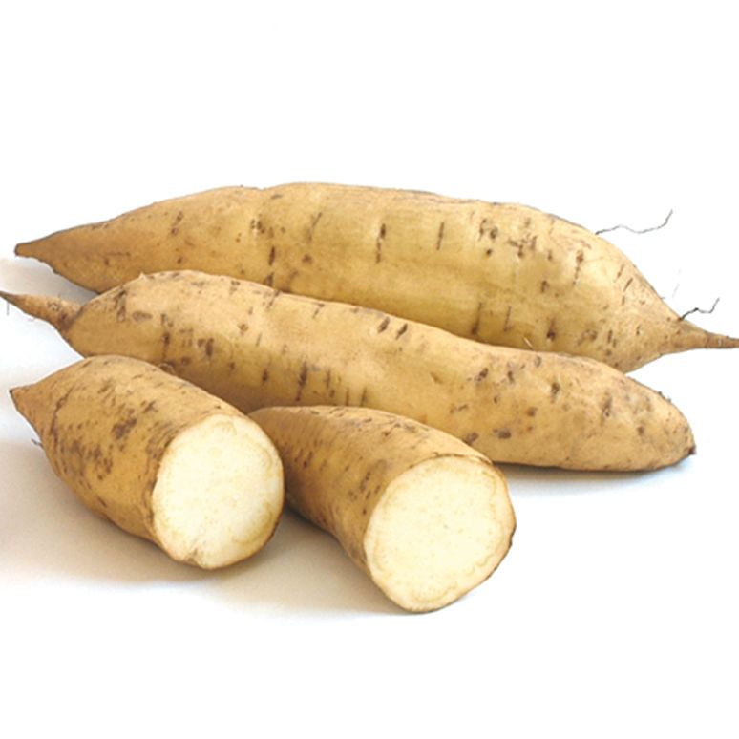
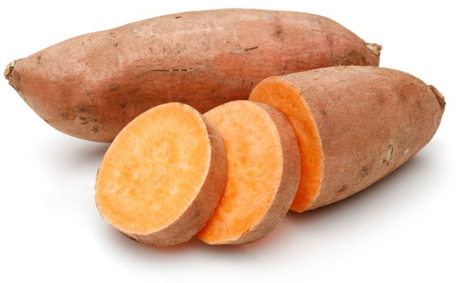
‘Tanzania’
‘Beauregard’
‘Beauregard’
Ugandan landrace
Resistant to RKN
LSU variety
Susceptible to RKN
‘Tanzania’ x ‘Beauregard’ (TB) Mapping Population, ~250 full-sib progeny

Slide 5
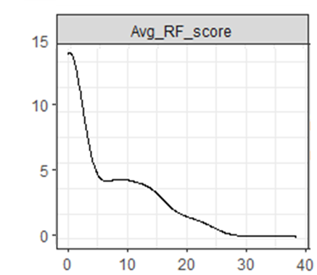
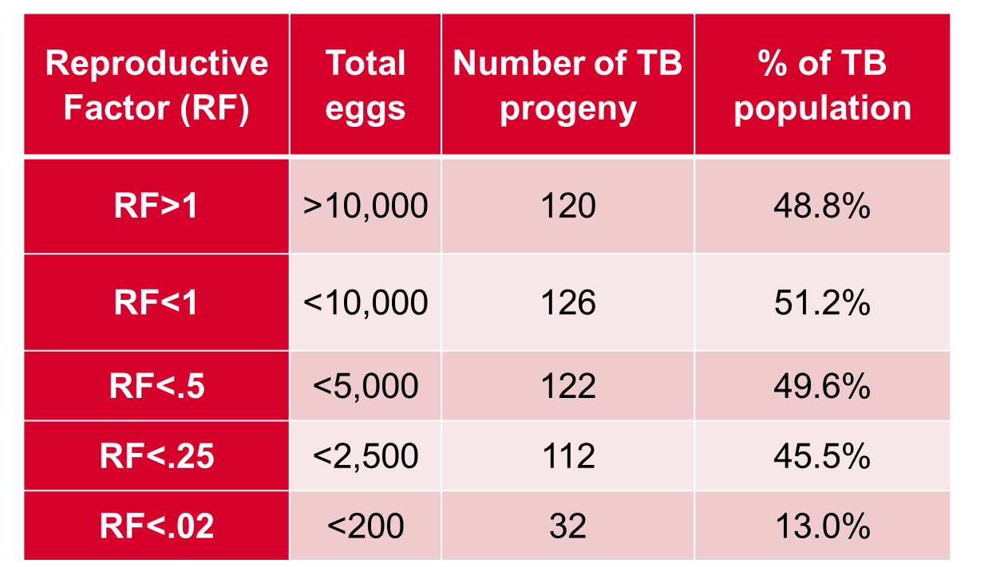
TB Segregates 1:1 for M. enterolobii Resistance
Reproductive Factor (Pi / Pf)
~50% of TB progenies were susceptible (RF>1)
~50% of TB progenies were resistant (RF<1)
Notes:
Define RF

Slide 6
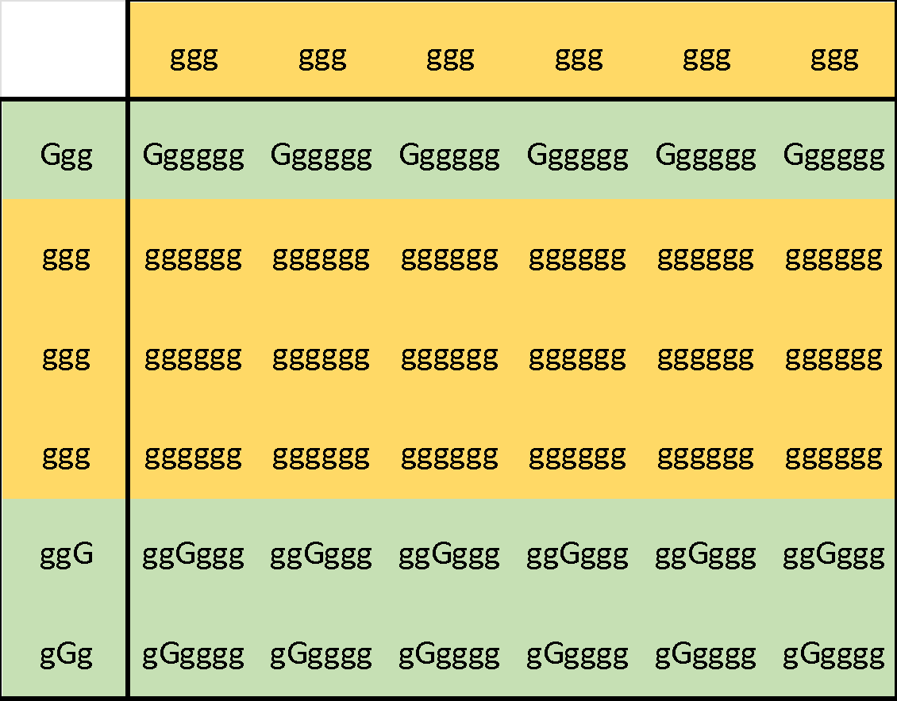
Beauregard (gggggg)
Tanzania (Gggggg)

Slide 7
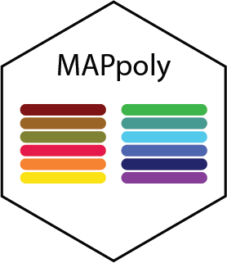
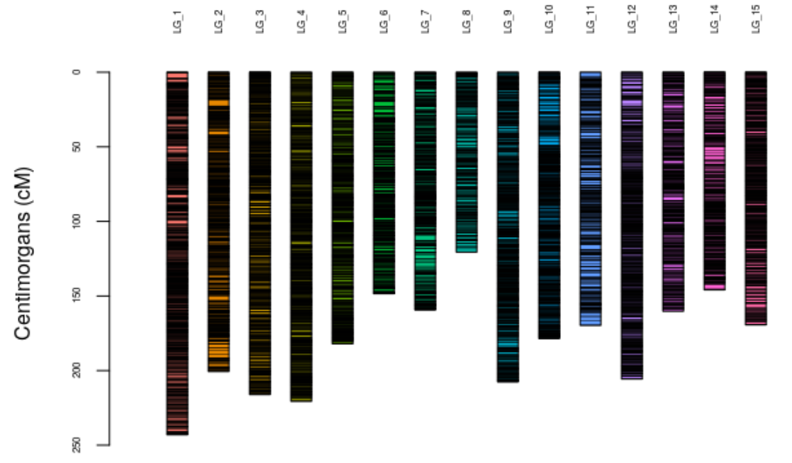
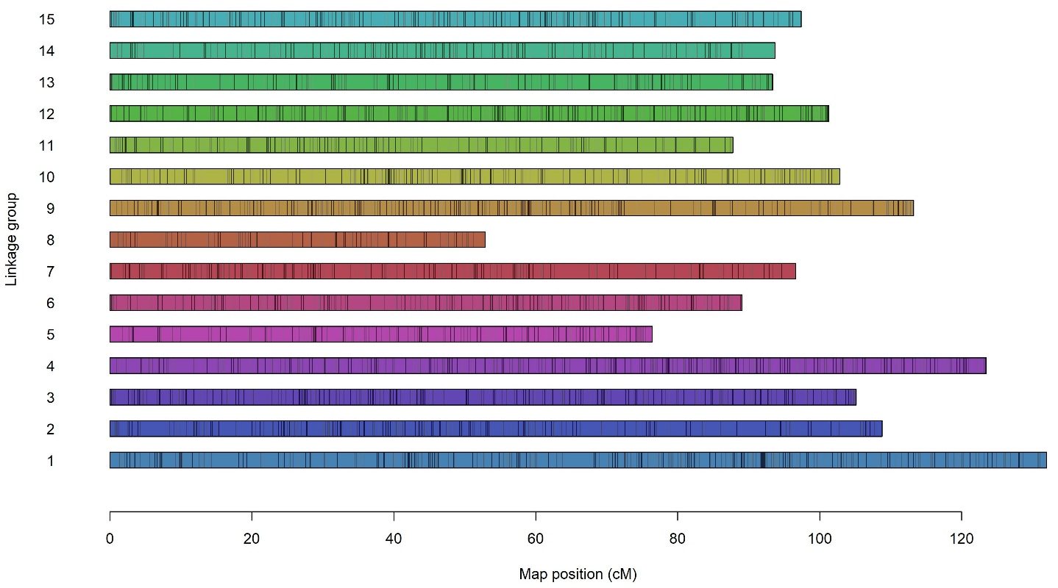
Hexaploid Sweetpotato Linkage Maps
TB Linkage Map
‘Tanzania’ x ‘Beauregard’
DC Linkage Map
DM04-0001 x ‘Covington’
Both based on I. trifida (2x) reference genome (Wu et al., 2018)

Slide 8
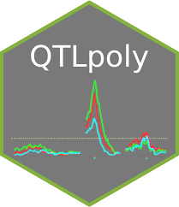
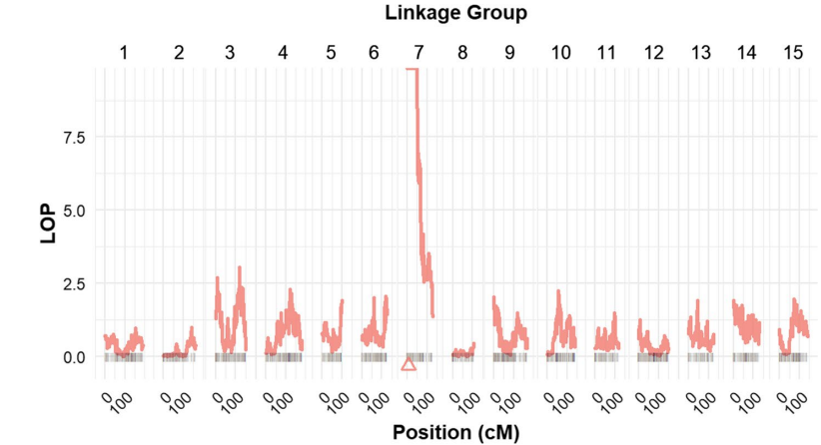
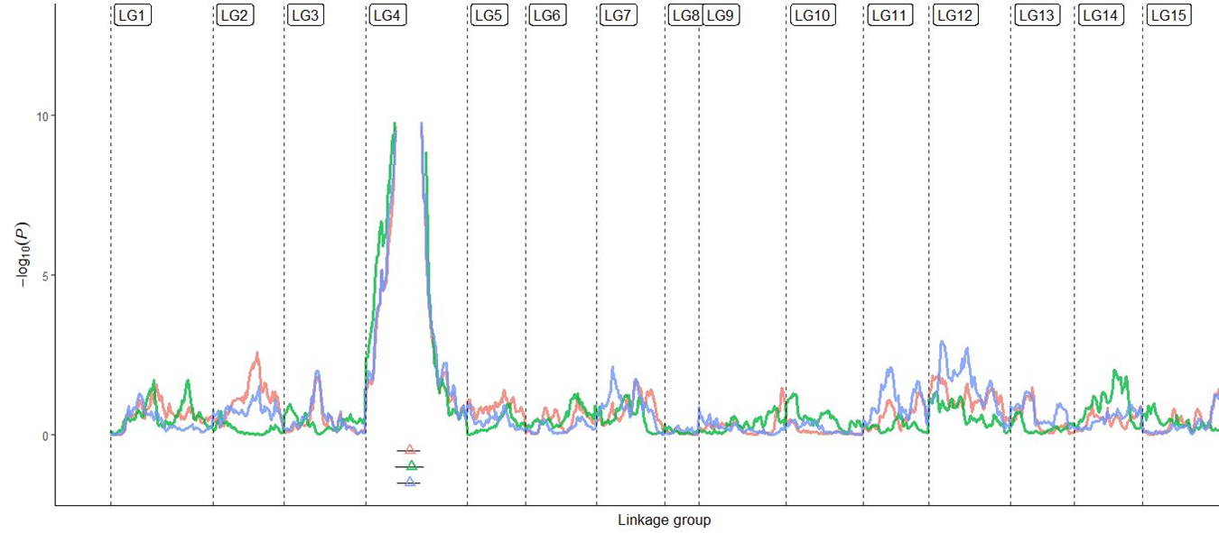
QTL for Meloidogyne Nematode Resistance
Southern RKN Resistance Locus
Guava RKN Resistance Locus
qIbMi-7.1
qIbMe-4.1
Notes:
Discuss marker design

Slide 9
KASP Markers:
RKN Resistance
M. enterolobii
Fitpoly (3.0.0) - Dosage calling
(Voorrips & Gort, 2018)
3 significant markers for M. enterolobii
1 significant marker for M. incognita
M. incognita

Slide 10
Dosage of 2:
GGgggg x gggggg
Dosage of 3:
GGGggg x gggggg
 | ggg | ggg | ggg | ggg | ggg | ggg
GGg | GGgggg | GGgggg | GGgggg | GGgggg | GGgggg | GGgggg
Ggg | Gggggg | Gggggg | Gggggg | Gggggg | Gggggg | Gggggg
ggg | gggggg | gggggg | gggggg | gggggg | gggggg | gggggg
ggg | gggggg | gggggg | gggggg | gggggg | gggggg | gggggg
ggG | ggGggg | ggGggg | ggGggg | ggGggg | ggGggg | ggGggg
gGG | gGGggg | gGGggg | gGGggg | gGGggg | gGGggg | gGGggg
 | ggg | ggg | ggg | ggg | ggg | ggg
GGG | GGGggg | GGGggg | GGGggg | GGGggg | GGGggg | GGGggg
GGg | GGgggg | GGgggg | GGgggg | GGgggg | GGgggg | GGgggg
Ggg | Gggggg | Gggggg | Gggggg | Gggggg | Gggggg | Gggggg
ggg | gggggg | gggggg | gggggg | gggggg | gggggg | gggggg
ggG | ggGggg | ggGggg | ggGggg | ggGggg | ggGggg | ggGggg
gGG | gGGggg | gGGggg | gGGggg | gGGggg | gGGggg | gGGggg
24/36 resistant
67% resistant progenies
30/36 resistant
83% resistant progenies

Slide 11
Dosage of 4:
GGGGgg x gggggg
 | ggg | ggg | ggg | ggg | ggg | ggg
GGG | GGGggg | GGGggg | GGGggg | GGGggg | GGGggg | GGGggg
GGG | GGGggg | GGGggg | GGGggg | GGGggg | GGGggg | GGGggg
GGg | GGgggg | GGgggg | GGgggg | GGgggg | GGgggg | GGgggg
Ggg | Gggggg | Gggggg | Gggggg | Gggggg | Gggggg | Gggggg
ggG | ggGggg | ggGggg | ggGggg | ggGggg | ggGggg | ggGggg
gGG | gGGggg | gGGggg | gGGggg | gGGggg | gGGggg | gGGggg
100% resistant progeny
Notes:
Transition to Advanced phenotpying…

Slide 12
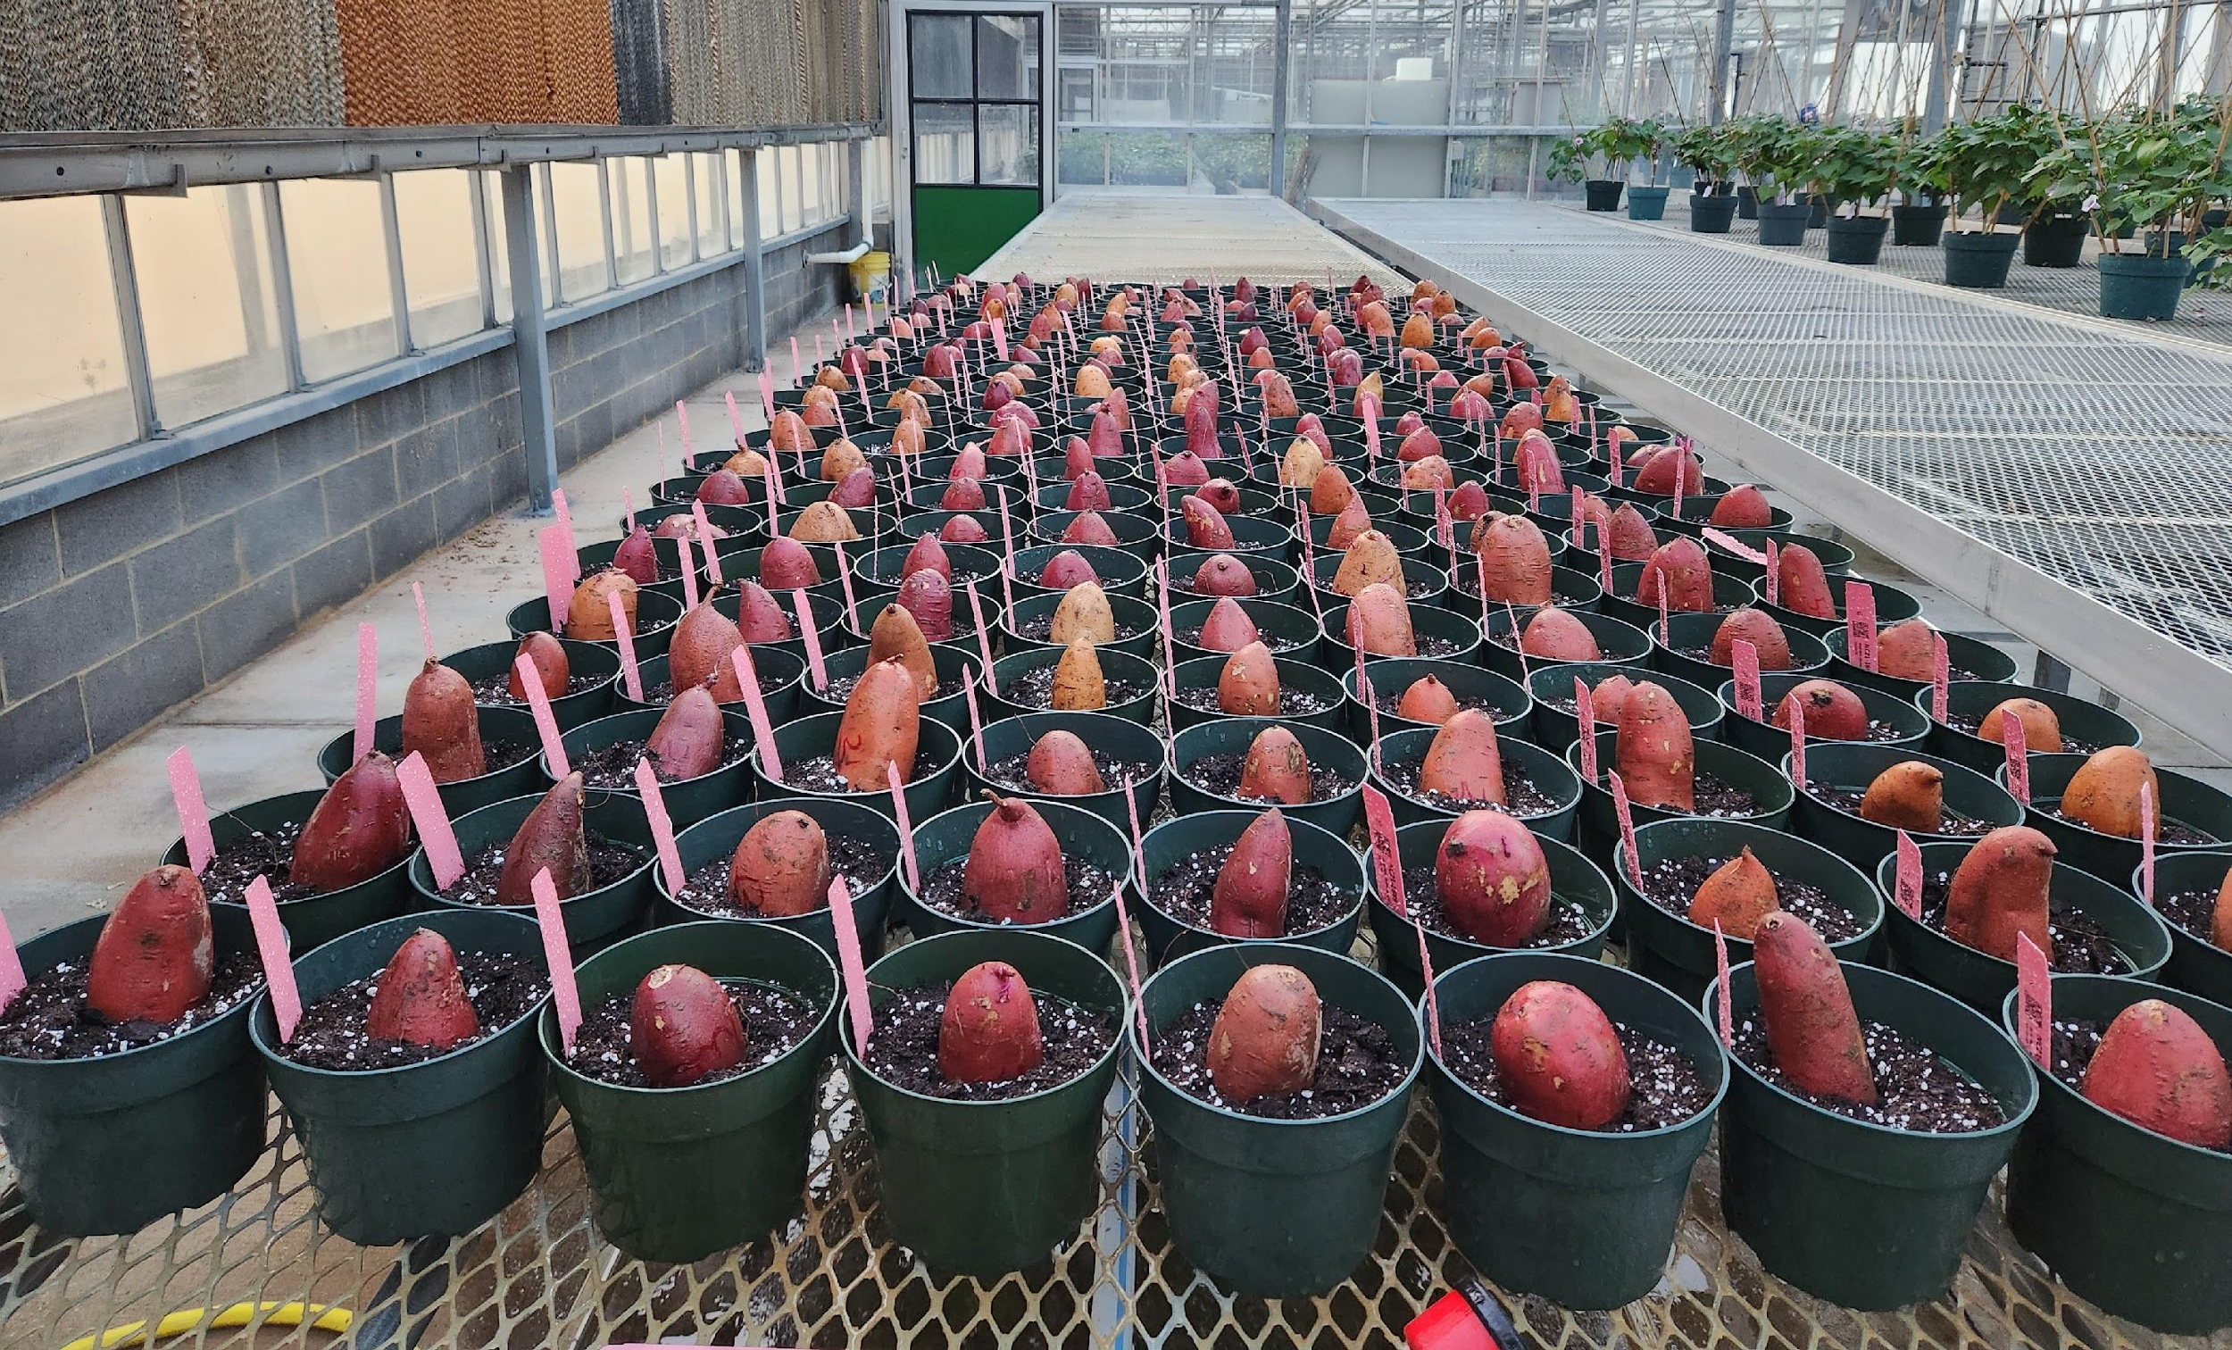
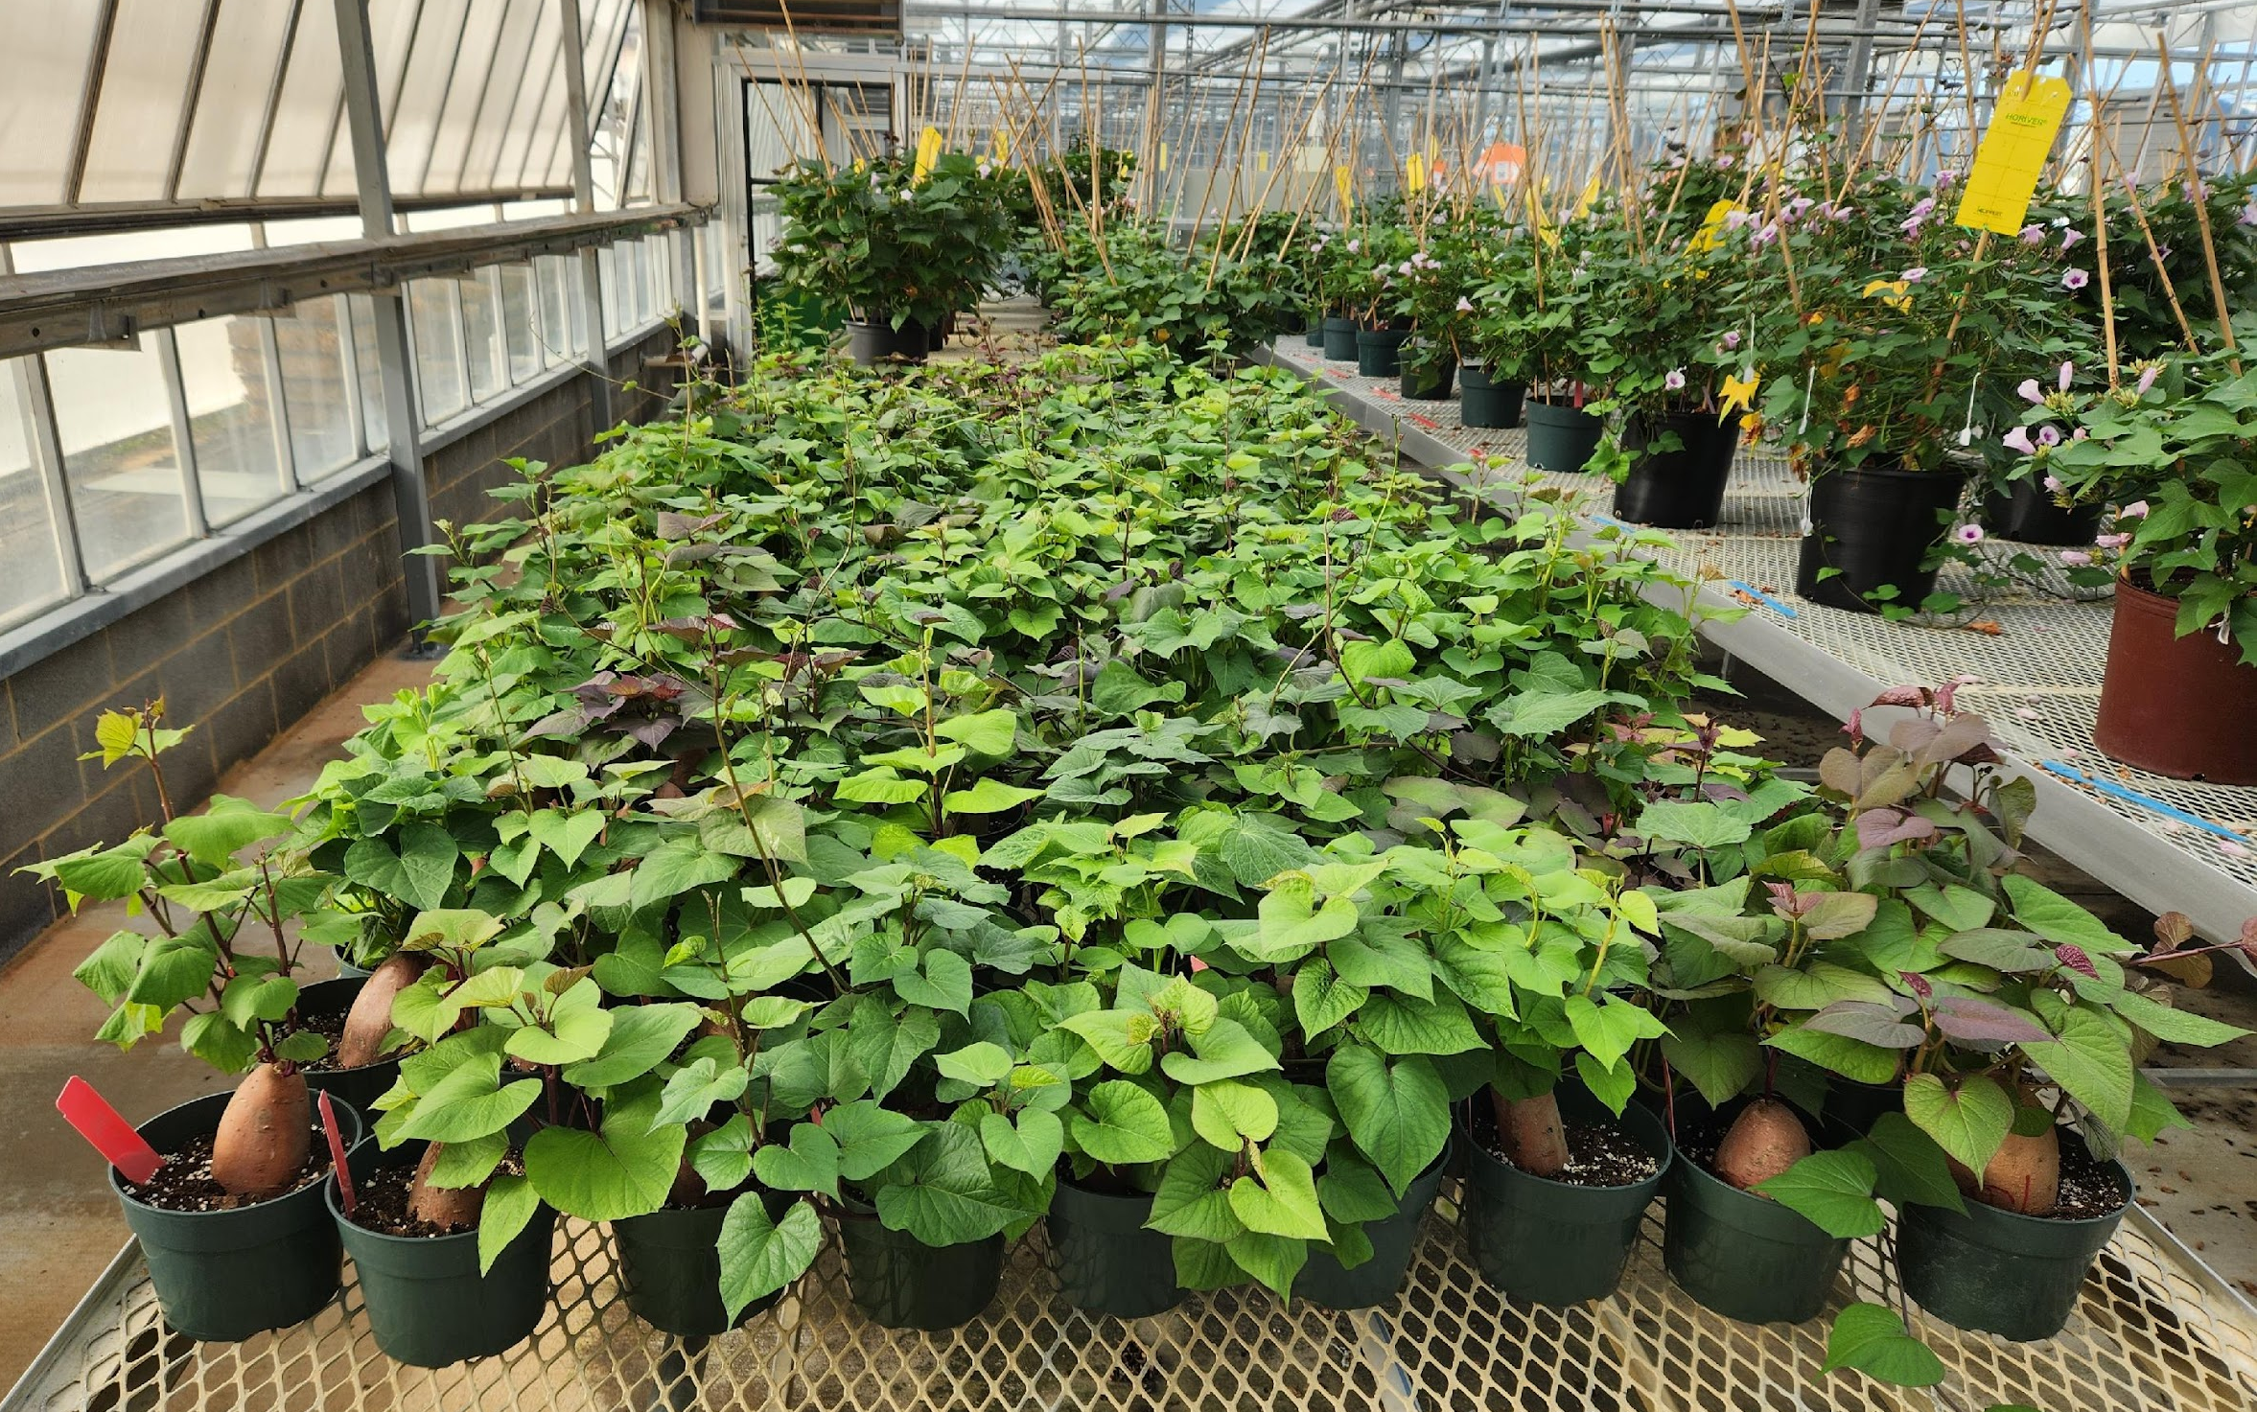
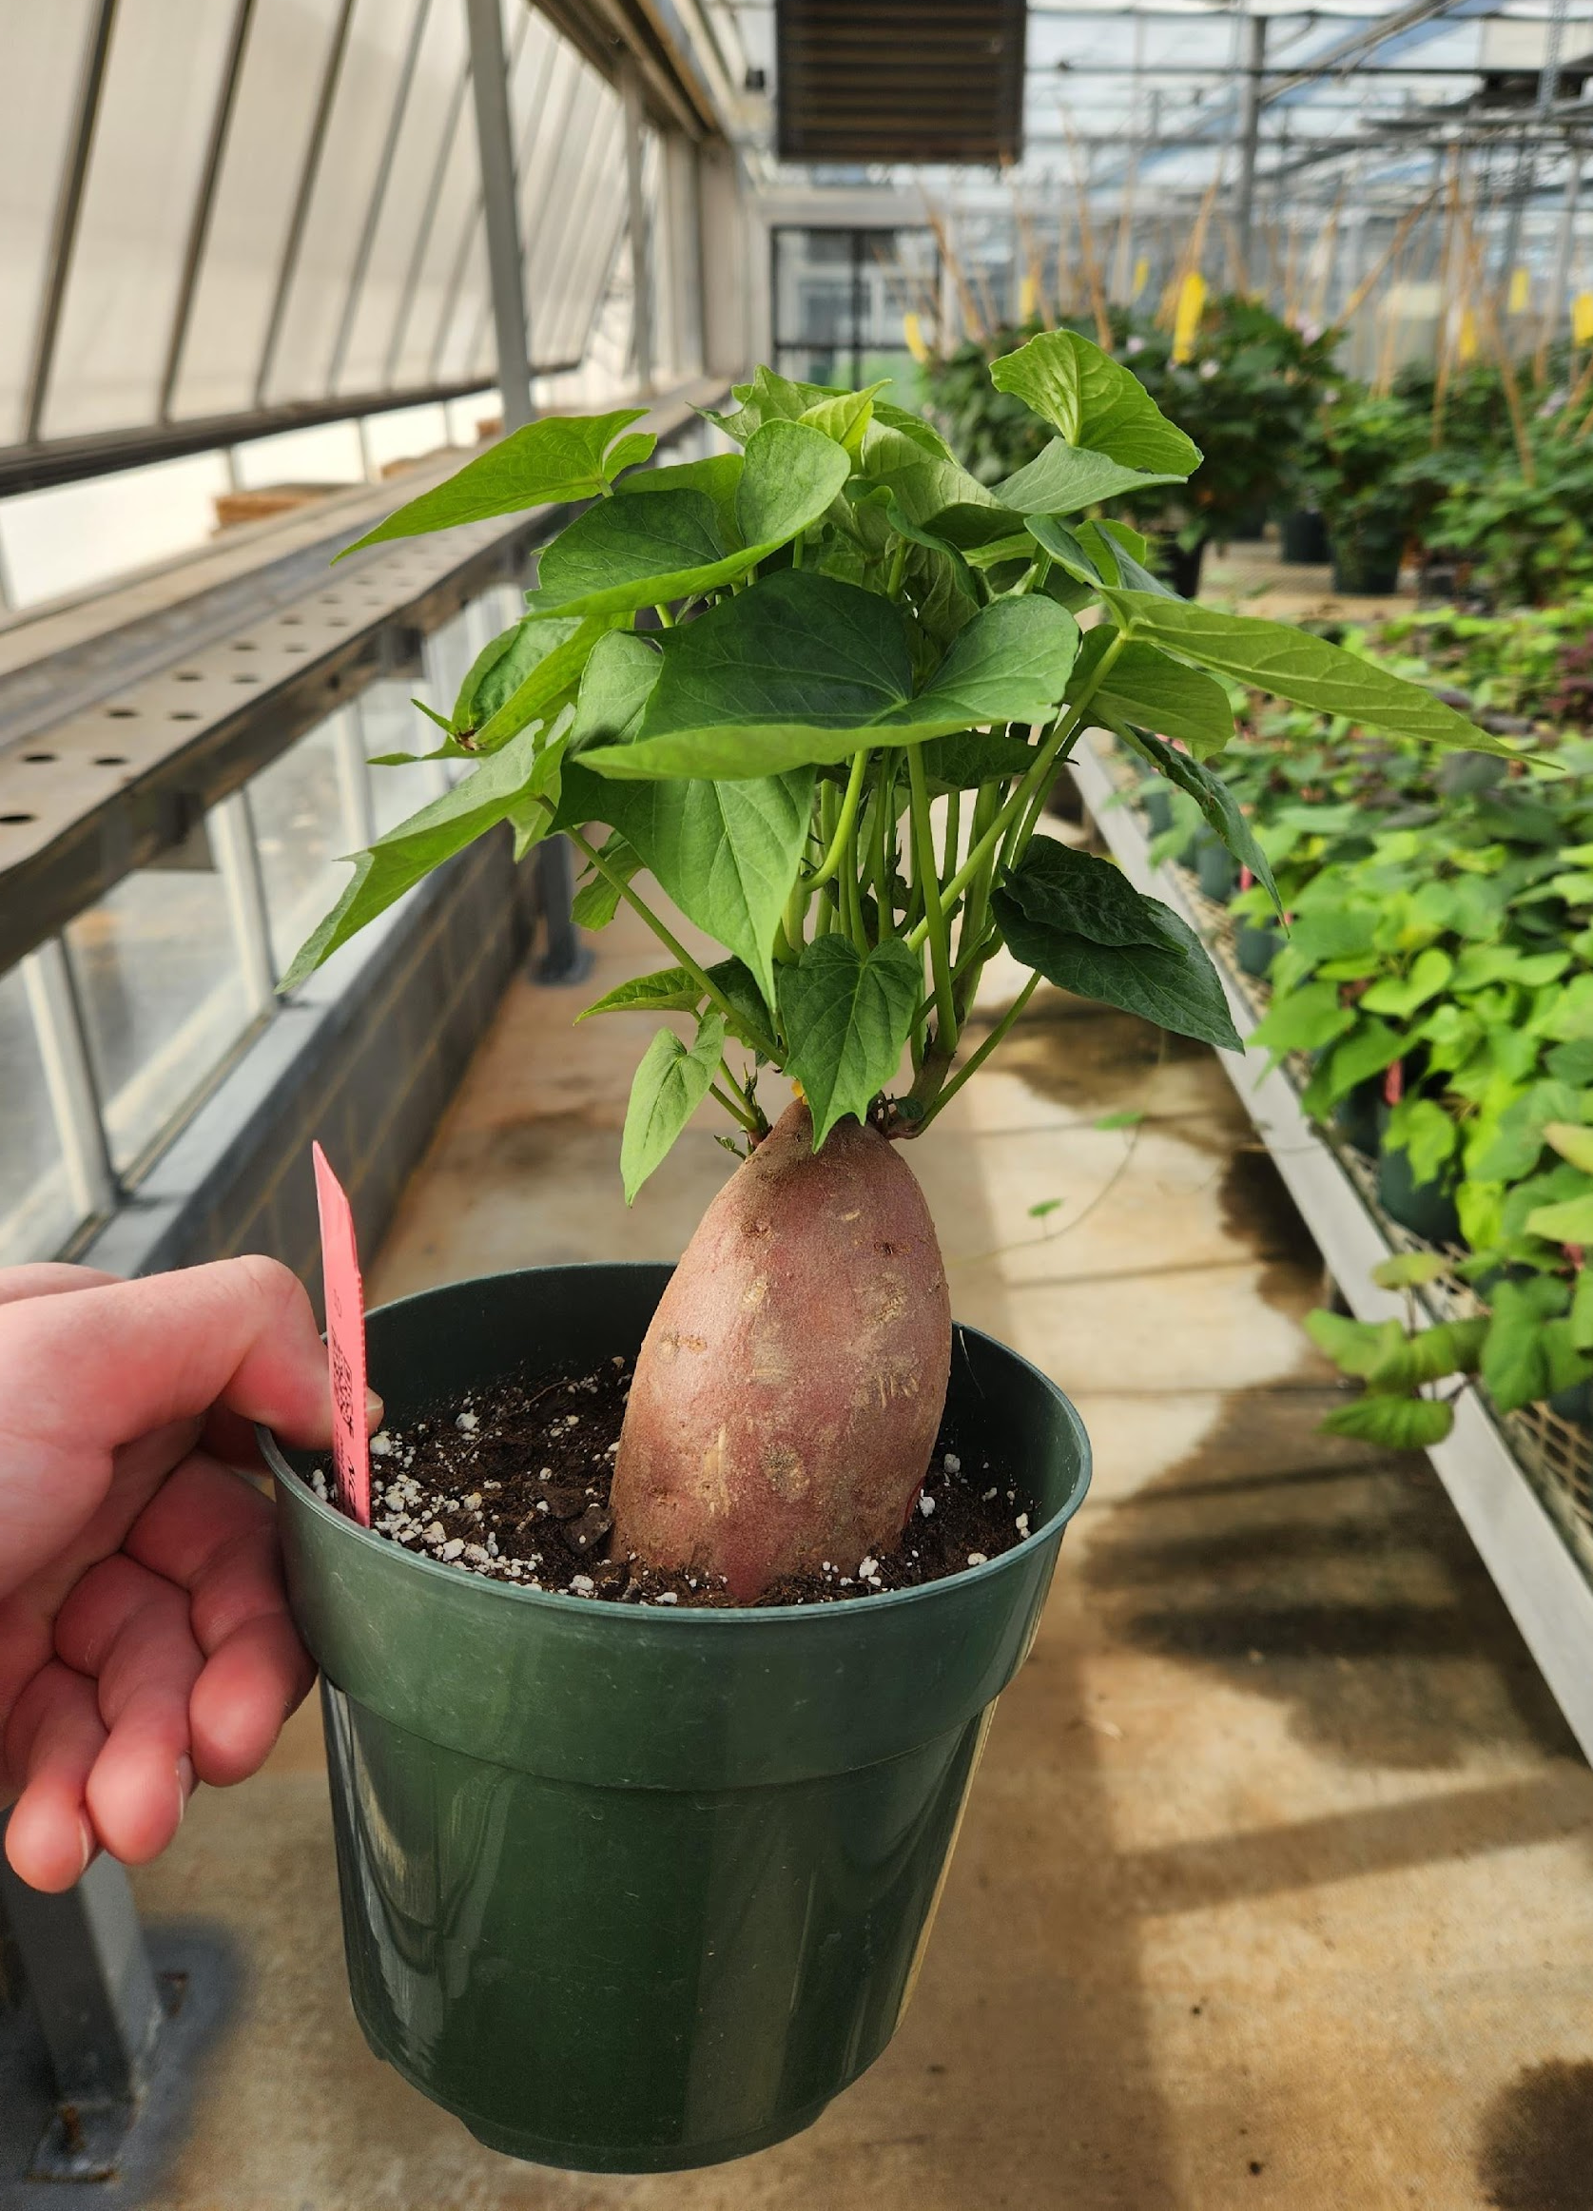
Dec 2022 – Jan 2023
Genotyping in year 2 > Phenotyping in year 4-5
Genotyped using KASP panel
M.e. 95% accurate
M.i. 76% accurate
Notes:
NC21s - second year materials; assay after visually selecting the 5% worth keeping

Slide 13
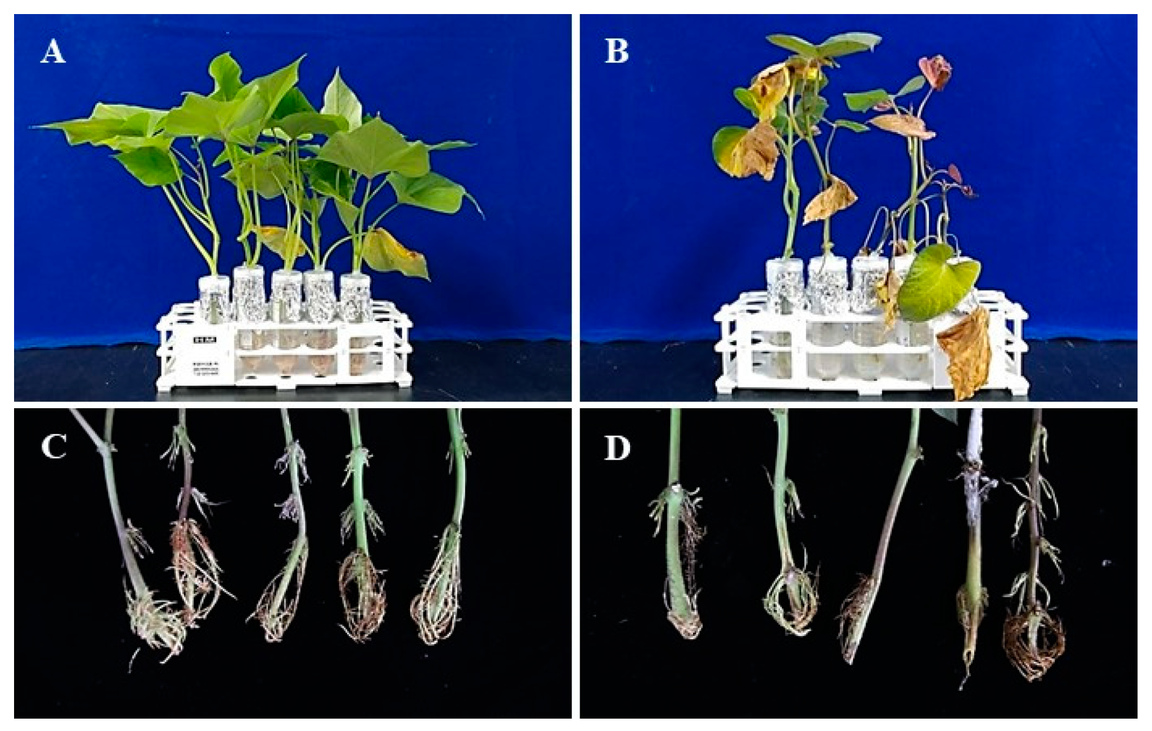
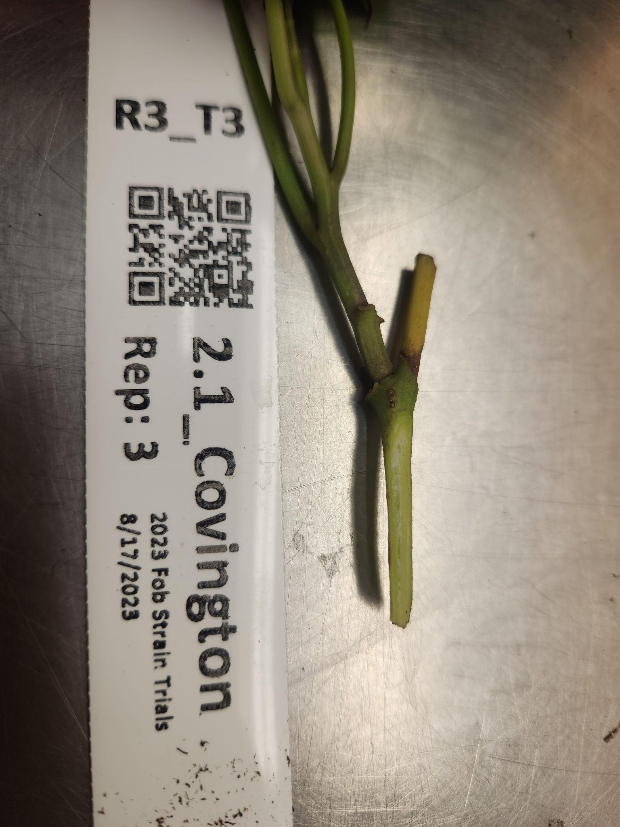
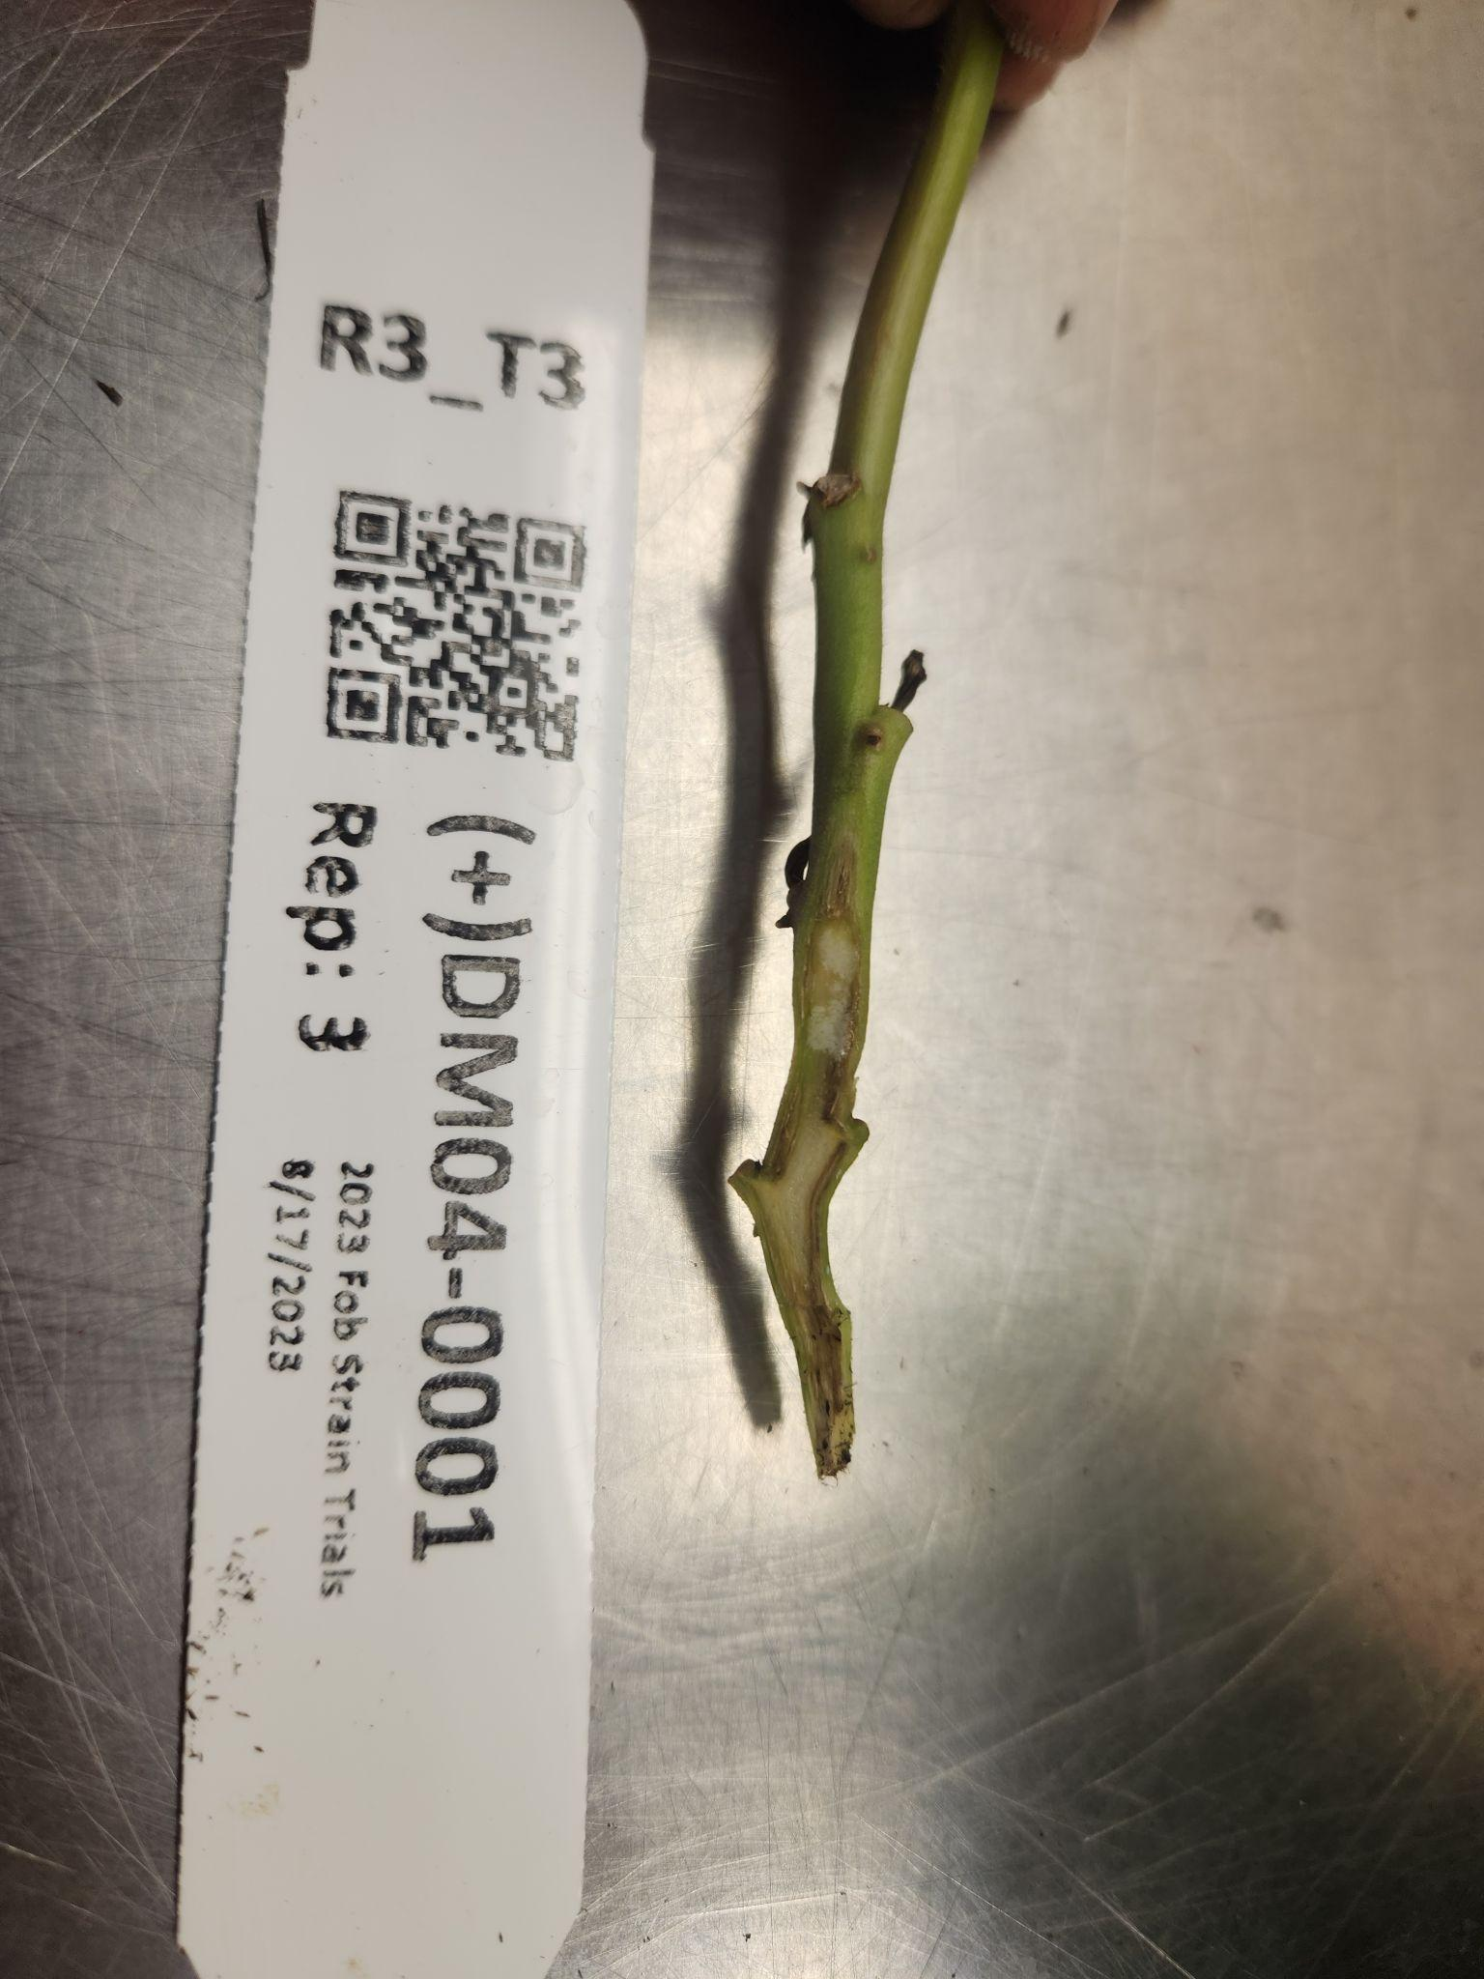
Fusarium Wilt (Fob)
“The most effective and efficient means of managing Fusarium wilt is the use of resistant cultivars.”
Clark et. al, 2013
Once most serious SP disease in USA. Cocktail of strains typically evaluated in GH assays.
Corn, soy, cotton, watermelon and wild Ipomoea can host but are asymptomatic
Most guava-resistant parents lack Fob resistance
DC Population: DM04-0001 x ‘Covington’ (550 progeny)
3 years of bioassay data (2016, 2017, 2023)
Notes:
Not a grower problem anymore? Red skinned SP are marketable in CA but that’s a complicated licensing issue and competes with NC growers.

Slide 14
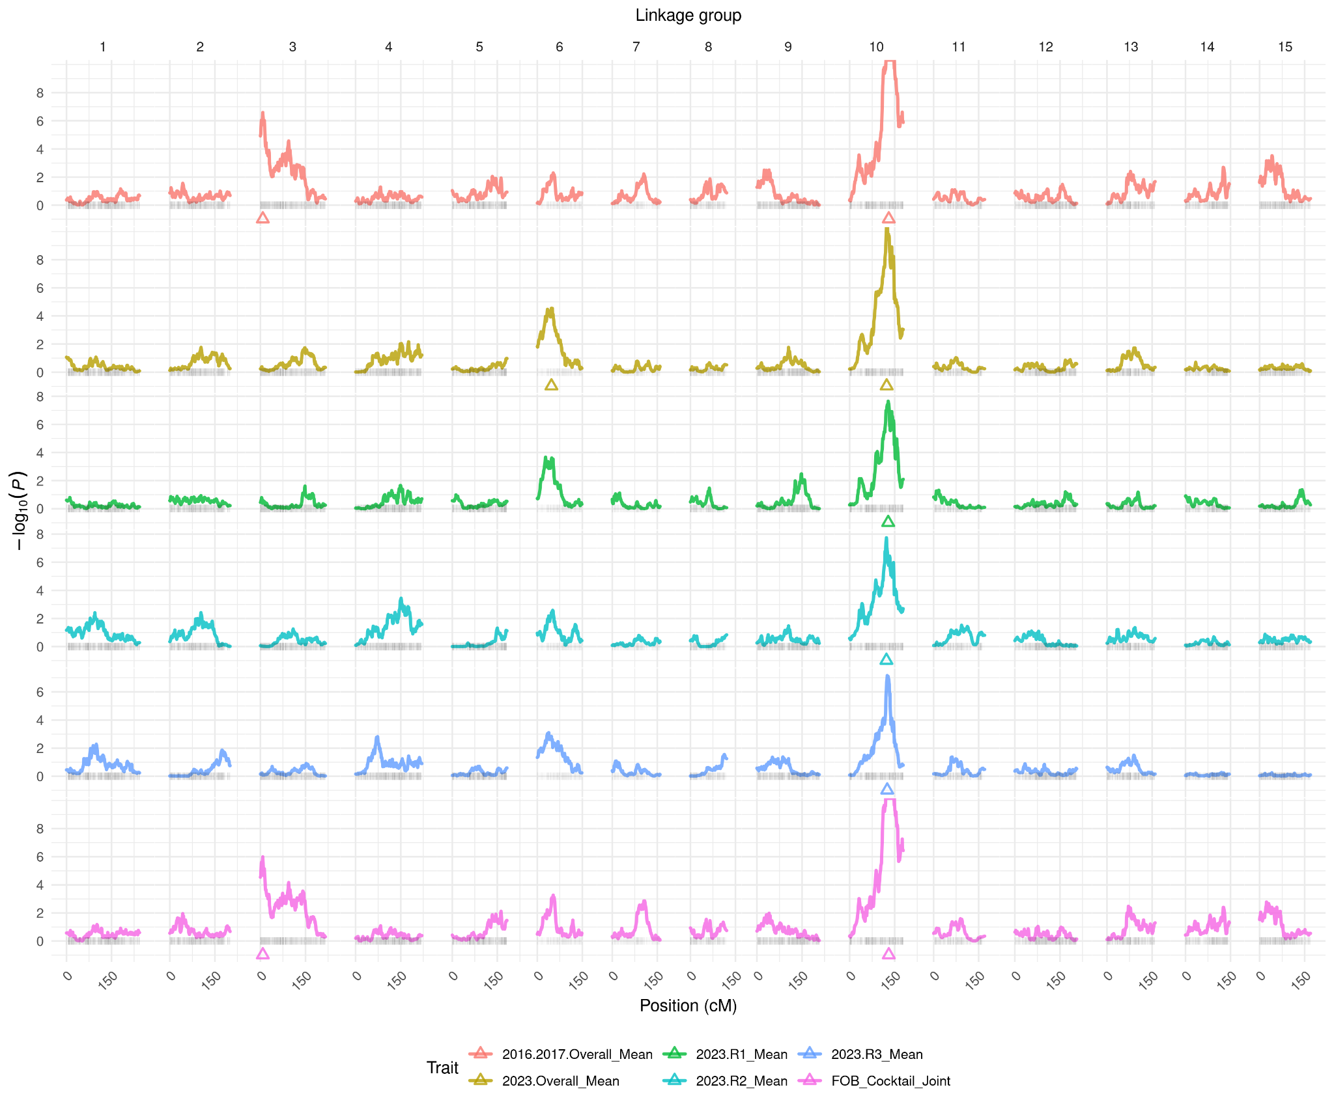
qIbFo-10.1

Slide 15
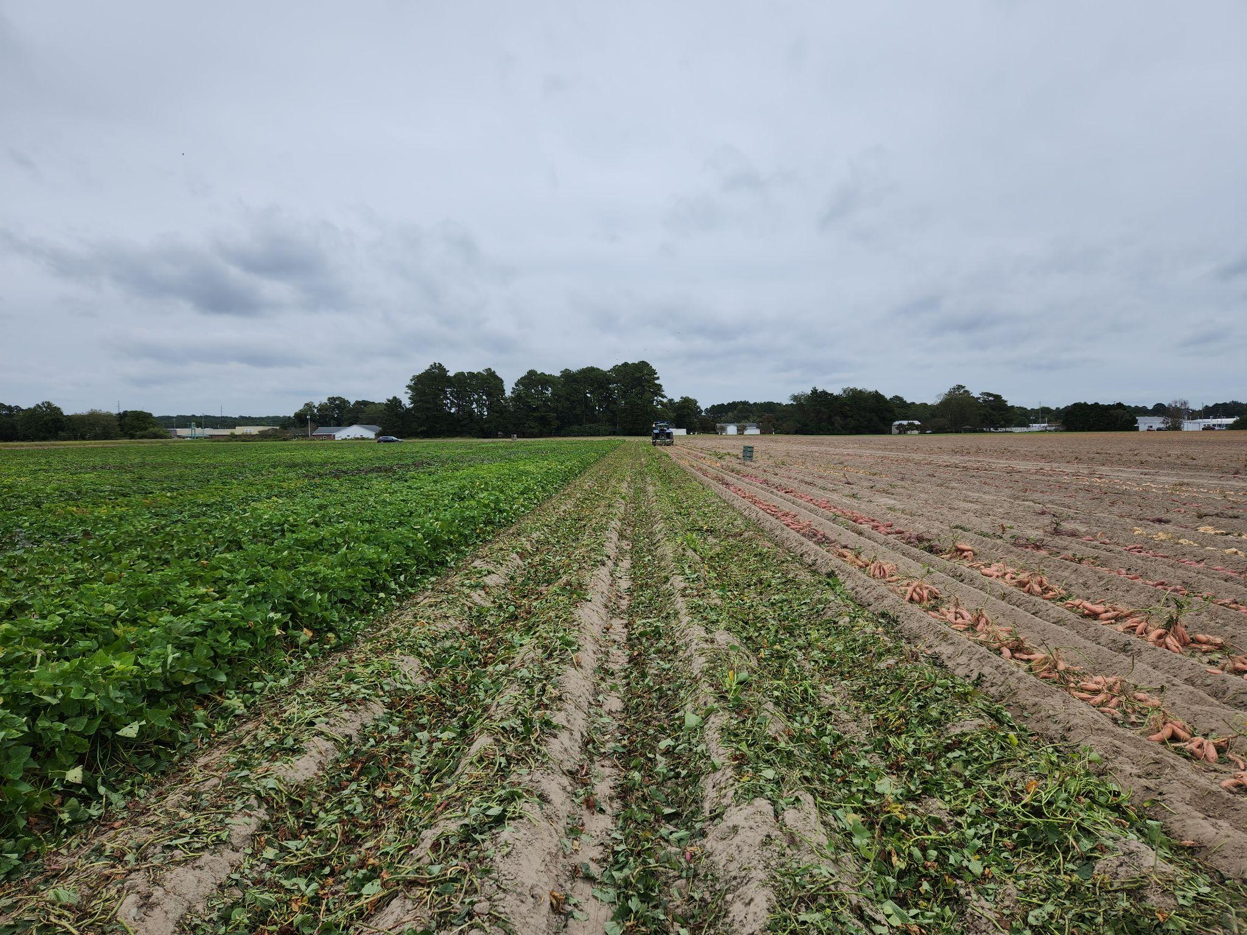
NCSU Genomic Selection
Notes:
What is GS? Genomewide markers are used to predict the value of an individual for breeding. First, TP to develop G and Phen for traits of interest. For us, priority is Y, SHP, #roots, GRKN. A statistical model is developed using measured trait values (PHEN) associated with certain markers. Next, we can take a DNA sample of a new (un-phenotyped) line and predict its value for these traits. Very crucial TP is representative of BP, and tested in multiple environments. GS has two main advantages over traditional breeding: can select without phenotypes, and do so earlier.

Slide 16
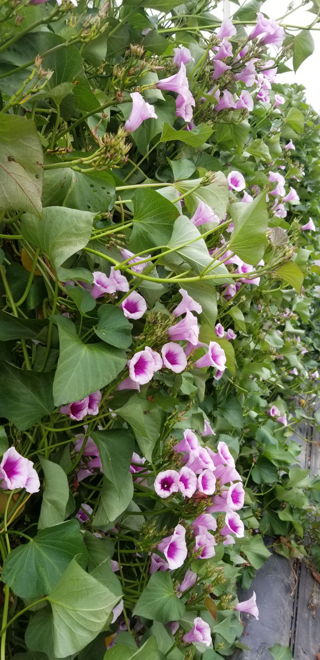
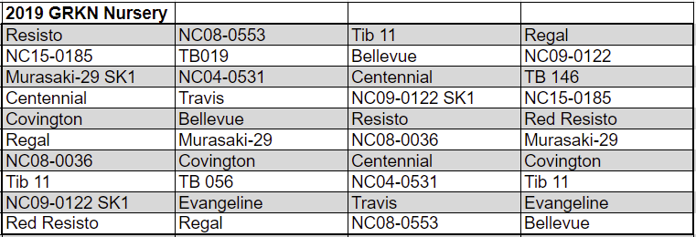
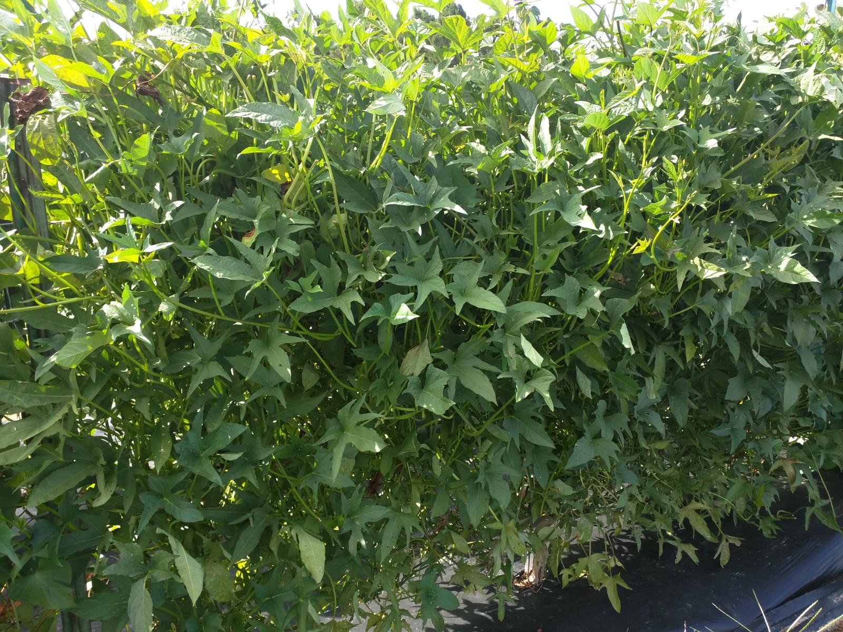
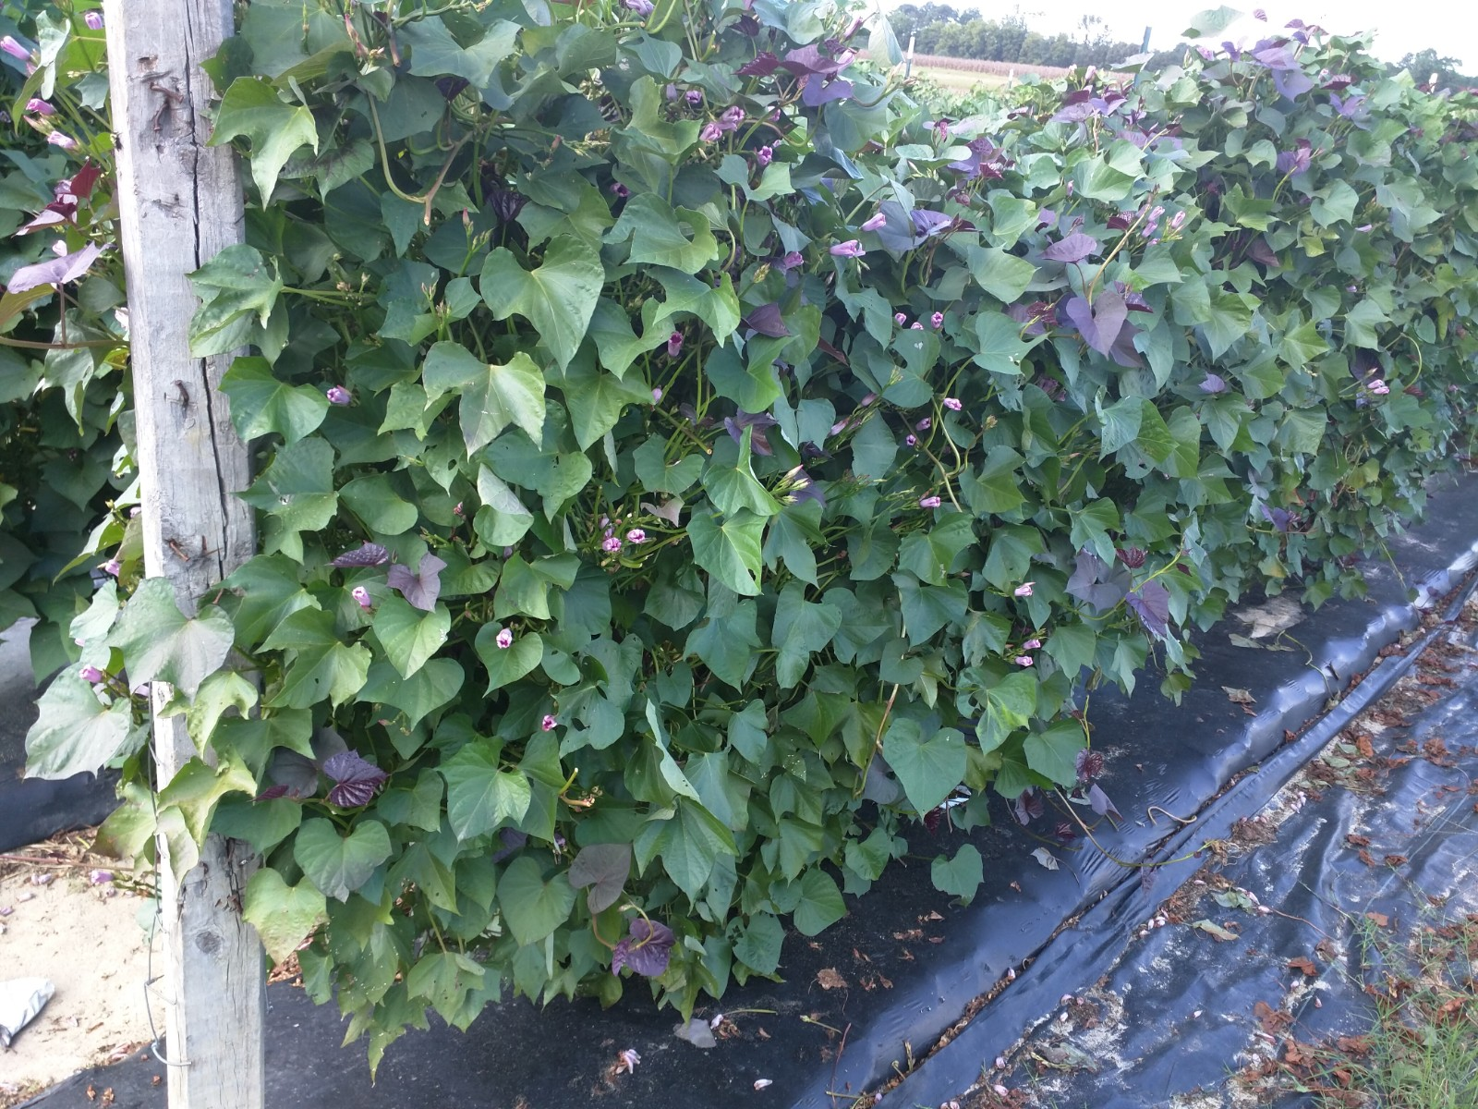
2020 Training Population
33 families
22-25 progeny per
650 total lines

Slide 17
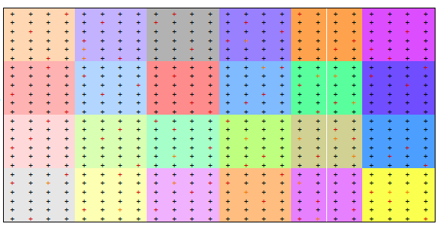
Augmented Row-Column Design
+
+
+
Check lines
GS TP lines
Parents

Slide 18
BLUP: a Breeding Value
Best – maximize correlations between true and predicted values
Linear – formed from linear combinations of observations
Unbiased – expected value is equal to the true value
Prediction – of random effects
A_{i} - additive effect of individual i
n - # of measurements of an individual
# of copies of a clone
# of progenies of a parent
(Phenotypic) EBV model for GS Field Trials:
y = checks + env + rep:env + check:env + parent + family:rep + pop + Pop:Env + spatial + e
Notes:
BLUP: take all information available and guess the true value of a line for breeding. Measured by phenotype and half the pedigree (maternal), but can be improved with genomic data which allows us to consider performance of relatives and paternal line also. Pedigree data is generally poor (and often inaccurate). IMPORTANT: can predict breeding value of an individual before it has been assayed. Some crops can take seed chips, like peanut, or animal breeders. We can test in year 1 - though more cost-effective in yr2+.
Random effects - not explicitly explained by model. We design for spatial variation, multi-env to capture environmental effects, control checks, etc.

Slide 19
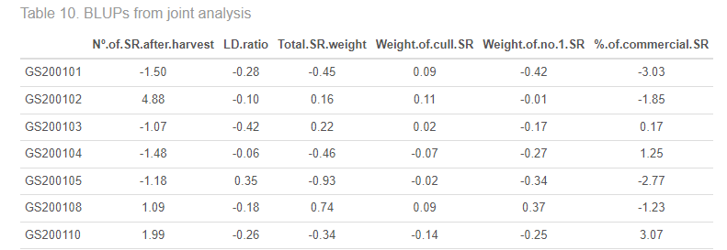
Population Means
Individual BLUPs
Mean + BLUP

Slide 20
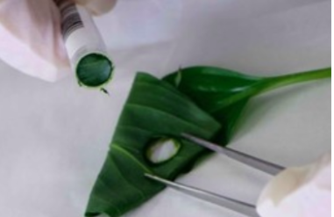
Genotyping with DArT
TB population (250)
DC population (550)
GS20 TP (550)
GS23 TP (550)
DArTag
3000 markers, polymorphic, distributed
Filtering monomorphic markers
Keep loci relevant to breeding regions
Add in MAS markers where possible
MADC files to BI to refine marker panel
Multiple GS models to be tested (gBLUP, rrBLUP, etc)
Compare to phenotypes and breeder selections
Mid-density markers may be sufficient for pedigree inferences

Slide 21
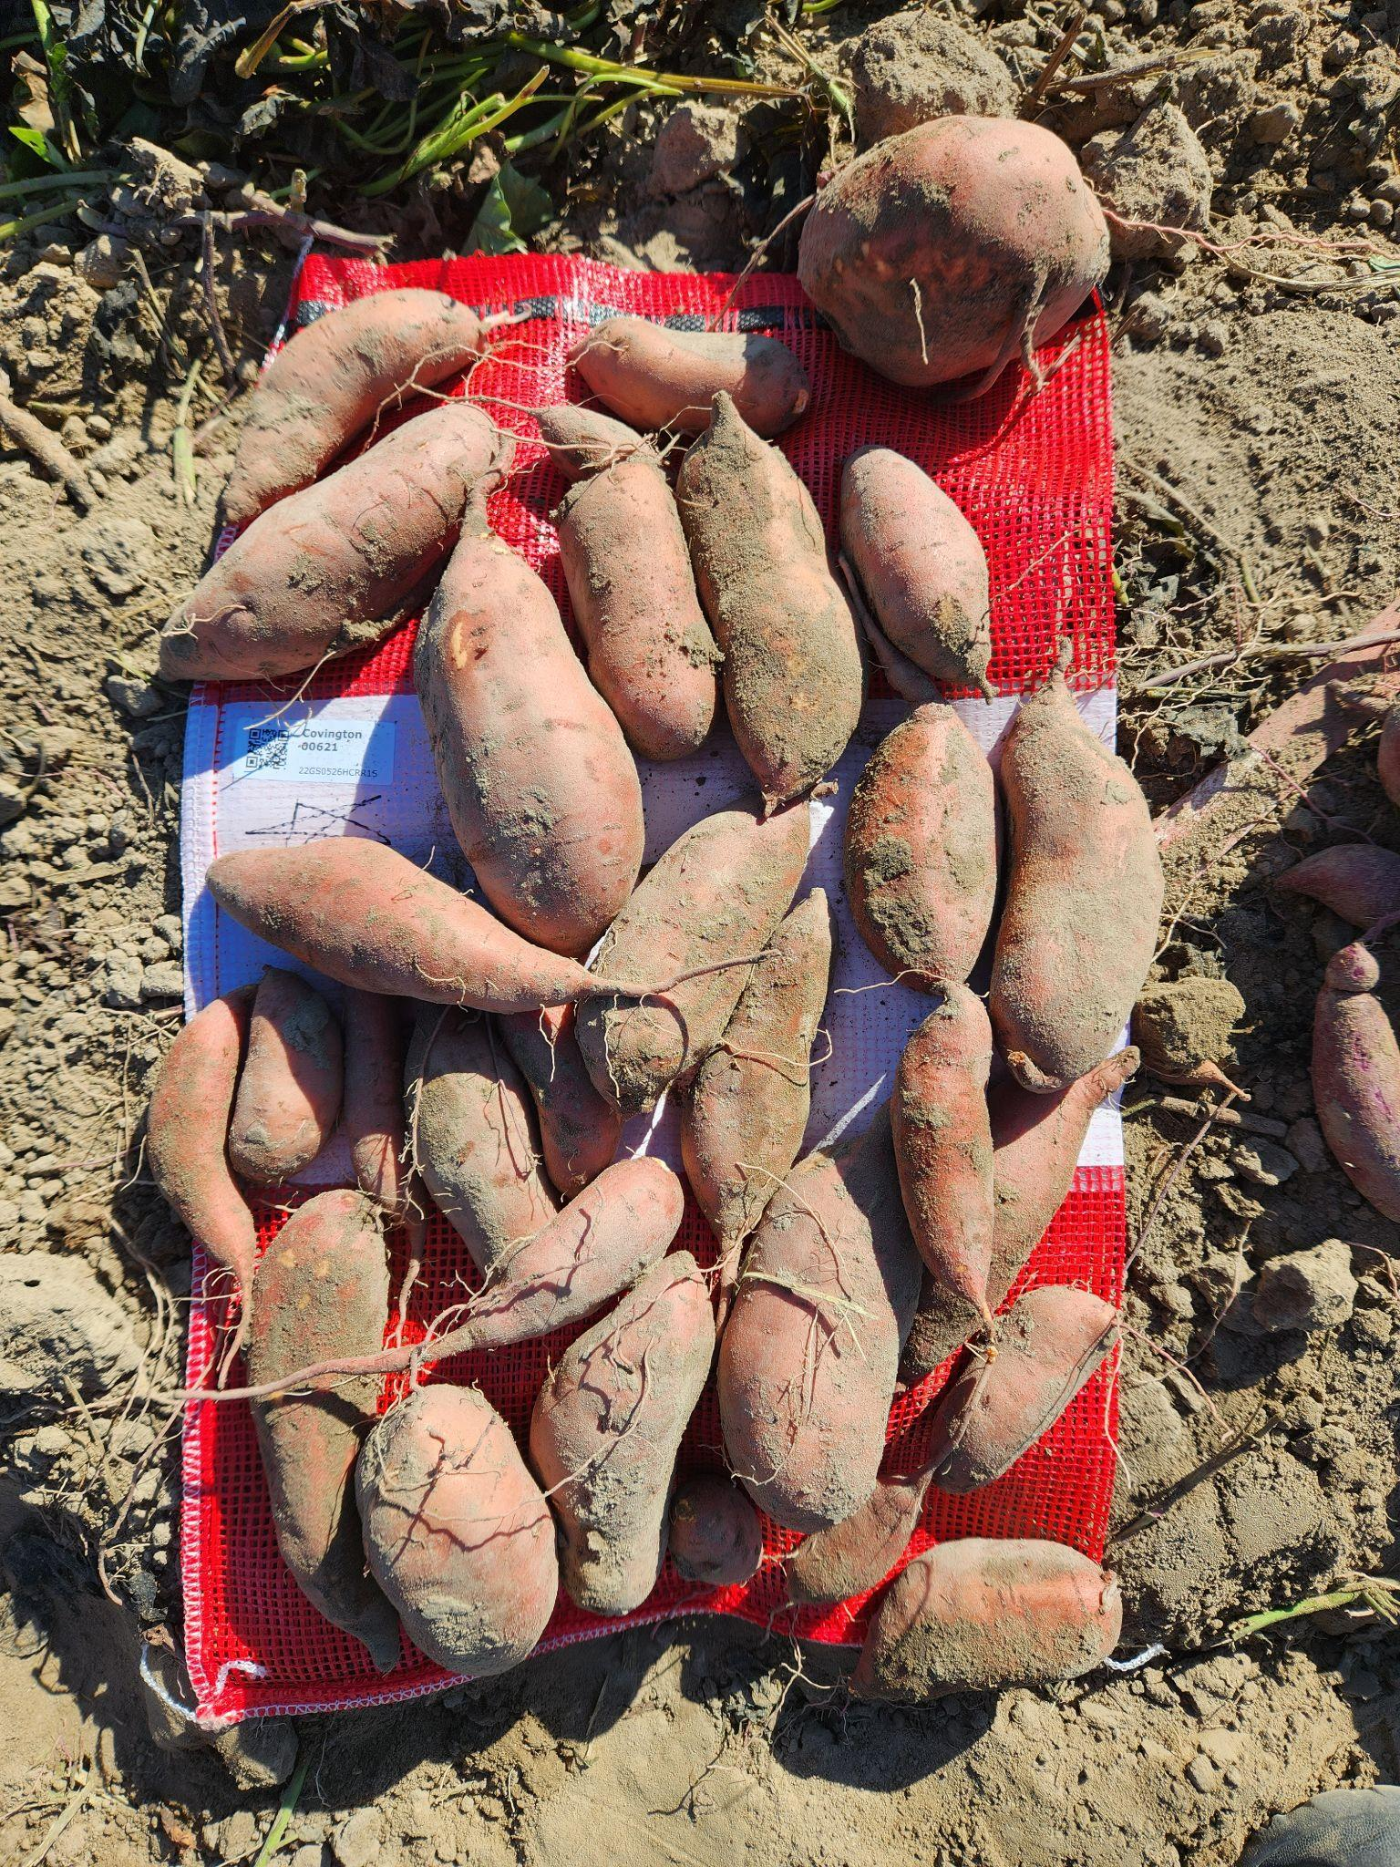
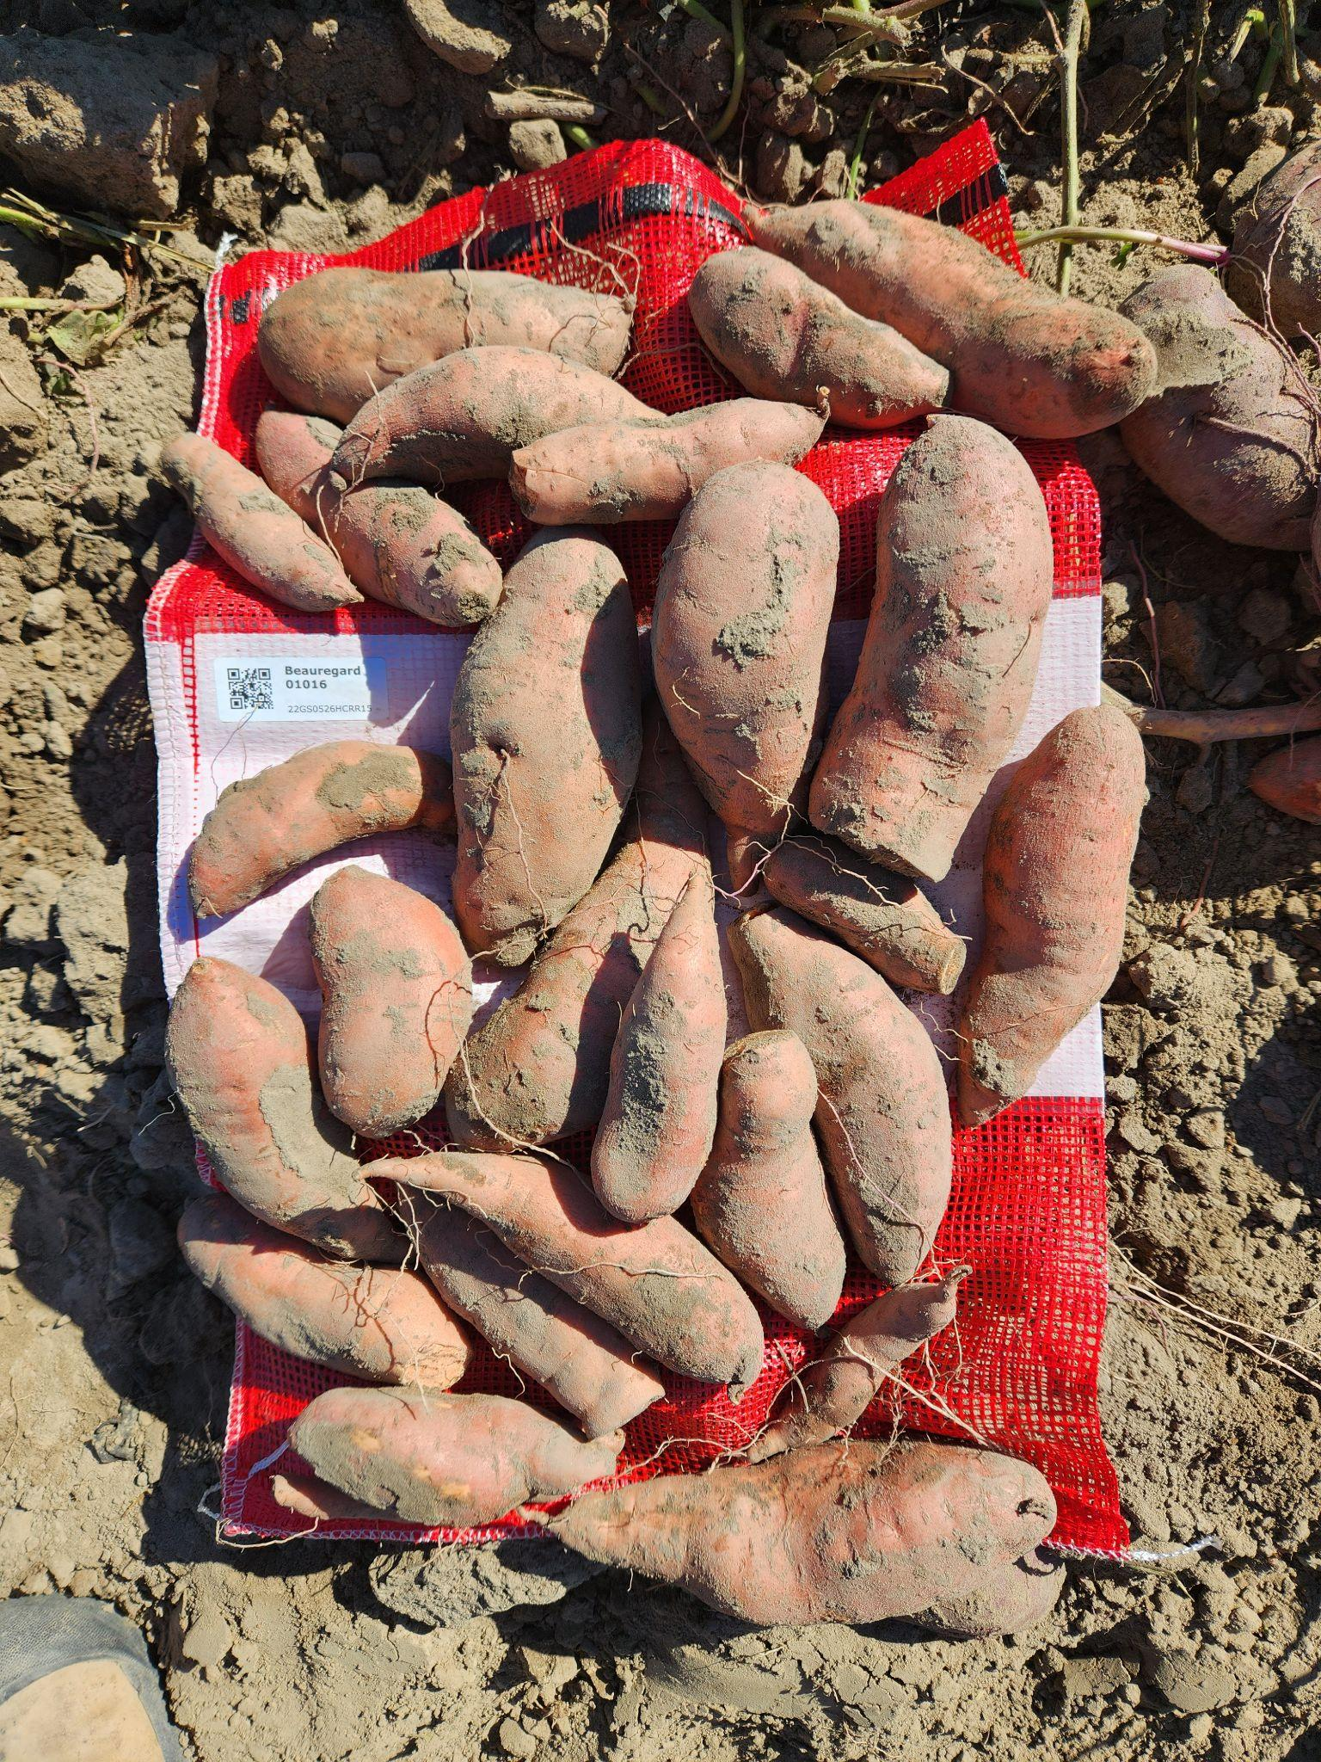
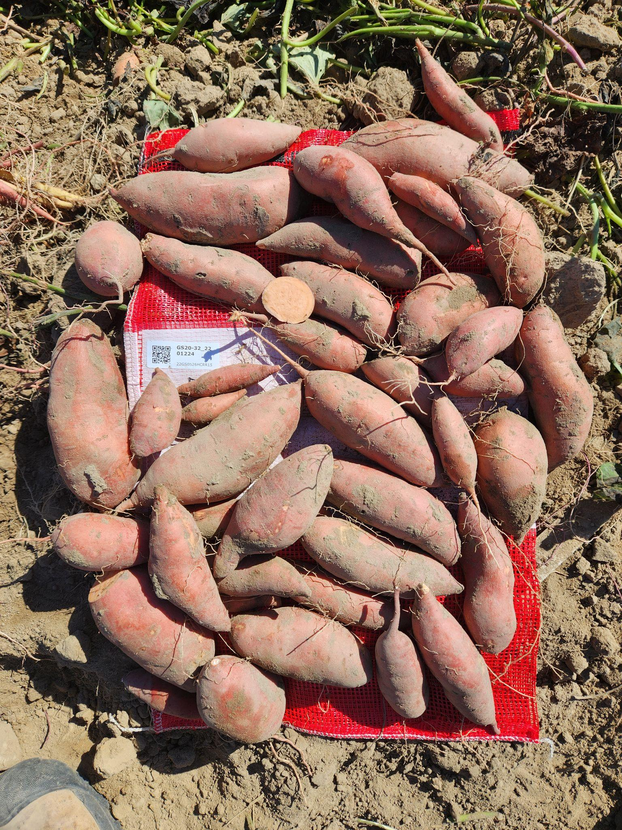
Phenotypic Selection is Not Being Replaced!
Covington
Beauregard
GS20-32-22
Notes:
Selection on visual appearance limits ability to select individuals with greatest yield impact
Moving toward selection for genetic merit…

Slide 22
Acknowledgements
Dr. G. Craig Yencho, Dr. Gina Brown-Guedira, Dr. Adrienne Gorny, Ken Pecota
Dr. Robin Buell, Dr. Mercy Kitavi, John Hamilton
Dr. Marcello Mollinari, Dr. Gabriel de Siqueira Gesteira, Dr. Sharon Williamson, Dr. Bonny Oloka, Dr. Victor Amankwaah, Tanner Schwarz, Chris Heim, Brandon Parker
Dr. Zhangjun Fei, Dr. Bode Olukolu, Dr. Shan Wu, Dr. Guilherme da Silva Pereira

Slide 23
Seed from Paired and Polycross Nurseries
Year 1
3-hill Plots, 1 Location
20,000 Seedlings
Year 2
25-plant Plots, 2 Locations
1,500 (~8%)
Asexual (Clonal) Propagation
Year 3
50- to 150-plant Plots, 3-5 Locations
150 (10%)
Years 4-6
Yield Trials (Grower and National Trials)
20 (~13%)
Variety Release
1
Years 6-8
Released varieties are sent to MPRU (tissue culture) and then scaled up for production by growers.
Lines that fall short of variety release are used as parents or “Elite” lines.
A variety can still fail after release

Slide 24
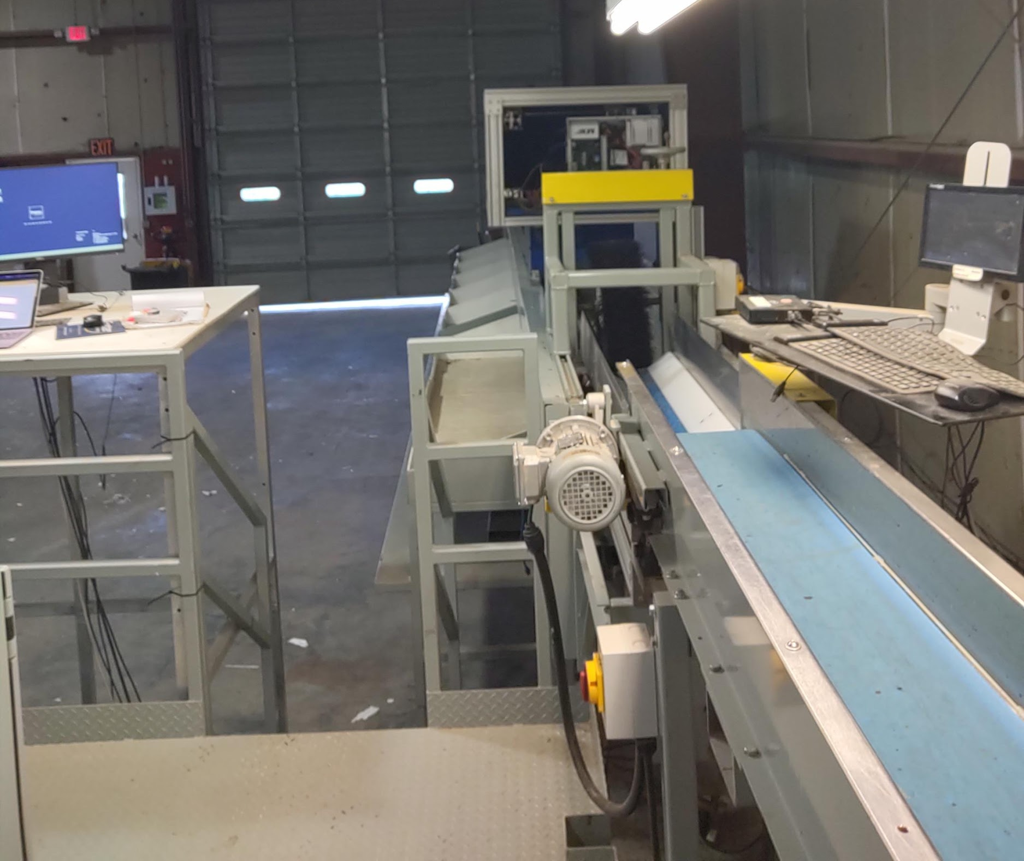
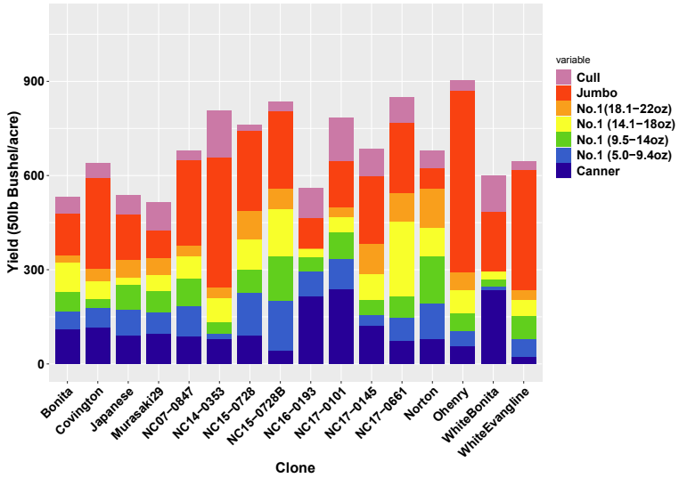
Phenotyping: Exeter Grader
Total Yield
Length : Diameter
Root Count
USDA Grade
Culls
Major Defects
Skin Color

Slide 25
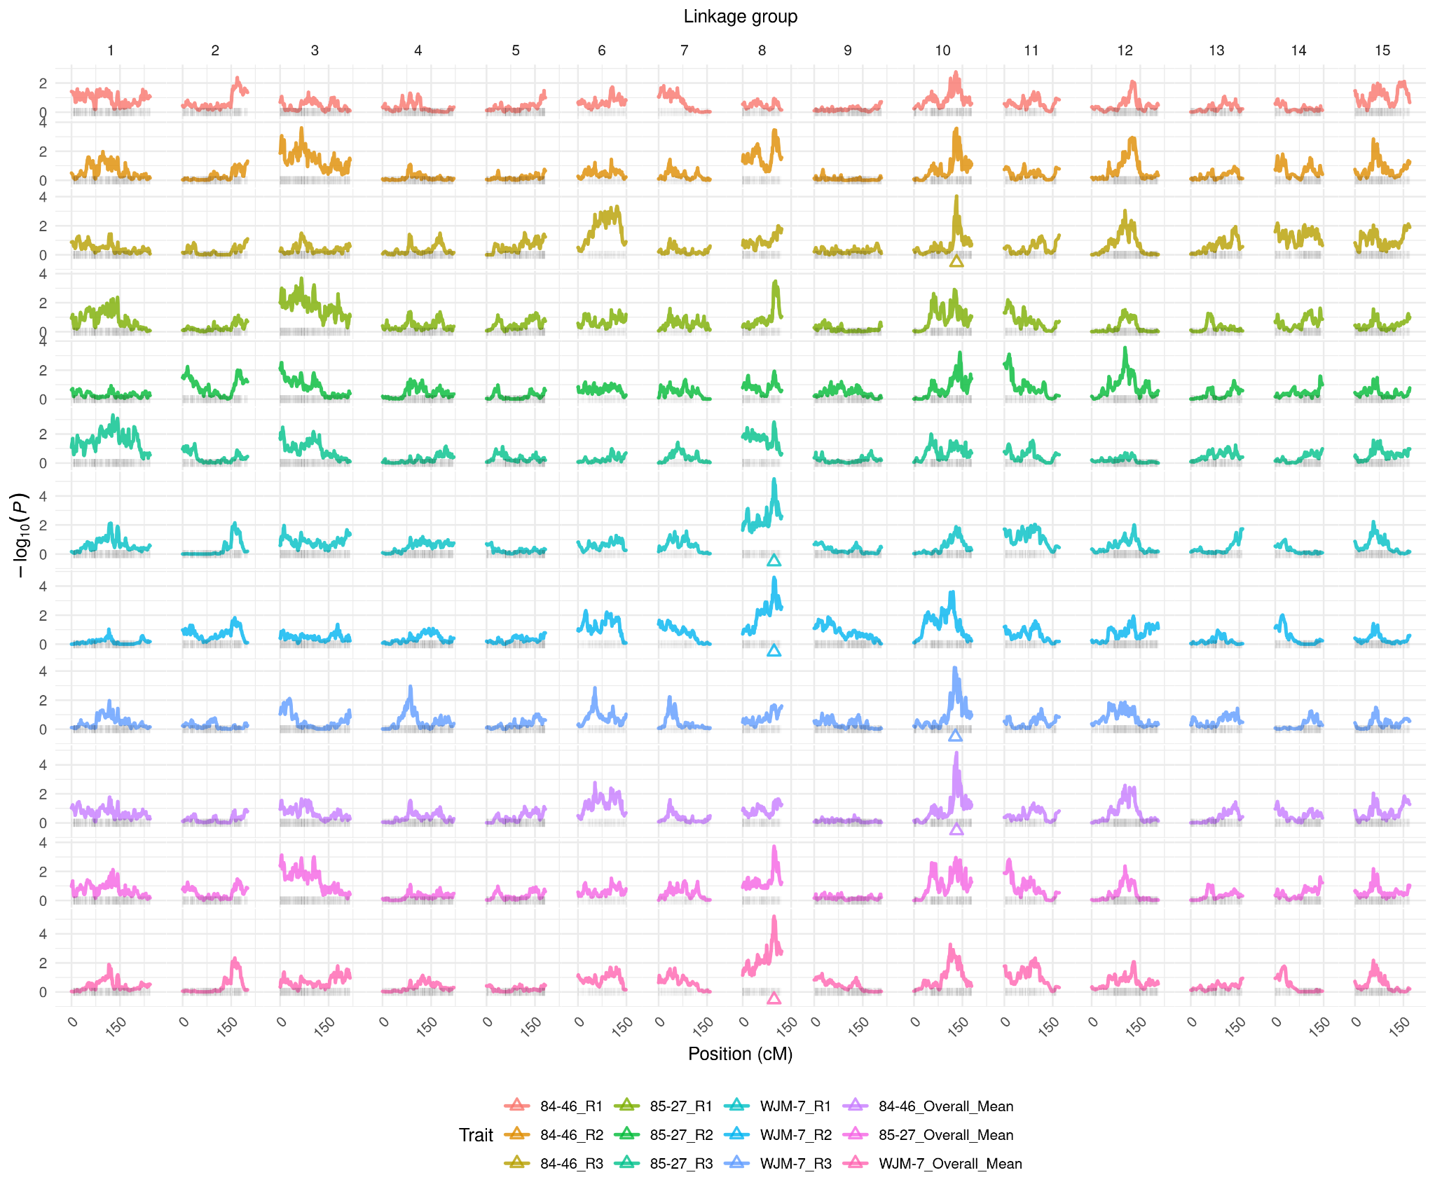
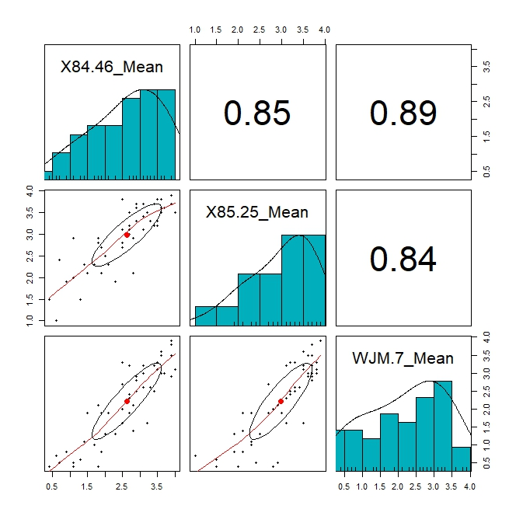
All Three Isolate Means

Slide 26
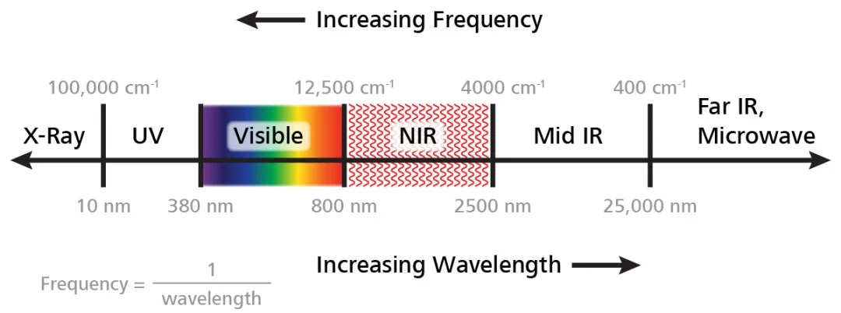
NIRS: Near-Infrared Spectroscopy
Measuring sugars, beta carotene, dry matter, amino acids, and more!

Slide 27
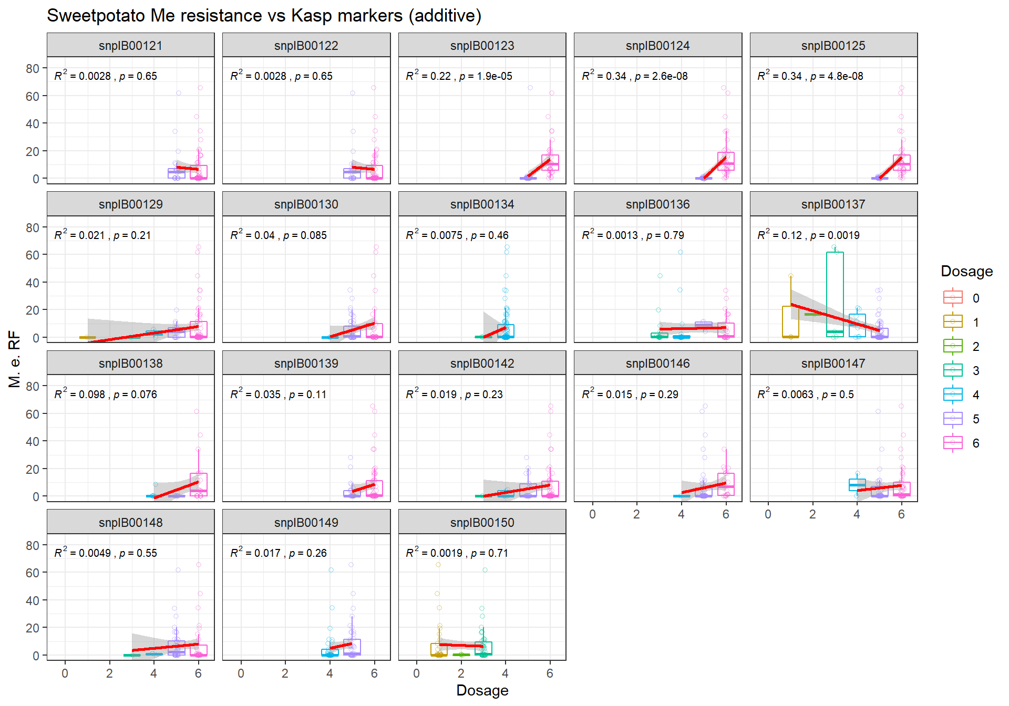
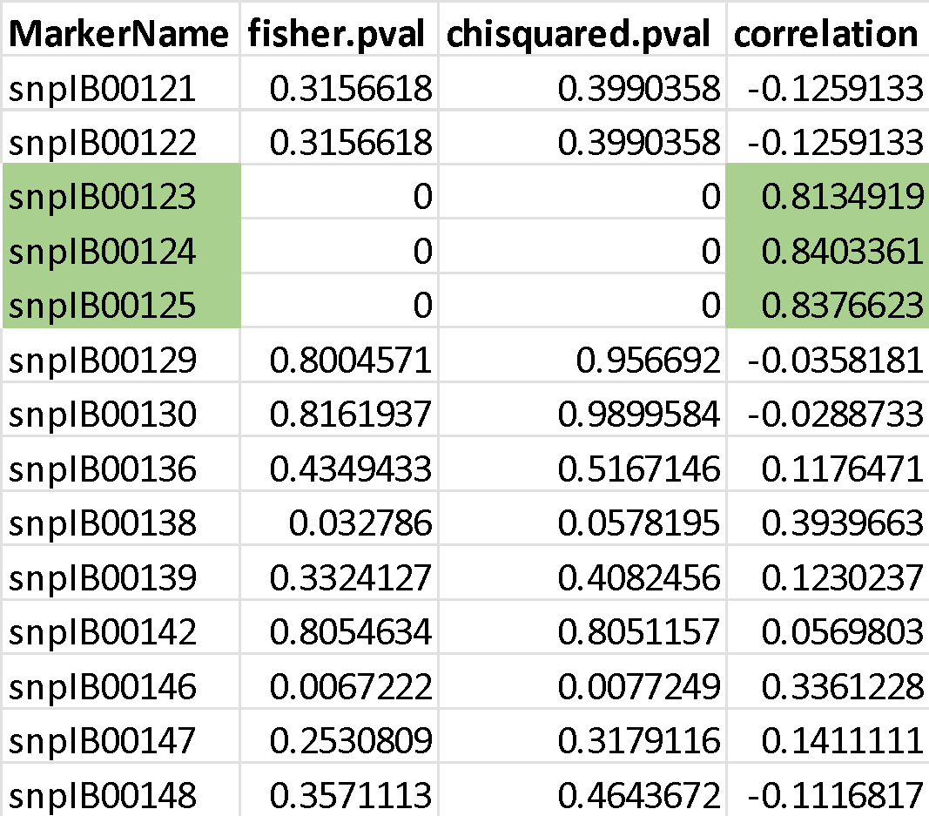
*Dominant model had nearly identical numbers at loci of interest
Notes:
6 Copies = resistance, 5 = not?

Slide 28
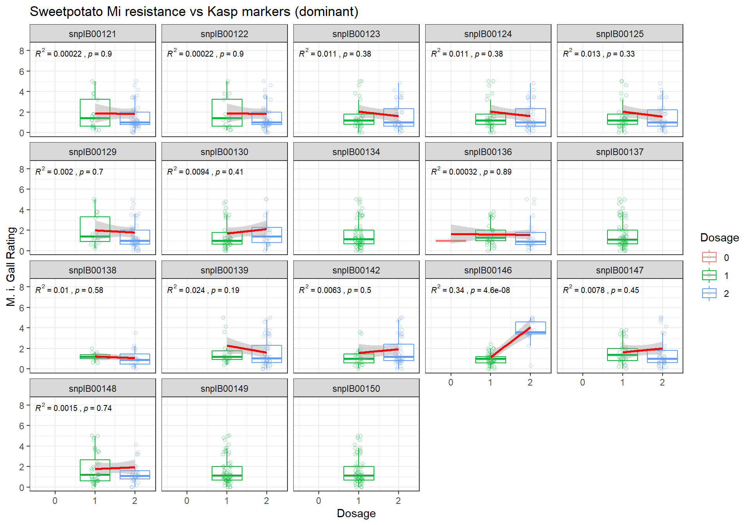

Slide 29
BLUPS
0-4 scale

Slide 30
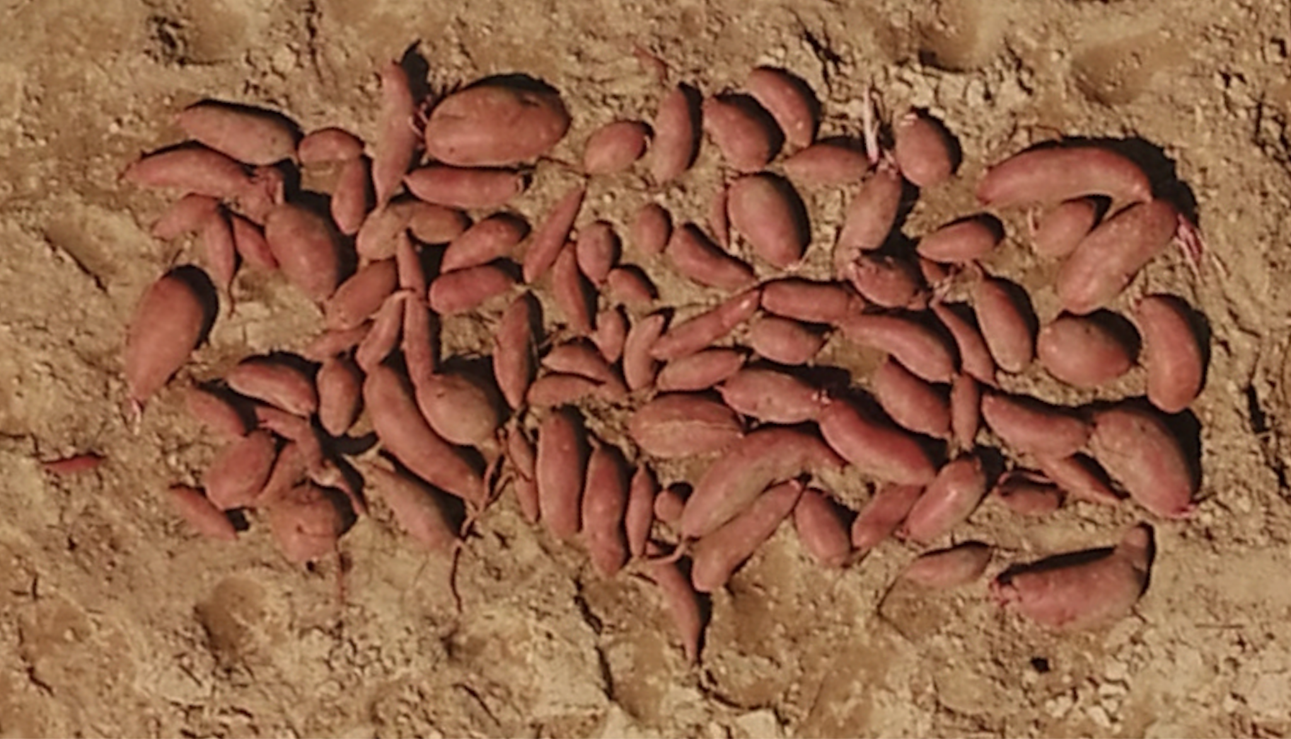

Slide 31
Paired Crossing

Slide 33
Select References
Brito, J., Powers, T. O., Mullin, P. G., Inserra, R. N., & Dickson, D. W. (2004). Morphological and Molecular Characterization of Meloidogyne mayaguensis Isolates from Florida. Journal of Nematology, 36(3), 232–240.
Cervantes-Flores, J. C., Yencho, G. C., & Davis, E. L. (2002). Host Reactions of Sweetpotato Genotypes to Root-knot Nematodes and Variation in Virulence of Meloidogyne incognita Populations. HortScience, 37(7), 1112–1116. https://doi.org/10.21273/HORTSCI.37.7.1112
Cervantes-Flores, J. C., Yencho, G. C., Kriegner, A., Pecota, K. V., Faulk, M. A., Mwanga, R. O. M., & Sosinski, B. R. (2008a). Development of a genetic linkage map and identification of homologous linkage groups in sweetpotato using multiple-dose AFLP markers. Molecular Breeding, 21(4), 511–532. https://doi.org/10.1007/s11032-007-9150-6
Cervantes-Flores, J. C., Yencho, G. C., Pecota, K. V., Sosinski, B., & Mwanga, R. O. M. (2008b). Detection of Quantitative Trait Loci and Inheritance of Root-knot Nematode Resistance in Sweetpotato. Journal of the American Society for Horticultural Science, 133(6), 844–851. https://doi.org/10.21273/JASHS.133.6.844
Clark, C. A., & Moyer, J. W. (1988). Compendium of Sweet Potato Diseases. APS Press.
EPPO. (2020, May). EPPO Alert List. https%3A%2F%2Fwww.eppo.int%2FACTIVITIES%2Fplant_quarantine%2Falert_list
Lambert, K., & Bekal, S. (2002). Introduction to Plant-Parasitic Nematodes. Introduction to Plant-Parasitic Nematodes. https://www.apsnet.org/edcenter/disandpath/nematode/intro/Pages/IntroNematodes.aspx
Mollinari, M., Olukolu, B. A., Pereira, G. da S., Khan, A., Gemenet, D., Yencho, G. C., & Zeng, Z.-B. (2020). Unraveling the Hexaploid Sweetpotato Inheritance Using Ultra-Dense Multilocus Mapping. G3 Genes|Genomes|Genetics, 10(1), 281–292. https://doi.org/10.1534/g3.119.400620
Mwanga, R. O. M., Odongo, B., p’Obwoya, C. O., Gibson, R. W., Smit, N. E. J. M., & Carey, E. E. (2001). Release of Five Sweetpotato Cultivars in Uganda. HortScience, 36(2), 385–386. https://doi.org/10.21273/HORTSCI.36.2.385
Oloka, B. M., da Silva Pereira, G., Amankwaah, V. A., Mollinari, M., Pecota, K. V., Yada, B., Olukolu, B. A., Zeng, Z.-B., & Craig Yencho, G. (2021). Discovery of a major QTL for root-knot nematode (Meloidogyne incognita) resistance in cultivated sweetpotato (Ipomoea batatas). Theoretical and Applied Genetics, 134(7), 1945–1955. https://doi.org/10.1007/s00122-021- 03797-z
Rolston, L.H., Clark, C.A., Cannon, J.M., Randle, W.M., Riley, E.G., Wilson, P.W. & Robbins, M.L. 1987 ‘Beauregard’ sweet potato HortScience 22 1338 1339
Rutter, W., Wadl, P., Mueller, J. D., & Agudelo, P. (2021). Identification of Sweetpotato Germplasm Resistant to Pathotypically Distinct Isolates of Meloidogyne enterolobii from the Carolinas. Plant Disease, PDIS-02-20-0379-RE. https://doi.org/10.1094/PDIS-02-20-0379-RE
Schwarz, T. R., Li, C., Yencho, G. C., Pecota, K. V., Heim, C. R., & Davis, E. L. (2021). Screening Sweetpotato Genotypes for Resistance to a North Carolina Isolate of Meloidogyne enterolobii. Plant Disease, 105(4), 1101–1107. https://doi.org/10.1094/PDIS-02-20-0389-RE
USDA/NASS. (2020). U.S. Department of Agriculture-National Agriculture Statistics Service. Quick Stats. https://quickstats.nass.usda.gov/#A75F6E09-3B83-3871-844A-AA85BB38768E
Wu, S., Lau, K. H., Cao, Q., Hamilton, J. P., Sun, H., Zhou, C., Eserman, L., Gemenet, D. C., Olukolu, B. A., Wang, H., Crisovan, E., Godden, G. T., Jiao, C., Wang, X., Kitavi, M., Manrique- Carpintero, N., Vaillancourt, B., Wiegert-Rininger, K., Yang, X., … Fei, Z. (2018). Genome sequences of two diploid wild relatives of cultivated sweetpotato reveal targets for genetic improvement. Nature Communications, 9(1), 4580. https://doi.org/10.1038/s41467-018-06983-8
Ye, W. M., Koenning, S. R., Zhuo, K., & Liao, J. L. (2013). First Report of Meloidogyne enterolobii on Cotton and Soybean in North Carolina, United States. Plant Disease, 97(9), 1262. https://doi.org/10.1094/PDIS-03-13-0228-PDN

Slide 34
M. enterolobii distribution
M. enterolobii host range ≥ 121 plants (EPPO, 2022)

Slide 35
Validation: GS Training Population
GS progenies:
90 had RF > 1 (36%)
161 had RF < 1 (64%)
*only assayed top 20% by yield BLUPs
Testing markers in February 2023

Slide 36
http://sweetpotato.uga.edu/

Slide 37
Candidate Genes
BLAST search within the 95% SI using I. trifida (v.3):
I. trifida high confidence gene set of 32,301 protein-coding genes represented by 44,158 gene models
3 resistance genes in I. trifida near 57.5cM (QTL peak)
NB-ARC domain-containing disease resistance proteins:
ift04g10180.t1, ift04g10190.t1, ift04g10200.t1
40 total genes in I. trifida detected within 3.2Mb
Nucleotide-binding adaptor shared by APAF-1, R proteins, and CED-4 domains are central to most R proteins, which recognize pathogens and trigger an innate immune response (Tameling et al., 2006; van Ooijen et al., 2008)

Slide 38
Beauregard (gggggg)
GGGggg | GGG
 | GGg
 | Ggg
 | ggg
 | ggG
 | gGG
GGGggg X gggggg
30/36 resistant
83% resistant progenies
Tanzania (Gggggg)
GGGGgg | GGG
 | GGG
 | GGg
 | Ggg
 | ggG
 | gGG
GGGG X gggggg
100% resistant

Slide 39
M. enterolobii host range ≥ 121 plants (EPPO, 2022)
Common Name | Scientific Name | Author(s) | Year
Acerola, Guarani cherry | Malpighia emarginata | Humphreys et al. | 2012
American black nightshade | Solanum americanum | Brito et al. | 2008
American burnweed | Erechtites hieraciifolius | Carneiro et al. | 2006
Banana | Musa sp. | Luquini et al. | 2019
Basil | Ocimum basilicum | Brito et al. | 2007
Bayberry, wax myrtle | Morella cerifera | Brito et al. | 2010
Beet, Chard | Beta vulgaris | Rodriguez et al. | 2003
Beggarticks, Shepherd's needles | Bidens sp. | Brito et al. | 2004
Black mulberry | Morus nigra | Paes-Takahashi et al. | 2015
Blue butterfly bush | Rotheca myricoides | Brito et al. | 2010
Bluebeard, blue mist | Caryopteris x clandonensis | Brito et al. | 2010
Brazilian guava | Psidium guineense | Maranhao et al. | 2003
Bugleweed | Ajuga reptans | Brito et al. | 2010
Butterbean | Phaseolus lunatus | Bitencourt et al. | 2010
Butterfly bush | Buddleia davidii | Brito et al. | 2010
Cabbage | Brassica oleracea var. capitata | EPPO | 2010
Cape jasmine | Gardenia jasminoides | Lu et al. | 2019
Carrot | Daucus carota | Wang et al. | 2014
Cassava, manioc, yuca | Manihot esculenta | Rosa et al. | 2014
Cauliflower | Brassica oleracea var. botrytis | Brito et al. | 2007
Celery | Apium graveolens | Rodriguez et al. | 2003
Chickpea | Cicer arietinum | Bernardes et al. | 2019
Chinese elm | Ulmus parvifolia | Moore et al. | 2020
Coffee | Coffea arabica | Villain et al. | 2006
Coffeeweed | Senna occidentalis | de et al. | 2020
Coleus | Coleus scutellarioides | Brito et al. | 2010
Collard | Brassica oleracea var. viridis | EPPO | 2010
Common fig | Ficus carica | Freitas et al. | 2014
Common guava | Psidium guajava | Carneiro et al. | 2001
Common vetch | Vicia sativa | Cetintas et al. | 2007
Cotton | Gossypium hirsutum | Galbieri et al. | 2020
Cowpea | Vigna unguiculata | Guimaraes et al. | 2003
Crapemyrtle | Lagerstroemia indica | Brito et al. | 2010
Cucumber | Cucumis sativus | Gómez-González et al. | 2020
Cultivated tobacco | Nicotiana tabacum | Yang et al. | 1983
Edible or ornamental amaranth | Amaranthus tricolor | Brito et al. | 2010
Eggplant | Solanum melongena | Rammah et al. | 1988
Garden huckleberry | Solanum scabrum | Chitambo et al. | 2016
Garden petunia | Petunia x hybrida | Mendes et al. | 2007
Ginger | Zingiber officinale | Xiao, et al. | 2018
Grape | Vitis sp. | Freitas et al. | 2014
Green amaranth, smooth pigweed | Amaranthus hybridus | Souza et al. | 2006
Greenbean, pinto bean | Phaseolus vulgaris | Guimaraes et al. | 2003
Common Name | Scientific Name | Author(s) | Year
Hemp | Cannabis sativa | Ren et al. | 2021
Ice plants | Lampranthus sp. | Santos et al. | 2019
Jack bean | Canavalia ensiformis | Brito et al. | 2004
Jackfruit | Artocarpus heterophyllus | Brito et al. | 2015
Jujube | Ziziphus jujuba | Long et al. | 2014
Lantana, shrub verbena | Lantana camara | Brito et al. | 2010
Lettuce | Lactuca sativa | Correia et al. | 2015
Lilyturf | Liriope muscari | Levin et al. | 2005
Melon | Cucumis melo | Bitencourt et al. | 2010
Mulberry | Morus | Sun et al. | 2019
Mulberryweed, hairy crabweed | Fatoua villosa | Brito et al. | 2004 a
Napa cabbage | Brassica rapa subsp. pekinensis | EPPO | 2010
Narrow-leaved bottlebrush | Melaleuca linearis | Marques et al. | 2012
Okra | Abelmoschus esculentus | Silva et al. | 2019
Pacara earpod tree | Enterolobium contortisiliquum | Yang et al. | 1983
Papaya | Carica papaya | Lima et al. | 2003
Parsley | Petroselinum crispum | Rodriguez et al. | 2003
Passionflower | Passiflora mucronata | Lima et al. | 2003
Pepper | Capsicum annuum | Yang et al. | 1983
Peruvian groundcherry | Physalis peruviana | Santos et al. | 2019
Pigeon pea | Cajanus cajan | Moreira et al. | 2018
Potato | Solanum tuberosum | Onkendi et al. | 2013
Privet | Ligustrum sp. | Brito et al. | 2010
Queen palm | Syagrus romanzoffiana | Levin et al. | 2005
Red bottlebrush | Melaleuca citrina | Brito et al. | 2010
Soybean | Glycine max | Rodriguez et al. | 2003
Squash, pumpkin | Cucurbita pepo | Carneiro et al. | 2006
Squash, pumpkin | Cucurbita moschata | Marques, et al. | 2012
Summer snapdragon | Angelonia angustifolia | Kaur et al. | 2006
Sunnhemp | Crotalaria juncea | Guimaraes et al. | 2003
Sweetpotato | Ipomoea batatas | Fargette et al. | 1987
Tea oil Camellia | Camellia oleifera | Zu et al. | 2020
Texas mulberry | Morus celtidifolia | Soares et al. | 2018
Tomato | Solanum lycopersicum | Yang et al. | 1983
Trailing Lantana | Lantana montevidensis | Brito et al. | 2010
Brassica vegetables | Brassica oleracea | Brito et al. | 2004
Waterleaf | Talinum fruticosum | Souza et al. | 2006
Watermelon | Citrullus lanatus | Ramírez-Suárez et al. | 2014
Weeping bottlebrush | Melaleuca viminalis | Brito et al. | 2010
Weeping willow | Salix x pendulina f. salamonii | Brito et al. | 2010
White mulberry | Morus alba | Sun et al. | 2019
White yam | Dioscorea rotundata | Kolombia et al. | 2016
Poor or Non-hosts: garlic, peanut, maize, oat, wheat, sorghum, grapefruit, sour orange
(Brito et al., 2004; Castagnone-Sereno, 2012; Gorny, 2020; Quesada-Ocampo, 2018)

Slide 40
M. enterolobii Prevention & Management
Major vector for RKN is human activity
Dirty equipment, tires, shoes, planting materials
Asexual propagation of infected materials
Nematicides may be effective for M. enterolobii
Costly – prohibitively so in developing nations
Can be neurotoxic to humans and animals
1,3 dichloropropene, fluopyram, fluensulfone, fluazaindolizine, and oxamyl
Resistance breeding: effective, safe, sustainable, and economical (Clark & Moyer, 1988)
… and slow!

Slide 41
Additive allelic effects
‘Beauregard’
‘Tanzania’
‘Beauregard’
‘Tanzania’
‘Beauregard’
‘Tanzania’
a b c d e f g h i j k l
a b c d e f g h i j k l
a b c d e f g h i j k l
Alleles
Alleles
Alleles
‘Beauregard’ contributed little to variation for resistance at peak position
‘Tanzania’ allele h causes phenotypic deviation from population means for all three resistance traits measured.
TB progenies with h are likely to be resistant to M. enterolobii
Trait | Population Mean (μ) | Additive Effect of allele h | Difference
RF | 6.06 | -5.53 | 0.53
Galls | 3.96% | -3.49% | 0.47%
Eggs/g. Root | 1,767 eggs | -1,593 eggs | 174 eggs
✓
✓
✓

Slide 42
Identifying SNPs within QTL for M. enterolobii and M. incognita
Beauregard WGS Read Alignment Pipeline
Tanzania 10x Read Alignment Pipeline
Trimming and filtering pipeline
‘Beauregard’ whole genome shotgun reads
Reads were trimmed using Cutadapt
Reads aligned with I. trifida using BWA-MEM
SAMtools to sort BAM files
Duplicates reads marked using biobambam
‘Tanzania’ 10X Genomics Chromium reads
Proprietary LongRanger pipeline
Duplicates marked using biobambam
Variant Calling
Freebayes
ploidy level of 6 (-p 6)
max read depth of 1000 (-g 1000)
minimum MAPQ of 30 (-m 30)
minimum base quality of 20 (-q 20)
Limit to SNPs within QTL support intervals
Indels, structural variants, low-quality SNPs removed
Biallelic simplex (0/0/0/0/0/1) or pentaplex (0/1/1/1/1/1) SNPs
Trim reads with Cutadapt
Align reads with 10x LongRanger pipeline (v2.2.2)
Align reads with BWA-MEM
Mark Duplicates with biobambam
Sort BAM file with SAMtools
Mark Duplicates with biobambam
Reference: I. trifida v3 assembly
Variant calling using Freebayes (v1.3.5)
KASP-compatible SNPs

Slide 43
QTL Analysis Details
Modified linkage map removed…
TB individuals with low marker density (>23% missing)
Markers with low representation (>25% absent)
TB119 - ‘Tanzania’ self
QTLpoly (v. 0.2.1): R package for full-sib autopolyploids
Statistical Model:
Random-effect multiple interval map (REMIM) approach
Tested RF, Eggs/g.root, gall scores
VIEWpoly (v. 0.1.1) for data visualizations (Taniguti et al., 2022)
NCSU computer cluster.
Score-based resampling took ~31 days!
Model Inputs:
1,000 repeated simulations
Window size = 20
Forward = 0.25, backward = 0.05
Based on score-based resampling to establish genome-wide significance
95% support interval was LOP-d where d = 1.5 (Pereira et al., 2020)

Slide 44
QTL Analysis: M. enterolobii resistance in TB
qIbMe-4.1
Trait Means | Linkage group | Position (cM) | Lower interval (cM) | Upper interval (cM) | p-value | h2
RF | 4 | 57.5 | 41.68 | 71.04 | <2.22e-16 | 0.7
Gall Count | 4 | 59.01 | 39.85 | 76.18 | <2.22e-16 | 0.67
Eggs/g.Root | 4 | 57.5 | 41.68 | 71.04 | <2.22e-16 | 0.7
70% of variation for M.e. resistance is explained by a single major QTL on linkage group 4.
10.0Mb region = 0.3% of 3.3Gb genome

Slide 45
qIbMi-7.1

Slide 46
Identifying SNPs for M. enterolobii & M. incognita for KASP Marker Design
Tanzania 10x Read Alignment Pipeline
Beauregard WGS Read Alignment Pipeline
Trim reads with Cutadapt
Align reads with 10x LongRanger pipeline (v2.2.2)
Freebayes
ploidy level of 6
max read depth of 1000
minimum MAPQ of 30
minimum base quality of 20
Search QTL support intervals
Indels, structural variants, low- quality SNPs removed
Biallelic simplex (0/0/0/0/0/1) or pentaplex (0/1/1/1/1/1)
Align reads with BWA-MEM
Mark duplicates with biobambam
Sort BAM file with SAMtools
Mark duplicates with biobambam
2,444 SNPs:
LG4 – 579 SNPs
LG7 – 1,865 SNPs
Reference I. trifida v3 assembly
Variant calling using Freebayes (v1.3.5)
KASP candidate SNPs
Notes:
Selected 24 KASP-compatible SNPs
12 on LG 4 for M. enterolobii
12 on LG 7 for M. incognita
Genotyped known resistant and susceptible lines:
122 TB lines (~50% of whole TB pop.)
82 M. enterolobii and M. incognita evaluated lines

Slide 47
McMaster plate images to machine learning (ML) counts
x24
model inference
imaging
x24

