Slide 1
Building Polyploid Statistical Genetics Workflows in R with the Targets and Future Packages
John McCallum, Roy Storey

Slide 2
OUTLINE
The challenge
Task graphs as a solution
GWASpoly vignette as a targets pipeline
https://bit.ly/gwaspolytargetsslurm

Slide 3
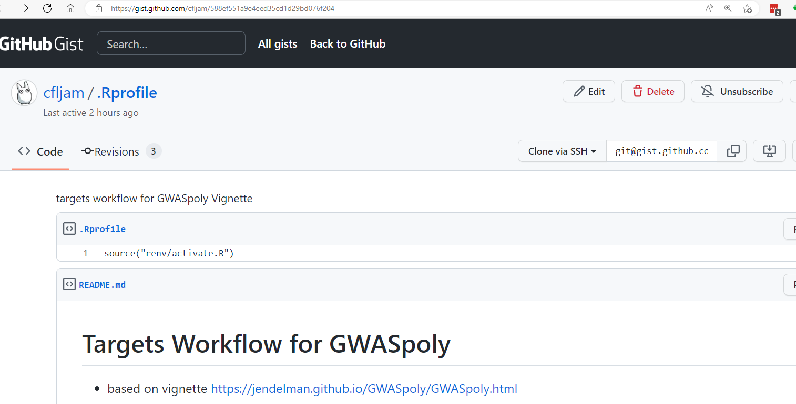
$ git clone git@gist.github.com:588ef551a9e4eed35cd1d29bd076f204.git

Slide 4

The Quantitative Genetics Sisyphean Loop
Get/update phenotypic data and clean
Get/update pedigree data and clean
Get/update genotype data and clean
Sample QC, align matrices
Fit models (in parallel? HPC?)
Provide useful reports and outputs
Talk to others, update data, hit bugs, session crashes
GOTO 1 ☹
Rmd

Slide 5
Workflow as a DAG (Directed Acyclic Graph)
Node is an object
Edges are functions that generate an object
Make operation applies functions only when inputs change
Caching preserves state
Function 1
Object 1
Object 2
Object 4
Function 2
Object 3

Slide 6
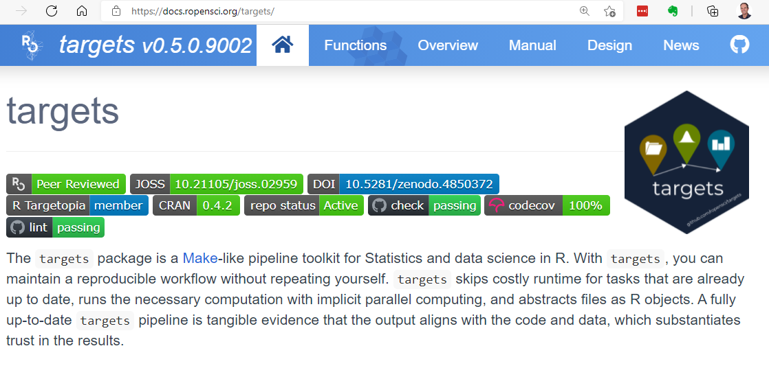
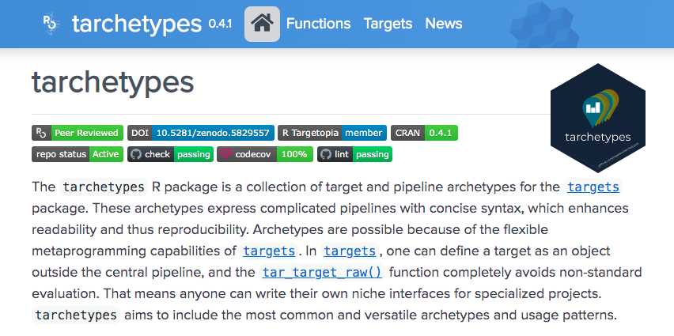
WHY targets ?
Developed at Eli Lilley for complex data engineering + Bayesian modelling :-)
R-oriented, make-like
Re-make of drake project with many enhancements
Nice caching with many storage options
HPC integration via future and clustermq
Succinct syntax
Awesome documentation

Slide 7
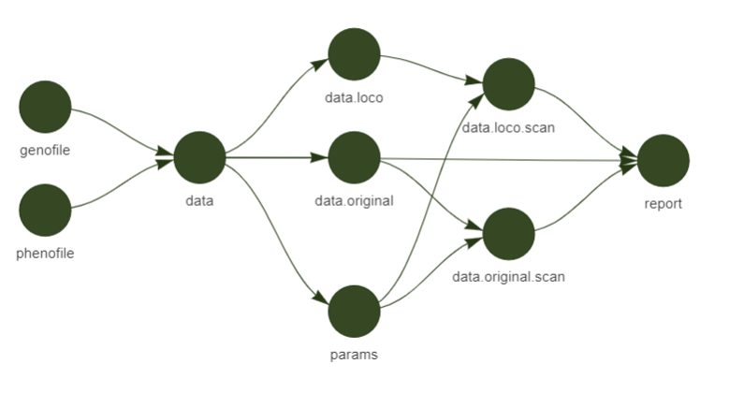
GWASPoly Vignette Workflow as DAG
Covariance Matrices : LOCO (leave-one-chromosome-out) random polygenic effect
Compile genotype and phenotype into a GWASpoly object
Genome scan mixed model
Rmarkdown report (tabulation, Manhattan plots etc)
Genome scan mixed model
Covariance Matrix : K model for random polygenic effect

Slide 8
Vignette Workflow as a _targets.R file
## load packages
source("./packages.R")
## Load your R files
lapply(list.files("./R", full.names = TRUE), source)
list( tar_target(
genofile,
system.file("extdata", "new_potato_geno.csv", package = "GWASpoly"), format = 'file' ),
tar_target(
phenofile,
system.file("extdata", "new_potato_pheno.csv", package = "GWASpoly"),
format = 'file' ),
tar_target(
data,
read.GWASpoly(ploidy = 4,
pheno.file = phenofile,
geno.file = genofile,
format = "numeric",
n.traits = 1,delim = "," )),
Load packages
and set globals
List of target definitions
Tracked
Input
files
Dependency on
Previous objects

Slide 9
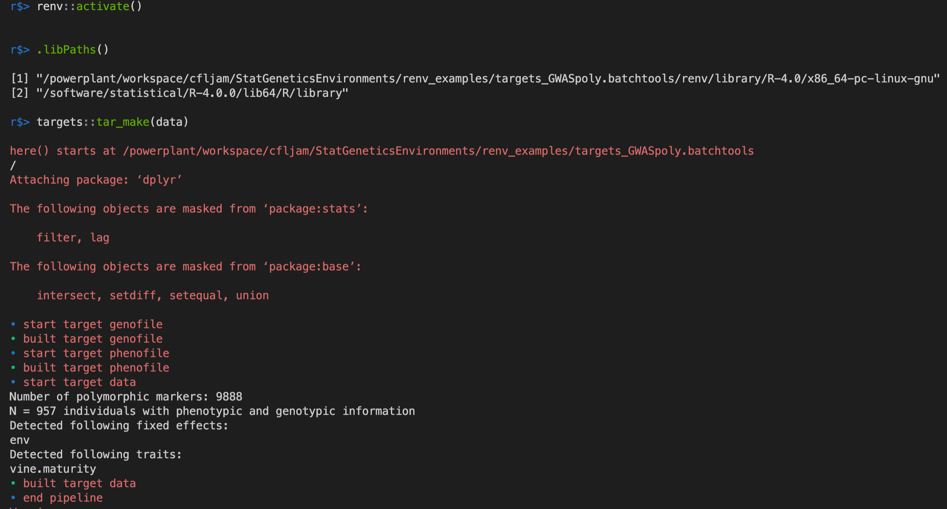
tar_make()
It's wise to use renv
Just make one target
targets::tar_make()
Runs in an R sub-procees using callr

Slide 10
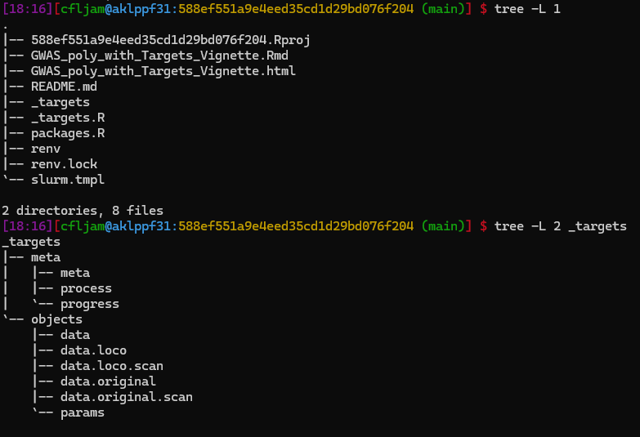
Cached data objects (RDS default or custom formats)

Slide 11
Let’s Parallelize
Covariance Matrices : LOCO (leave-one-chromosome-out) random polygenic effect
Genome scan mixed model
Genome scan mixed model
Covariance Matrix : K model for random polygenic effect

Slide 12
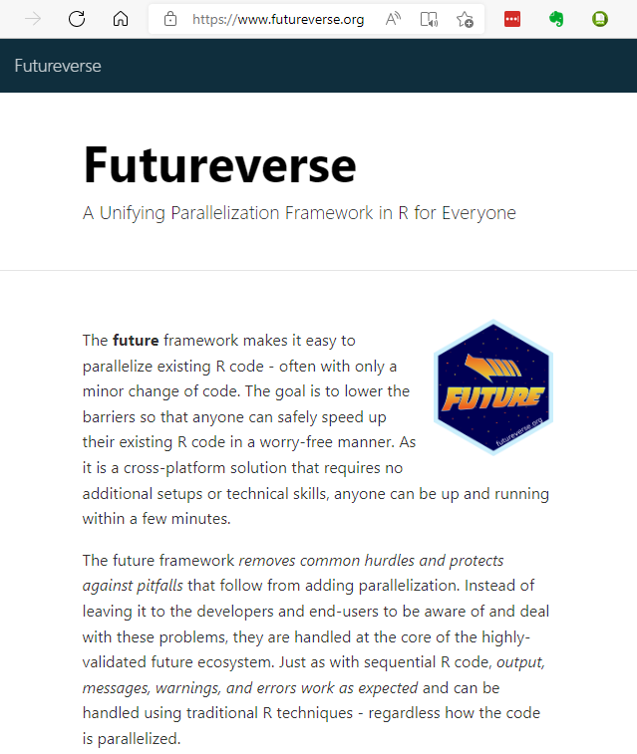
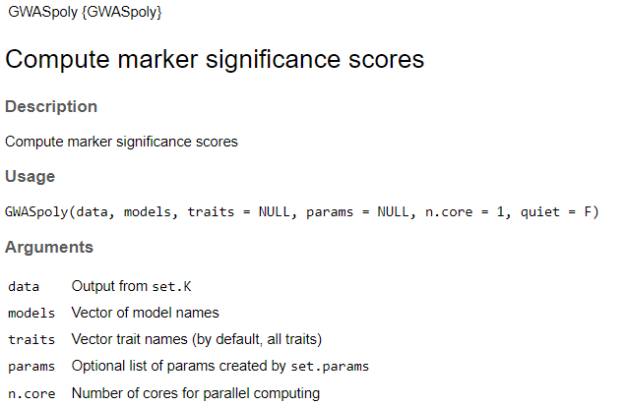
..and Multicore (with Future)
We want to run in parallel across 2 worker nodes, each with 16 cores

Slide 13
Declare our Execution Plan in _targets.R Header
RLinuxmodules::module('load slurm')
future::plan(
strategy = batchtools_slurm,
template = “slurm.tmpl")
## Set default options for targets
tar_option_set(deployment = 'main',
resources = tar_resources(future = tar_resources_future(
resources = list(num_cores = 4))))
plan to use slurm
bsub template file
Default to running on head node
if we run on slurm, request 4 cores as default
To specify a different execution model, we just change the future::plan
        sequential
    multisession/multicore
    batchtools_lsf etc etc

Slide 14
Define Target-Specific Resources
tar_target(
data.loco.scan,
GWASpoly(
data = data.loco,
models = c("additive", "1-dom"),
traits = c("vine.maturity"),
params = params,
n.core = 16),
deployment = 'worker',
resources = tar_resources(future =
tar_resources_future(resources= list(num_cores = "16"))))
Function call with 16 cores
Request 16 cores on worker

Slide 15
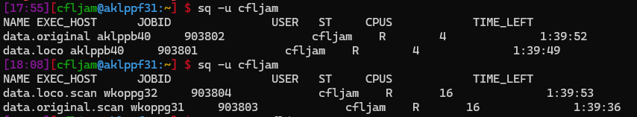
Running Pipeline with Multiple Workers
Run with a maximum of two worker nodes
r$>tar_make_future(workers=2L)
✔ skip target genofile
✔ skip target phenofile
✔ skip target data
• start target data.loco
• start target data.original
• built target data.original
• start target params
• built target params
• start target data.original.scan
• built target data.loco
• start target data.loco.scan
Analyzing trait: vine.maturity
P3D approach: Estimating variance components...Completed
Testing markers for model: additive
Testing markers for model: 1-dom-alt
Testing markers for model: 1-dom-ref
• built target data.original.scan
Analyzing trait: vine.maturity
P3D approach: Estimating variance components...Completed
Testing markers for model: additive
Testing markers for model: 1-dom-alt
Testing markers for model: 1-dom-ref
• built target data.loco.scan
• start target report
• built target report
• end pipeline
Data object already built
Run in parallel 4 cores
Run in parallel 16 cores
Render our RMarkdown report

Slide 16
Rmarkdown in a Targets Workflow
In _targets.R
tarchetypes::tar_render(report,
'./doc/GWAS_poly_with_Targets_Vignette.Rmd',
deployment = 'worker')
In Rmd file
```{r}
tar_load(data.loco.scan)
qq.plot(data.loco.scan,trait="vine.maturity") +
ggtitle(label="LOCO")
```
Load object from cache
Changes in objects referenced in Rmd will trigger re-knit

Slide 17
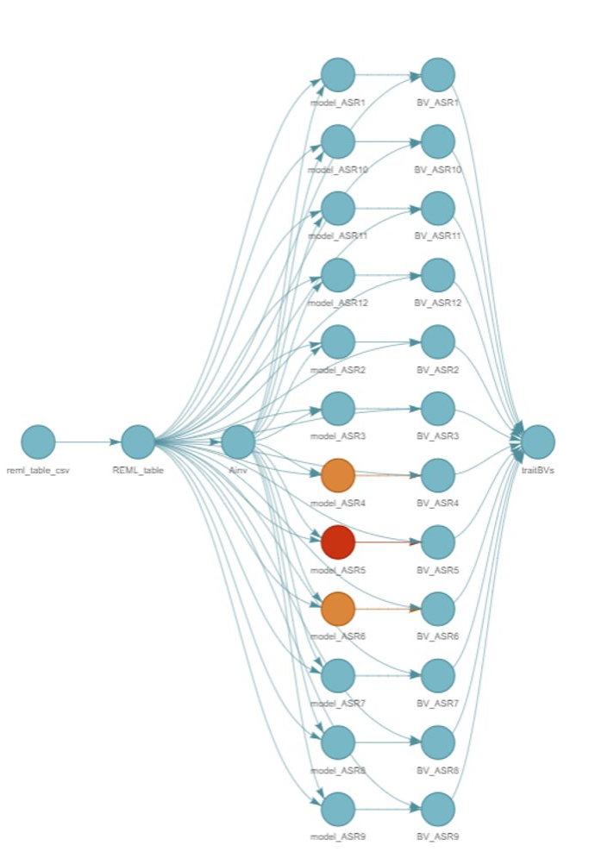
In Summary
Encourages best practice
  Functional approach
  Testing of data and functions
  Consistent project structure
Eases cognitive burden, collaboration for ‘complex’ projects
  R environment management is critical (use renv)
Enables complex orchestration & parallelization
Caching
  simpler iteration than xfun::cache_rds
  options for portability (AWS, feather etc) and Rmarkdown chunks

Slide 18
Thank you
Funded by
Plant & Food Research Kiwifruit Royalty Investment Programme
USDA NIFA Specialty Crop Research Initiative 'Tools for Polyploids'
John.mccallum@plantandfood.co.nz

