Slide 1
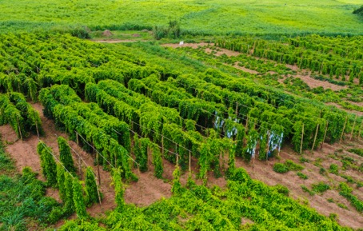
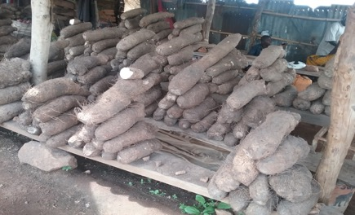
Effort towards yam breeding modernization using genomic tools
P.Agre@cigar.org
Paterne Agre; Marlee R. Labroo; Patrick Adebola; Giovanny E. Covarrubias-Pazaran & Asrat Asfaw
Polyploids workshop: San Diego, California,January, 2023

Slide 2
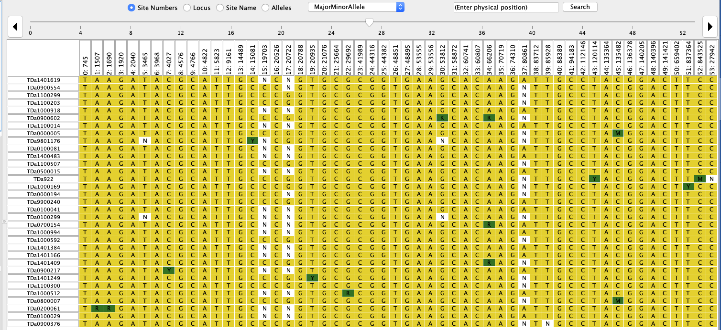
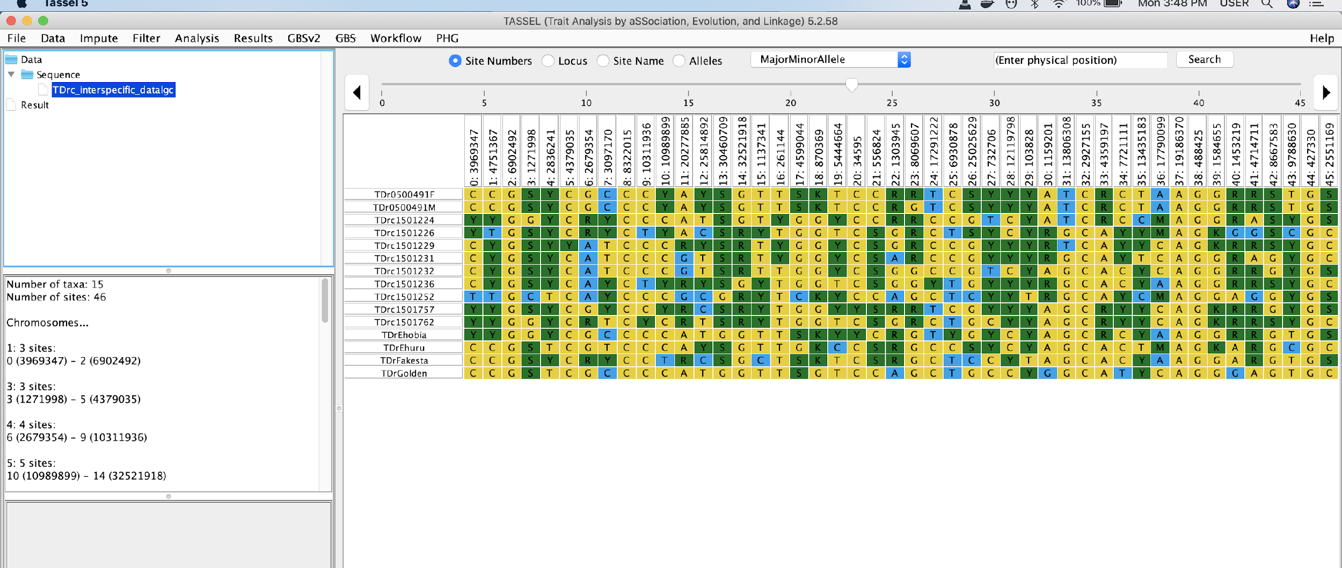
Yam modernization using genomic tools
Outline
Detection of Marker-trait association
          Genome-wide association
  QTL mapping
Markers validation and deployment
Cross prediction
Take home message

Slide 3
Yam modernization using genomic tools
Different genotyping platforms used
  WGRS == 333 samples (used for GWAS, genetic group development and for QC/QA development)
  GBS (227 D.alata for linkage mapping
  197 D.rotundata for linkage analysis)
  DArT (Ldseq)
    506 D. rotundata == GWAS and for pop validation, forward marker development
    100 D. alata GWAS for key agronomic and for tuber quality traits
    86 D.rotundata farmer varieties (trait profiling)
    2903 D. rotundata for GPCP
    940 D.rotundata (SCG Abuja)
    1624 D. rotundata (Seedling nursery Abuja)
    Intertek
      374 multiple yam species (QC/QA markers development/validation)
      940 D. rotundata for markers validation
      374 D. rotundata deployement of QC/QA

Slide 4
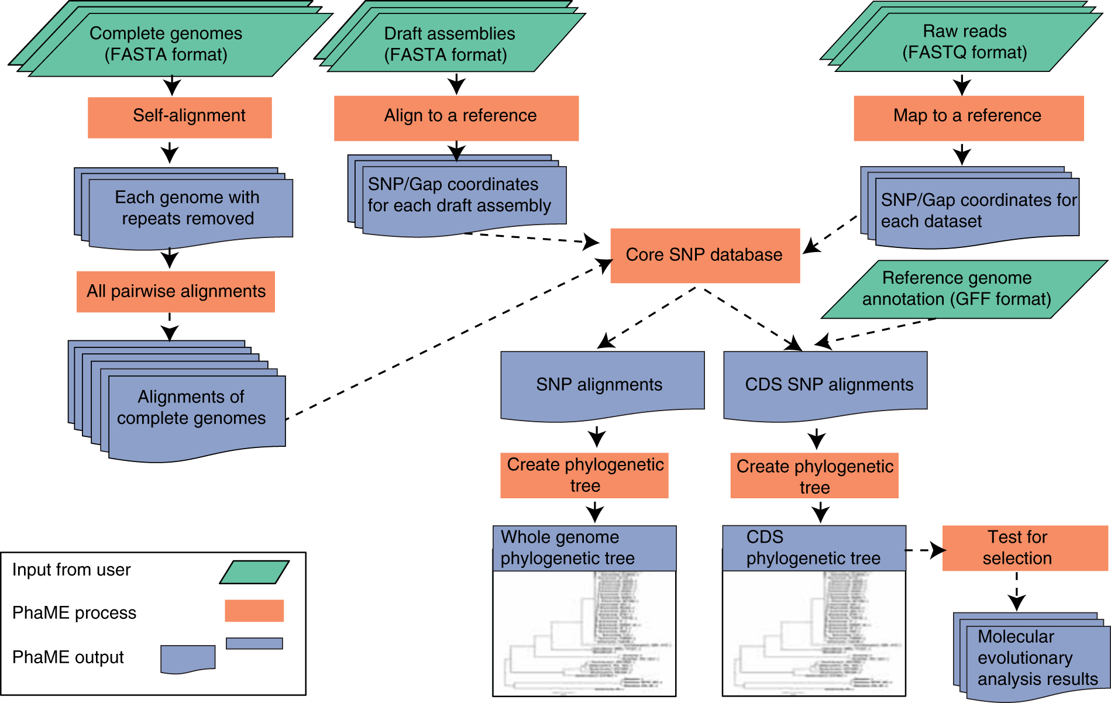
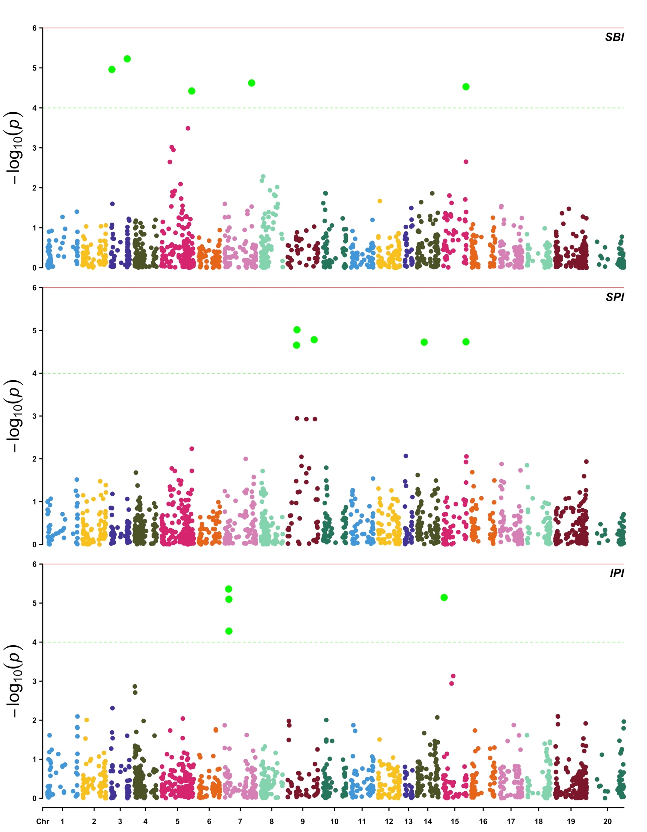
Yam modernization using genomic tools
Yam SNP alignment and Quality control pipeline establishment
QTL/Traits association analysis
Several traits considered
Several population analyzed
Notes:
The yam breeding has developed a robust bioinformatic pipeline for SNP calling and implementation of quality check. The protocol is well documented using Java script and summarized as flowchart

Slide 5
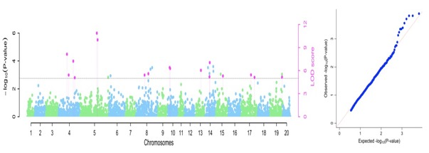
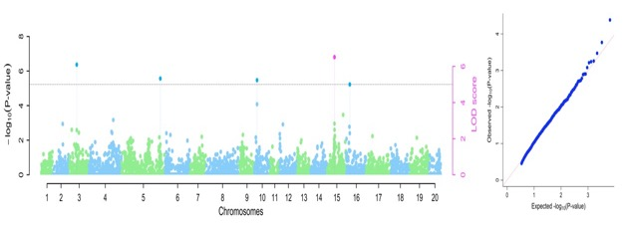
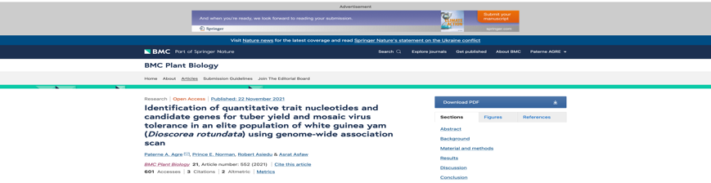
Yam modernization using genomic tools
Genome-wide association
Multiples SNPs markers identified for tuber yield
Multiples SNN markers identified to be associated YMV
Notes:
Using a breeding panel population and through trait-association method we identified several genomic region controlling key agronomic traits.

Slide 6
Yam modernization using genomic tools
Genome-wide association
Flowering Intensity
Plant sex
Plant vigor

Slide 7
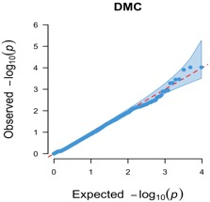
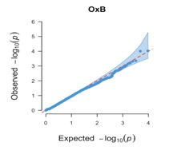
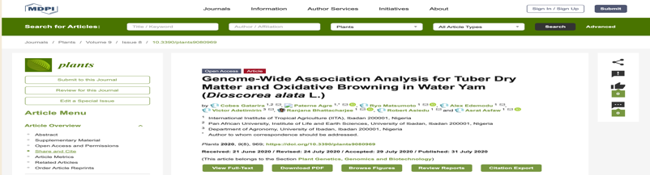
Yam modernization using genomic tools
Genome-wide association
Tuber dry matter (DMC)
Tuber oxidative browning (OxB)
Notes:
We used different genetic model (General, Additive, Dom-ref and dom-Alt) to identify genomic region controlling DMC and oxidative browning index

Slide 8
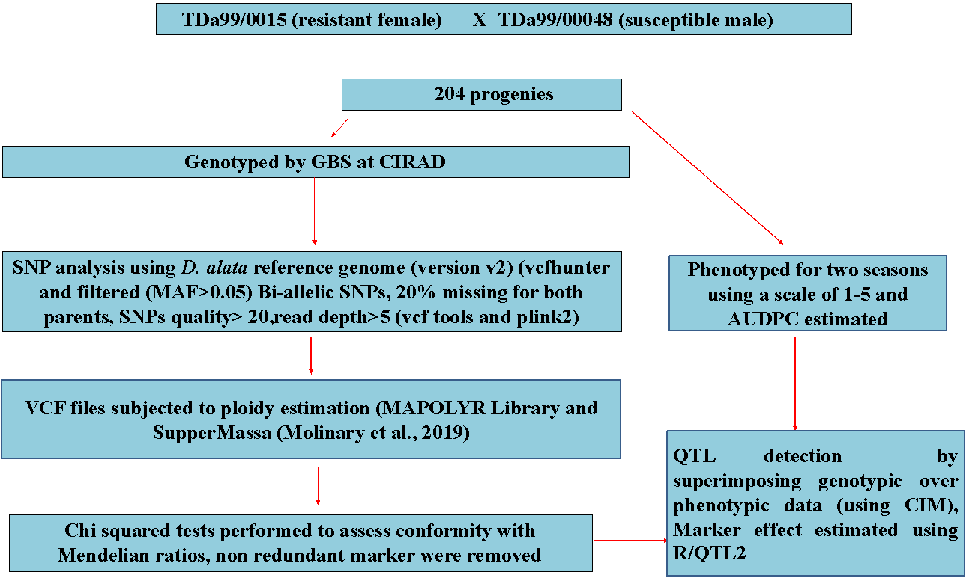
  QTL Mapping
Yam modernization using genomic tools
QTL detection workflow chat

Slide 9
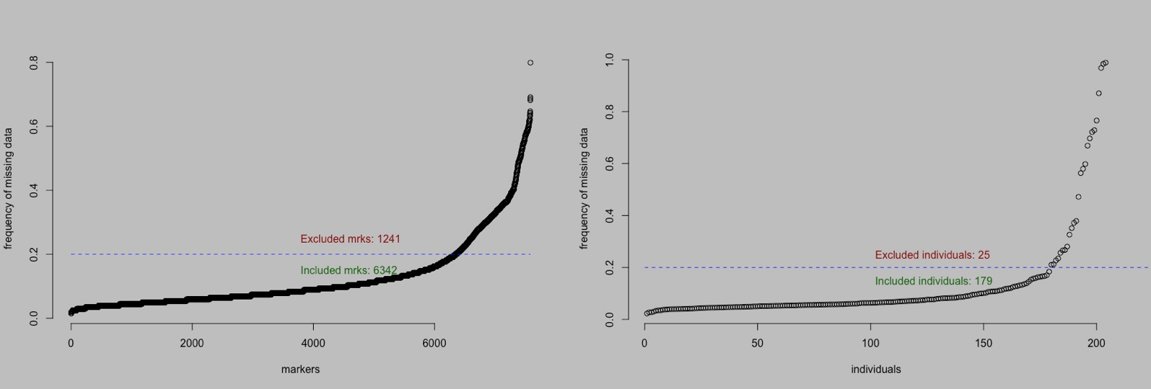
  QTL Mapping
Yam modernization using genomic tools
Notes:
SNP quality assessment using Mapoly for SNP

Slide 10
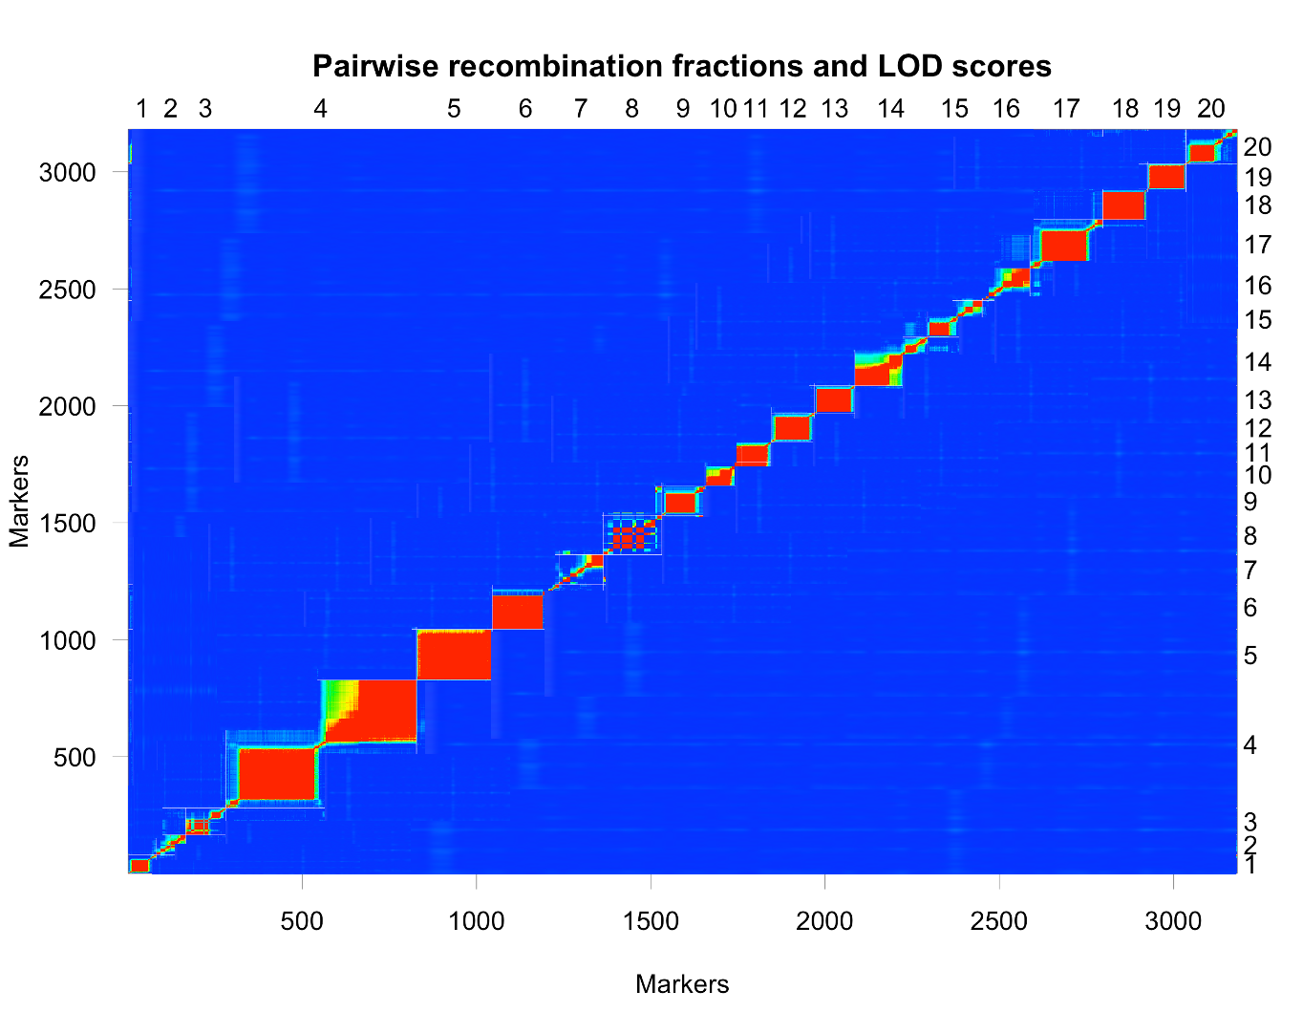
  QTL Mapping
Yam modernization using genomic tools
Notes:
A pairwise comparison of recombination fractions after SNP markers were ordered across the 20 chromosomes

Slide 11
  QTL Mapping
Yam modernization using genomic tools
Distribution of SNP markers per LG
Chr | Number of SNPs | Chromosome Length (cM) | Average SNP distance | Maximum Gap
Chr1 | 80 | 80.93 | 1.95 | 5.00
Chr2 | 84 | 109.17 | 1.28 | 6.01
Chr3 | 115 | 64.63 | 0.56 | 4.48
Chr4 | 520 | 92.32 | 0.16 | 8.26
Chr5 | 199 | 109.19 | 0.50 | 7.71
Chr6 | 191 | 109.52 | 0.57 | 5.54
Chr7 | 127 | 59.84 | 0.48 | 5.26
Chr8 | 200 | 91.39 | 0.48 | 4.44
Chr9 | 124 | 77.12 | 0.62 | 5.80
Chr10 | 104 | 57.13 | 0.55 | 5.52
Chr11 | 85 | 55.95 | 0.66 | 7.94
Chr12 | 125 | 83.22 | 0.65 | 4.30
Chr13 | 116 | 95.55 | 0.78 | 5.47
Chr14 | 208 | 51.447 | 0.25 | 4.40
Chr15 | 180 | 34.70 | 0.18 | 2.39
Chr16 | 139 | 77.16 | 0.61 | 9.07
Chr17 | 208 | 67.44 | 0.31 | 3.95
Chr18 | 129 | 75.71 | 0.54 | 7.23
Chr19 | 111 | 33.09 | 0.28 | 2.03
Chr20 | 139 | 35.48 | 0.23 | 3.41
Total | 3,184 | 1,460.98
Notes:
Improved genetic map based D.alata reference genome, SNP markers well distributed across the 20 chromosomes

Slide 12
  QTL Mapping
Yam modernization using genomic tools
Markers associated with anthracnose disease tolerance in water yam
Markers | Chr | Pos (cM) | LOD | R² (%) | Gene function
Qyad-7-1 | 7 | 10.60 | 4.51 | 33.7 | DRNTG_08663.1
QTL-7-2 | 7 | 19.21 | 5.28 | 29.54 | DRNTG_08664.1, DRNTG_23336.1
Qyad-15 | 15 | 28.80 | 4.43 | 30.90 | DRNTG_14305.1
Qyad-18 | 18 | 61.4 | 4.65 | 39.40 | DRNTG_18245.1, DRNTG_29617.1
https://pubmed.ncbi.nlm.nih.gov/35205389/
Notes:
Four QTLs distributed on 3 chromosomes were detected to be associated with the anthracnose disease severity score

Slide 13
Yam modernization using genomic tools
Markers validation and deployment
For the validation we focused on 7 traits in D. rotundata
Tuber yield per plant
Yam mosaic virus
Plant sex
Flowering intensity
Plant vigor
Tuber appearance
Tuber shape

Slide 14
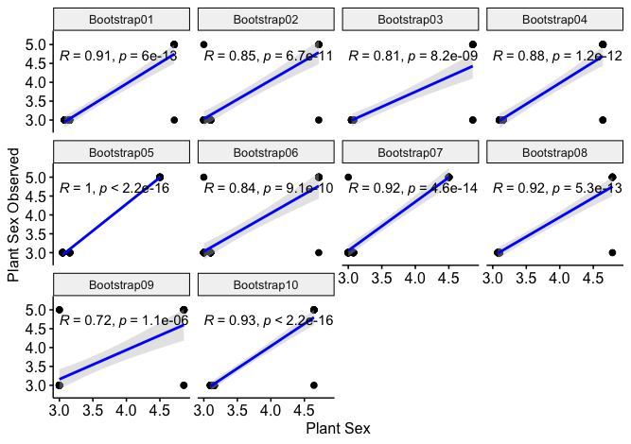
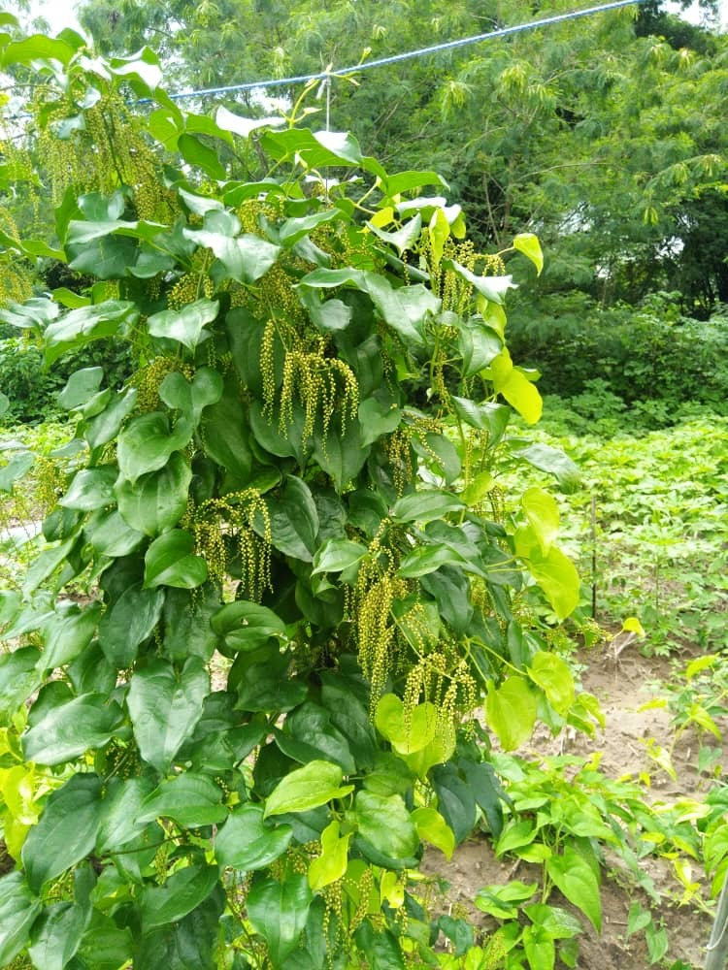
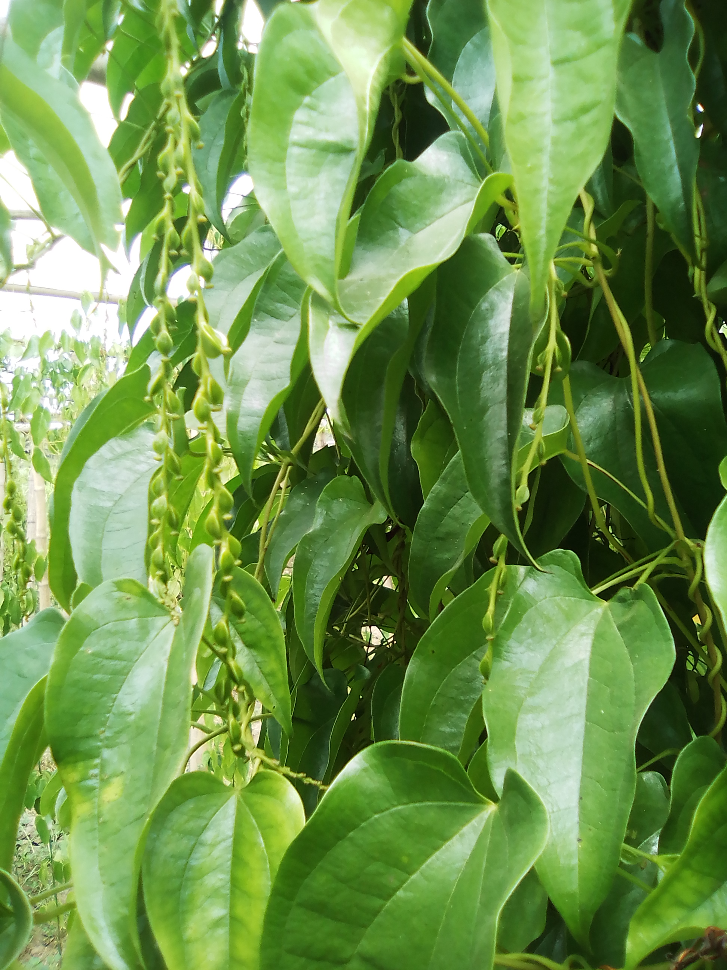
Yam modernization using genomic tools
Markers validation and deployment
184 samples were selected with known and unknown plant sex information
Notes:
We tested the converted SNP marker for the plant sex. The markers displayed high prediction accuracy (85%). Related SNP information have been deposited into EiB website to be used by the breeding community.

Slide 15
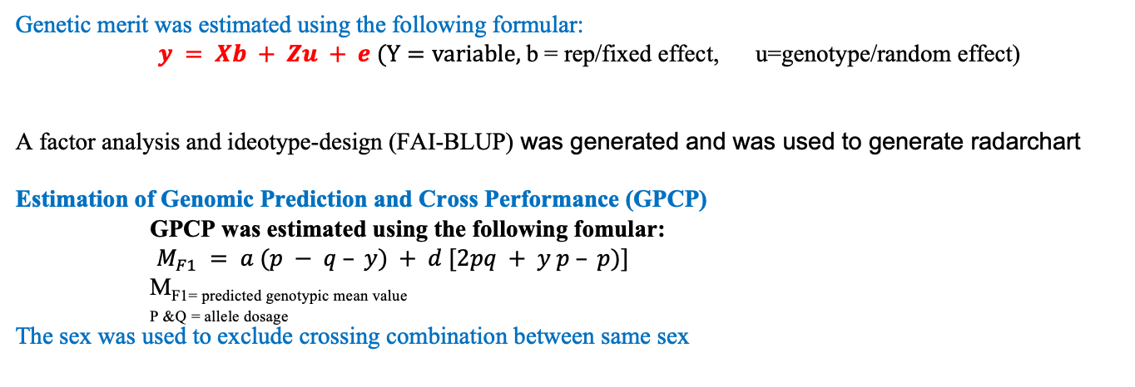
Yam modernization using genomic tools
Genetic merit was estimated using the following formular:
$y = Xb + Zu + e (Y=variable,$b = rep/fixed effect, u=genotype/random effect)
A factor analysis and ideotype-design (FAI-BLUP) was generated and was used to generate radarchart
Estimation of Genomic Prediction and Cross Performance (GPCP)
GPCP was estimated using the following fomular:
$M_{F1} = a (p − q – y) + d [2pq + y p – p)]$
MF1= predicted genotypic mean value
_{P &Q = allele dosage}
The sex was used to exclude crossing combination between same sex
A total 2648451 cross combination was obtained using the GPCP model. The value ranged from -2.55 to 4.21

Slide 16
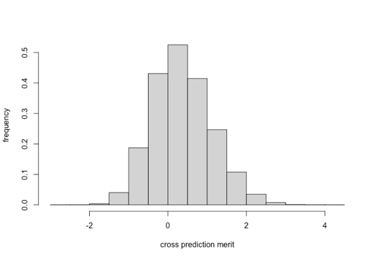
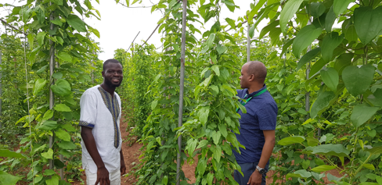
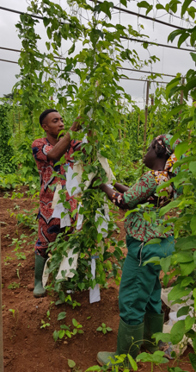

Yam modernization using genomic tools
Selection and advancement
Class 1:
Cross combinations with merit > 3
Above1500 cross combination
Unique parents from the crossing combination: 325
Pheno selected clones:
Identified 72
Reduced breeding cycle to 3 years
Class 2:
Cross combinations with merit between 2 and 3
Above 55000 cross combination
Unique parents from the crossing combination: 1639
Pheno selected clones:
Identified 86
Total selection 158
@6.86% selection intensity

Slide 17
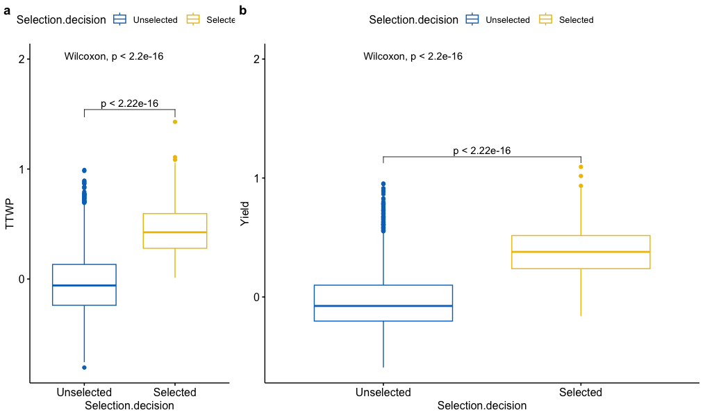
Yam modernization using genomic tools
Trait performance between the selected progenies and the unselected

Slide 18
Take home message
Several sequencing platform have been been used in the breeding program for different breeding purposes
SNP calling road map defined and implemented
Genomic method fully implemented in the breeding program for parents selection and characterization
SNP region controlling key traits (agronomic and tuber quality) documented
QA/QC markers developed and deployed in the breeding program for routine activities
Markers assisted selection implemented in the breeding program
Genomic Prediction for Cross Performance established

Slide 19


Yam Breeding Unit
Bioscience IITA Ibadan
Polyploidy group
Excellence in Breeding
INTERTEK
University of Illinois
AfricaYam Partners’
Thank you
A member of CGIAR consortium
www.iita.org

