Slide 1
Genetic Marker Imputation in Polyploids
Jeffrey Endelman
January 12, 2023
Funding from USDA NIFA Award #2020-51181-32156

Slide 2
Two Scenarios
 | Scenario 1 | Scenario 2
Population Structure | Arbitrary (”panel”) | Connected F1 populations
Application | GWAS, GS | Joint linkage mapping, GS
Focus on genotyping-by-sequencing (WGS, RAD, amplicon, capture, etc.)
But imputation methods and software can be applied to SNP arrays

Slide 3
Panel Imputation
In diploids, haplotype-based approaches to imputation (e.g., BEAGLE, PHG) are well established and effective
For polyploids, this is still “work in progress”
  (see Voorrip’s talk on PolyHaplotyper tomorrow)
Methods covered in this talk:
  MVN-EM, Multivariate Normal Expectation-Maximization
  RF, Random Forest

Slide 4
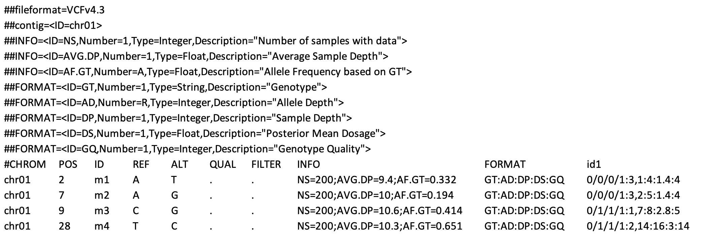
Variant Call Format (VCF)
Metadata
Header
“Fixed” Fields
(data for each variant)
Data for each sample
(id1, id2, etc.)

Slide 5
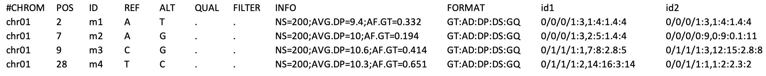
FORMAT is colon-delimited list of genotype keys for each sample, defined in the metadata
Key | Explanation | Example
AD | comma-delimited list of the read counts for each allele | 1,7
DP | total depth for the sample | 8
GT | slash-delimited list of the predicted genotype 0 = REF, 1 = ALT1, 2 = ALT2, … | 0/1/1/1
GQ | PHRED-scaled error of GT | 5

Slide 6
Genotype Quality (GQ)
Higher probability (p) → less genotype uncertainty (q = 1–p)
Quantified using PHRED scale, named after Phred software developed for human genome project (Ewing and Green 1998)
  GQ = -10 log₁₀(q)
q | GQ
0.1 | 10
0.05 | 13
0.01 | 20
0.001 | 30

Slide 7
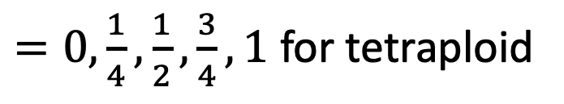
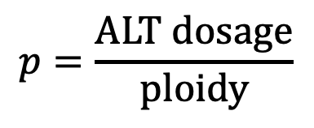
Binomial Model (bi-allelic variants)
ALT allele depth (k) modeled as binomial random variable
  DP = n
  AD = n–k, k
  p = probability of observing ALT allele
Without error or bias,
More complex model needed for real data
  Sequencing error (SE), Allelic bias (AB), Overdispersion (OD)
$$p=\frac{ALT dosage}{ploidy}$$
$=0,\frac{1}{4},\frac{1}{2},\frac{3}{4},1$ for tetraploid
Reference: R package updog (Gerard et al. 2018)

Slide 8
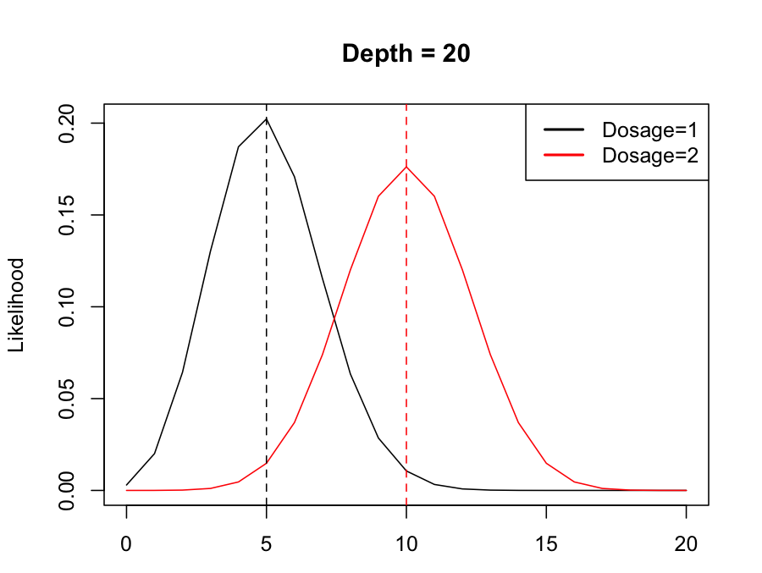
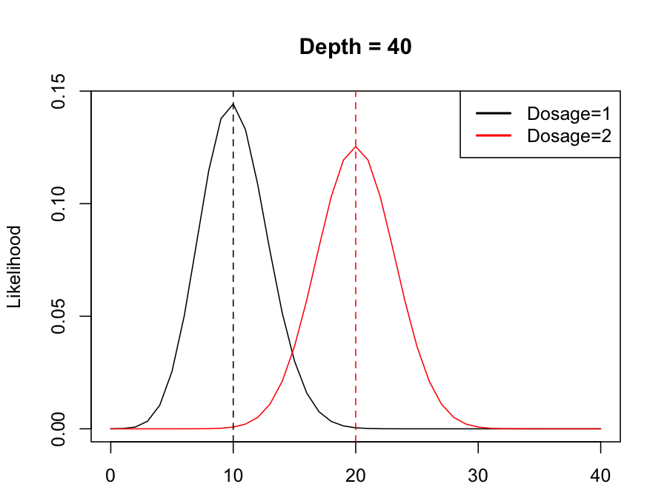
Higher DP → Less overlap between distribution for different dosages
Tetraploid Example
ALT Depth
ALT Depth

Slide 9
Maximum Likelihood Genotype
ALT Depth
AD = 28,12
→ GT = 0/0/0/1
AD = 22,18
→ GT = 0/0/1/1

Slide 10

Maximum Posterior Probability
Most software uses Bayesian framework to output GT based on the mode (i.e., peak) of the posterior distribution
Commonly used priors
  Expected frequency of offspring in a mapping population
  Hardy-Weinberg Equilibrium, based on pop allele frequency
  “Proportional Norm”, see Gerard and Ferrão (2019)
$$Posterior probability∝\left(Prior probability\right)\left(Likelihood \right)$$
($∝$ = “proportional to”)

Slide 11
Posterior Mean of Allele Dosage (DS)
Alternative to GQ for representing uncertainty
  Real number, not integer
Fractional values of dosage compatible with quantitative genetic analyses (GS, GWAS)
As DP increases, DS becomes equivalent to GT
Key | Example
GT | 0/1/1/1
AD | 1,7
DP | 8
GQ | 5
DS | 2.8

Slide 12
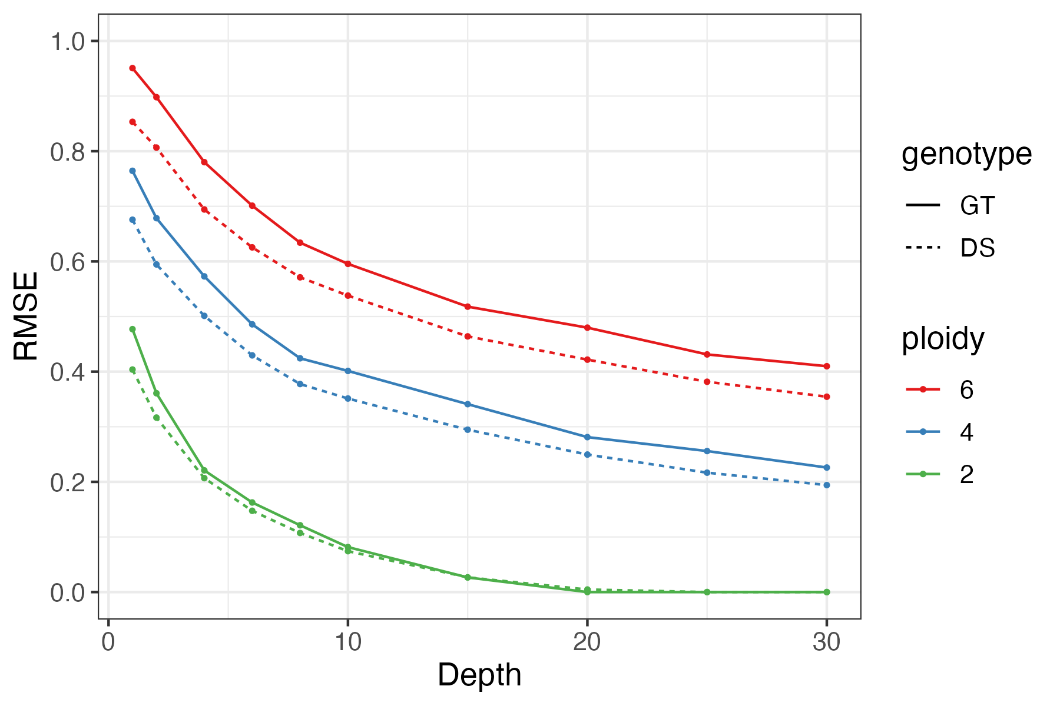
Simulation: DS vs GT
Simulated HWE population and GBS markers
Error = root mean squared error (RMSE) between true and predicted genotype
Higher ploidy → larger RMSE and greater benefit from DS vs. GT
Error

Slide 13
Software Options for DS
Options if your VCF file does not have DS:
polyRAD (Clark et al. 2019)
  Advantage: fast
  Disadvantage: does not model allelic bias
polyBreedR (Endelman)
  Uses updog package, which has complete model but is slower
  Bias, overdispersion, and other parameters stored as INFO in the output VCF

Slide 14
https://github.com/jendelman/polyBreedR
Vignette coming soon!

Slide 15
MVN-EM Imputation
Treats DS vector for the population as multivariate normal (MVN)
  M step: Missing values imputed by BLUP, conditional on the cov matrix between individuals
  E step: cov matrix updated
Has been available in rrBLUP package for diploids since 2012, through function A.mat
  Can be used for polyploids by rescaling DS
New interface in package polyBreedR, function impute

Slide 16
polyBreedR::impute

Slide 17
Random Forest (RF) Imputation
Machine learning algorithm based on decision trees
Each marker analyzed as response variable, using neighboring markers as predictors
  User specifies window size (default = 100 markers on either side)
Rules selected to minimize average variance of both groups
Final prediction is average over many trees
  (default = 100)
x₁₇ < 1.81
x₁₅ < 1.75
x₇ < 0.45
x₉ < 2.35
x₉ < 1.10
x₃₉ < 3.65
x₄ < 2.35

Slide 18
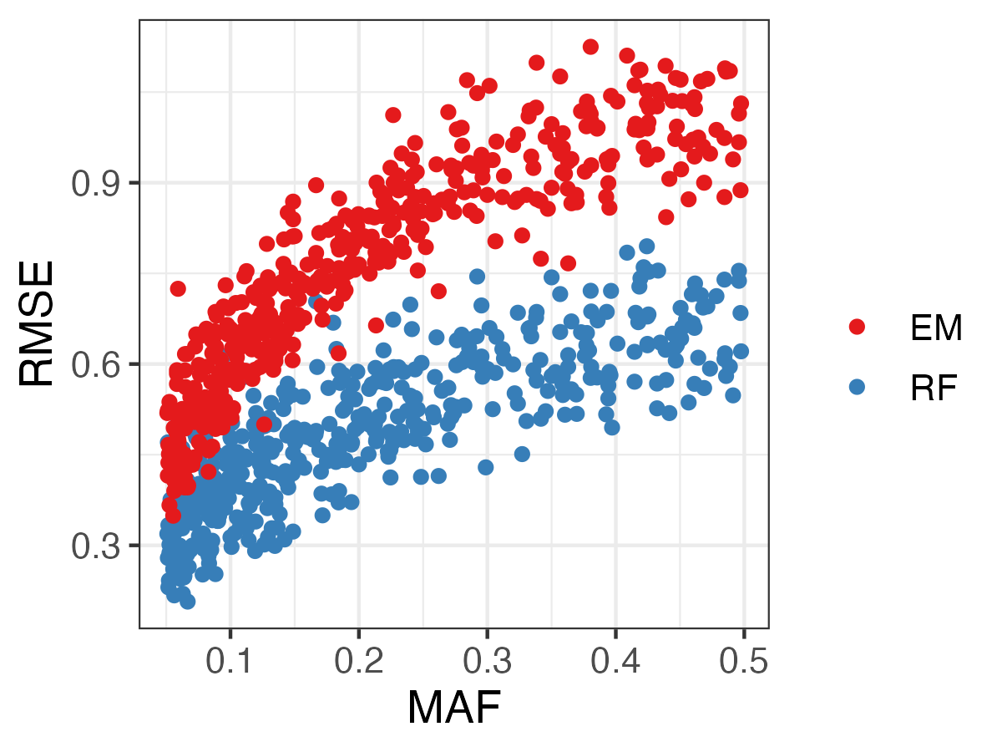
Tetraploid, N = 600
500 markers
Error
RF is better
Error increases with MAF for both methods
For next set of comparisons, average markers with MAF > 0.3

Slide 19
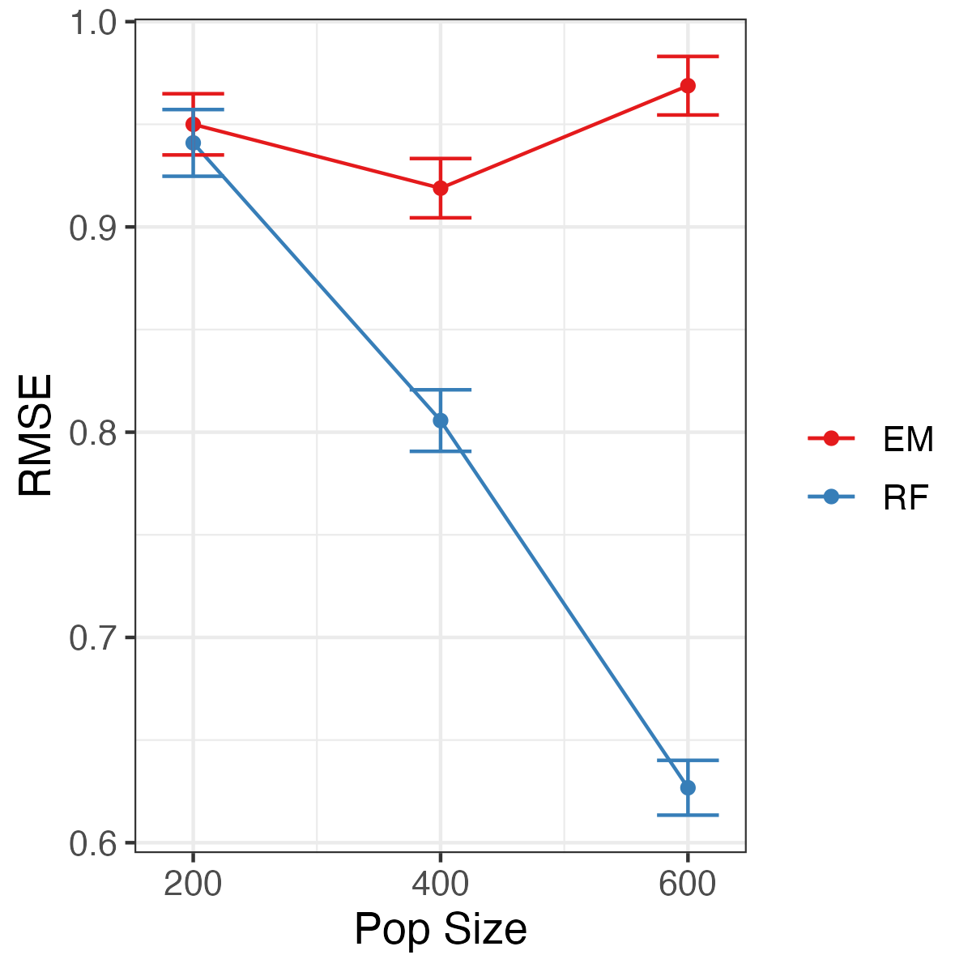
Tetraploid
Imputation Error decreases with population size for RF, not EM
Error

Slide 20
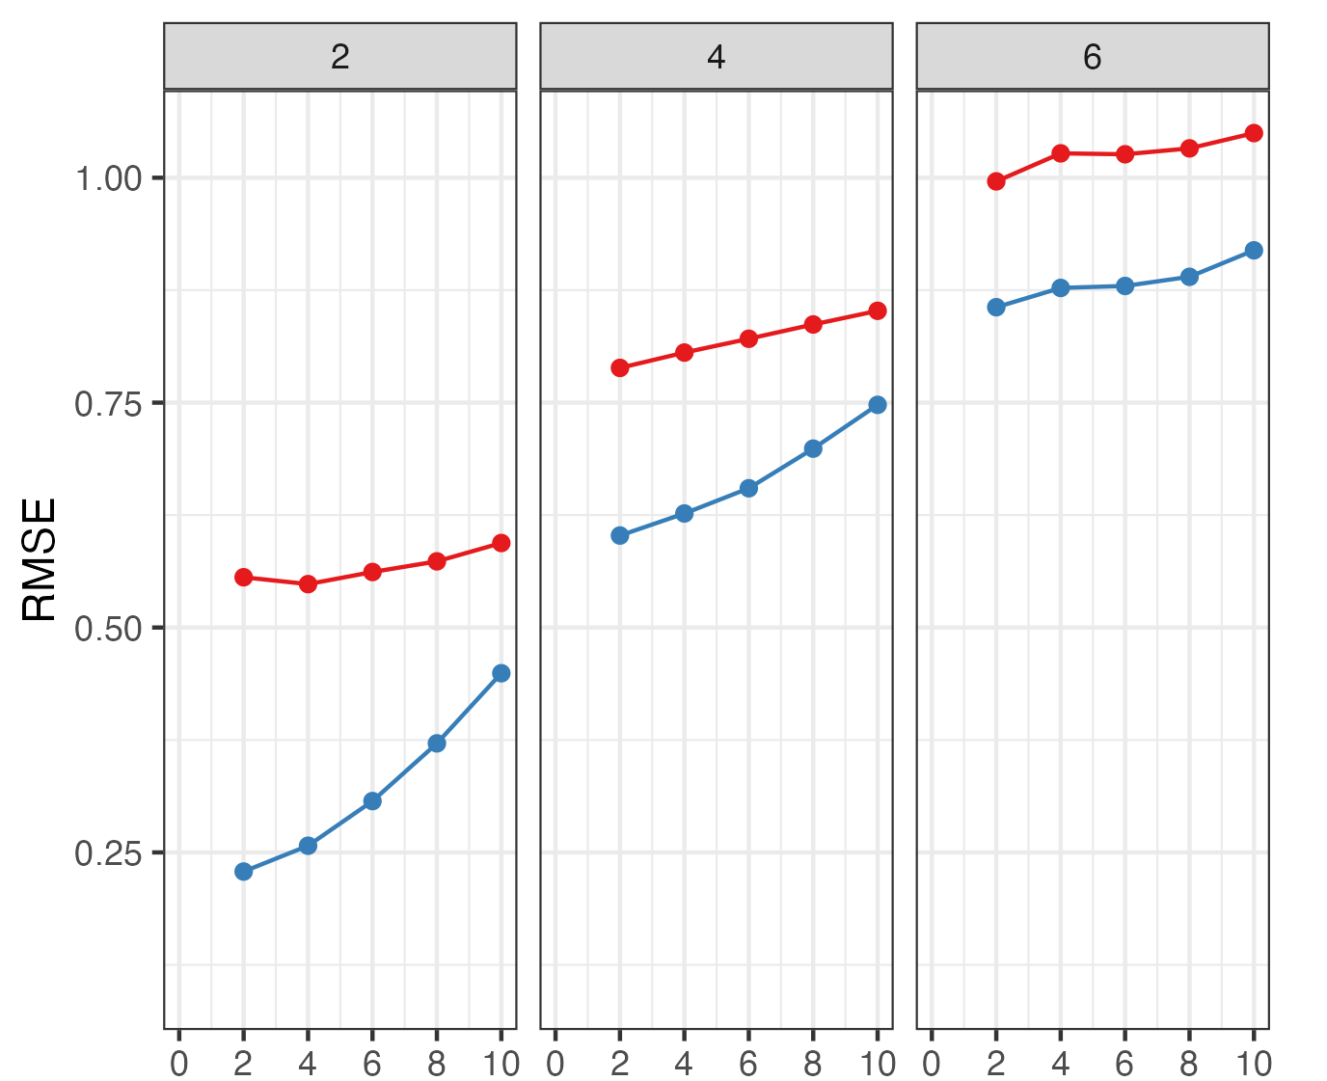
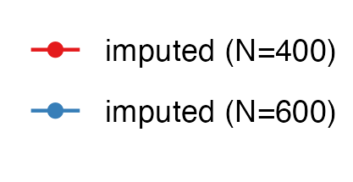
RF Imputation
Ploidy
Error increases with higher ploidy
Removing genotypes with low depth (and therefore more uncertainty) did not improve imputation
Worsens because the training set decreases
Depth Threshold

Slide 21
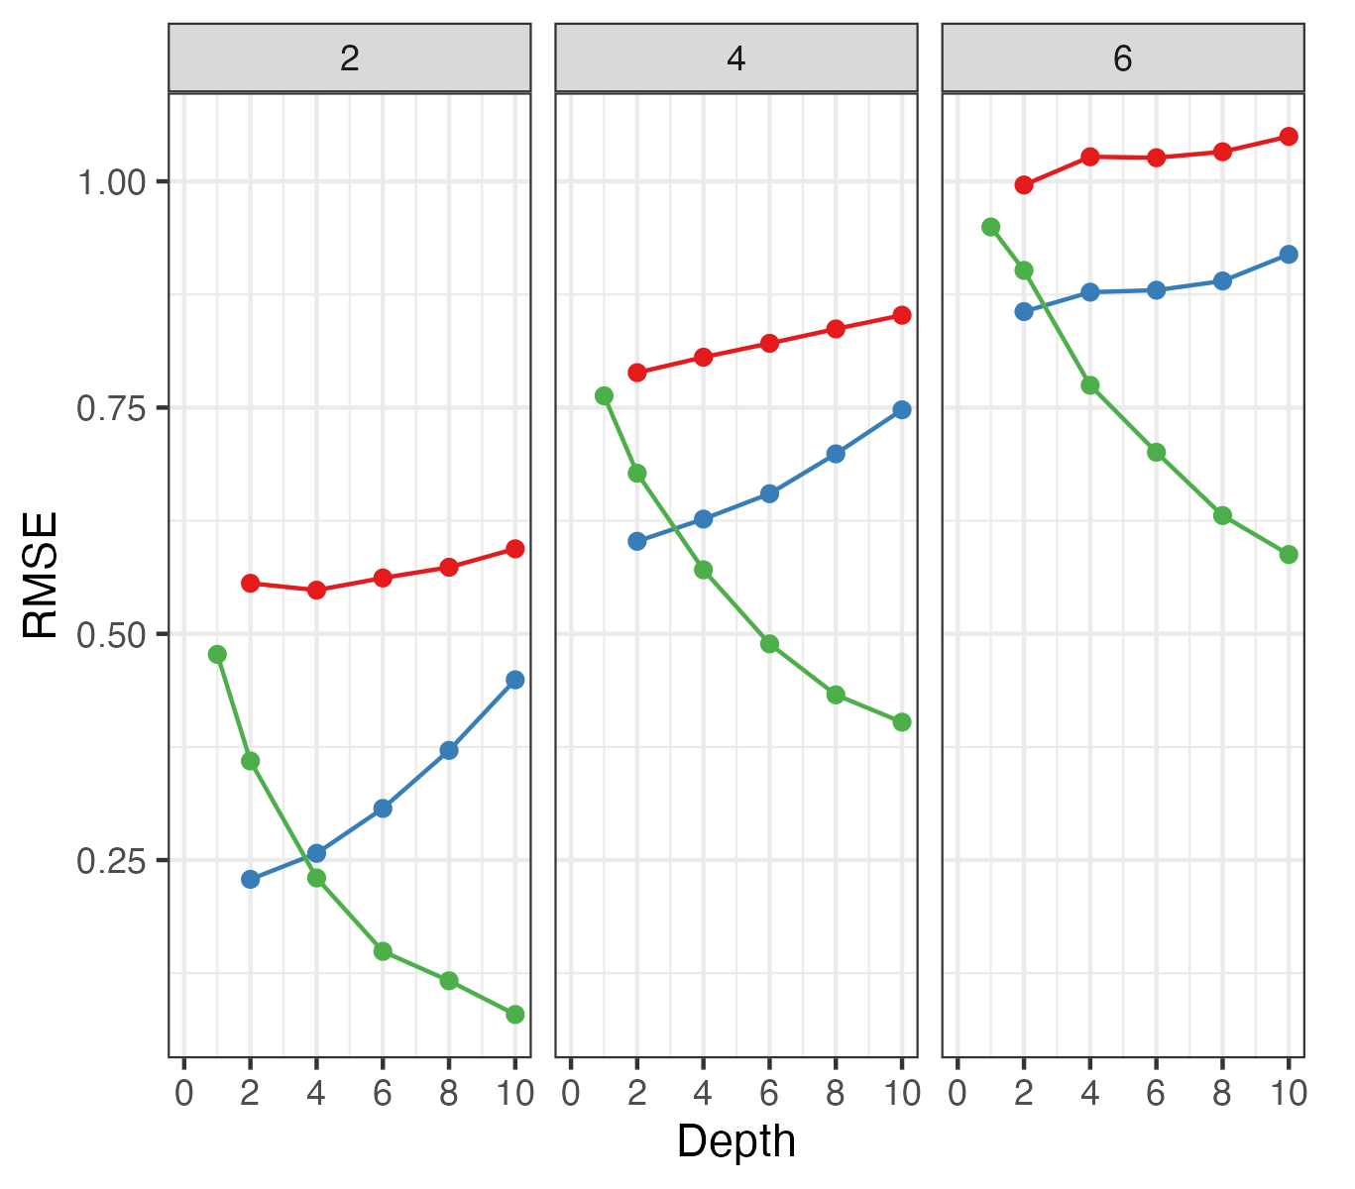
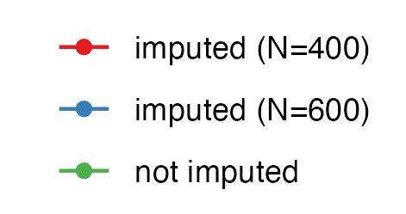
RF Imputation
Ploidy
Imputed genotype can have less error than genotype call at low depth
Crossover point depends on ploidy, pop size and structure—extrapolation from this simulation to all cases may be risky
Illustrates potential for setting minimum depth > 1 for genotype call
genotype call

Slide 22
polyBreedR::impute
Vignette coming soon!

Slide 23
Genetic Marker Imputation in Polyploids
Jeffrey Endelman
January 12, 2023
Funding from USDA NIFA Award #2020-51181-32156

