Slide 1
Polyploid linkage & QTL mapping with polymapR and polyqtlR
SCRI Tools for Polyploids workshop, 13th January 2022
Peter Bourke
Plant Breeding
Wageningen University & Research
<peter.bourke at wur.nl>

Slide 2
Acknowledgements
Polyploids Team @ Wageningen (in particular Chris Maliepaard, Roeland Voorrips & Paul Arens)
Christine Hackett, BioSS, James Hutton Institute, Scotland.
Workshop assistants: Jonathan Kunst & Alejandro Therese Navarro
TKI Polyploids projects & partners (project numbers TU 263, BO-26.03-002-001; KV 1605-20; BO-26.03-009-004)
USDA NIFA Specialty Crop Research Initiative Award # 2020-51181-32156 (09/01/20 - 08/31/24)

Slide 3
Outline of this workshop
Refresher: polymapR - polyqtlR pipeline
polymapR updates
probabilistic genotypes
polyqtlR updates
automatic building of multi-QTL model
genotype curation
visualising meiotic patterns
static (here)
live (RStudio)

Slide 4
Refresher: polymapR - polyqtlR pipeline
polymapR (Bourke et al., 2018) and polyqtlR (Bourke et al., 2021) are separate R packages for linkage and QTL mapping
Connection: output of polymapR = input of polyqtlR
Developed in stages over a number of mapping projects
Auto-tetraploid potato
Auto-tetraploid rose
Auto-hexaploid chrysanthemum
Auto-triploid Alstroemeria
Diploids (2x potato) & allo-octoploid strawberry
Bourke et al. (2018) Bioinformatics 34 (20) 3496-3502; Bourke et al. (2021) Bioinformatics 37 (21) 3822-3829

Slide 5
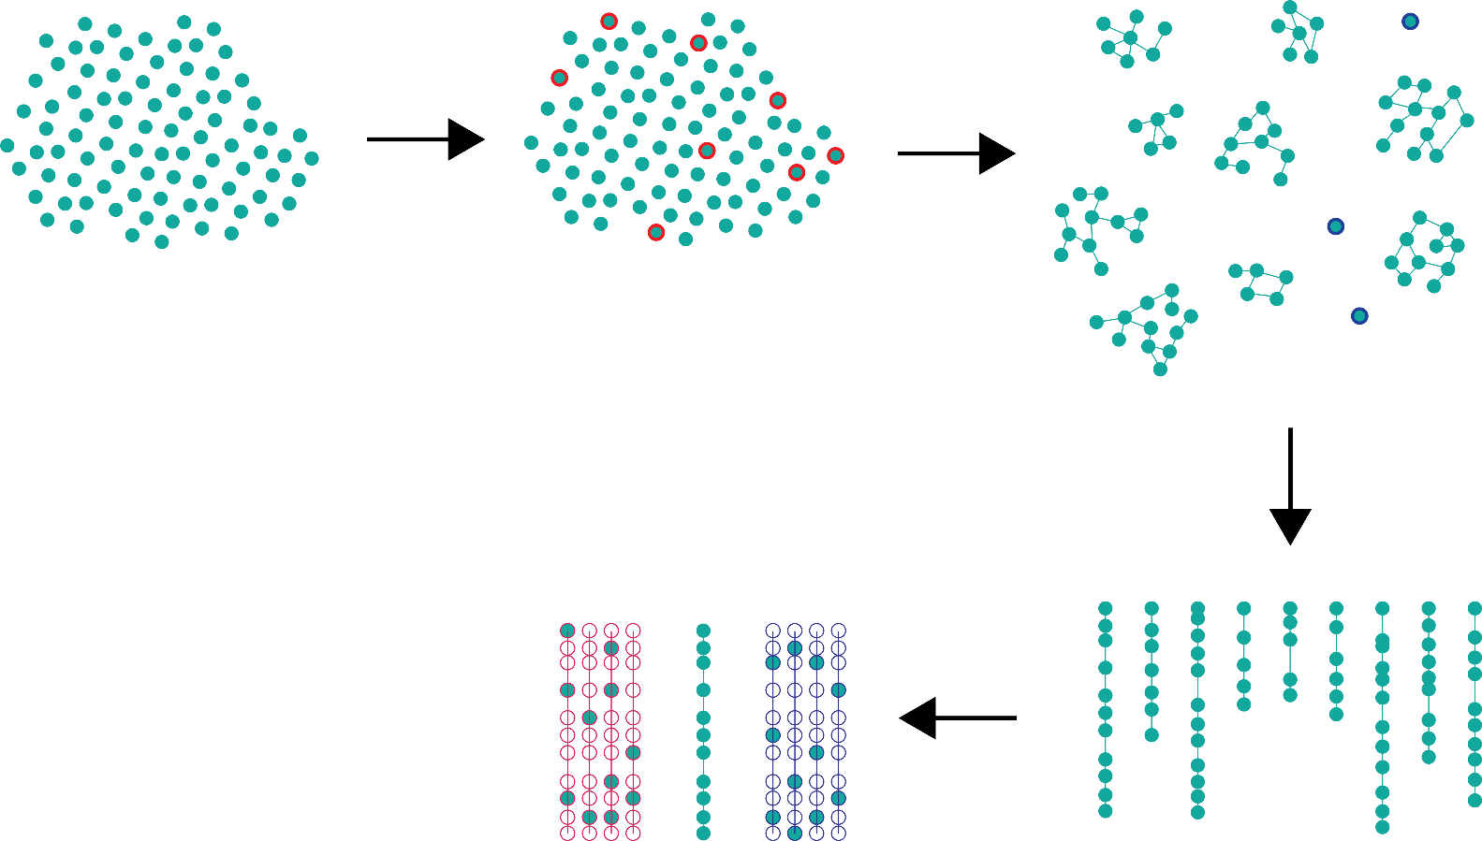
Refresher: polymapR

Slide 6
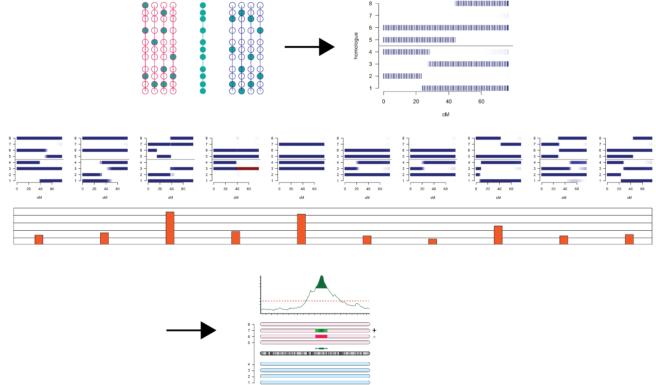
Refresher: polyqtlR
IBDs
+
Trait

Slide 7
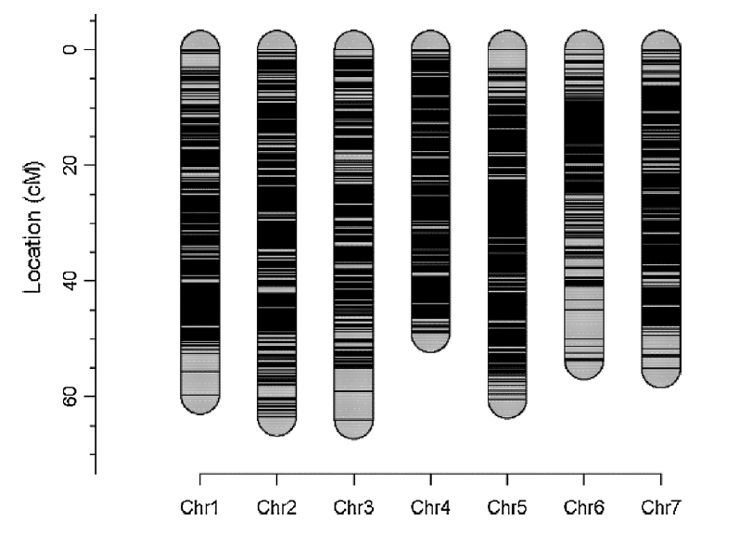
Example applications: polymapR - polyqtlR
Mapping resistance to black spot (Diplocarpon rosae) in 4x rose (Zurn et al., 2020) – 6.5k SNP array markers (Axiom) over 7 linkage groups
Zurn et al. (2020) Theor. Appl. Genet 133: 2011-2020

Slide 8
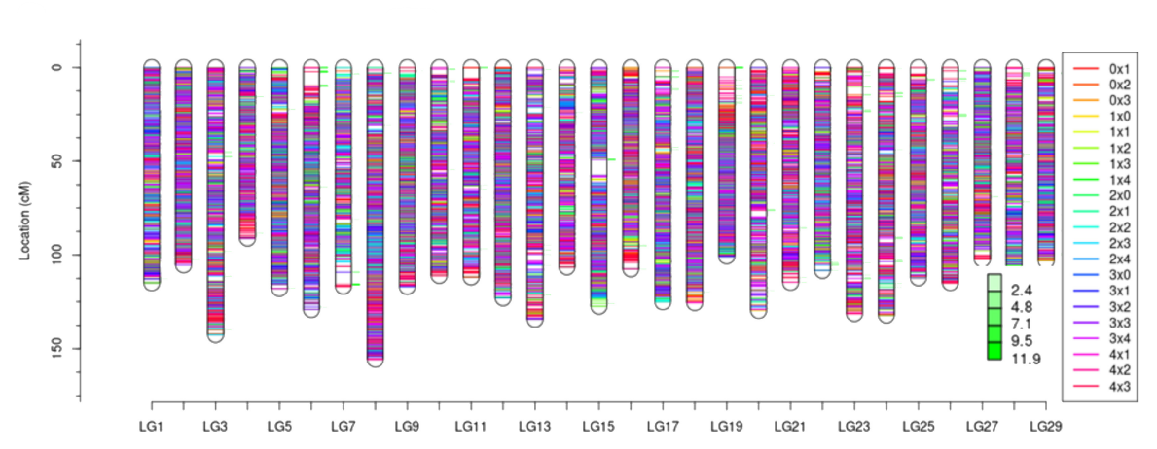
Example applications: polymapR - polyqtlR
Mapping resistance to Pseudomonas syringae in 4x kiwifruit (Tahir et al., 2020) – 39k Capture-Seq markers over 29 linkage groups
Tahir et al. (2020) Pathogens 9 (11) 967

Slide 9
polymapR update
A feature not previously mentioned is the use of probabilistic rather than discrete genotypes for mapping
Genotype-calling is usually probabilistic, requiring an extra step to “discretise” results (rounding them to integers in some way)
We can use the probabilities directly without discretising

Slide 10
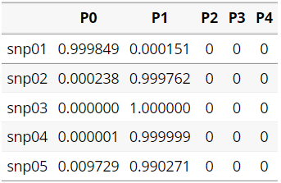
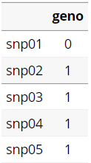
polymapR update
What do these genotypes look like?
Probabilistic
Discrete

Slide 11
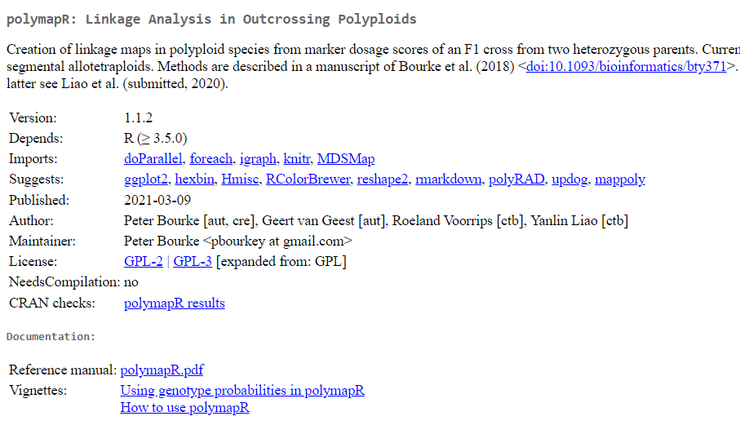
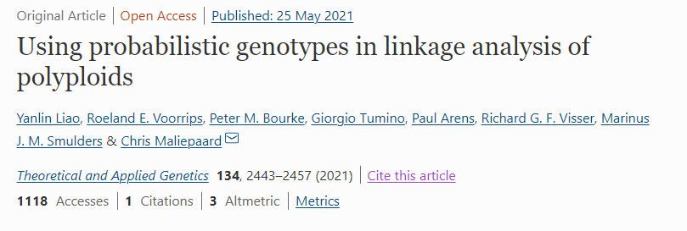
https://CRAN.R-project.org/package=polymapR

Slide 12
polyqtlR updates
Automatic building of multi-QTL model
Genotype curation
Visualising meiotic patterns

Slide 13
Switch over to RStudio..

