Slide 1
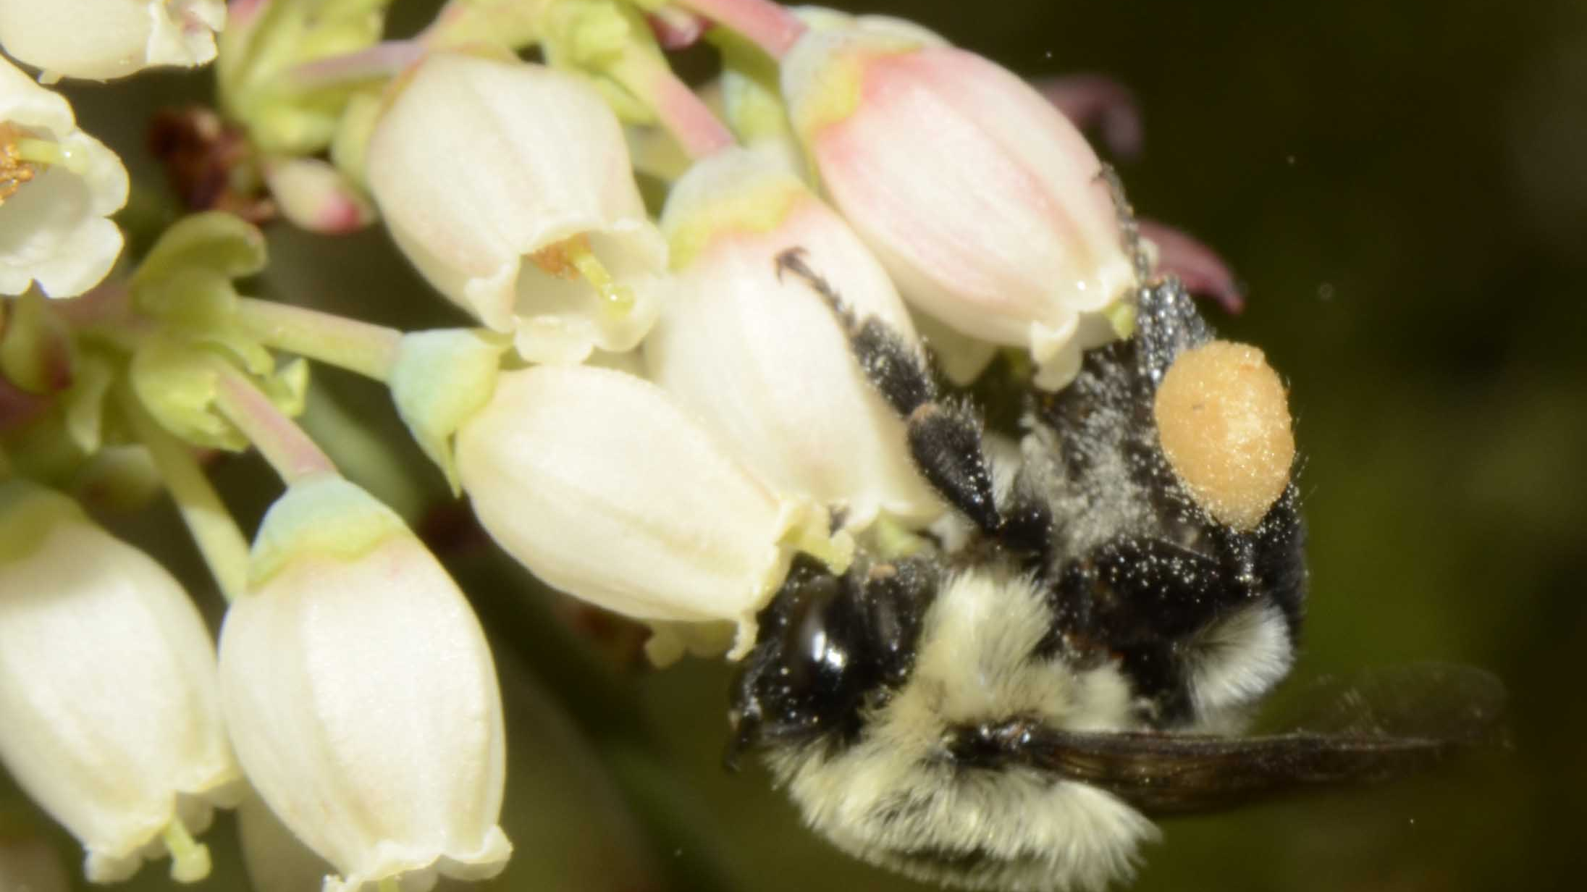

Developing resources for research and breeding in blueberry (Vaccinium sect. Cyanococcus)
Ira A. Herniter & Nicholi Vorsa
Department of Plant Biology, Rutgers University,
New Brunswick, NJ 08901

Slide 2
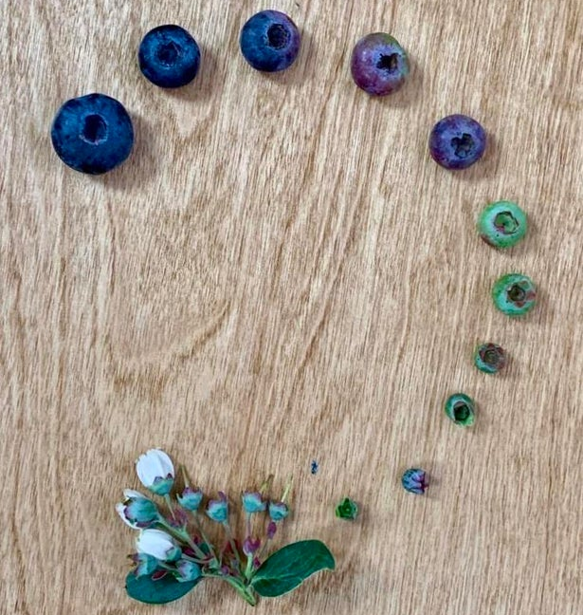
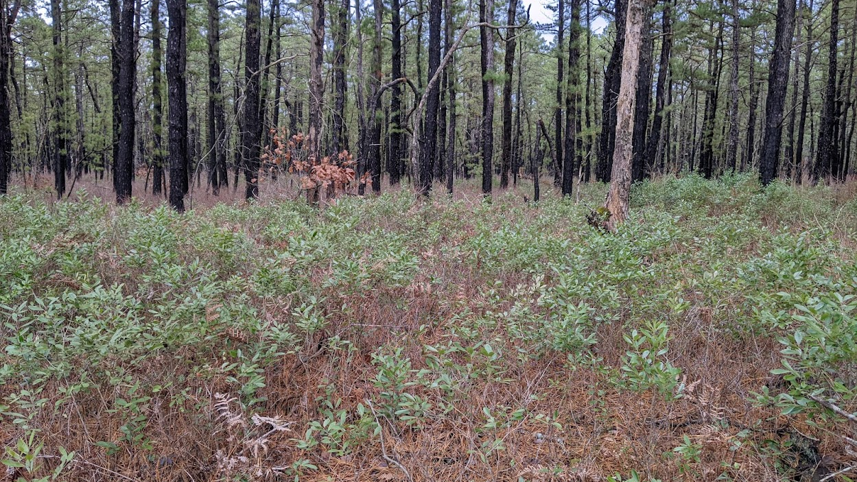
What, exactly, is a blueberry?
Family Ericaceae, genus Vaccinium, sect. Cyanococcus
Defined by clusters of large blue and purple berries
True blueberry is native to North America
  Other species around the world
Blueberry undergrowth in Pine Barrens
Notes:
Ericaceae – heather family
Vaccinium has ~450 species
Mostly cool areas of N hemispshere
Also in tropical areas – Madagascar & Hawaii
Blueberry likes to grow in acidic soil, usually as understory plant
Under oak or pine
Fire-adapted, can regrow from rhizomes after above-ground parts are burned

Slide 3
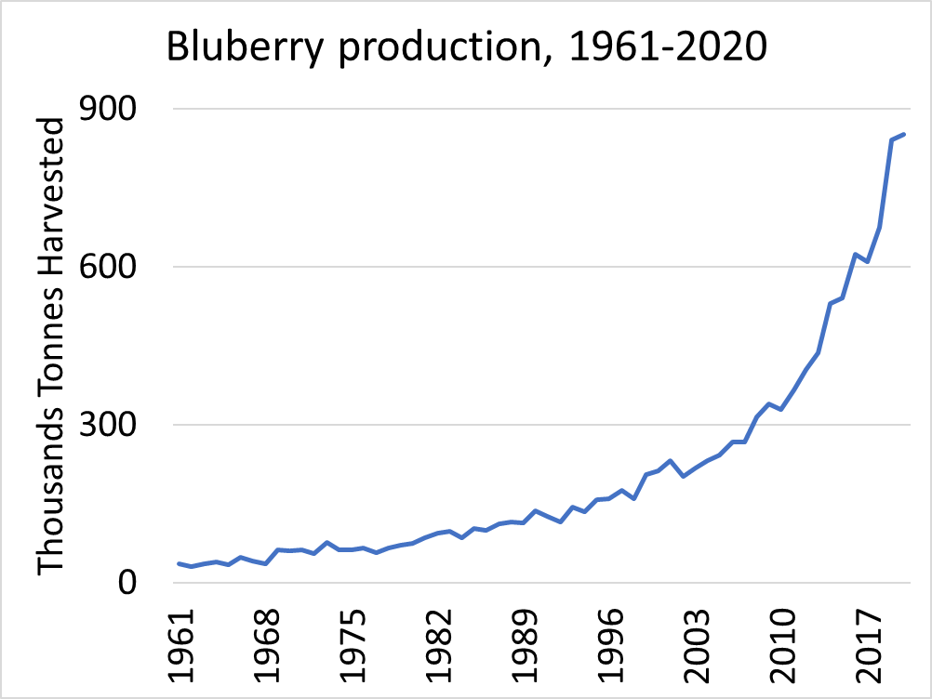
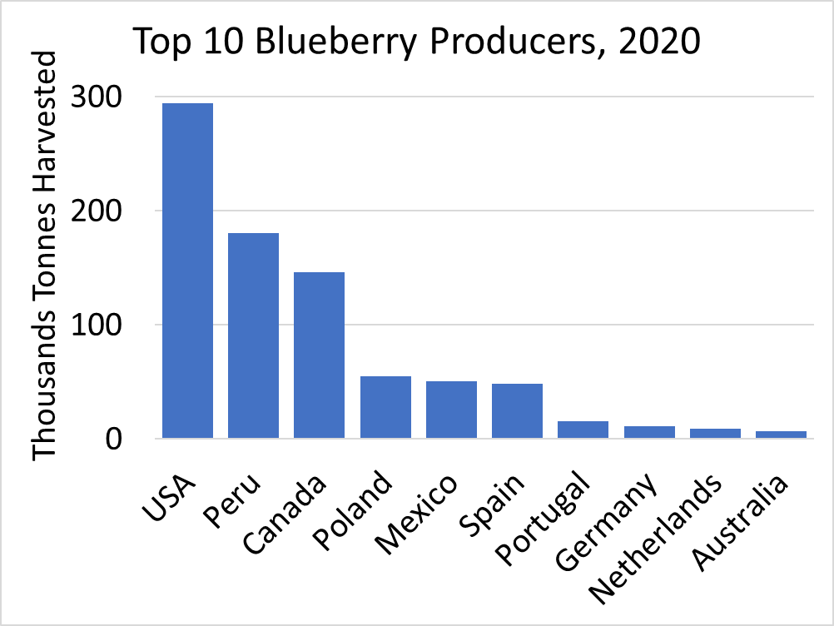
fao.org/faostat/
Notes:
Blueberry commercially cultivated since 1916
Left
Only in the last 20 years has production taken off
Due to increasing consumer interest in potential health benefits, esp from anthocyanins
Right
American and European production tripled since 2000
Peruvian market production is recent, beginning in 2010

Slide 4
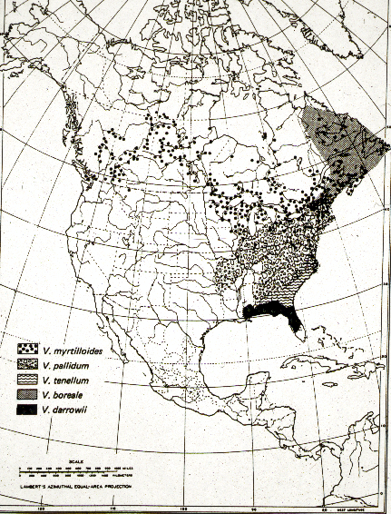
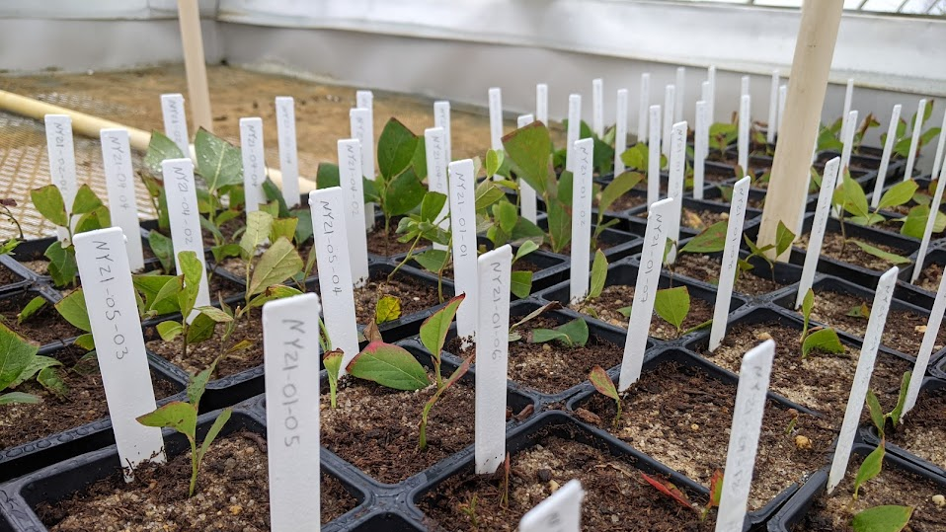
Available resources
Native to North America
Extensive germplasm collection maintained
  Includes mostly North American accessions, but also those from around the world
Genome sequences and genotyping coming online
Samples collected from Upstate New York
Notes:
Like all crops, blueberry breeding and cultivation faces challenges
Including, but not limited to:
Climate change
Insect pressure
Disease pressure
Slow generation time
Inbreeding depression
obligate outcrosser
But, have many resources at out disposal
Native to N America, as shown by the map
Germplasm collection includes over 500 accessions
Photo is of samples collected summer 2021 in upstate NY
Multiple species and cultivars sequenced
Genomic revolution has come to blueberry
Genotype-by-sequencing data allows for accurate trait mapping and MAS

Slide 5
Interspecific F2 populations
Population: | BNJ16-2 | BNJ16-3 | BNJ16-4 | BNJ16-5
#individuals: | 301 | 88 | 986 | 80
Notes:
Crosses between corymbosum and darrowi
Image shows ancestry of 1 of 4 pops
All 4 pops are interspecific
16-2&3 are reciprocal, as are 16-4&5
Large populations increase potential recombination events,
Allows

Slide 6
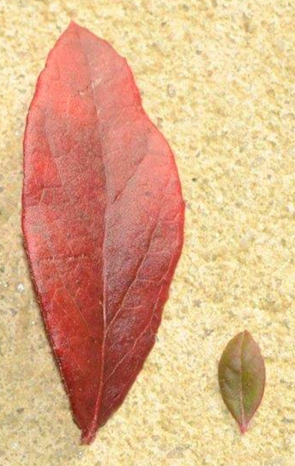
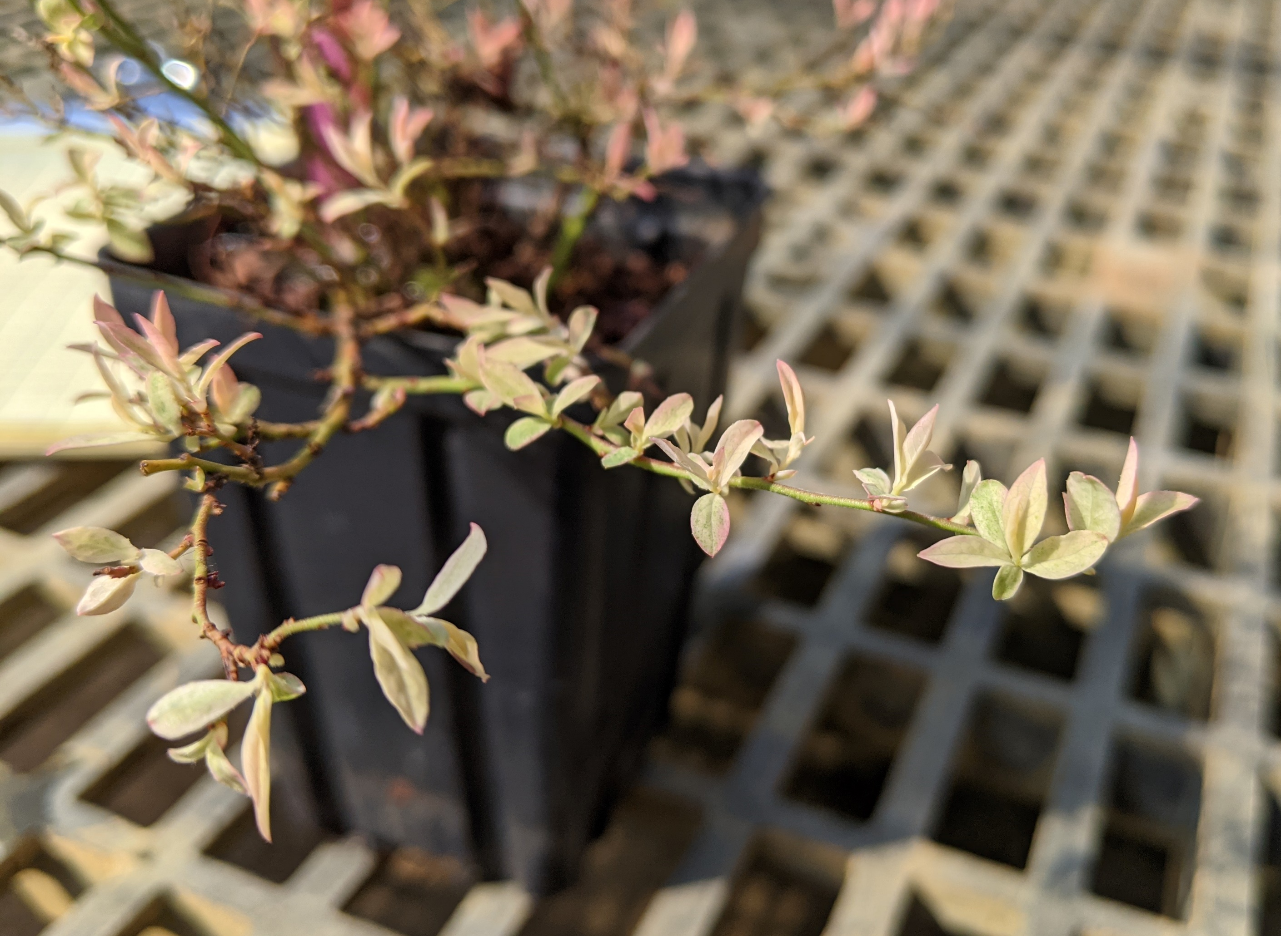
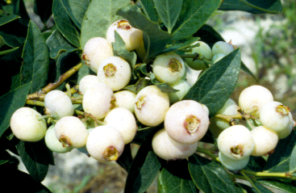
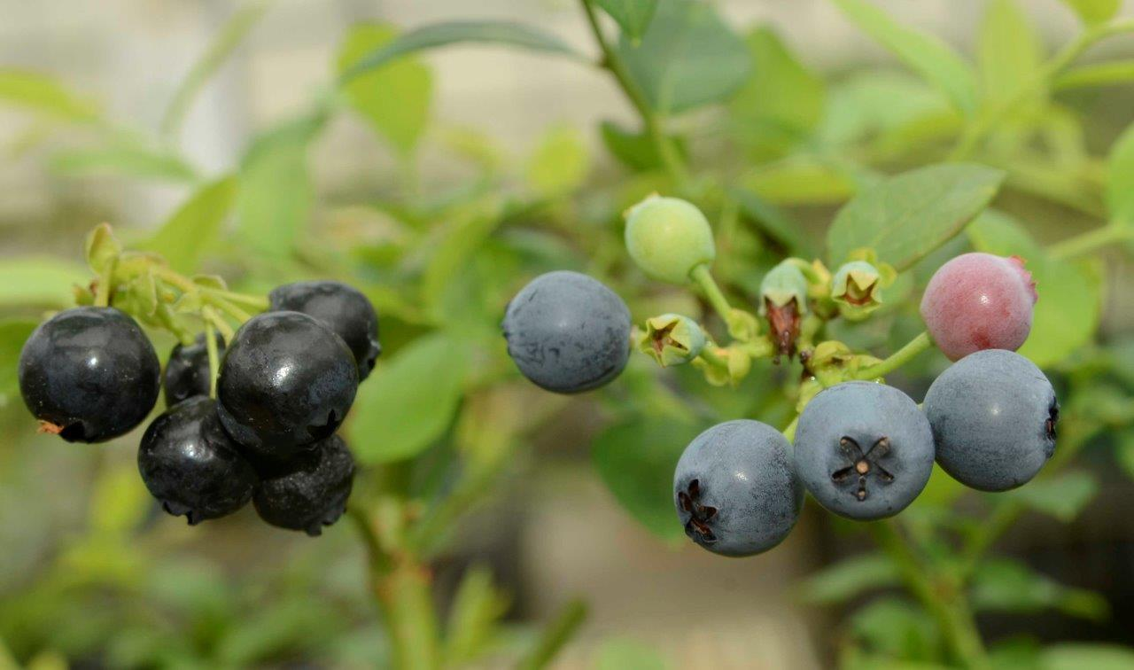
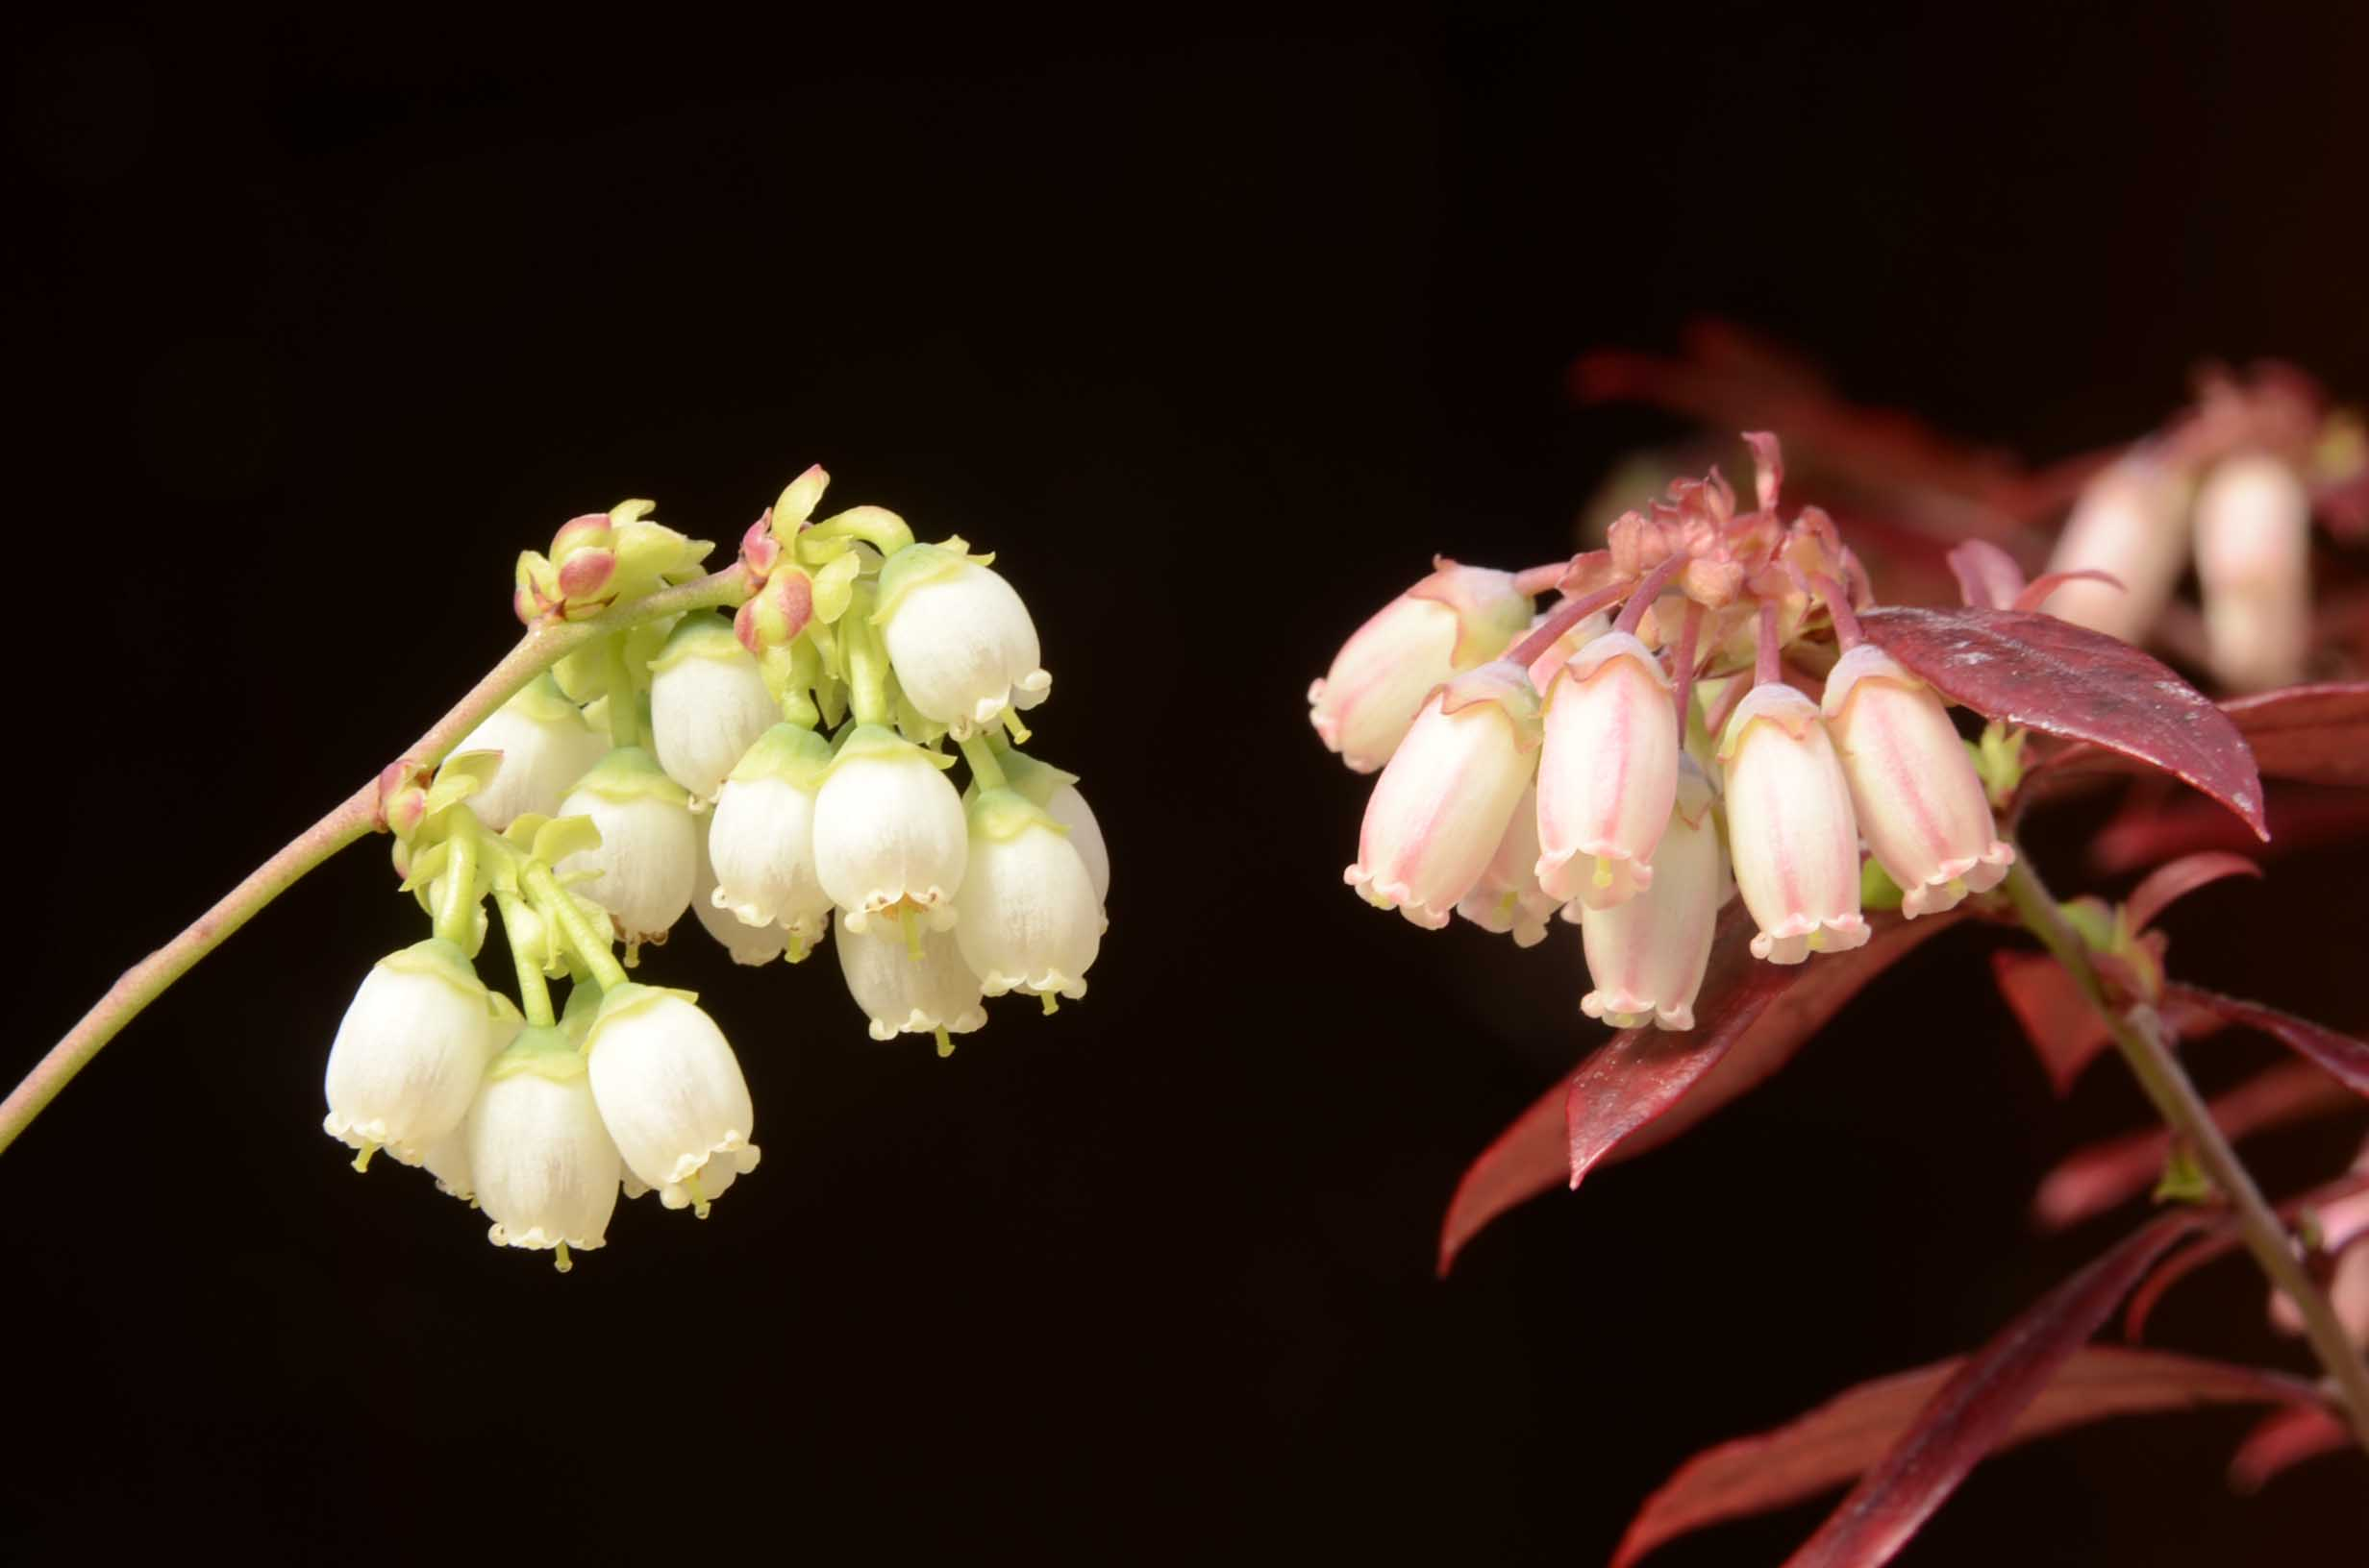
BNJ16 Phenotypic variation
Leaf Traits
Albino Berries
Albino Juvenile Leaves
Flower Shape & Color
Waxed Berries
Notes:
These populations segregate for a range of fascinating traits
Some visual traits include:
Albino juvenile leaves
These plants new leaves start as white and only become green as they develop.
Segregation ratios suggest the effects of 3 loci
Albino berries
Segregation ratios match a single locus trait
Flower shape and color
Rounded bells vs elongated tubes
presence or absence of pink coloration along the lines of the fused petals
Waxed berries
Wax reflects light, reducing the internal temperature of the berries
May be important for maintaining fruit quality under high-heat conditions
Both the amount of wax as well as the presence or absence appears to segregate
Leaf traits
This includes both leaf size and leaf shape
Leaf shape is a highly complex trait, which we are measuring using computational tools. I’ll go into more detail in a couple slides.

Slide 7
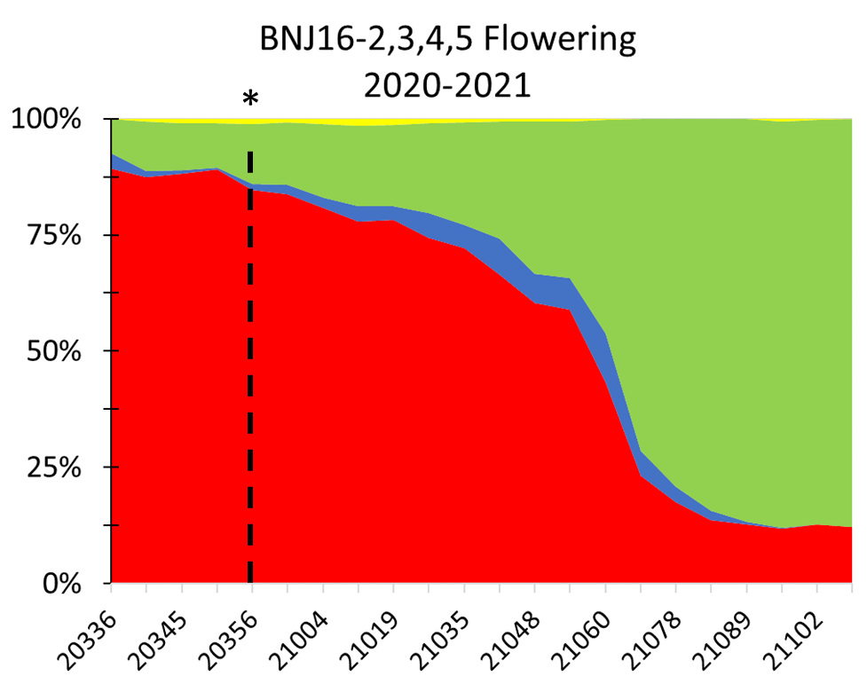
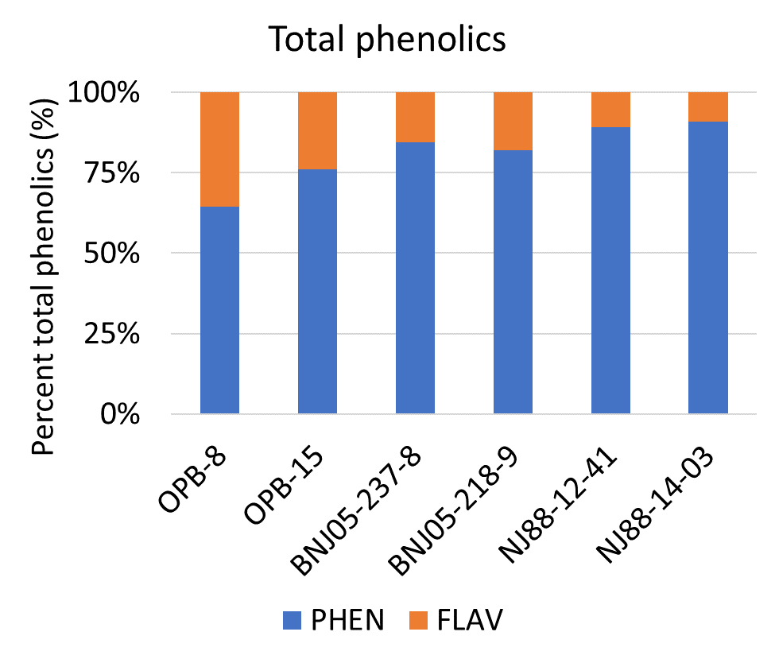
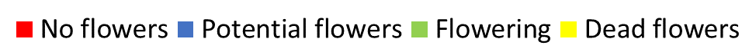
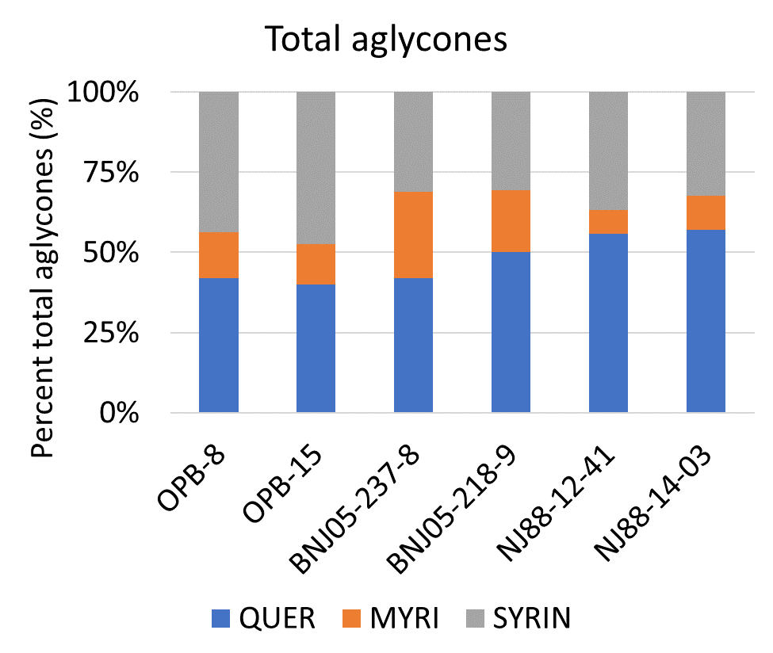
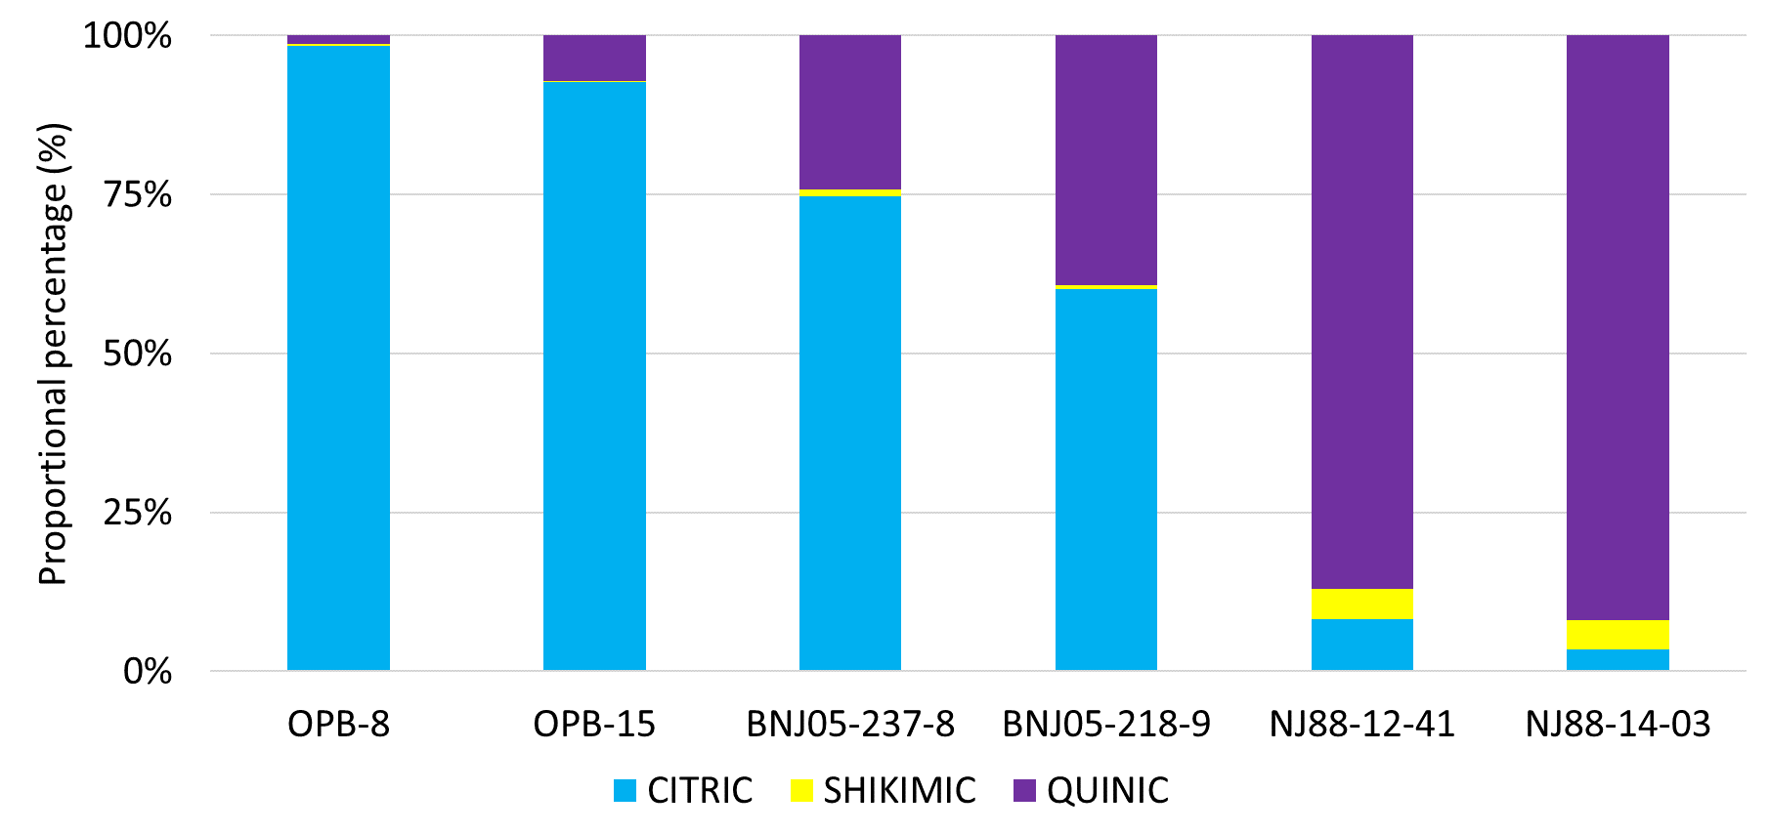
BNJ16 Phenotypic variation II
Organic Acid content
Notes:
The populations also segregate for non-visual traits
On the top left you can see the time for first flowering over winter and spring 2020 and 2021
The dashed line shows the data of the winter solstice, before which ~1/8th of the plants had flowered
Current hypothesis is that there are at least two distinct controls for flowering: day length and direction of change in day length
The other graphs show variation in the relative levels of organic acids, phenolics, and aglycones in the parents and F1 plants
Distinct variation likely to show up in the F2 population as well

Slide 8
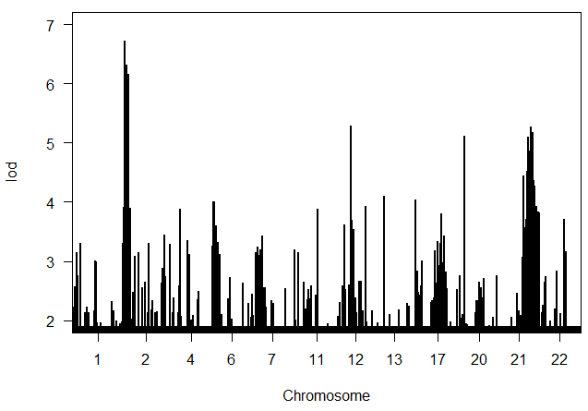
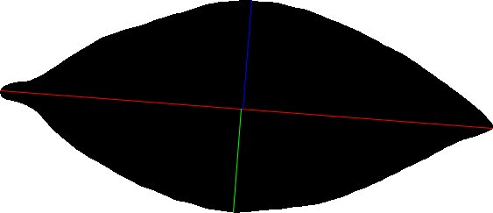
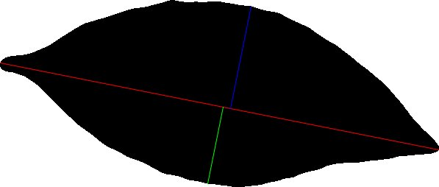
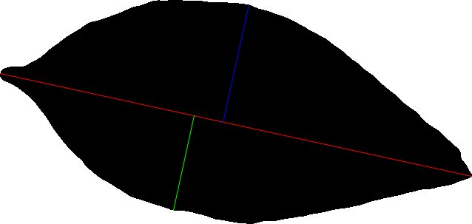
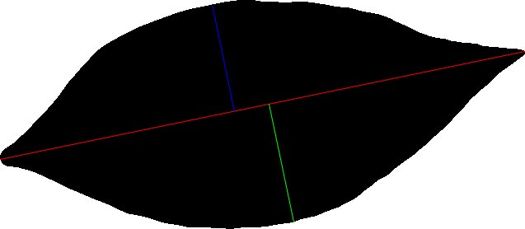
QTL mapping of leaf Feret Ratio
BNJ16-4 001-260
Notes:
This slide shows the results of mapping leaf Feret Ratio
The mapping is very preliminary, and uses physical location, not genetic distance to order the map
Feret’s diameter is the longest straight line than can be drawn inside a shape
Width is the widest point perpendicular to the diameter
Ratio is Feret’s diameter over width
Demonstrates the potential for other trait mappings in blueberry
In the coming months and weeks, as our genotyping data for the populations comes online, we expect to assemble a long list of mapped traits, starting with those noted in this presentation.

Slide 9
Acknowledgements
Contact me: ira.herniter@rutgers.edu
Rutgers University
  Dr. Nicholi Vorsa
  Dr. Jennifer Johnson-Cicalese
  Yurah Kim
  Sara Knowles
  Konrad Wysocki
  Thomas Spain
  Lance Scibilia
Delaware State University
  Dr. Latha Melmaiee
  Dr. Krishna Kulkarni
USDA
  Dr. James Polashock
  Dr. Jeffery Neyhart
  Joe Kawash
  Kristia Adams
North Carolina State University
  Dr. Massimo Iorizzo
  Dr. Hamed Bostan
  Dr. Marti Pottorf
Notes:
As with any research program, the information presented today is available because of the efforts of many people at many institutions.
I’d like to thank everyone involved in the research presented today.
And thanks to you for viewing.
If you have any questions or comments, please reach out; I’d love to meet with you.

