Slide 1

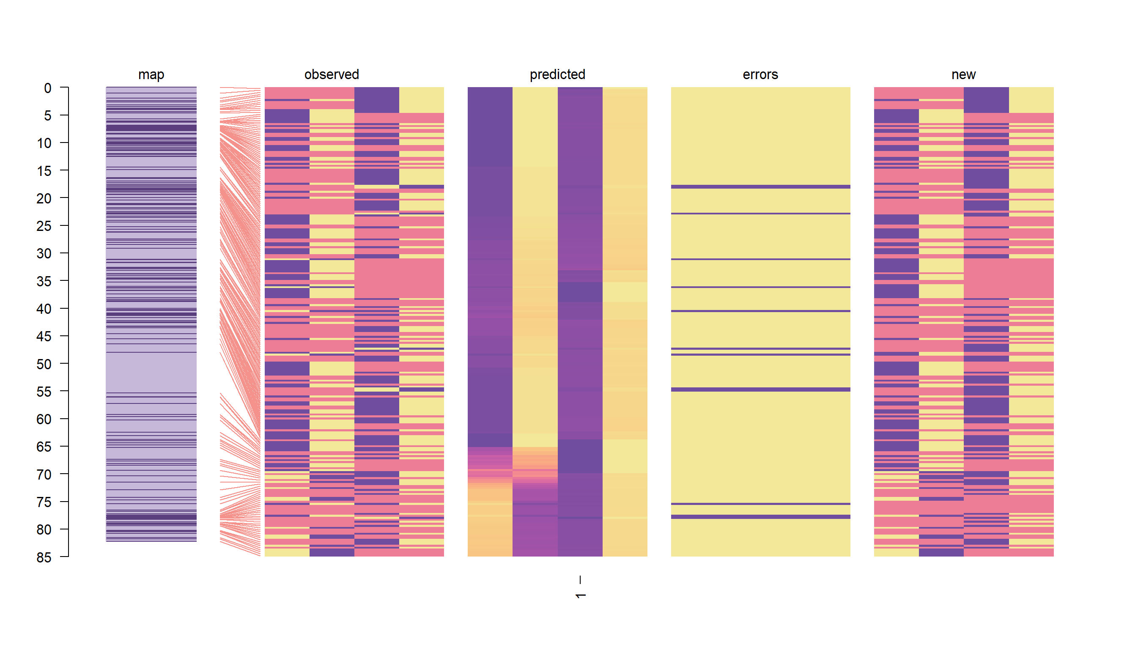
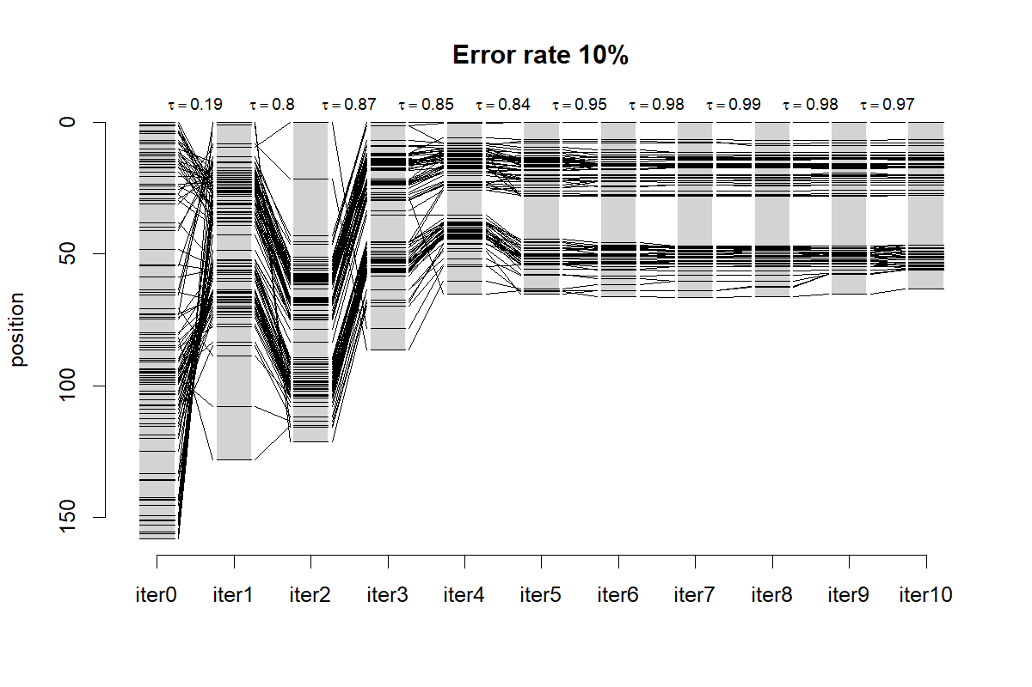
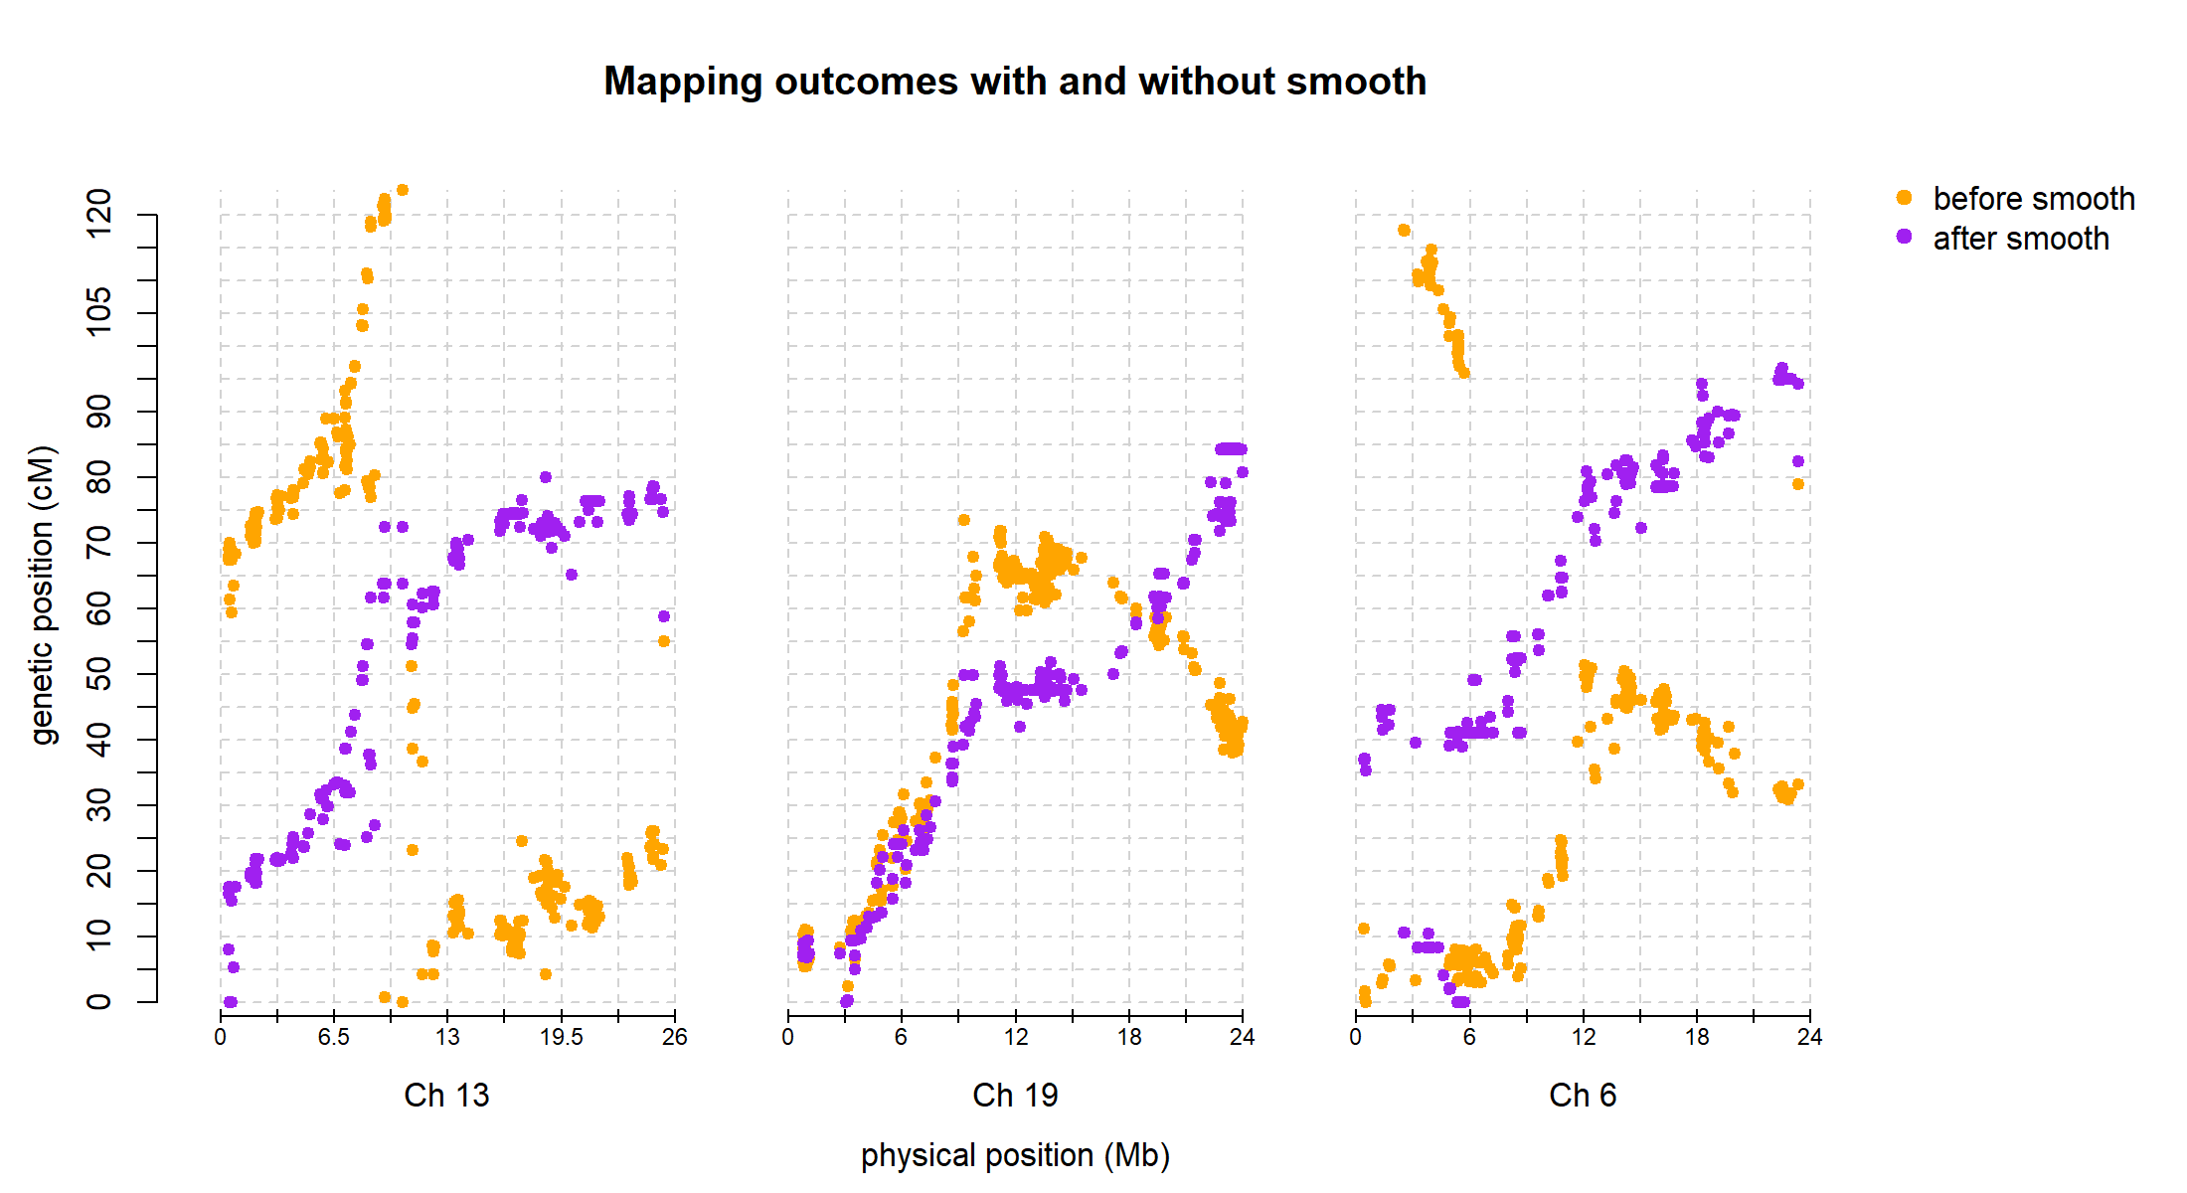
Smooth Descent
A ploidy-aware algorithm to improve linkage mapping in the presence of genotyping errors
Alejandro Thérèse Navarro
December 2021

Slide 2
Introduction
Genetic mapping in strawberry using genotypes with high error rate
SMOOTH (van Os et al. 2005) genotyping error detection based on map order.
Eliminate genotyping errors iteratively to improve map order.
Applicable 1x0 or 0x1 markers in diploids.
Implementation in R and some changes:
All marker types used, all (even) ploidies accepted, improved prediction method.

Slide 3
Smooth Descent: naïve IBD
Given a genetic map (marker order and distances)
P1
P2
hom1
hom2
hom3
hom4
genotype | Hom 1 | Hom 2 | Hom 3 | Hom 4
A
C
C
C
AC
1 | 0 | 0.5 | 0.5
T
A
T
A
TT
1 | 0 | 1 | 0
A
A
G
A
AG | 0.5 | 0.5 | 1 | 0
A
G
G
G
AG | 1 | 0 | 0.5 | 0.5
C
T
C
C
TC | 0 | 1 | 0.5 | 0.5
C
A
C
C
CC | 1 | 0 | 0.5 | 0.5
A
A
C
A
AC | 0.5 | 0.5 | 1 | 0.5
A
T
A
T
AA | 1 | 0 | 1 | 0
Identity by Descent (IBD) probability matrix

Slide 4
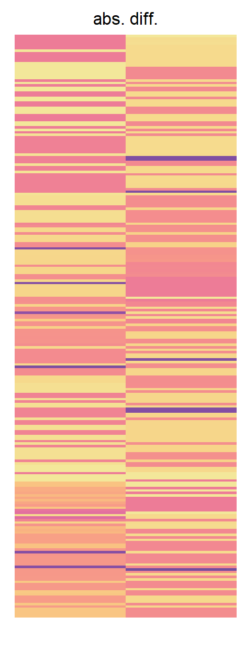
Smooth Descent: prediction
Prediction: local, weighted average of informative probabilities.
Error detection: difference between observed and predicted IBDs above threshold
IBD probabilities:
1
0.5
0

Slide 5
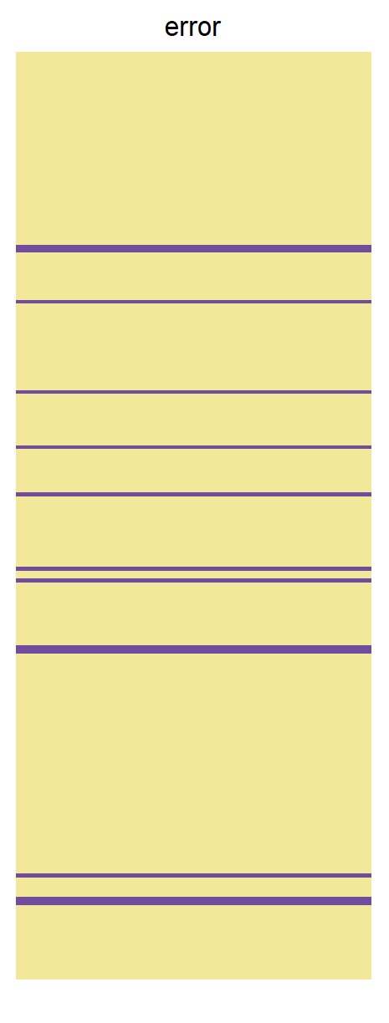
Smooth Descent: prediction
Prediction: local, weighted average of informative probabilities.
Error detection: difference between observed and predicted IBDs above threshold
IBD probabilities:
1
0.5
0

Slide 6
Smooth Descent: prediction
IBD probabilities:
1
0.5
0

Slide 7
Smooth Descent: iterative mapping
Smooth Descent is applied iteratively:
Correct genotypes
Estimate linkage map
Repeat

Slide 8
Real data strawberry
Smooth Descent used with strawberry sequence marker data.

Slide 9
Simulation tests
Simulated 10 diploid populations 100 individuals. Added error rates to test SD efficacy.
Special A: heterogeneous rate across individuals
Special B: heterogeneous rate along map
Optimal with few iterations

Slide 10
Simulation tests in autopolyploids
Map reconstruction is also improved.
Genotype correctness is also improved.
Less effective as ploidy increases:
Genotyping errors affect order more
Less corrections can be made due to IBD uncertainty

Slide 11
Conclusions
Smooth Descent is an iterative algorithm for mapping in the presence of genotyping errors.
Simple IBD estimation and genotype correction
Estimate error rates, recombinations
Software: github.com/alethere/smoothdescent
Article: preprint Theoretical Applied Genetics

Slide 12


Acknowledgements
Peter Bourke
Eric van de Weg
Chris Maliepaard
Fernanda Alves Freitas Guesdes
Natascha van Lieshout
Paul Arens
Richard Finkers
Herman van Eck
Johan Willemsen
Thijs van Dijk
Thanks for your attention
Questions?

