Slide 1
Reads2Map
Practical and Reproducible Workflows to Build Linkage Maps from Sequencing Data
Cristiane Taniguti
Lucas Taniguti
Gabriel Gesteira
Thiago Oliveira
Jeekin Lau
Getúlio Ferreira
Rodrigo Amadeu
David Byrne
Oscar Riera-Lizarazu
Guilherme Pereira
Marcelo Mollinari
Augusto Garcia

Slide 2
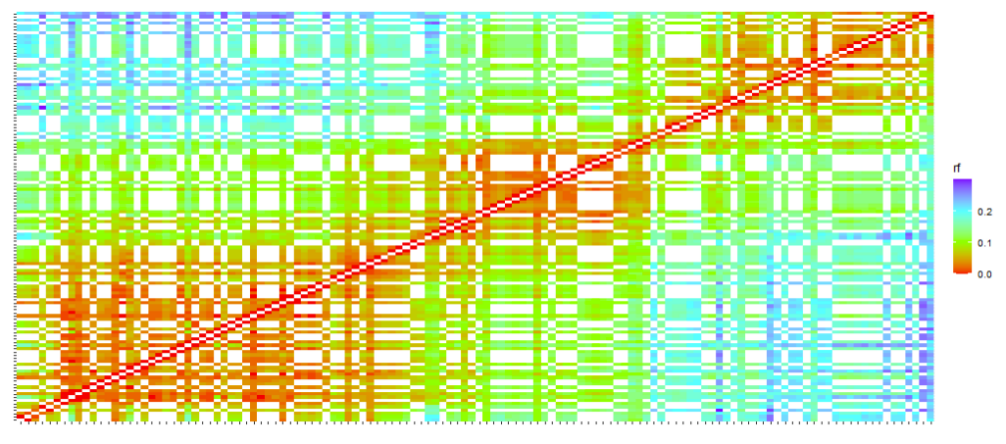
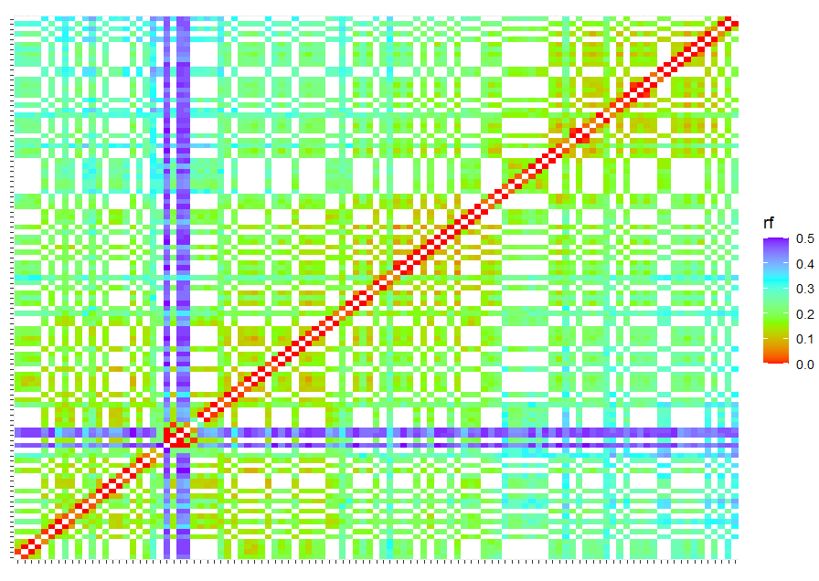
Motivation
Simulations results
Sequencing based markers
Characteristics:
Thousands of markers
Different types of libraries
Reliable price
Genotyping errors
Consequences:
Requires bioinformatic skills
Requires computational resources
Wrong number of recombination
events

Slide 3
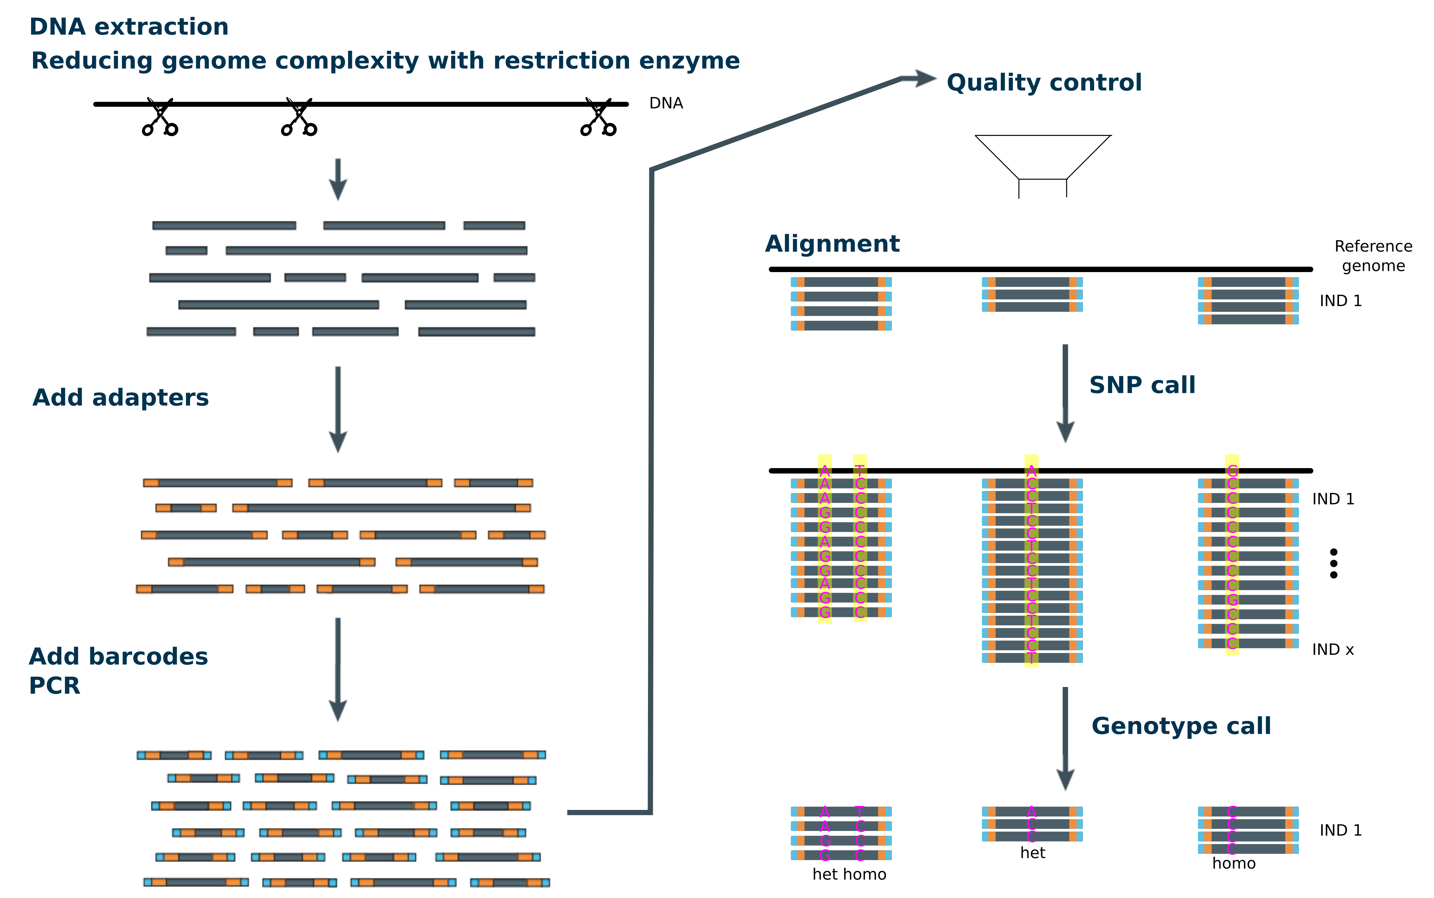
Motivation
Genetic map quality is related to upstream processes

Slide 4
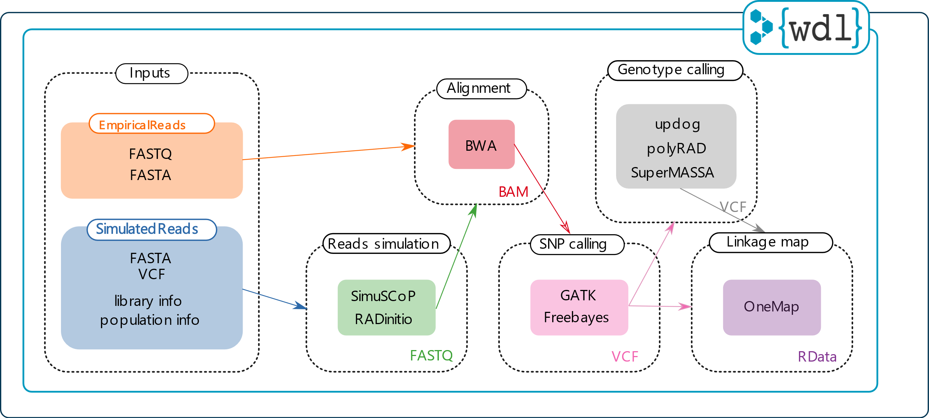
Implementation
Join several bioinformatics and statistical analyses
Workflow Description Language (WDL - “widdle”) – Broad Institute (human genome research)
Best practices
EmpiricalReads2Map
SimulatedReads2Map
Diploid species

Slide 5
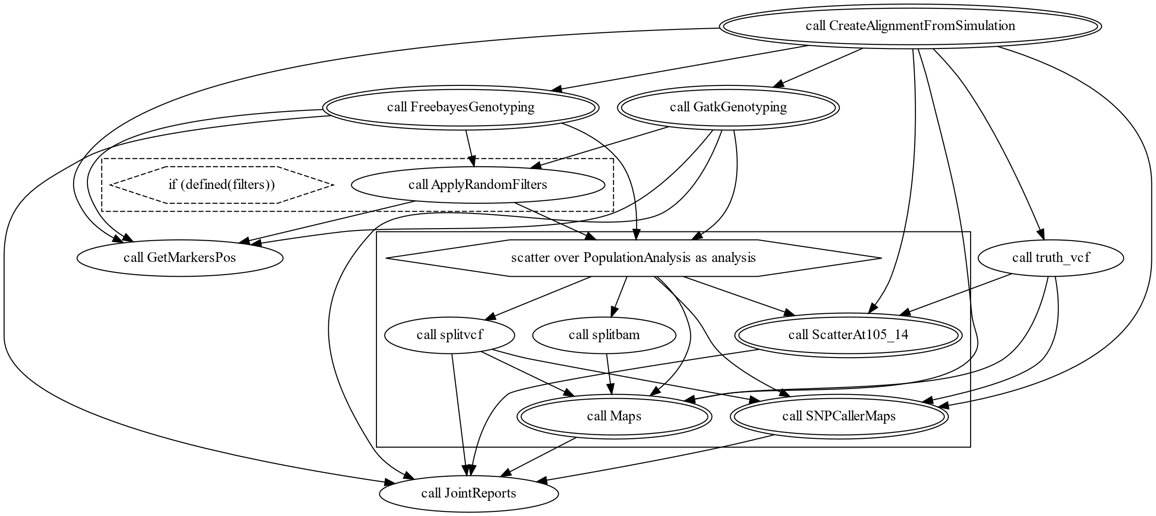
Implementation
Workflows
Sub-workflows
Tasks
$ java -jar /path/to/womtool.jar graph tasks/SimulatedSingleFamily.wdl > SimulatedSingleFamily.dot
$ dot –Tsvg SimulatedSingleFamily.dot –o SimulatedSingleFamily.svg

Slide 6
Implementation
Containers
High Performance Computing (HPC) or Cloud environments (terra.bio)
$ java -jar /path/to/cromwell.jar run -i inputs/EmpiricalSNPCalling.inputs.json EmpiricalSNPCalling.wdl

Slide 7
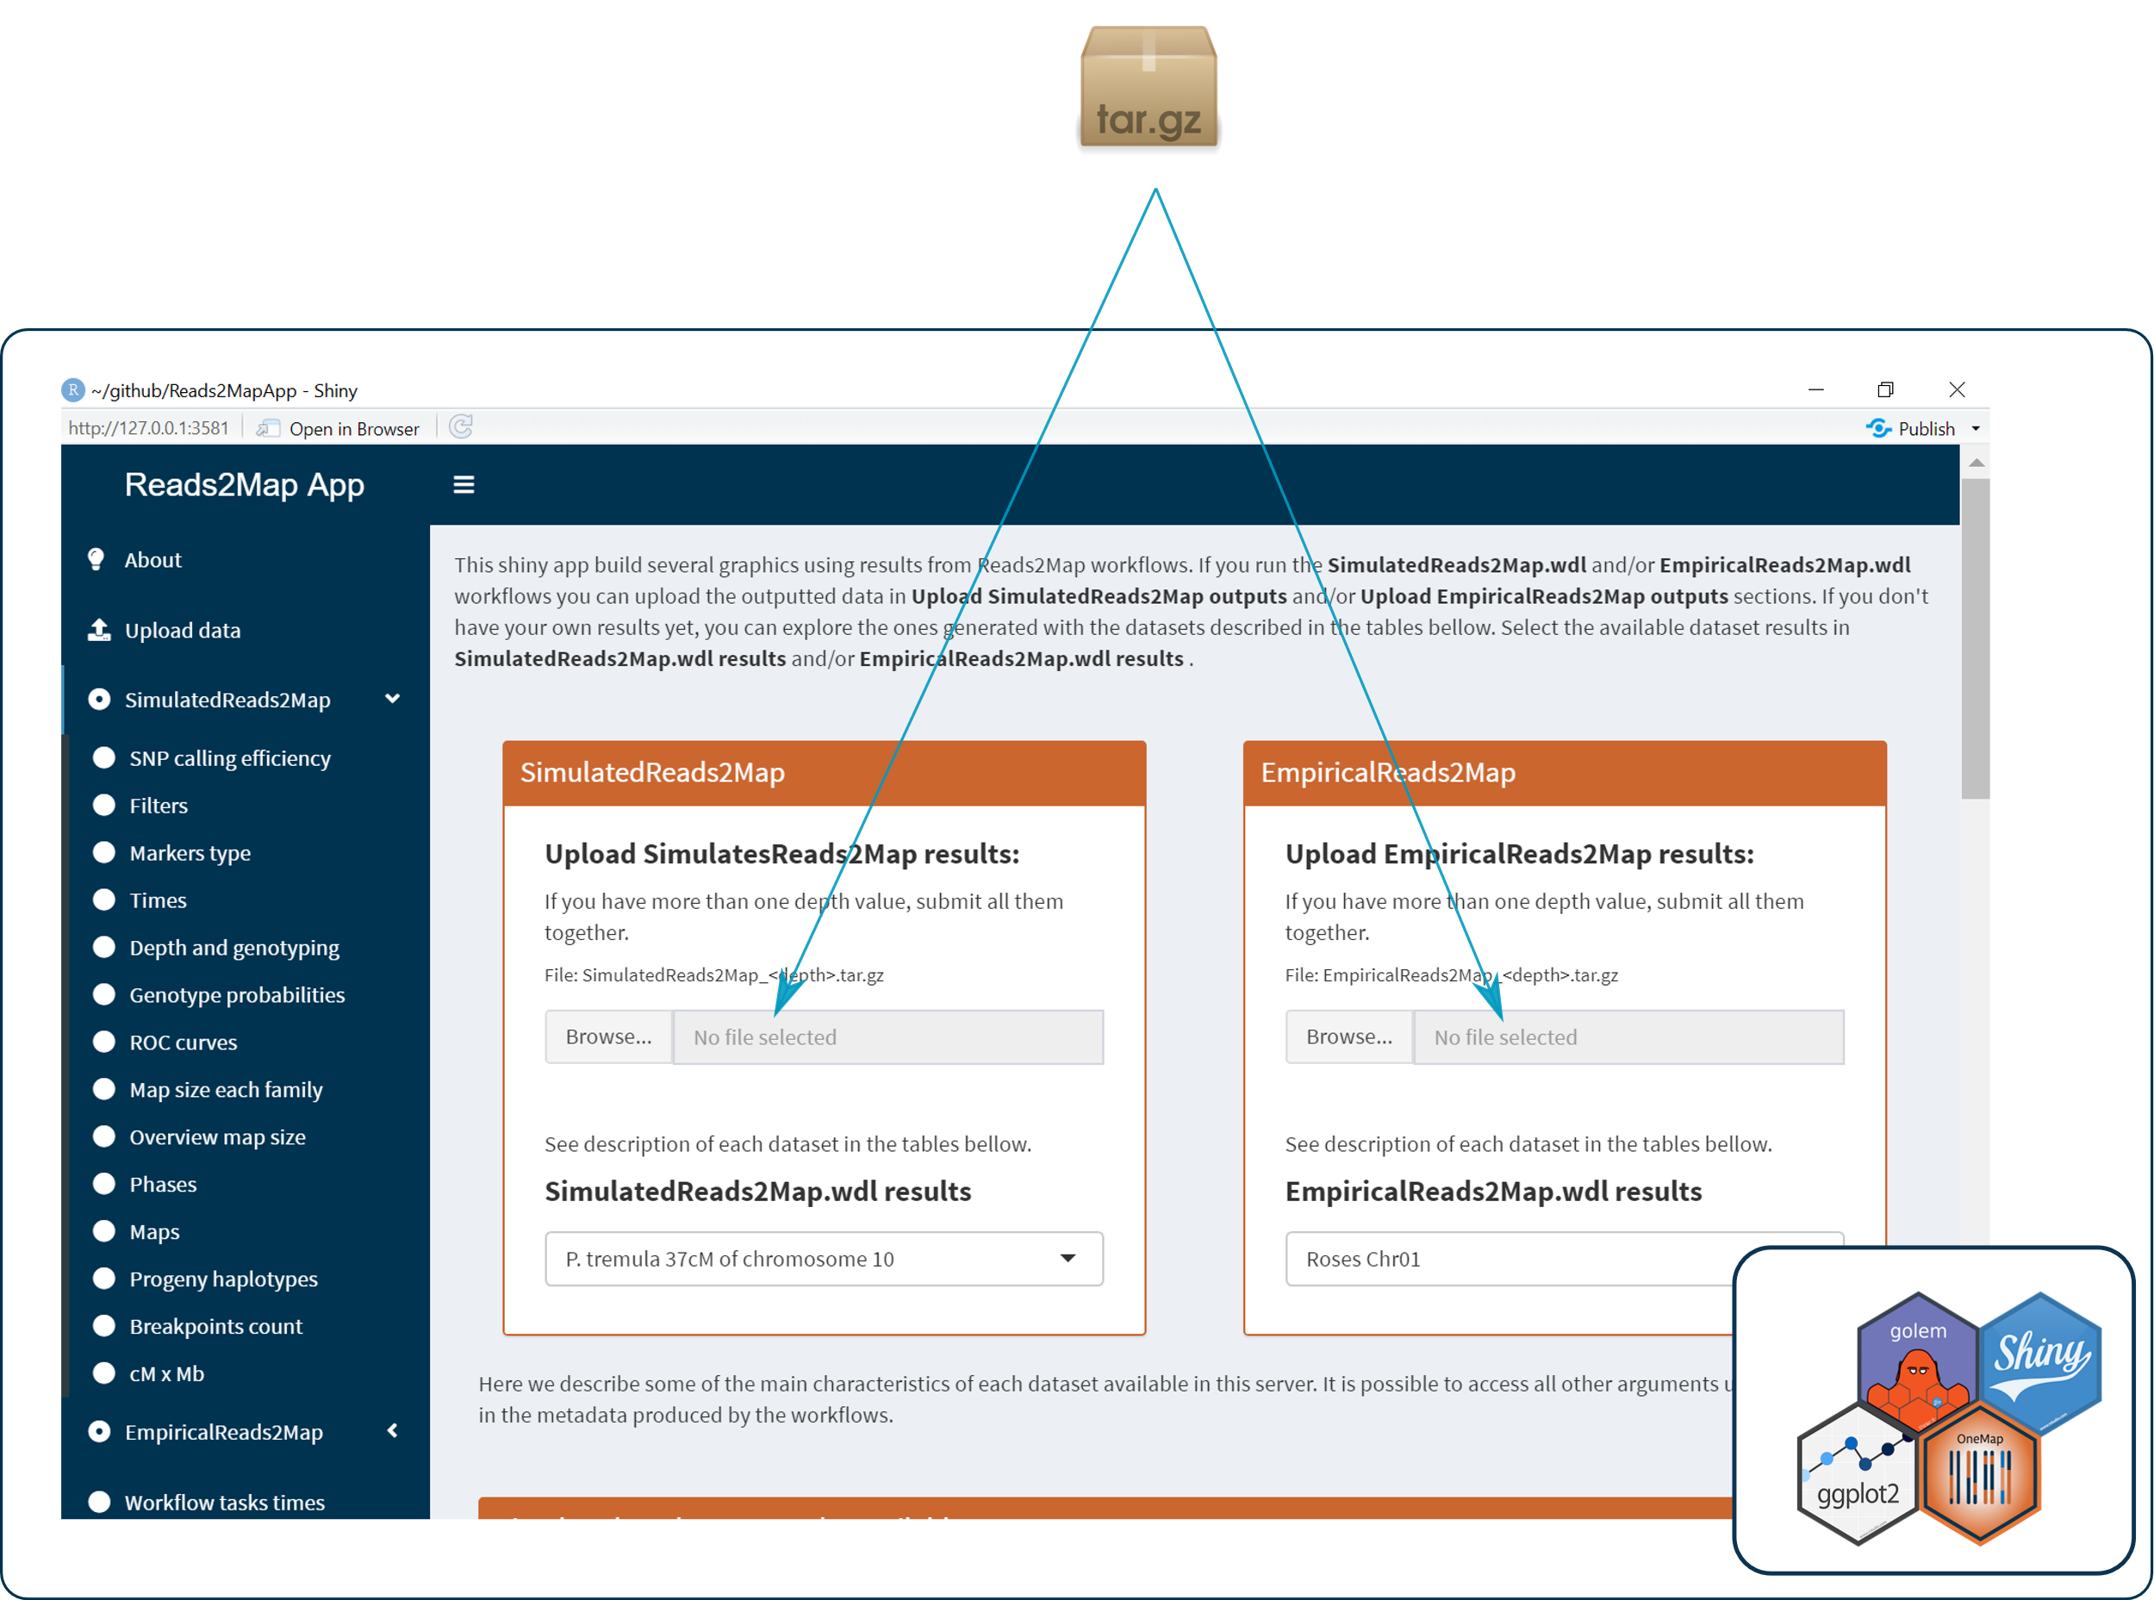
Implementation
Visualization and exploration

Slide 8
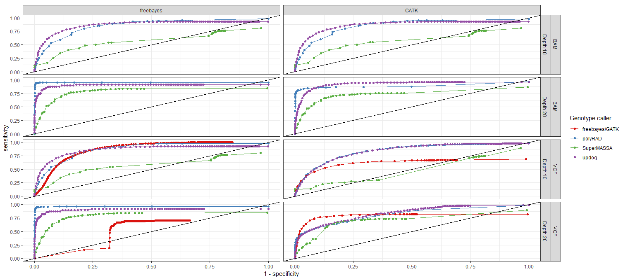
SimulatedReads2Map example results
Genotype probability's reliability

Slide 9
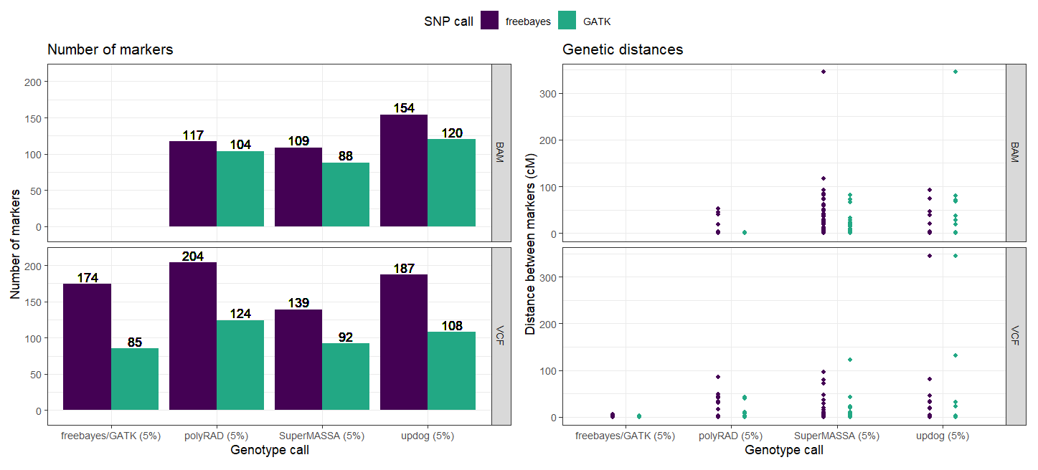
EmpiricalReads2Map example results
Diploid roses

Slide 10
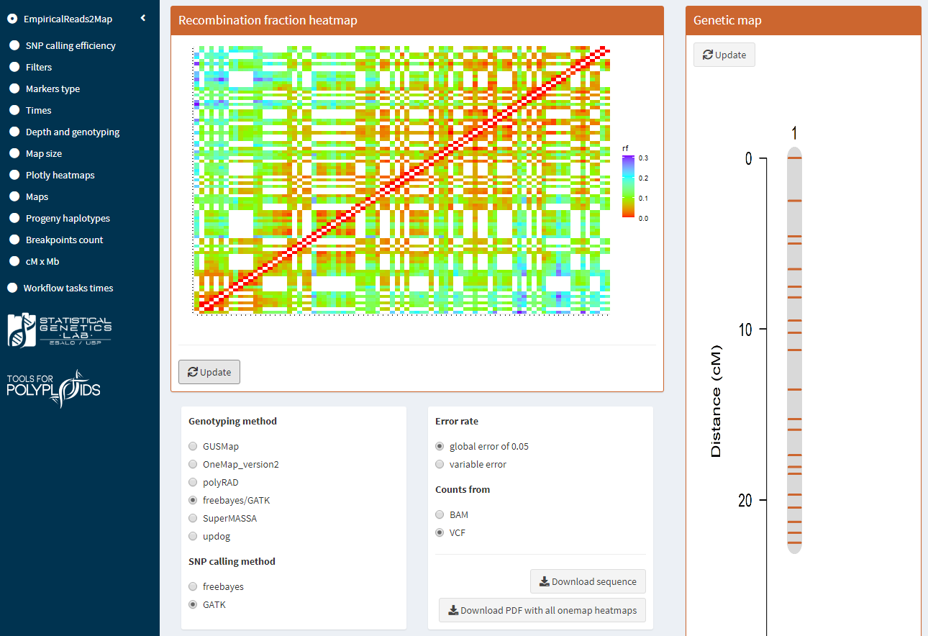
Example results
Outputted maps:
Empirical: 34
Simulated: 68
Test only a subset of one group and repeat the pipeline to others

Slide 11
Conclusion and perspectives
The WDL + Docker + Cromwell + Shiny structure makes the Reads2Map multi-platform,
pratical, user-friendly and reproducible
Updates in upstream software can be easily implemented and tested
Reads2Map points to the best combinations of upstream software and parameters
evaluating the quality of the built genetic maps quality
Next Reads2Map updates will be focused in adding MAPpoly and polymapR
for downstream linkage map construction of autopolyploid species.
OneMap package updates – new version on CRAN (2.8.0)

Slide 12
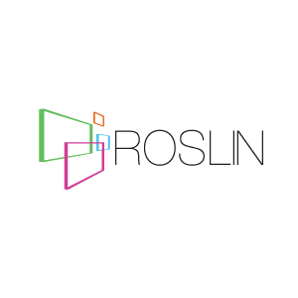
Project Members
Other funding agencies

Slide 13
Other Project Members

Slide 14
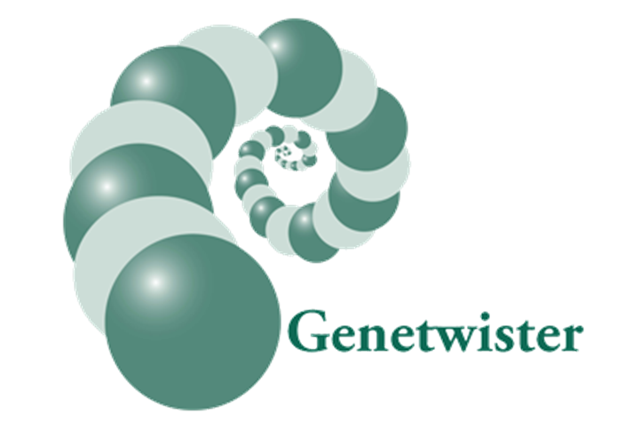
Other Collaborators
Neuhouse Farms
Woolf Roses L.L.C.

