Slide 1

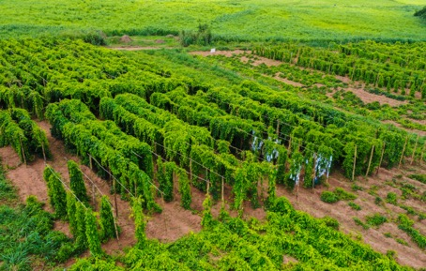
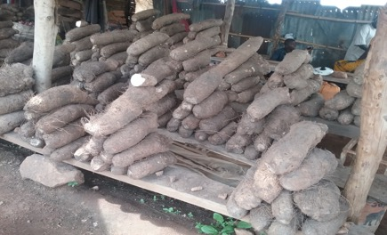
Paterne Agre*, Kwabena Darkwa, Bunmi Olasanmi, Olufisayo Kolade, Pierre Mournet, Ranjana Bhattacharjee, Antonio Lopez-Montes, David De Koeyer, Patrick Adebola, P. Lava Kumar, Robert Asiedu and Asrat Asfaw
p.agre@cigar.org
Identification of QTLs Controlling Resistance to Anthracnose Disease in Water Yam (Dioscorea alata)
San Diego, USA, 2021
A member of CGIAR consortium
www.iita.org

Slide 2

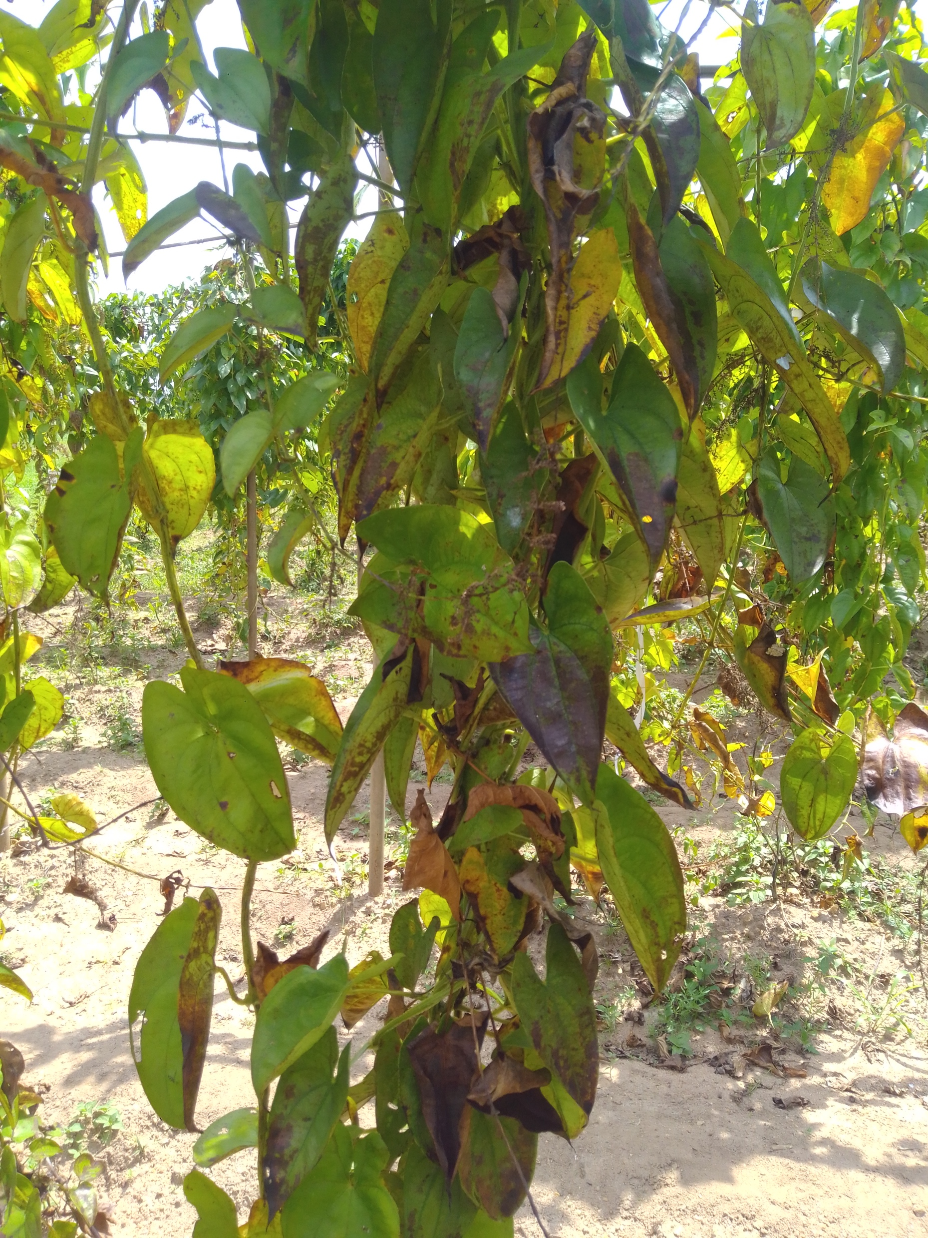
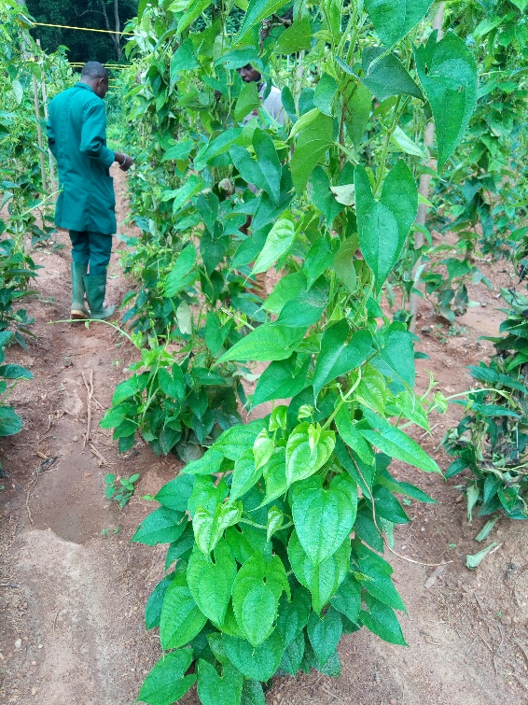
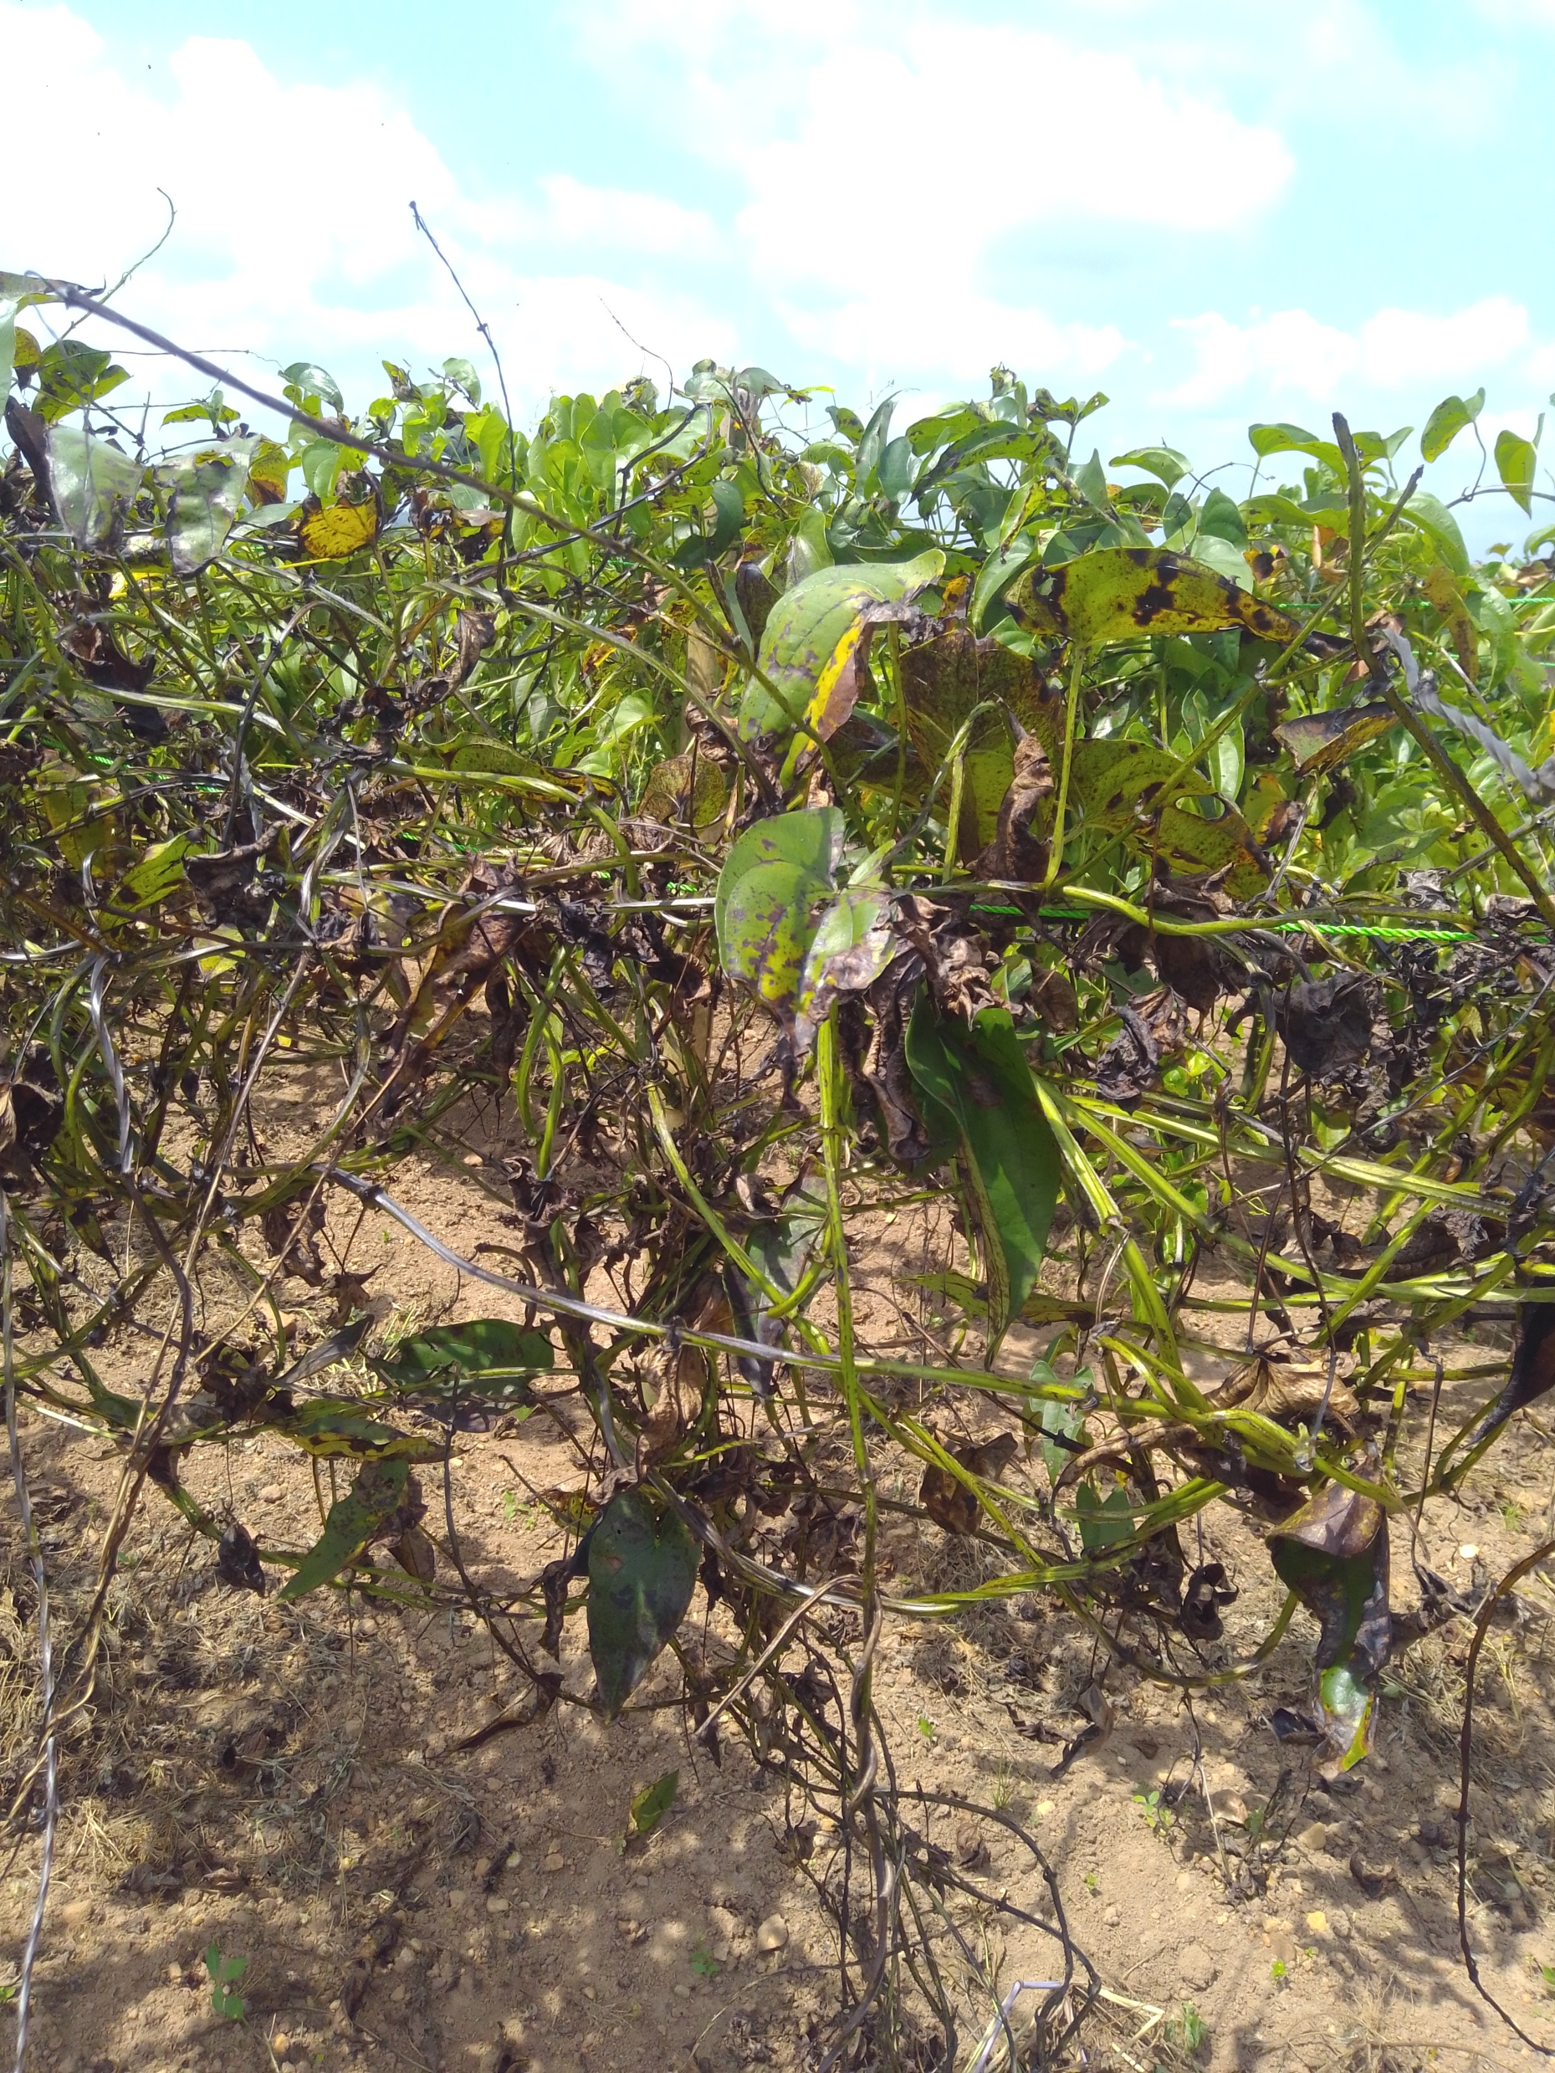
Outlines
Introduction
Materials and Methods
Results and Discussion
Conclusion
Acknowledgments

Slide 3

Introduction
Yam (Dioscorea spp.): Food and Cash crop in West Africa, Asia, The Pacific and Latin America
    - 300 m people in Africa
    - 6.7 million ha land
    - 58 million tons (average of
    2010-2016)
Dioscoreaceae with multi-species
(Dioscorea alata) is one of the most important food yams in the tropical zone
Anthracnose disease is one of the most important disease for alata production
Breeding through classical is too challenging and costly
A member of CGIAR consortium
www.iita.org

Slide 4
Introduction
Objectives
Identify genomic regions (QTLs) and putative genes modulating yam anthracnose disease in D. alata population
Materials and Methods
206 yam genotypes originated from bi-parental crosses were used for the analysis
A member of CGIAR consortium
www.iita.org

Slide 5
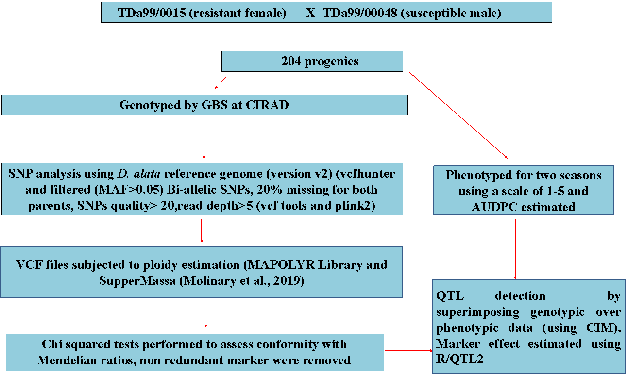
  Linkage analysis for QTL detection for YAD tolerance in D. alata
Materials and methods

Slide 6
  Linkage analysis for QTL detection for YMV tolerance in D. rotundata
Results and Discussion
Table: Mean squares and heritability estimate for yam anthracnose disease severity
 | Mean Squares |  |  | CV | Broad sense heritability
Trait | Genotype | Year | Genotype x Year | (%) | (%)
AUDPC | 163.01 * | 2190.01** | 3371.8*** | 17.6 | 70.64

Slide 7
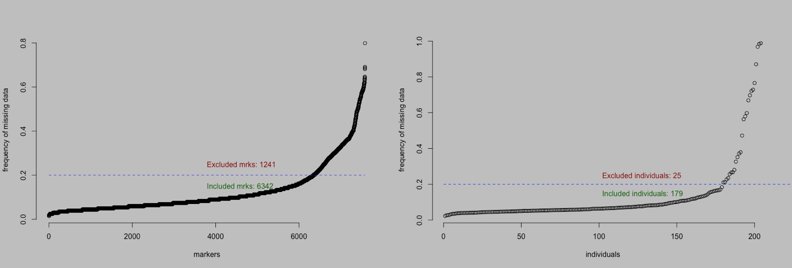
  Linkage analysis for QTL detection
Results and Discussion
SNP quality assessment for missing markers and genotypes

Slide 8
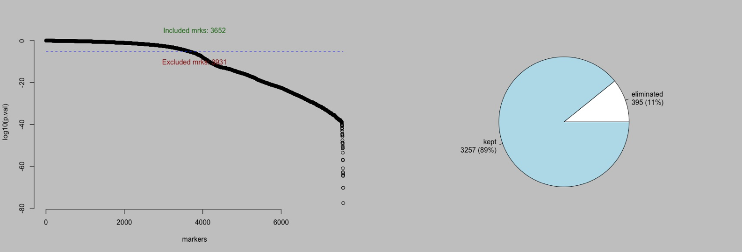
  Linkage analysis for QTL detection
Results and Discussion
Evaluation of polymorphic SNP markers in the biparental population for segregation distortion using chi- square test

Slide 9
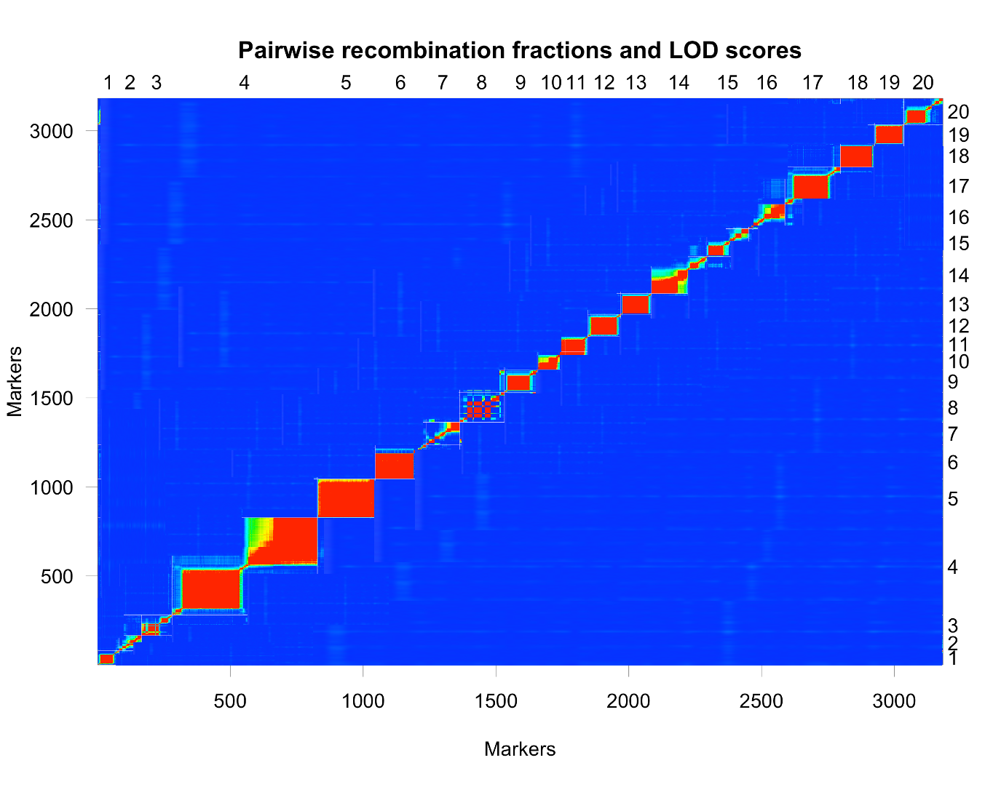
  Linkage analysis for QTL detection
Results and Discussion
Recombination fraction of genotyped GBS markers. A pairwise comparison of recombination fractions after SNP markers were ordered across the 20 chromosomes

Slide 10
  Linkage analysis for QTL detection
Results and Discussion
Table : Distribution of SNP markers and linkage group length (cM) in each chromosome
Chromosomes | Number of SNPs | Chromosome Length (cM) | Average SNP distance | Maximum Gap
Chr1 | 80 | 80.93 | 1.95 | 5.00
Chr2 | 84 | 109.17 | 1.28 | 6.01
Chr3 | 115 | 64.63 | 0.56 | 4.48
Chr4 | 520 | 92.32 | 0.16 | 8.26
Chr5 | 199 | 109.19 | 0.50 | 7.71
Chr6 | 191 | 109.52 | 0.57 | 5.54
Chr7 | 127 | 59.84 | 0.48 | 5.26
Chr8 | 200 | 91.39 | 0.48 | 4.44
Chr9 | 124 | 77.12 | 0.62 | 5.80
Chr10 | 104 | 57.13 | 0.55 | 5.52
Chr11 | 85 | 55.95 | 0.66 | 7.94
Chr12 | 125 | 83.22 | 0.65 | 4.30
Chr13 | 116 | 95.55 | 0.78 | 5.47
Chr14 | 208 | 51.447 | 0.25 | 4.40
Chr15 | 180 | 34.70 | 0.18 | 2.39
Chr16 | 139 | 77.16 | 0.61 | 9.07
Chr17 | 208 | 67.44 | 0.31 | 3.95
Chr18 | 129 | 75.71 | 0.54 | 7.23
Chr19 | 111 | 33.09 | 0.28 | 2.03
Chr20 | 139 | 35.48 | 0.23 | 3.41
Total | 3,184 | 1,460.98

Slide 11
  Linkage analysis for QTL detection for YAD tolerance in D. alata
Results and Discussion
The genetic map was improved through the Consensus genetic map showing a perfect SNP distribution highly saturated with limited gap

Slide 12
  Linkage analysis for QTL detection for YAD tolerance in D. alata
Results and Discussion
Summary of significant QTLs detected for yam anthracnose disease tolerance in water yam
Four QTL distributed on 3 chromosomes were detected to be associated with the YAD
Markers | Chr | Pos (cM) | LOD | R² (%) | Gene function
Qyad-7-1 | 7 | 10.60 | 4.51 | 33.7 | DRNTG_08663.1
QTL-7-2 | 7 | 19.21 | 5.28 | 29.54 | DRNTG_08664.1, DRNTG_23336.1
Qyad-15 | 15 | 28.80 | 4.43 | 30.90 | DRNTG_14305.1
Qyad-18 | 18 | 61.4 | 4.65 | 39.40 | DRNTG_18245.1, DRNTG_29617.1

Slide 13
  Linkage analysis for QTL detection for YAD tolerance in D. alata
Results and Discussion
Stability of the identified QTL over a year
Interactions among the detected QTL
Markers interaction | df | MS | P-value | Adjusted R-squared
Qyad-7-1: QTL-7 - 2 | 1 | 55.9 | 0.835 | 0.04147
Qyad-7-1: Qyad-15 | 1 | 5303.5 | 0.0456* | 0.02544
Qyad7 -1: Qyad-18 | 1 | 155.2 | 0.734 | -0.0002131
QTL-7 -2: Qyad-15 | 1 | 2580.7 | 0.158 | 0.04395
Qyad-7-2: Qyad-18 | 1 | 6341.0 | 0.026* | 0.06074
Qyad-15: Qyad-18 | 1 | 1408.4 | 0.309 | -0.01079
Qyad-7-1: QTL-7-2: Qyad-15: Qyad-18 | 3 | 1247.7 | 0.068 | 0.04413
QTL by environment analysis considering the major QTL
 | Sum Sq | Mean Sq | F value
Year | 174125 | 87062 | 370.9525
Qyad-7-1 | 12.25 | 12.25 | 0.0002**
QTL-7-2 | 101 | 101 | 0.0003*
Qyad-15 | 129 | 129 | 0.0001**
Qyad-18 | 2.6 | 2.6 | 0.0002**
Year x Qyad-7-2 | 275 | 112 | 0.789ns
Year x QTL-7-2 | 342 | 78 | 0.02*
Year x Qyad-15 | 278 | 110 | 0.226ns
Year x Qyad-18 | 178 | 89 | 0.567ns

Slide 14
  Linkage analysis for QTL detection for YAD tolerance in D. alata
Results and Discussion
The presence alleles C is responsible for predicting high disease score in D. alata population
Action
Validate QTL
SNP conversion into KAPS marker for MAS

Slide 15


Acknowledgements
Yam Breeding Unit
Bioscience IITA Ibadan, Nigeria
Polyploidy group
Excellence in Breeding module 5
INTERTEK
Thank You
A member of CGIAR consortium
www.iita.org

