Slide 1
Novel Genomic Resources Enable Association Mapping in Blackberry
Mason Chizk, Margaret Worthington, Carmen Johns , Carly Godwin, Lacy Nelson, John R. Clark, Rishi Aryal, and Hamid Ashrafi.

Slide 2
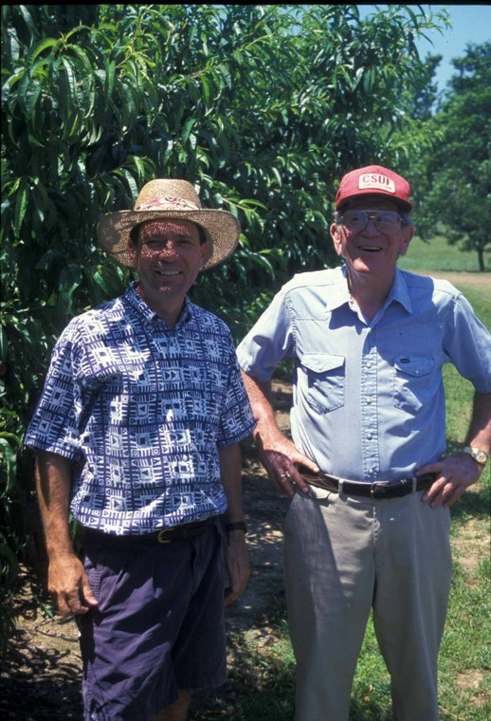

UA Blackberry Breeding Program
Began in 1964 under the leadership of Dr. James Moore
Largely autotetraploid ‘Eastern’ blackberry species
Major breeding goals have included:
  High fruit yield
  Large berry size
  Sweet flavor
  Shipping Quality
  Primocane Fruiting
  Thornless erect canes
How can we speed up the breeding pipeline in our tetraploid crop?

Slide 3
FRS – Clarksville, AR
Fruit Harvest
Imaging Pipeline
Fruit Morphology
Note-Taking
Tissue Collection
Sequencing
Seed Pipeline
Composition Pipeline
SNP Calling and Filtering
Farm
Sample Collection
Data Collection
Analysis
BLUPs
Linkage Disequilibrium
Population Structure
GWAS
GWAS
Candidate Validation

Slide 4



GWAS in Tetraploid Blackberry
Rubus argutus reference genome
High-throughput phenotyping methods (and students 😆)
Better read depth for tetraploid dosage calling
Software to handle polyploid SNP calls and associations
One does not simply do a Genome-Wide Association

Slide 5
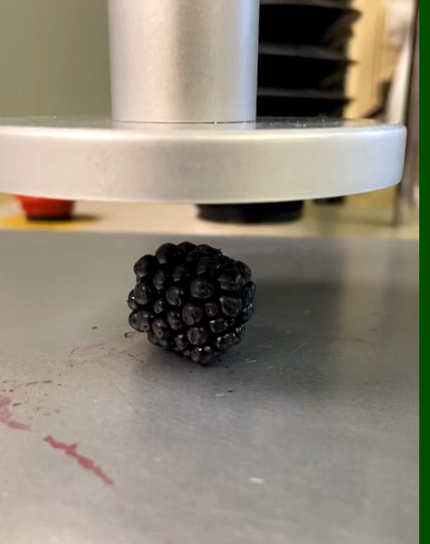
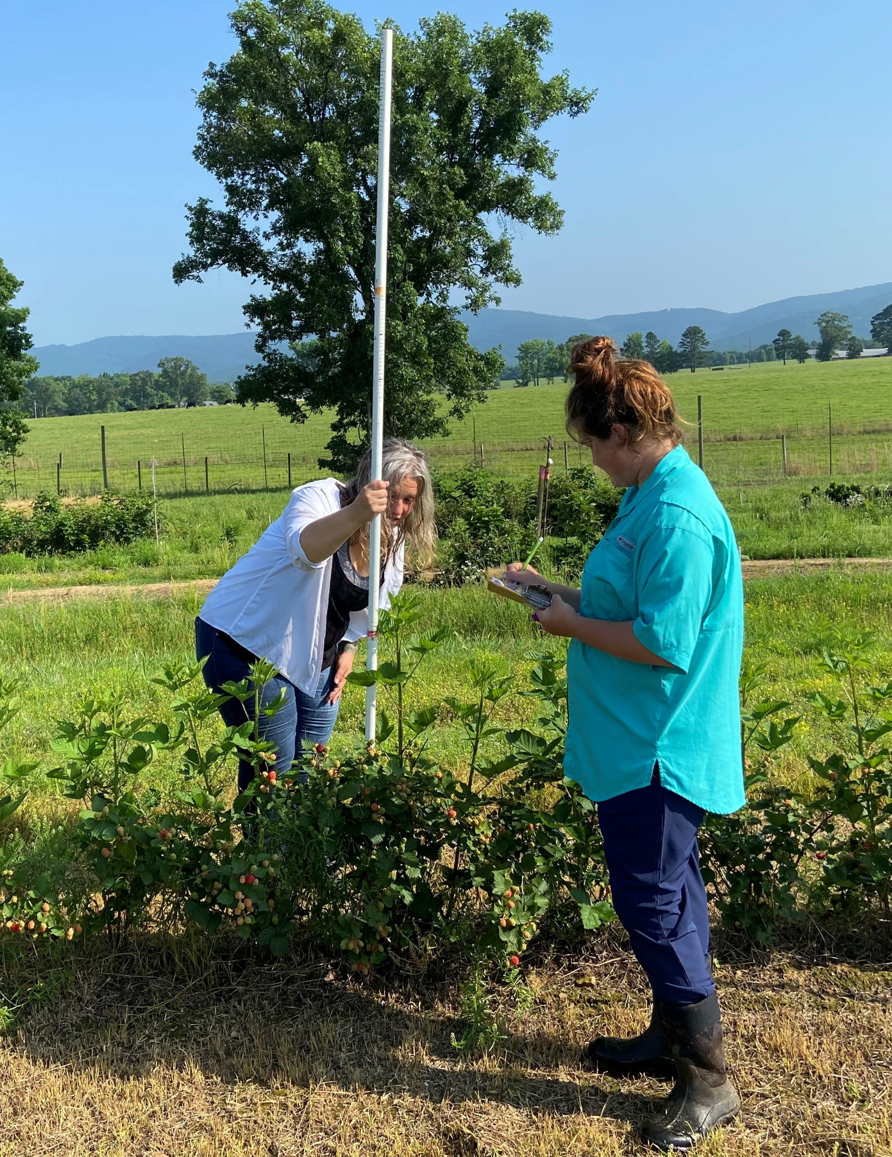
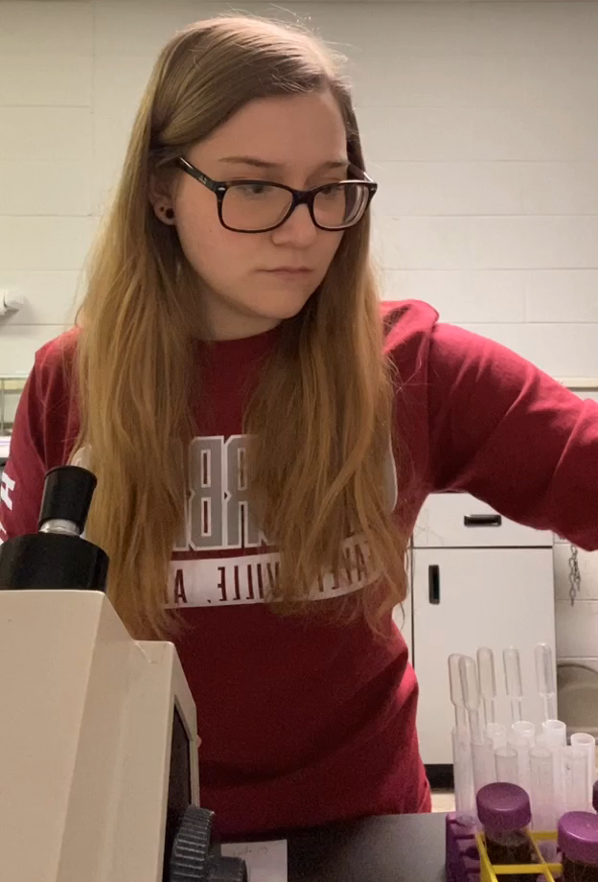
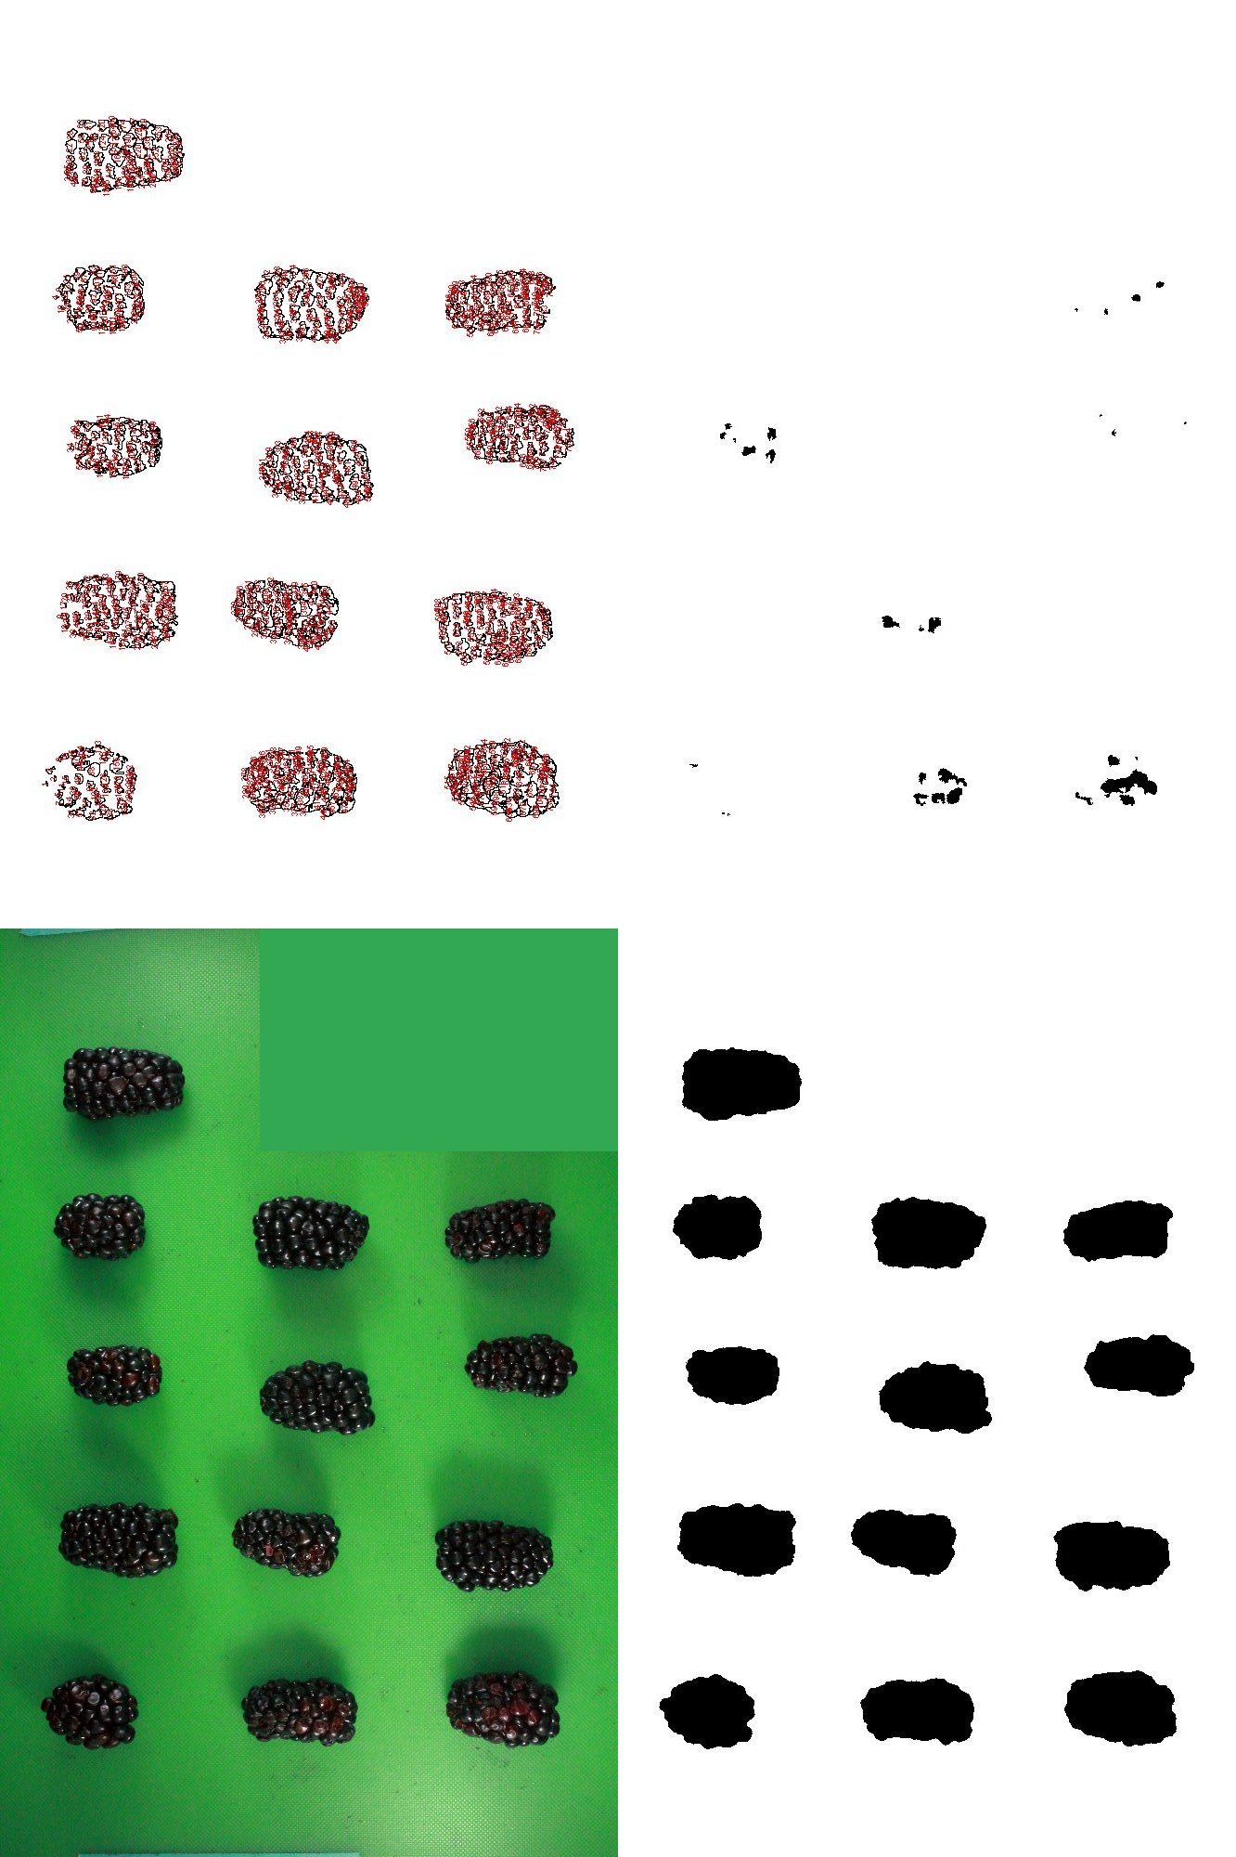
GWAS in Tetraploid Blackberry
Traits Measured:
10 Berry Weight
Berry Length
Berry Width
Drupelet Number
Berry Firmness
RDR
Thorniness
Primocane Fruiting
Primocane Height
Number of Seeds
100-Seed Weight
Seed W/L Ratio
Soluble Solids
Titratable Acidity
pH
Rubus argutus reference genome
High-throughput phenotyping methods (and students 😆)
Better read depth for tetraploid dosage calling
Software to handle polyploid SNP calls and associations
Location: 1
Years: 3
Genotypes: 301

Slide 6


GWAS in Tetraploid Blackberry
Rubus argutus reference genome
High-throughput phenotyping methods (and students 😆)
Better read depth for tetraploid dosage calling
Software to handle polyploid SNP calls and associations
library(updog)
library(GWASpoly)

Slide 7
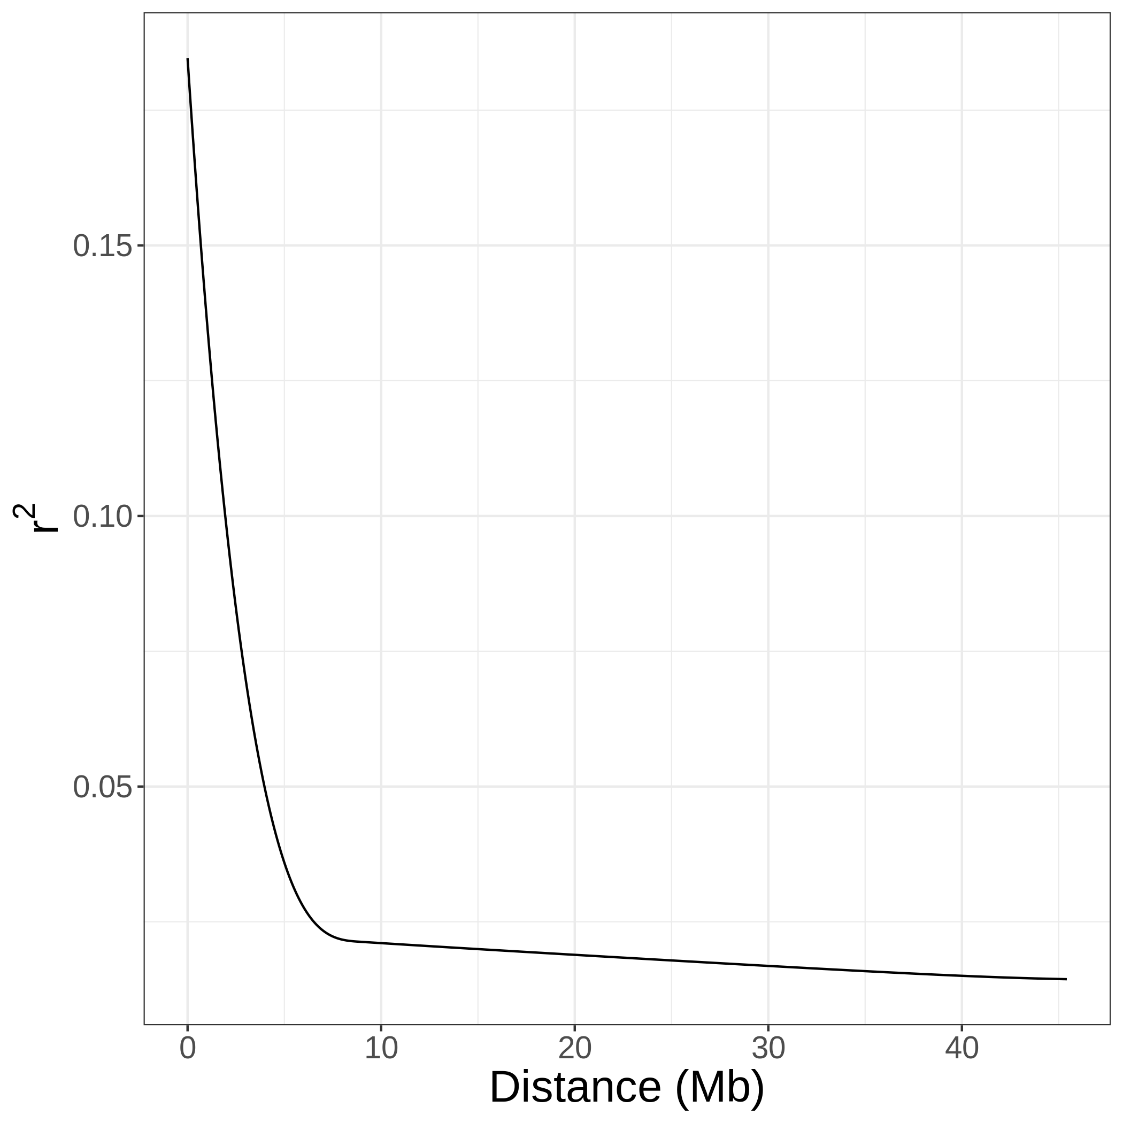
Linkage Disequilibrium
May extend as far as 7 Mb for some loci
It is possible for valid QTL to be relatively distant from causal genes

Slide 8

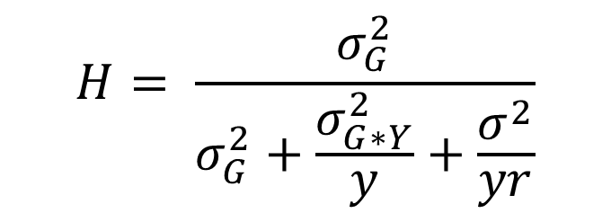
Phenotypic Analysis – BS Heritability (entry mean)
Pipeline | Trait | H
Fruit Morphology | Drupelets/Fruit | 0.67
 | Firmness | 0.68
 | 10-Fruit Wt | 0.79
 | Length | 0.74
 | Width | 0.55
Seed Morphology | 100-Seed Wt | 0.91
 | WL ratio | 0.91
 | Area | 0.89
 | Seeds/ Fruit | 0.7
Fruit Composition | SSC | 0.61
 | pH | 0.67
 | TA | 0.69
Plant Physiology | Primocane Height | 0.81
$$H= \frac{σ_{G}^{2}}{σ_{G}^{2}+\frac{σ_{G∗Y}^{2}}{y}+\frac{σ^{2}}{yr}}$$
OR
$$H= \frac{σ_{G}^{2}}{σ_{P}^{2}}$$

Slide 9

Association Models Used - GWASpoly
y = Xβ+ Sα+ Qv+ Zu+ e
y = Xβ+ Sα+ Zu+ e
TA
Seed Area
Primocane Fruiting
100-seed wt
81,064 SNPs
> 150x read depth
K (‘LOCO’from GWASpoly)
Primocane Height
RDR
Seeds/Fruit
Drupelet #
Firmness
10-Fruit Weight
pH
Q (K=6 from structure)
SSC
Width
Thorniness
Length
Seed W/L

Slide 10
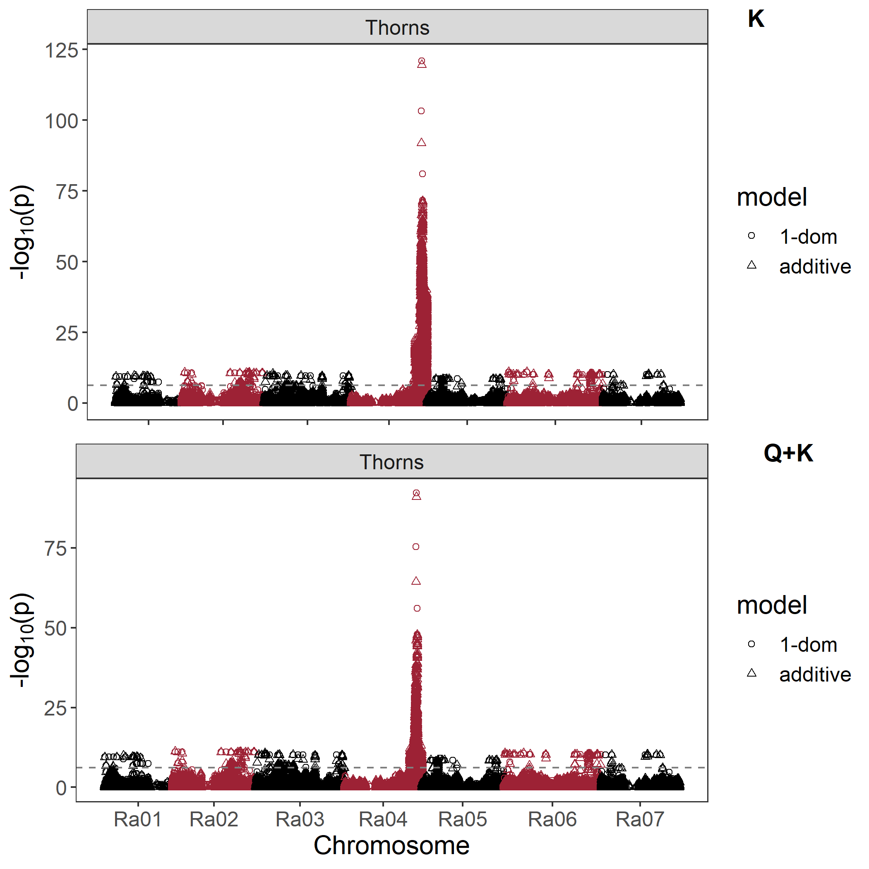
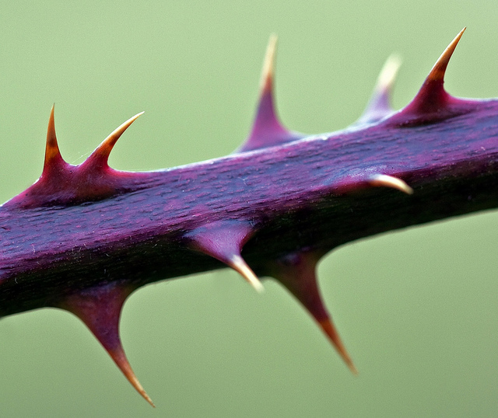
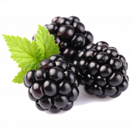
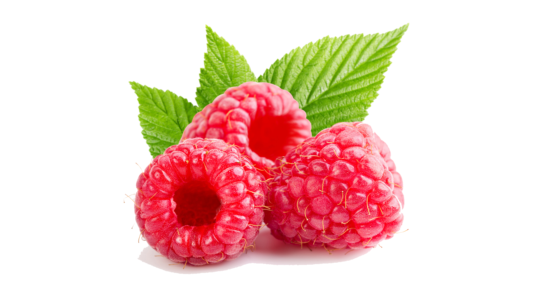
Association – Thorns (Qualitative)
Chromosome 4: 33.6 Mb
  Panel ~ 90% thornless
Khadgi and Weber, 2020 identified a peak at 34.7 Mb on chromosome 4 in red raspberry
Likely a MYB16-like TF

Slide 11
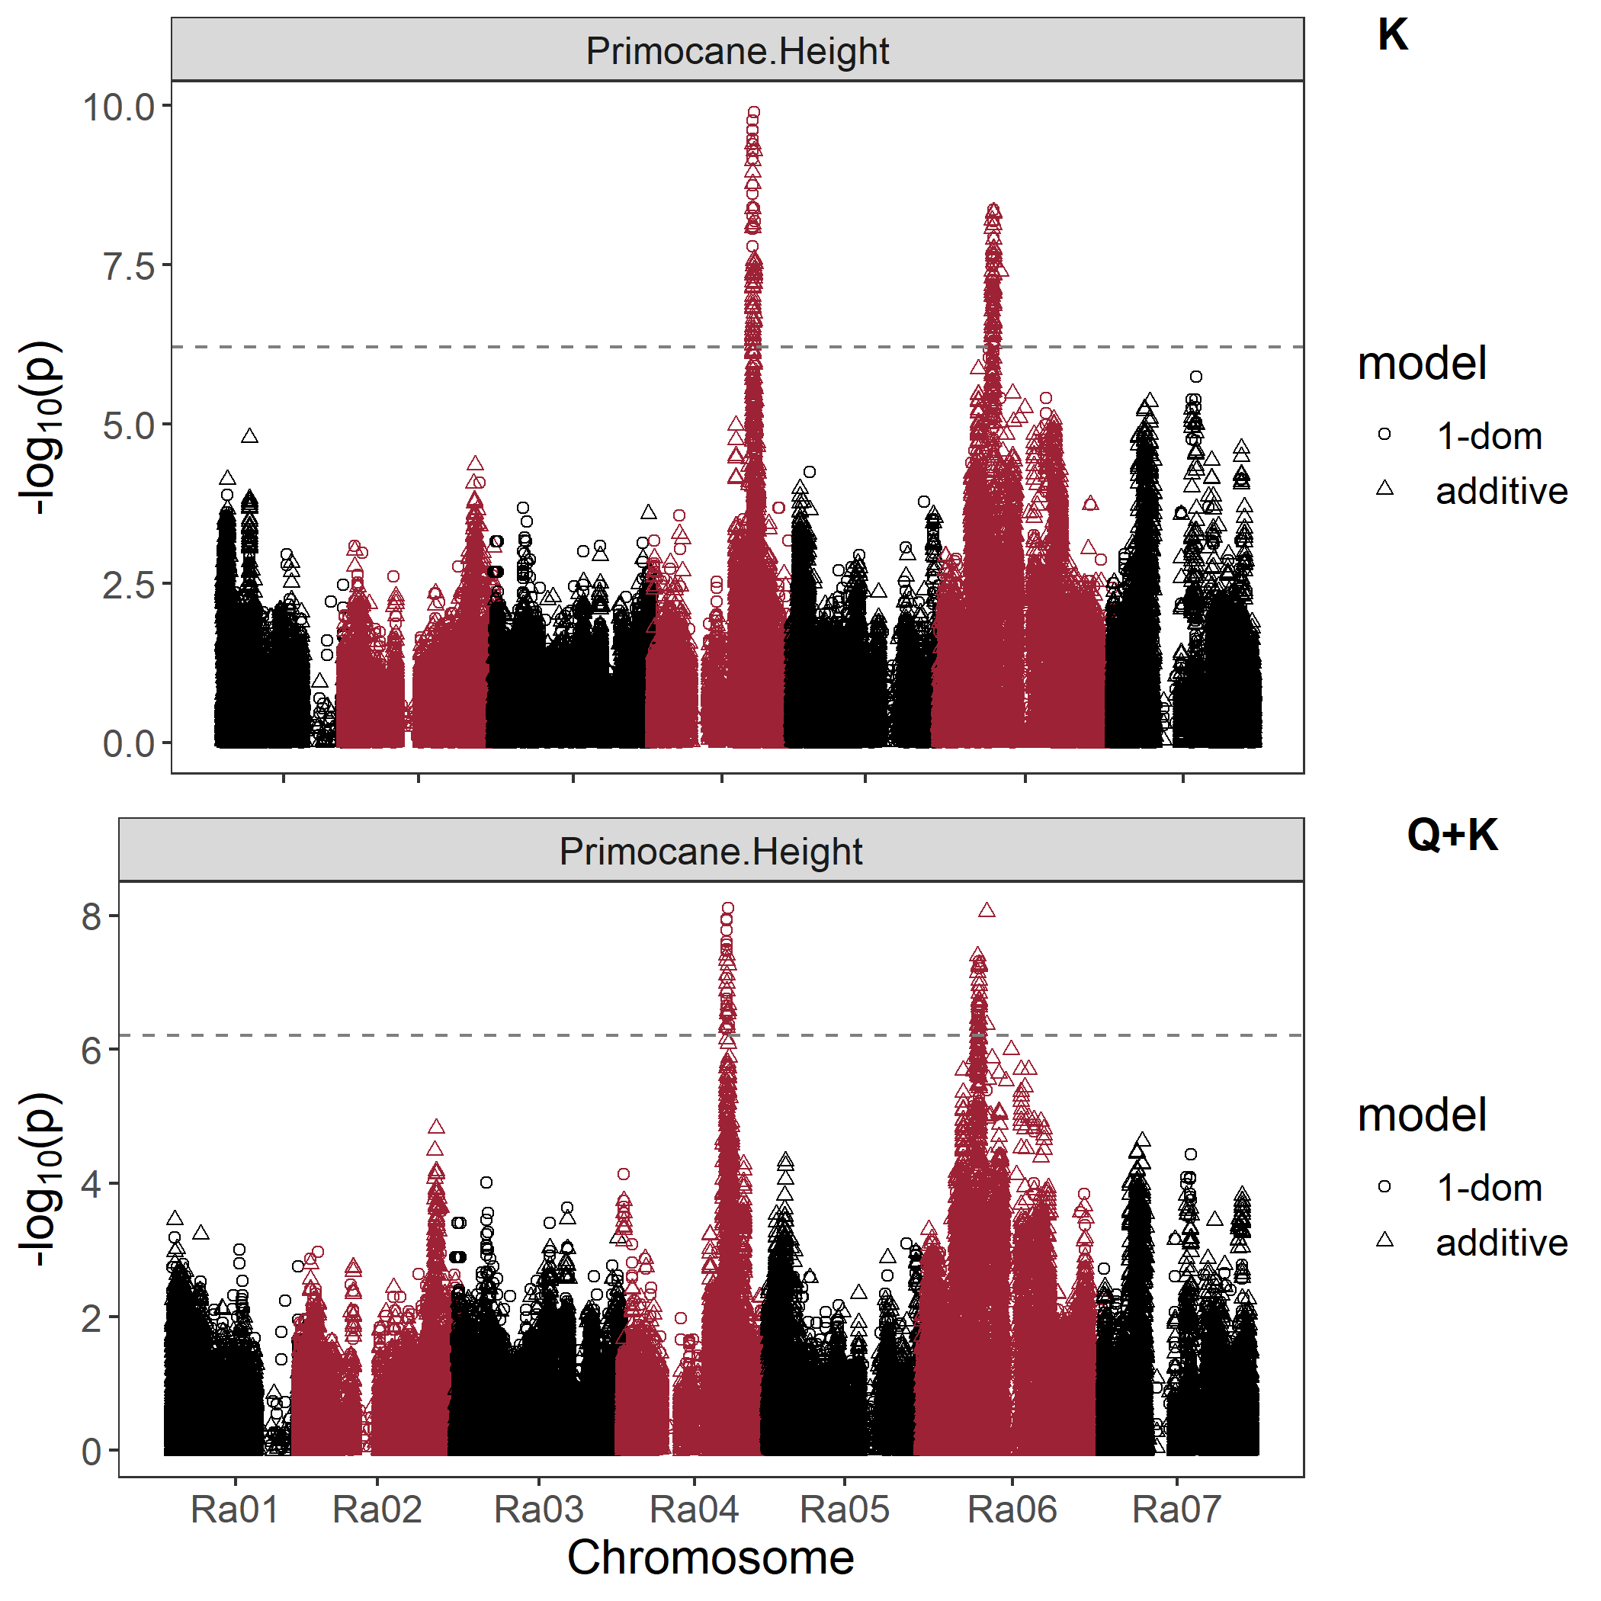
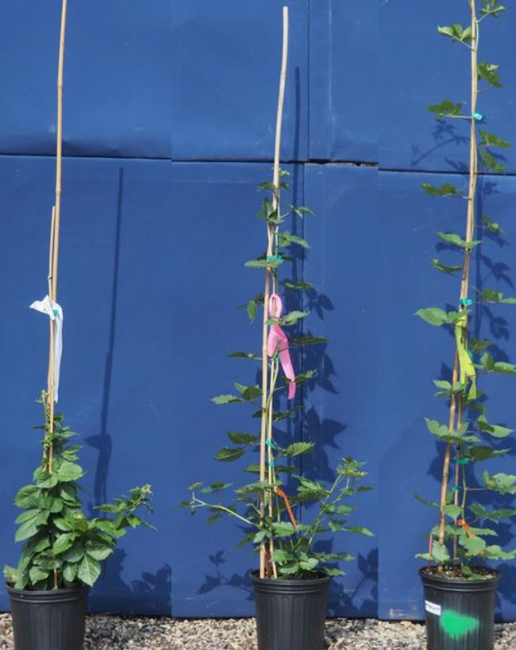
Association – Primocane Height
Chromosome 4: 26.0Mb
  gibberellin 2-oxidase 6 (‘green revolution’ gene)
Chromosome 6: 16.2Mb

Slide 12
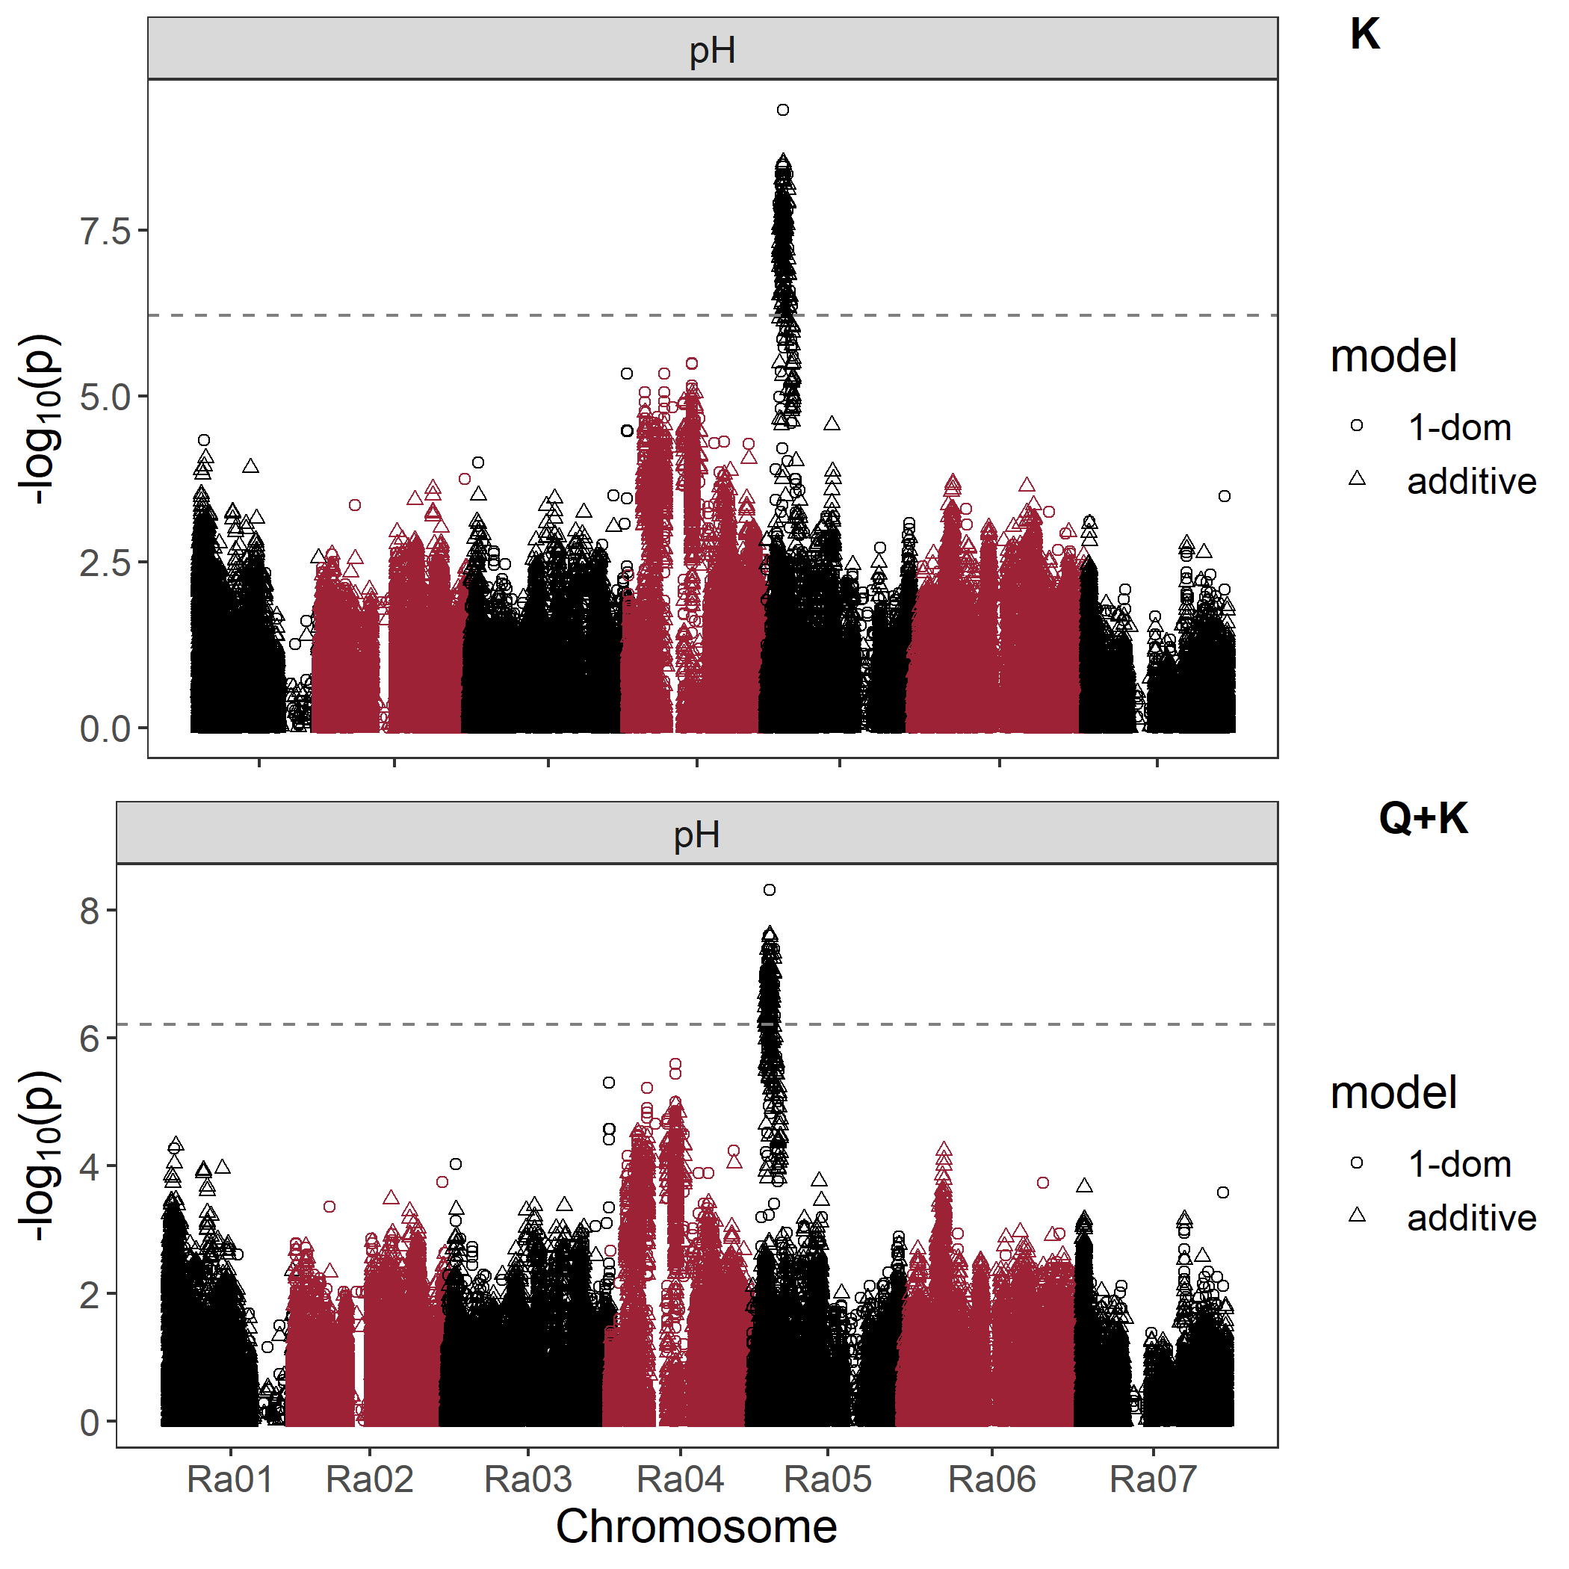
Association – Fruit pH
Strong negative correlation (-0.74) with titratable acidity
Chromosome 5: 4.4Mb
Possible Candidates:
Malate and Citrate Pathway: 3 MS genes and 1 PEPC gene).
‘Acid Trap’ Mechanisms: 2 ALMT9 (homolog of apple MA2 gene)

Slide 13
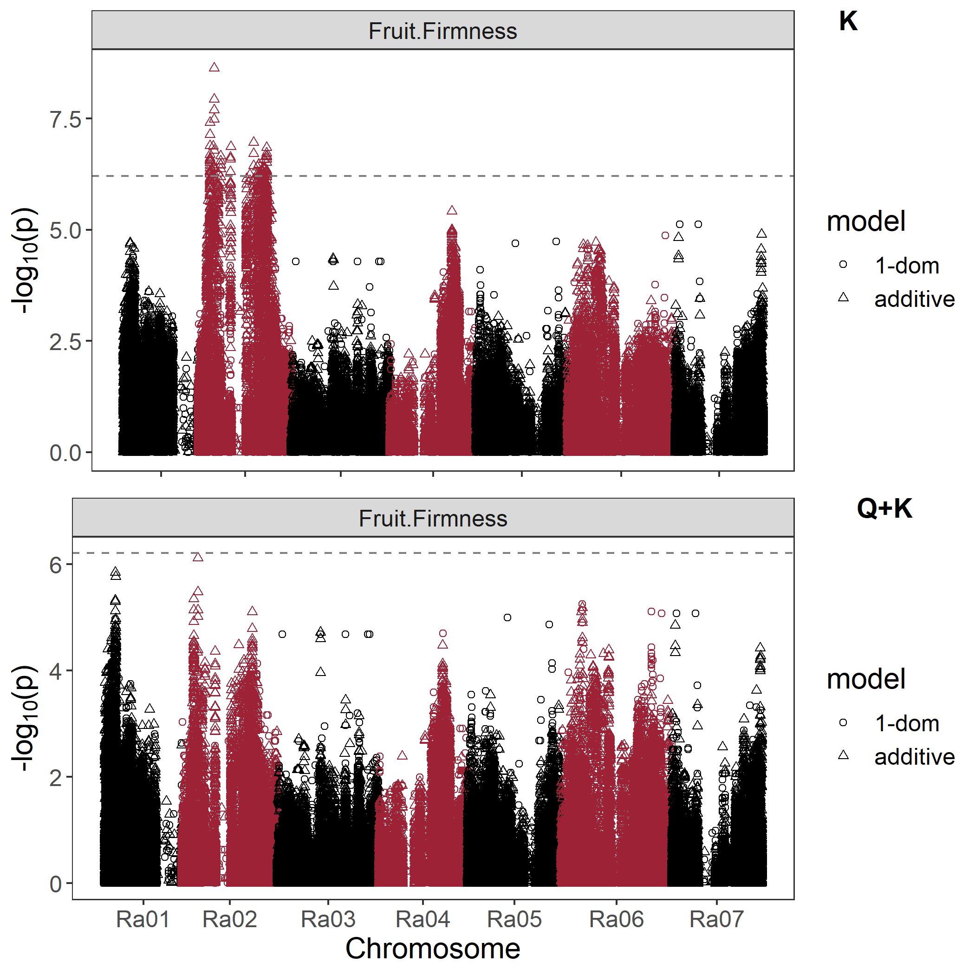
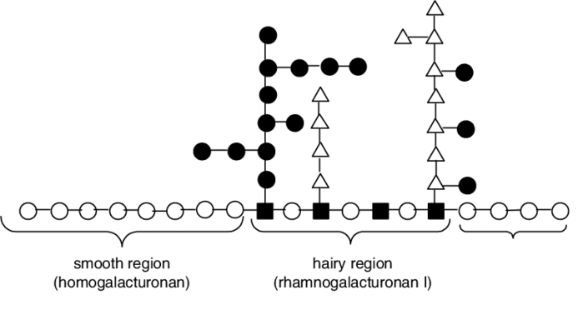
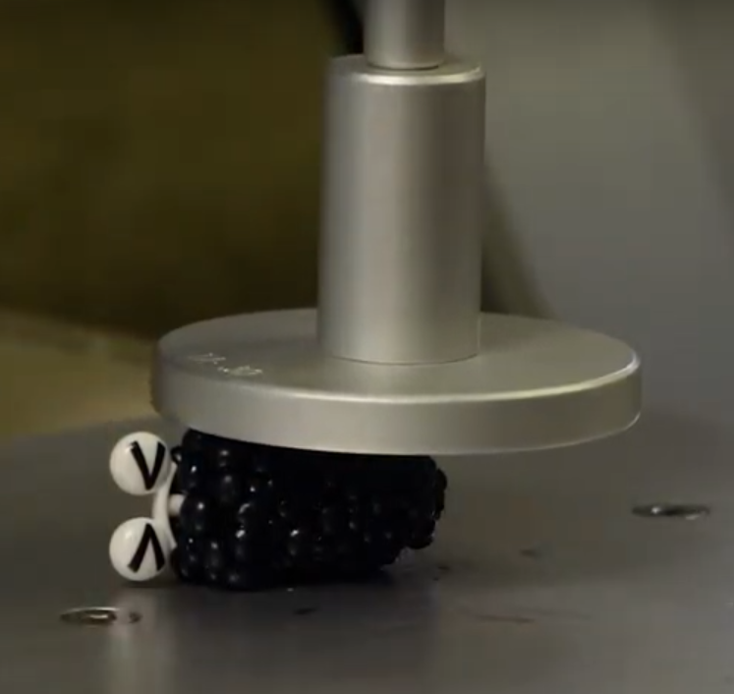
Association – Fruit Firmness
Chromosome 2: 6.3Mb
Possible Candidates:
Pectin Modification: 1 polygalacturonase and 1 β-glucosidase
Next steps: gene expression study and cell wall disassembly in soft vs. crispy genotypes

Slide 14
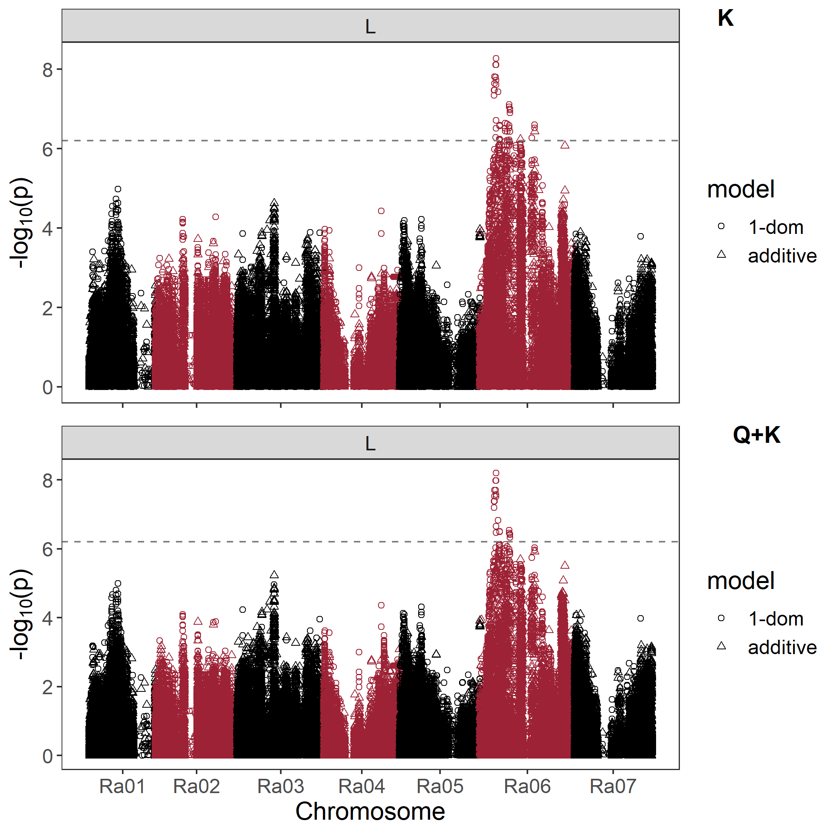
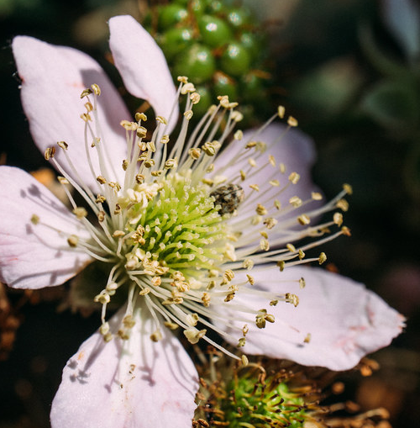
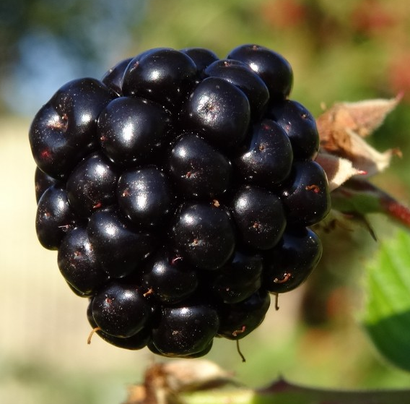
Association – Fruit Length
Highly correlated with drupelet # (0.83), 10-fruit weight (0.84), and seeds/fruit (0.56)
Chromosome 6: 7.6Mb

Slide 15
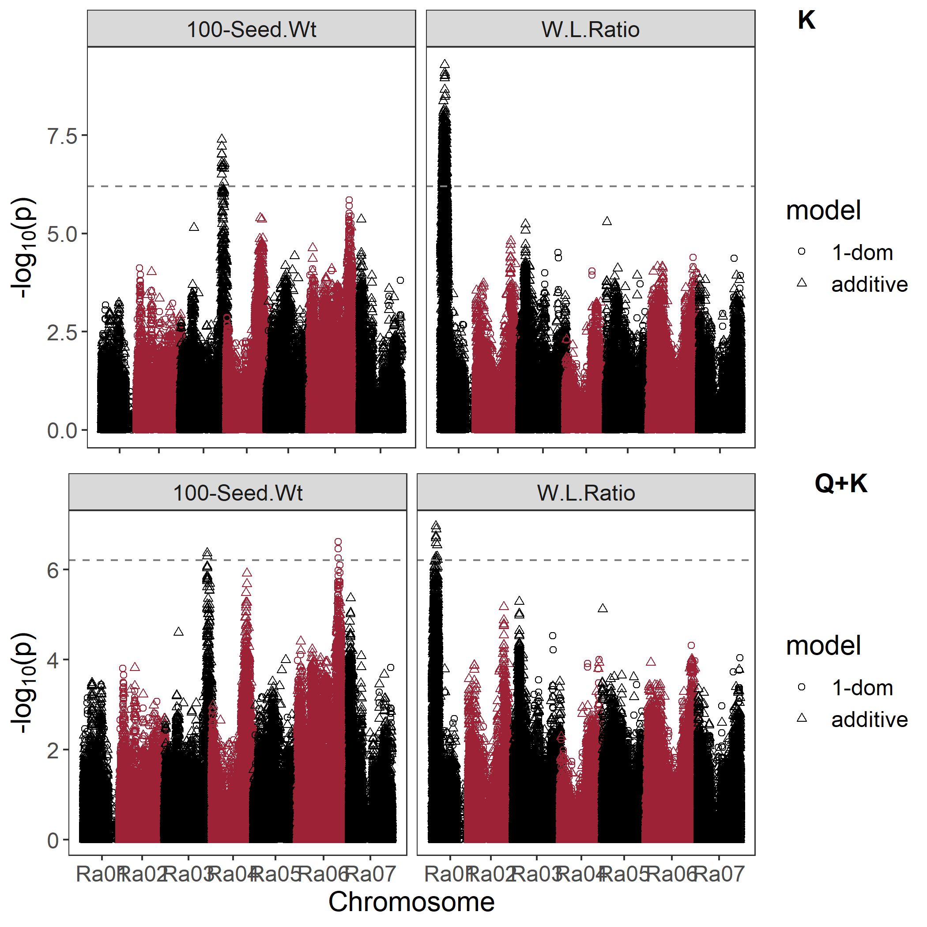
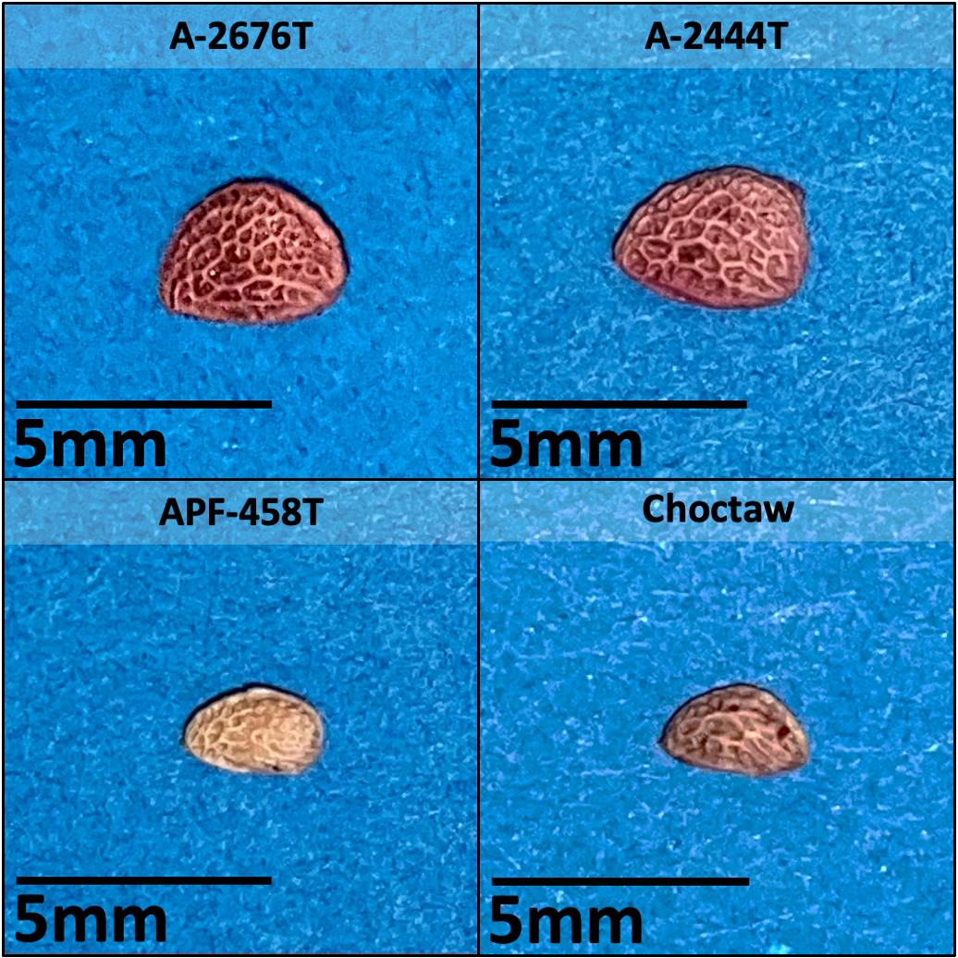
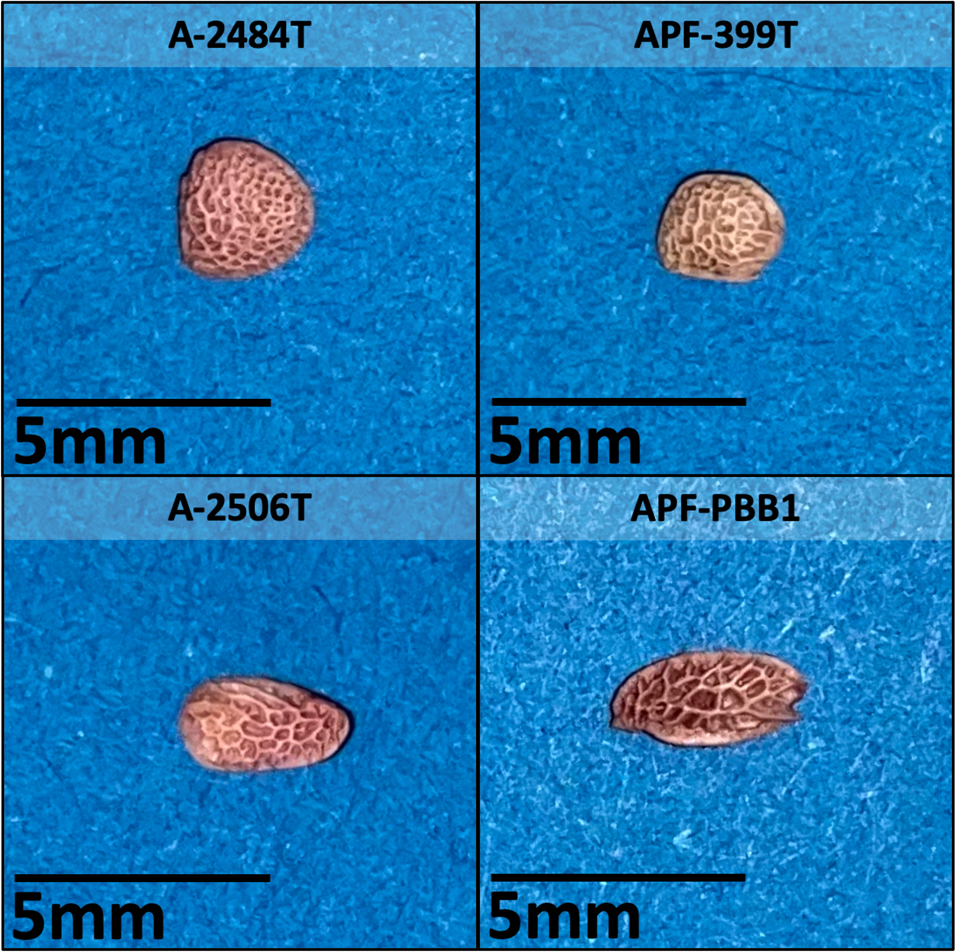
Association – 100-Seed Wt & Seed W/L
100-seed wt correlated with seed area (0.84)
Chromosome 3: 35.6Mb (100-seed wt)
Chromosome 1: 3.0Mb (Seed W/L)
Homologs of seed size and shape in rice and Arabidopsis thaliana

Slide 16

Conclusions
Predictive QTL were identified in most traits relating to plant architecture, fruit morphology/composition, and seed morphology
Berry width and SSC were not highly heritable and did not have QTL
The most exciting story is yet to be told… (SPOILER: Primocane Fruiting QTL with LOD 60)

Slide 17
Next Steps and Future Work
Develop and validate diagnostic markers for large-effect QTL
Explore candidate genes and potential mechanisms
  RNA sequencing in texture-diverse blackberry cultivars
Train a genomic selection model to overcome quantitative traits with low-effect markers

Slide 18
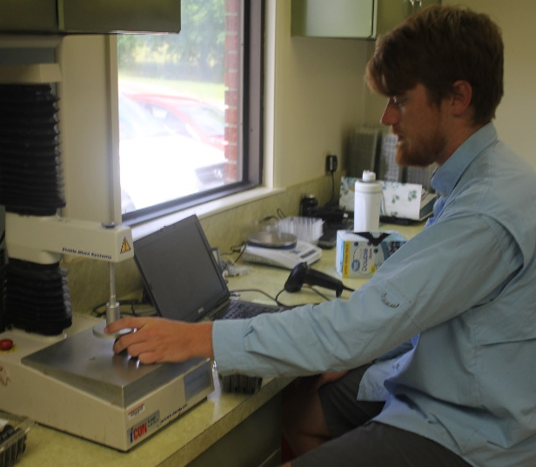



Acknowledgments
Advisor: Dr. Margaret Worthington
Dr. John Clark
FRS farm crew at Clarksville, AR
Fellow Students: Kenneth Buck, Carly Godwin, Carmen Johns, Mitch Armour, Autumn Brown, Isabella Norsworthy
Lab Manager: Lacy Nelson

