Slide 1

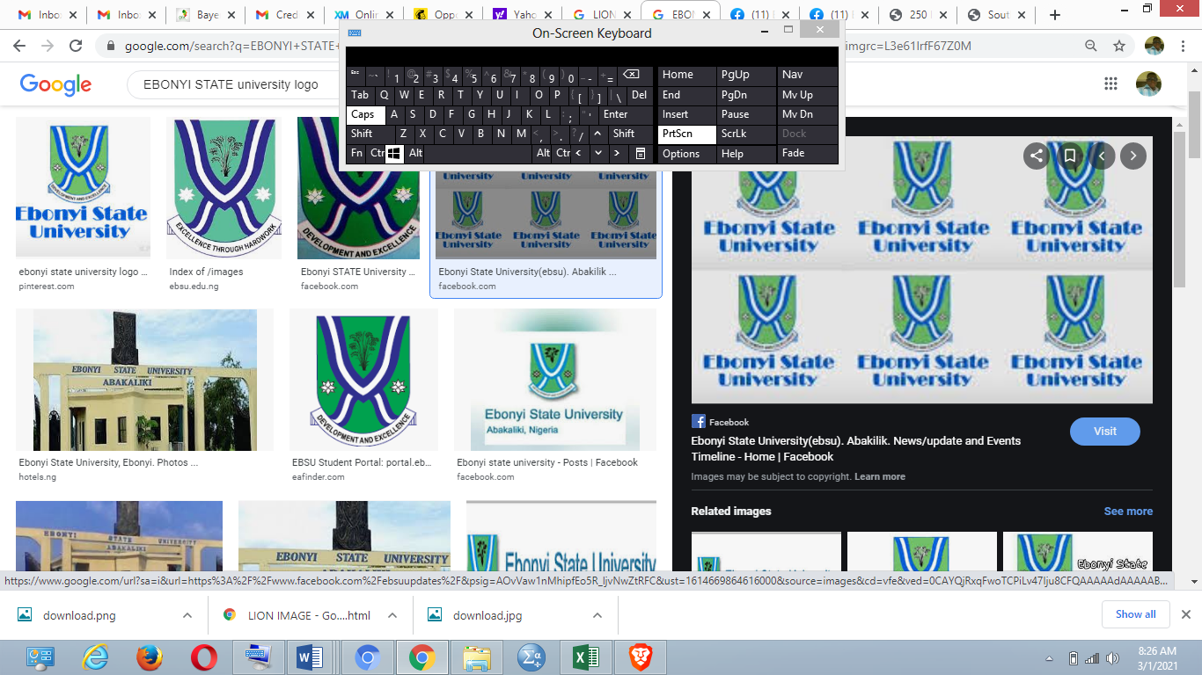
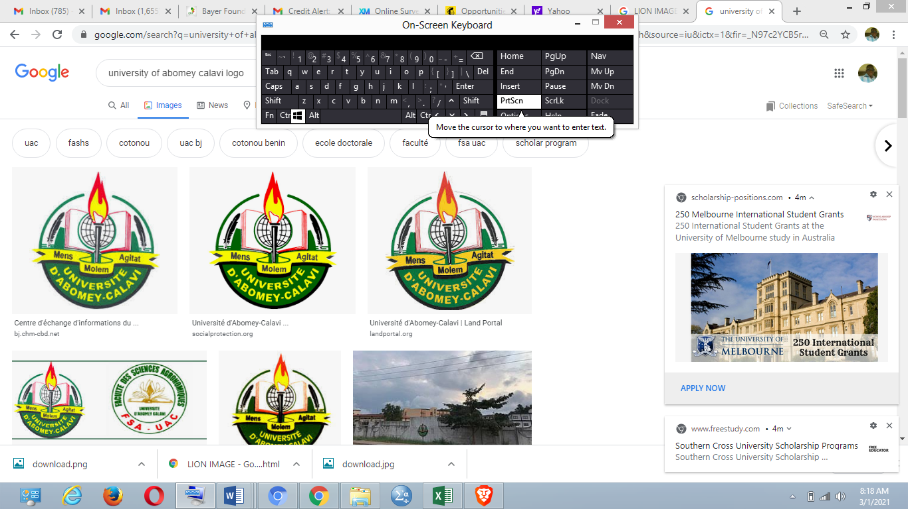


EVALUATION OF MUSA ACCESSIONS INDIGENOUS TO BENIN REPUBLIC FOR RESISTANCE TO BLACK SIGATOKA DISEASE
*Nweze Nwabueze Peter^{1,2,3},
Enoch G. Achigan-Dako²,
Celestine A. Afiukwa¹,
Happiness O. Oselebe¹
Affiliations
1= Ebonyi State University, Nigeria
2=Laboratory of Genetics, Biotechnology and Seed Science, (GBioS), University of Abomey Calavi, Benin
3=Lionking Biotech Labs, Nigeria
Insert your institutions’ logos here.

Slide 2
Introduction
Musa species are important food crops that are cultivated in over 128 countries globally (Kamal et al., 2012).
Black Sigatoka Disease (BSD) caused by Pseudocercospora fijiensis is a major constraint to banana production.
Its damaging effect ranges from 30% to 50% loss (Barekye et al., 2011), and even up to 80% yield loss in untreated field (Churchill, 2011).
Aim of the study
To identify Benin local Musa genotypes resistant to Black Sigatoka disease which could be recommended to farmers for cultivation and to breeders for use as resistance donors in future improvement programs.
Insert your institutions’ logos here.

Slide 3
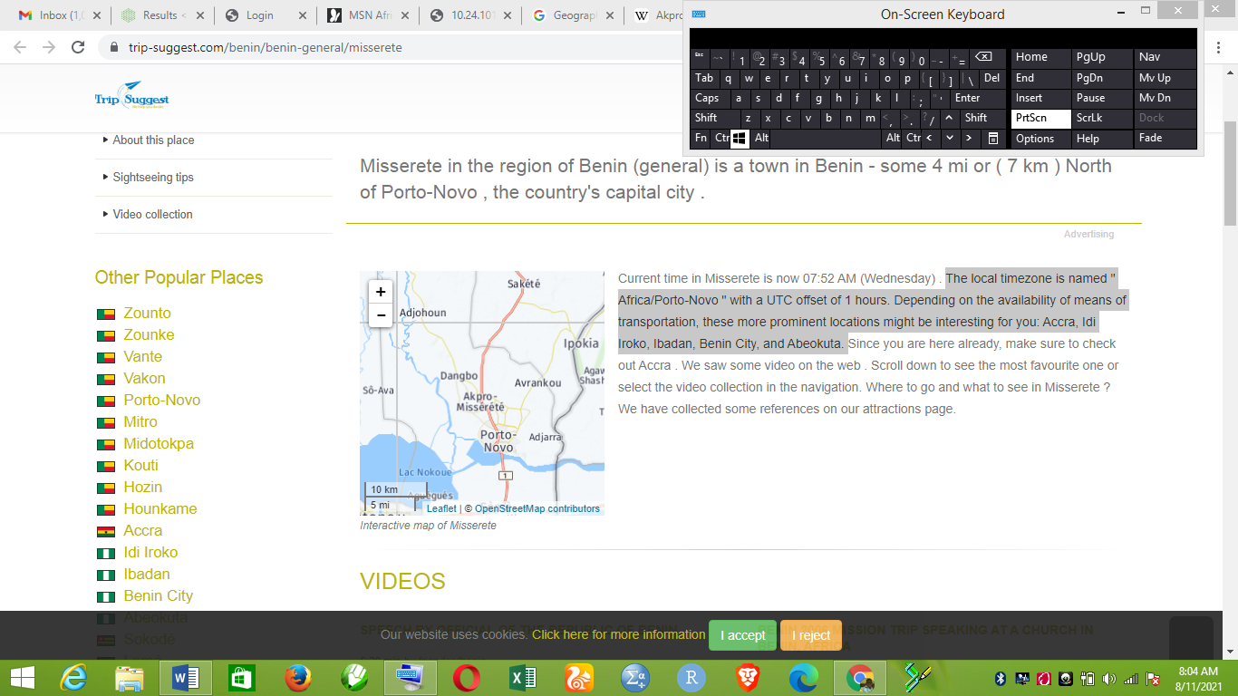
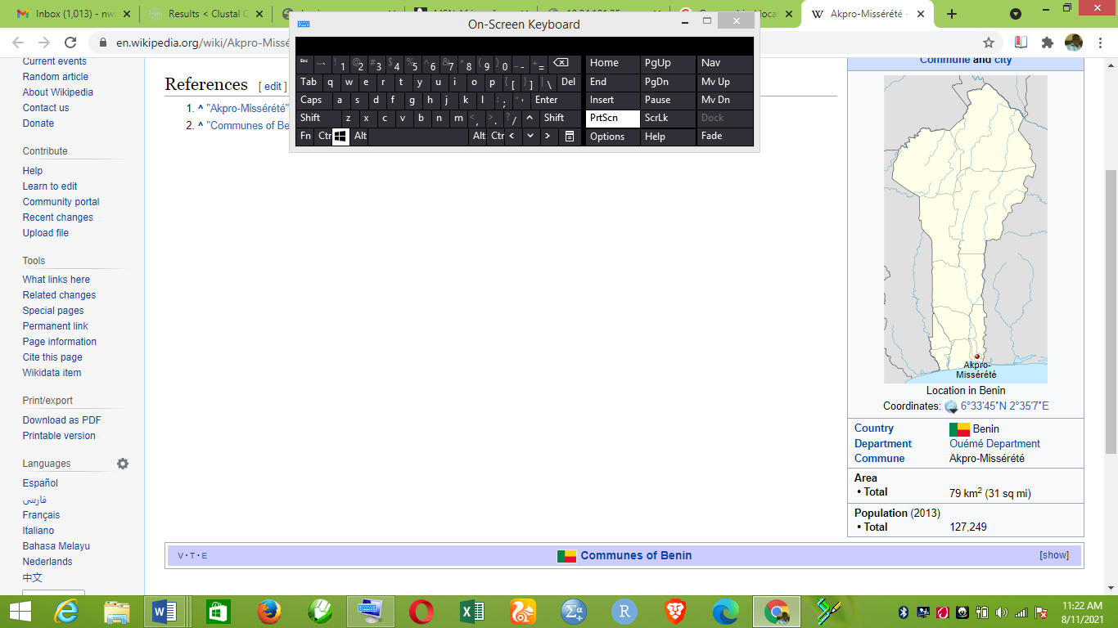
Materials and Methods
Study location
Latitudes 6º33’45’N
Longitudes 2º35’7’E
Approximately 7km
Average amount of annual precipitation is: 999.9 mm (39.37 inch)c
Fig 1: Map showing study area (Source: https://trip-suggest.com/benin/benin-general/misserete (2021))
Insert your institutions’ logos here.

Slide 4
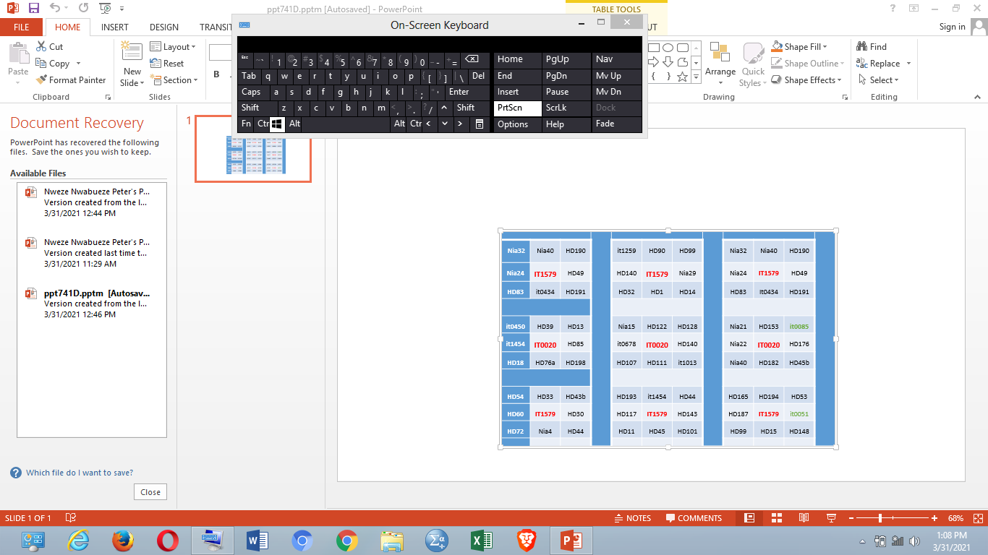
METHODS
Sucker collection, multiplication and maintenance
RESEARCH DESIGN:
Augmented split plot design;
9 whole plots arranged in 3x3 square
Augmented split plot design
Agro-Morphological Data Collection
Assessment of Disease Development/Incidence
Assessment of Disease severity
Data Analysis:
Summary statistics, ANOVA, Correlation, PCA and Cluster
SA, 12%LD, 25%LD, 50%LD and 100%LD
(Barekye et al., 2011).
YSL, NSL, INSL, AUDPC and DSI
(Barekye et al., 2011)
MOLECULAR ANALYSIS:
DNA extract, PCR, Electrophoresis,
DNA sequencing & analysis
Fig 2: Research Methodology
Insert your institutions’ logos here.

Slide 5
Results
Table 1: Summary Statistics on Sensitivity (incidence and severity) of Musa accessions grown in Benin Republic to Sigatoka Disease
Parameter | Disease Incidence |  |  |  |  | Disease Severity
 | SA | 12%LD | 25%LD | 50%LD | 100%LD | NSL | YLS | INSL | DSI | AUDPC
Min. | 10.00 | 7.00 | 12.00 | 16.00 | 20.00 | 3.00 | 2.00 | 12.50 | 13.33 | 58.0
1st Qu. | 18.00 | 16.00 | 26.00 | 35.00 | 44.00 | 6.00 | 3.00 | 25.00 | 30.95 | 123.0
Median | 20.00 | 20.00 | 32.00 | 41.00 | 49.00 | 7.00 | 3.00 | 33.33 | 35.56 | 145.0
Mean | 20.68 | 21.71 | 32.49 | 41.31 | 49.07 | 7.03 | 3.22 | 32.21 | 35.33 | 146.6
3rd Qu. | 24.00 | 27.00 | 38.00 | 46.00 | 55.00 | 8.00 | 4.00 | 37.50 | 39.58 | 166.0
Max. | 36.00 | 45.00 | 59.00 | 67.00 | 75.00 | 14.00 | 6.00 | 60.00 | 52.00 | 239.0
Sig. | >0.0001 | >0.0001 | >0.0001 | >0.0001 | >0.0001 | >0.0001 | >0.0001 | >0.0001 | >0.0001 | >0.0001
Insert your institutions’ logos here.

Slide 6
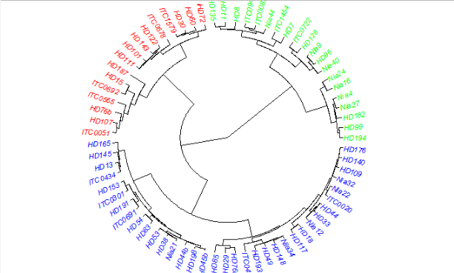
Results
Hierarchical cluster using phenotypic indicators of BSD resistance showed the presence of 3 clusters (A-C) according to their sensitivity to the disease.
Cluster A = 20 Highly resistant accessions
Cluster B = 16 highly susceptible accessions
Cluster C = 36 Intermediate resistant accessions
B
A
C
Figure 3: Clustering of Benin Musa accession in accordance to their Sensitivity to Sigatoka Disease.
Insert your institutions’ logos here.

Slide 7
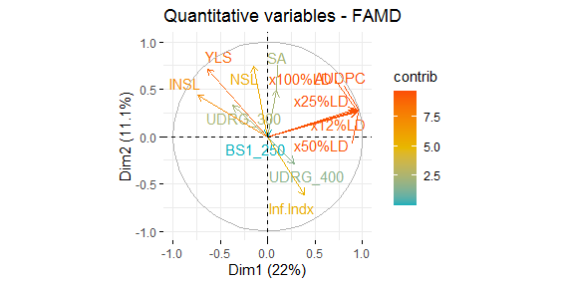
MSA Results
HD30_UDRG -----------------------------------GATAGCTACAGATCACCTGAAATAG
HD107_UDRG -----------------------------------GGTTTCCACAGATATTTCAGGGTAG
HD72_UDRG -----------------------------------GAATTCTATCGATATTTCAGGAGAT
HD15_UDRG CCACAATTAGAGCTTGTTCTGACTTCCAGATT--TGGTGTCTAAAGGTGCTCTTGGGGTG
Nia4_UDRG AAATAATTAGAGCTCGTTCTTCCTTTTTGG----TTGTGTCATCATGTGCTCTTGGGGTG
HD99_UDRG ACATAATTAGAGCTCGTTCTGCCTTCTTAA----TTGTGTCATCATGTGCTCTTGGGGTG
ITC0722_UDRG CCACAATTAGAGCTTGTTCTGACTTCCAAT----TTGGGTCAACAGGTGCTCTTGGGGCG
HD128_UDRG ACACAAGTAGAGCCTGTTCTGACTTCCGAT----TTGTGTCATCAGGTGCTCTTGGGTCG
HD117_UDRG AAACATGTAGAGCTTGTTCTGACTTCCGAT----TTGTGTCTACAGGTGCTCTTGGGGCG
HD08_UDRG CCCAAATTAGAGCGTGTTCATACTTCCCATTTGGTTGCGTCACCATGTCTTCTTGGGGTG
HD194_UDRG AATTAAATAGAGCTCGTACTTCCCTTTTGGA---TTTCTTCACCATGTCTTCCTGGTCCA
ITC0020_UDRG AATGAATTAGAGCTCGTACTTCCCTTTTGG----TTGCTTCACCATGTCTTCTTGGTCCA
* .* ... ..
HD30_UDRG ------------------------------------------------------------
HD107_UDRG ------------------------------------------------------------
HD72_UDRG ------------------------------------------------------------
HD15_UDRG ATTGGAATTCAACGCAACATATAGCACATTTACAACCAAAGTGGAATATGTGAATTGAAG
Nia4_UDRG -TTGGAATCCAACA-CCCAAAGAACACCTGAACAACCAAAGTGGTAGAT-TGAAAAGCAG
HD99_UDRG -TTGGAATCCAACA-ACCCAAGAACACCTGAACAACCAAAGTGAAAGAT-TGAAAAGCAG
ITC0722_UDRG -ATGGAATTCAACG-CCCAAAGAACACCTTTACAACCAAAGTGGAAGG--TGAATTGCT-
HD128_UDRG -TTGGAATCCAACG-ACACAAGAACACCTTTACAACCAAATTGGAAGG--TGAATTGAAG
HD117_UDRG -TTGGAATCCATCA-ACCCTAGAACACCTTTACAACCAAATTGAAATG--TGAATTGAAG
HD08_UDRG -GAGTTGTGCTGCA-TTCAATCAACACCTGAACAACTTAAGAACCAAAA-ATTAAAGCCA
HD194_UDRG -TTGGAGTCCCGCA-ACCAATCAACACCTGAACAACCAAAGAACCAGAA-ATTGAAGCCA
ITC0020_UDRG -TTTGAATCCAGCA-ACCAATCAACACATGAACAACCTAAGAACCAAAT-TGTGAAGCCA
Fig. 4: The multiple sequence alignment (MSA) result of the UDRG showed areas of missing sequences among 3 highly susceptible accessions
Fig. 5: FAMD biplot showing marker-trait association study
Insert your institutions’ logos here.

Slide 8
Discussion
High significant variation (P < 0.0001) was observed in the BSD incidence and severity indices (SA, NSL, YLS, INSL, DSI and AUDPC).
Tree analysis grouped the accessions into 3 main clusters; resistant (A), susceptible (B) and intermediate resistant (C) accessions.
DNA-based dendograms also revealed 3 main clusters similar to the morphological data tree.
From the FAMD result: The 300bp allele of the marker exhibited significant association with some phenotypic indicator traits (YSL and INSL) of BSD resistance.
MSA result revealed that susceptible accessions tends to have missing sequences.
Insert your institutions’ logos here.

Slide 9
Summary
This study identified black sigatoka disease resistant Musa accessions among genotypes cultivated in Benin Republic and has provided a genetic tool (UDRG_300) which can be further verified and exploited for improvement of the Musa species for sigatoka disease resistance.
These resistant accessions can also be recommended to breeders and farmers for propagation to enhance food security in the region.
There is, however, need to repeated this trial with larger number of accessions (above 200) and across different ecological areas.
The impact of ploidy level of the genotypes on BSD sensitivity need to be studied.
Insert your institutions’ logos here.

Slide 10



Acknowledgments
Insert your institutions’ logos here.

