Slide 1
Genome-Wide Association for Drought Tolerance in Potato
João Vitor Nomura
PhD Student, University of São Paulo/Brazil
Visiting Student at Endelman Group, University of Wisconsin-Madison

Slide 2
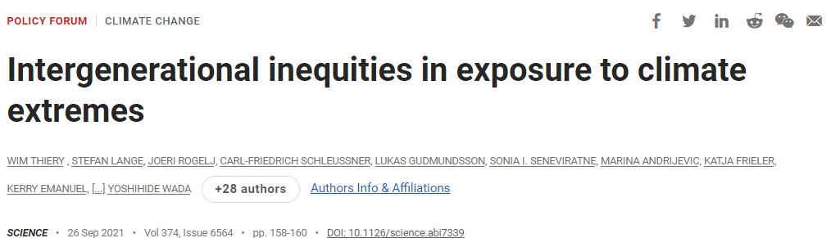
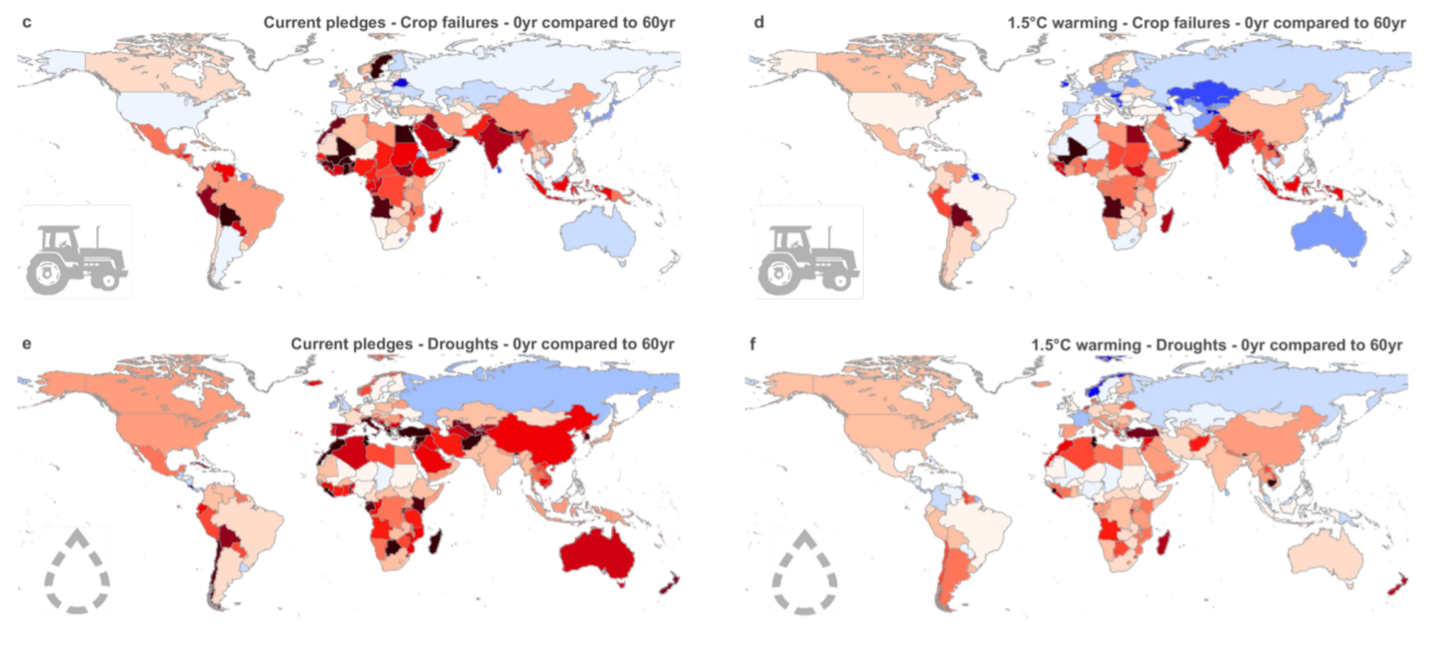
Introduction
6x Extreme heat waves
Food security
Varieties adapted

Slide 3
Abiotic stress
Heat
Drought
Bonierbale et al., 2020

Slide 4
Breeding populations
Target Env | Subtropical Lowlands | Temperate Lowland and mid-elevation | Mid-elevation tropics | Highland tropics
Target Traits | Heat Long dormancy period Cold chipping Dry matter Virus Resistance | Photoperiod Drought Salinity Virus Resistance | PVY LB Heat Chips Low glycoalkaloid | Drought LB Biofortification
Population | LTVR | LTVR | LTVR LBHT | B BIOT
Countries | China Vietnam India Bangladesh | Uzbekistan Tajikistan Georgia Kyrgyzstan | Kenya Rwanda Ethiopia Buthan Nepal | Peru Bolivia Colombia Ecuador Central America

Slide 5
LTVR
Lowland Tropics Virus Resistant
Lowland Adapt
Heat
Earliness
PVX
PVY
Yield
Earliness
LD
Processing
Earliness
Heat – Drought
Processing
PLVR
Earliness
LB
Quality
C1
C2
C3
C4
C5
C6
C7
1970’s
1980’s
1990’s
2000’s
2007
2016

Slide 6
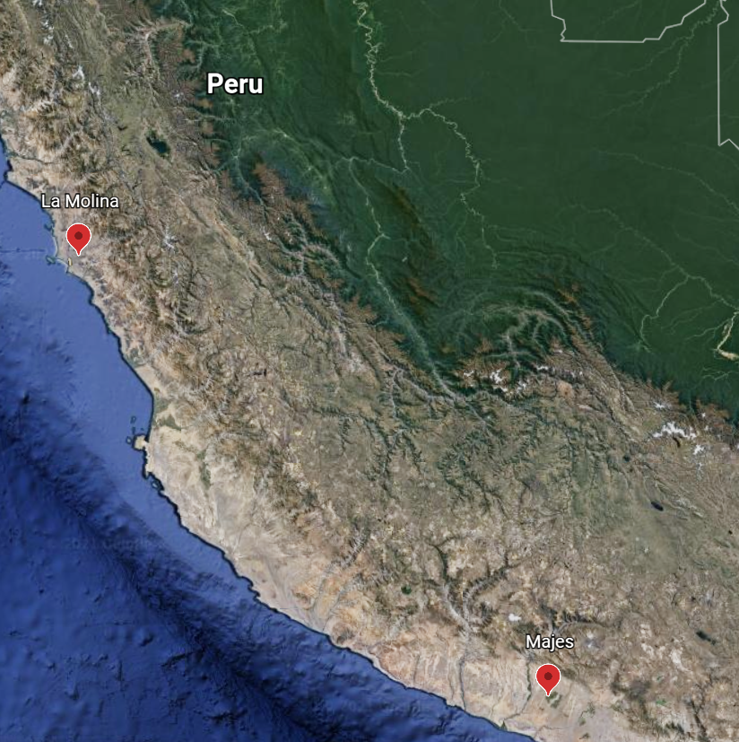
Material and Methods
La Molina 2020
28ºC/20ºC
Arid Subtropical Lowlands
Majes 2018
27ºC/18ºC
Arid Subtropical Lowlands
Google

Slide 7
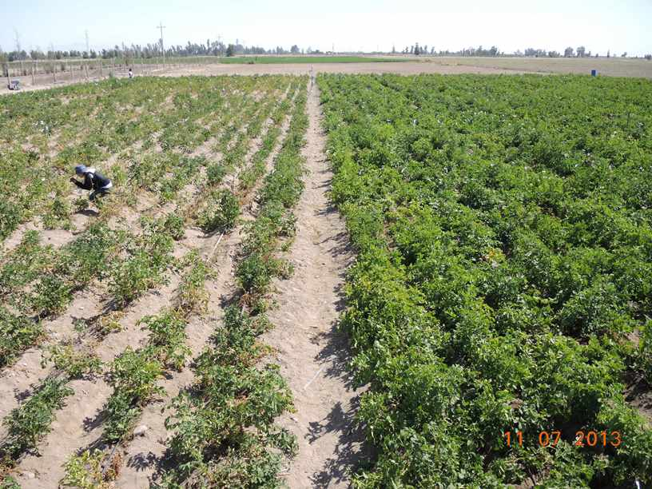
Material and Methods
Drought x Full Irrigation
Deficit started in tuberization
Full: 2-3 days interval
Drought: 15 days interval
Amoros, W., & Salas, E. (2013)

Slide 8
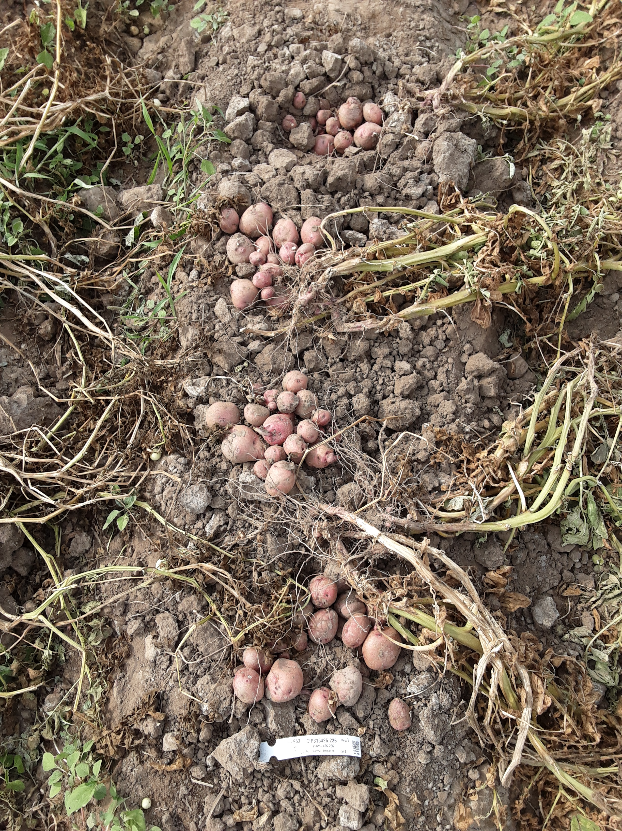
Material and Methods
Traits:
Yield (g plant⁻¹)
Tuber Set (tubers plant⁻¹)
Dry Matter (%)
Amoros, W., & Salas, E. (2013)

Slide 9
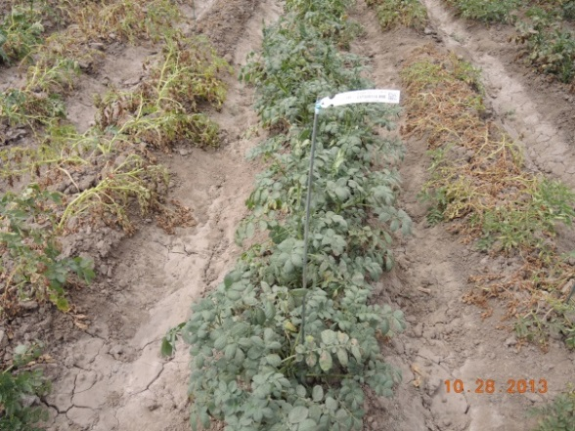
Material and Methods
655 clones from CIP
DArTag ~ 2,244 markers
updog package (Gerard et al., 2018)
StageWise package (Endelman, 2021)
Amoros, W., & Salas, E. (2013)

Slide 10
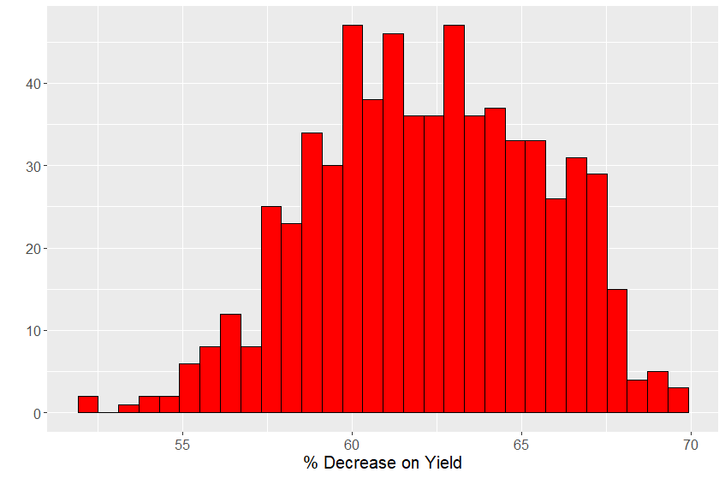
Drought impact on traits
Yield
Full: 533 g/plant
Drought: 204 g/plant
62%

Slide 11
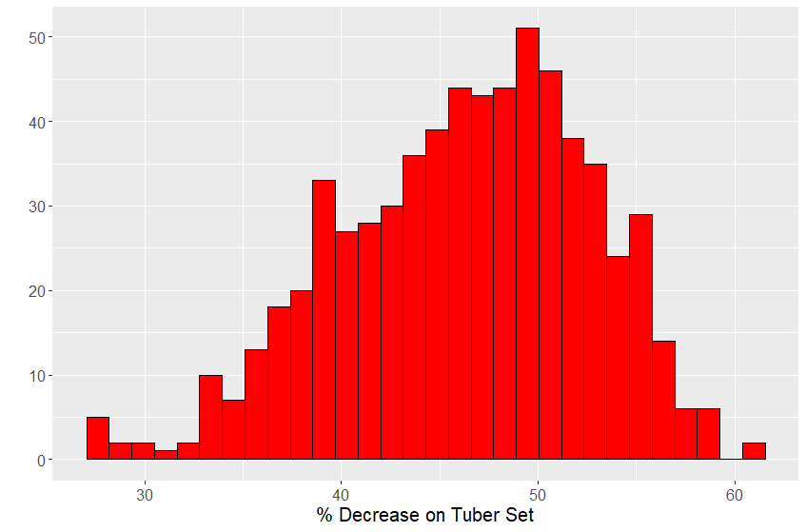
Drought impact on traits
Tuber Set
Full: 9.38 tubers/plant
Drought: 4.96 tubers/plant
47%

Slide 12
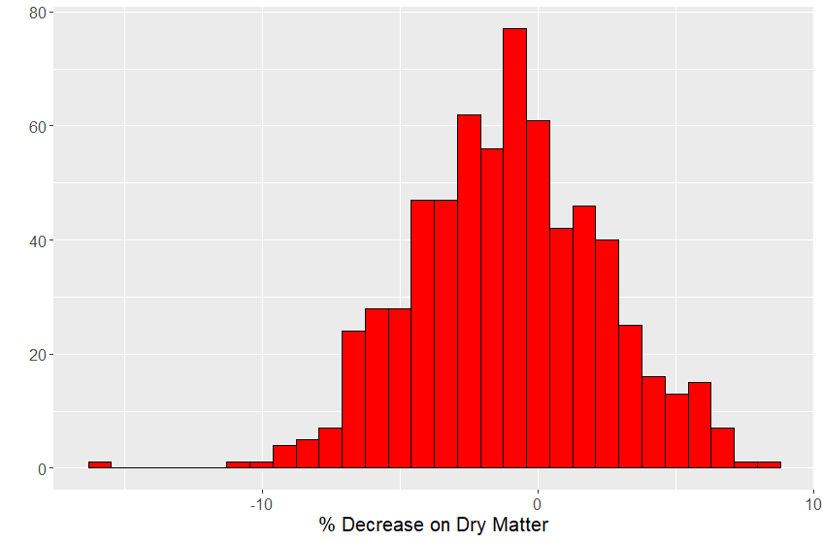
Drought impact on traits
Dry Matter
Full: 18.58%
Drought: 18.76%

Slide 13
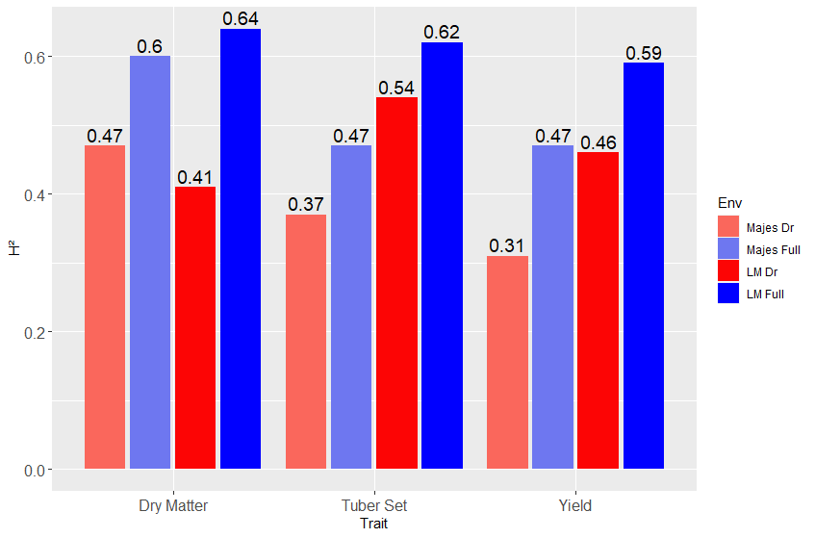
Heritability (plot)
Higher H² in La Molina
Decrease in drought level
Bigger effect of residuals

Slide 14
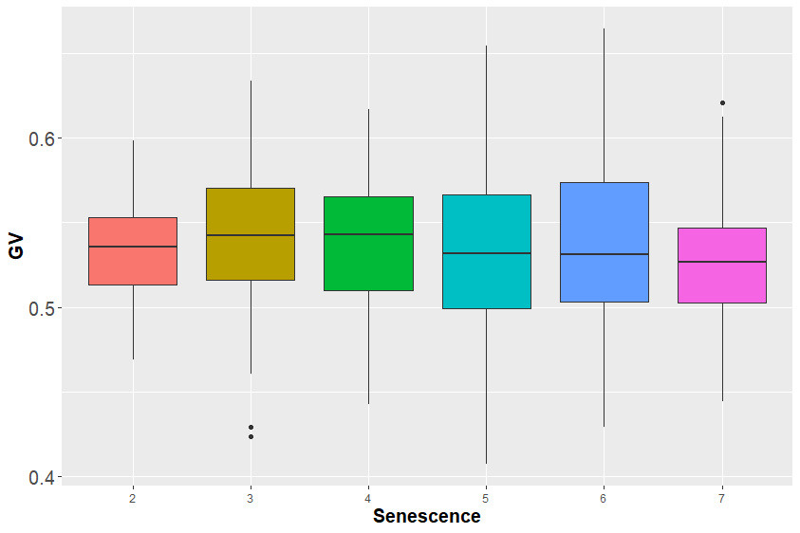
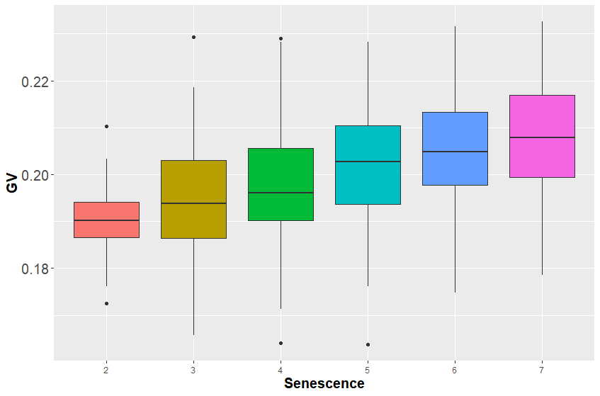
Maturity score X Yield
Yield
Full irrigation
Yield
Drought
LATE
EARLY
LATE
EARLY

Slide 15
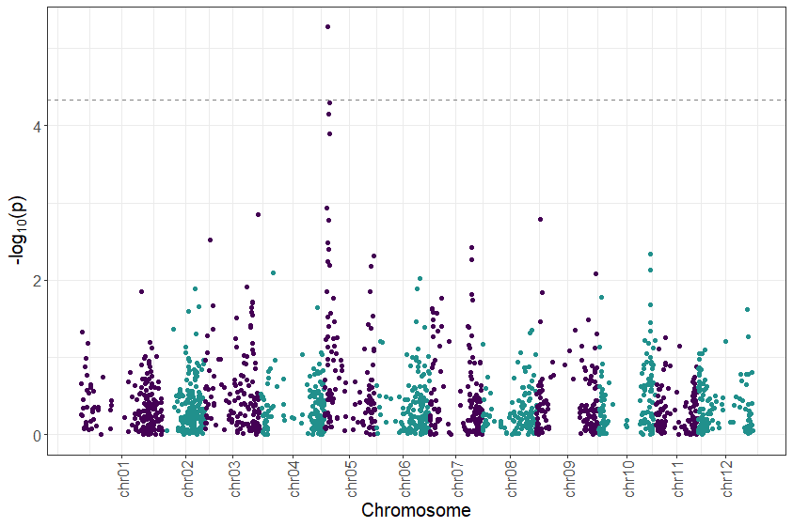
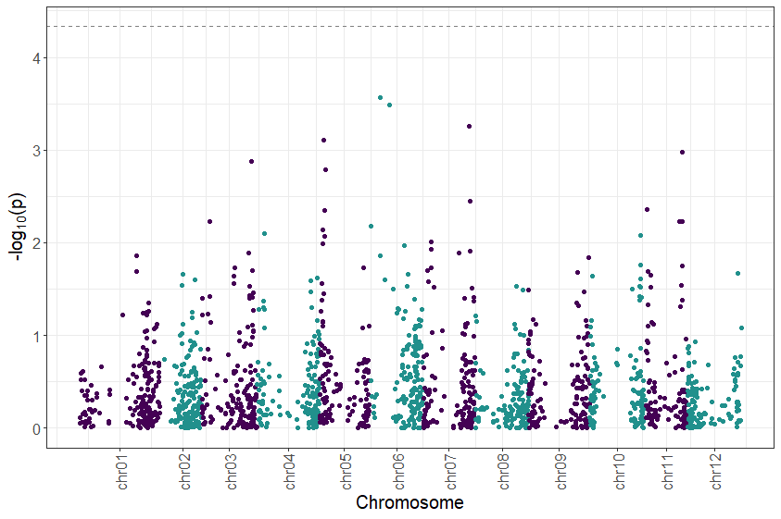
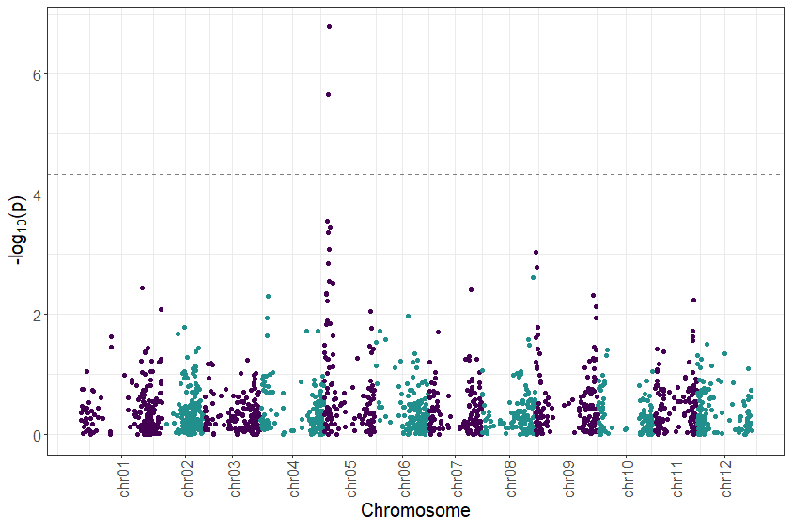
GWAS for yield
Yield Full Irritagation Treatment
Maturity
Yield Drought Treatment
Near the gene CDF1

Slide 16
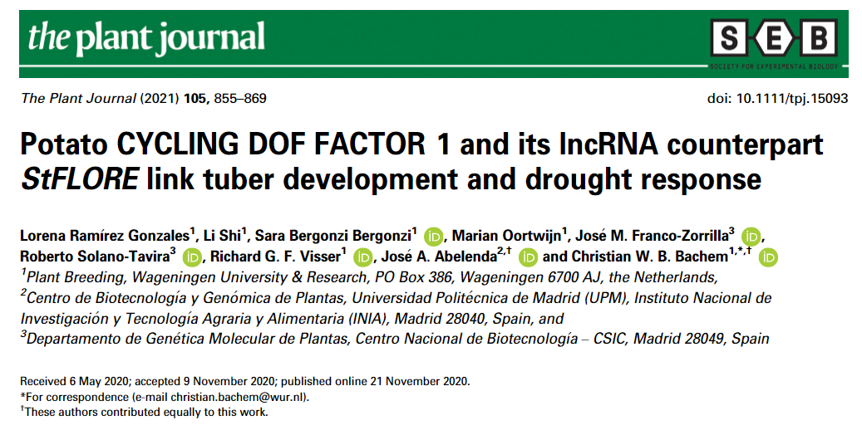
StCDF1 and StFLORE
Indirect induction of tuberization
Response to ABA
Regulation of stomata size and number
Lowest water loss
Fitness reduction under full irrigation

Slide 17
Conclusions
CDF1 appears to be important for drought tolerance.
Understand the dynamics of CDF1 for breeding.

Slide 18



Thank you!
Questions?

Slide 19
References
Bonierbale M.W., Amoros W.R., Salas E., de Jong W. (2020) Potato Breeding. In: Campos H., Ortiz O. (eds) The Potato Crop. Springer, Cham. https://doi.org/10.1007/978-3-030-28683-5_6
Corrales, A.-R., Carrillo, L., Lasierra, P., Nebauer, S. G., Dominguez-Figueroa, J., Renau-Morata, B., Pollmann, S., Granell, A., Molina, R.-V., Vicente-Carbajosa, J., and Medina, J. (2017) Multifaceted role of cycling DOF factor 3 (CDF3) in the regulation of flowering time and abiotic stress responses in Arabidopsis. Plant, Cell & Environment, 40: 748– 764. doi: 10.1111/pce.12894.
Endelman, J. (2021), Two-stage analysis of multi-environment trials for genomic selection and GWAS. Available: https://github.com/jendelman/StageWise
Gerard, D., Ferrão, L. F. V., Garcia, A. A. F., Stephens, M. (2018), Genotyping Polyploids from Messy Sequencing Data. Genetics, 210: 789-807. https://doi.org/10.1534/genetics.118.301468
Ramírez Gonzales, L., Shi, L., Bergonzi, S.B., Oortwijn, M., Franco-Zorrilla, J.M., Solano-Tavira, R., Visser, R.G.F., Abelenda, J.A. and Bachem, C.W.B. (2021), Potato CYCLING DOF FACTOR 1 and its lncRNA counterpart StFLORE link tuber development and drought response. The Plant Journal, 105: 855-869. https://doi.org/10.1111/tpj.15093

