Slide 1
Genetic Maze for polygenic traits in heterozygous polyploid kiwifruit population
Jibran Tahir (PhD Massey)
Scientist
Molecular and Digital Breeding

Slide 2
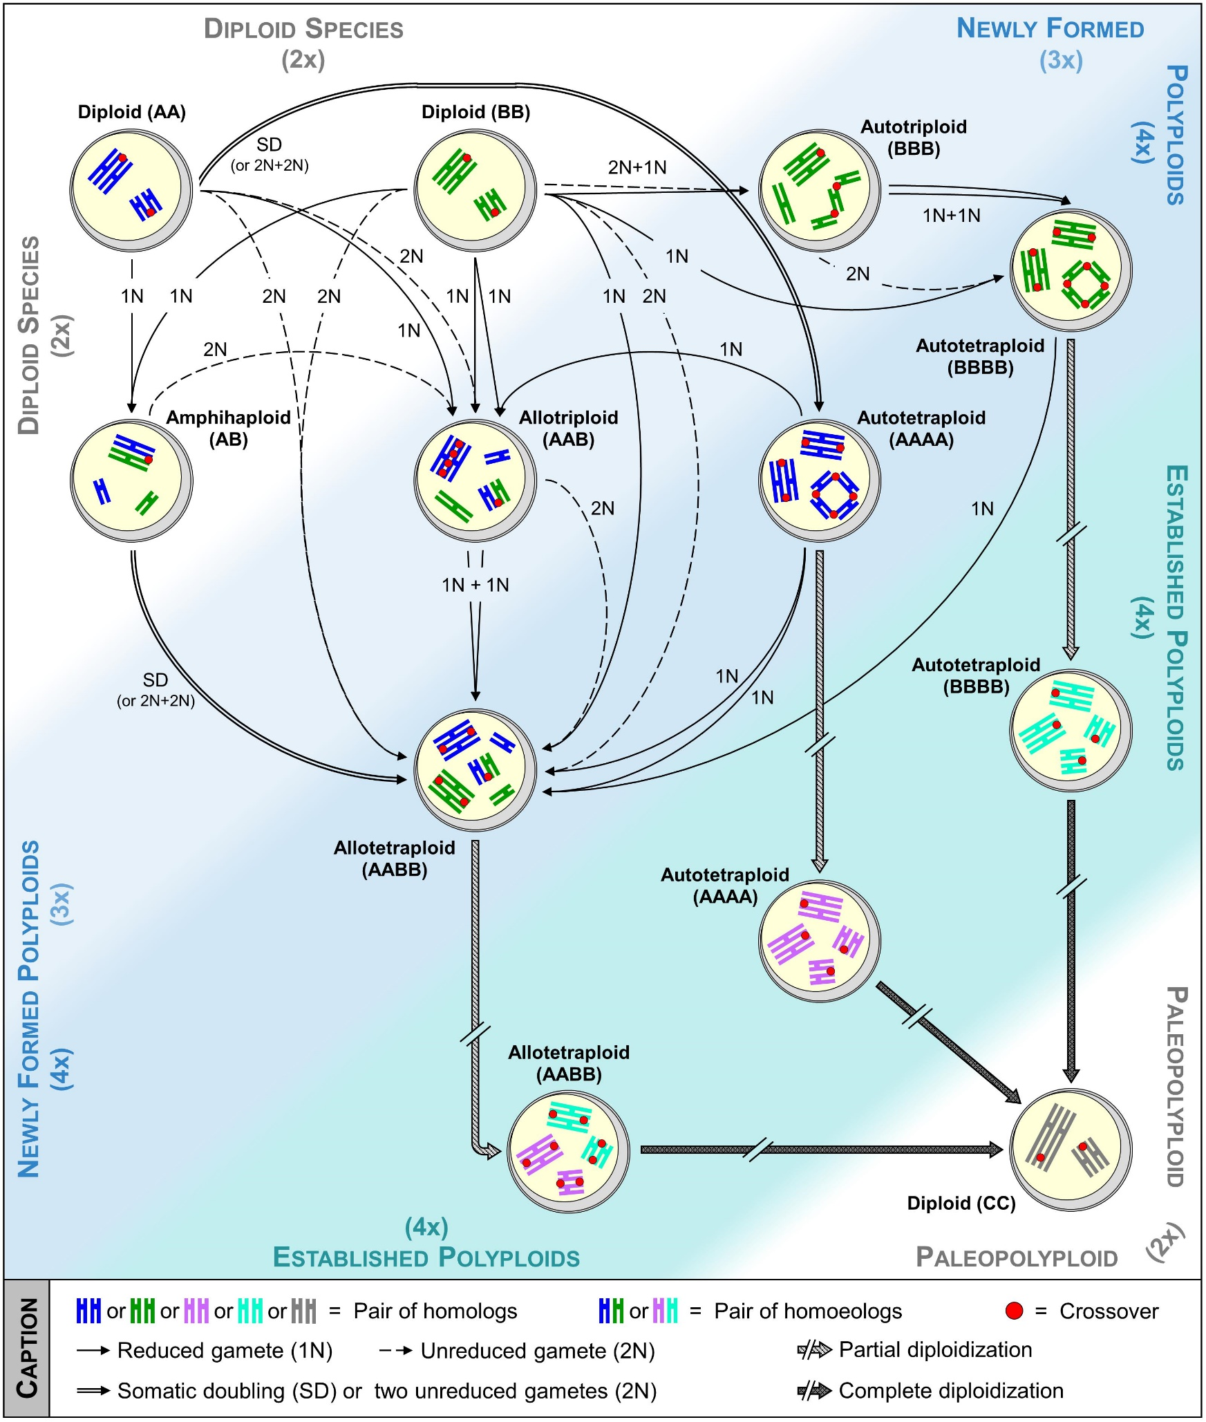
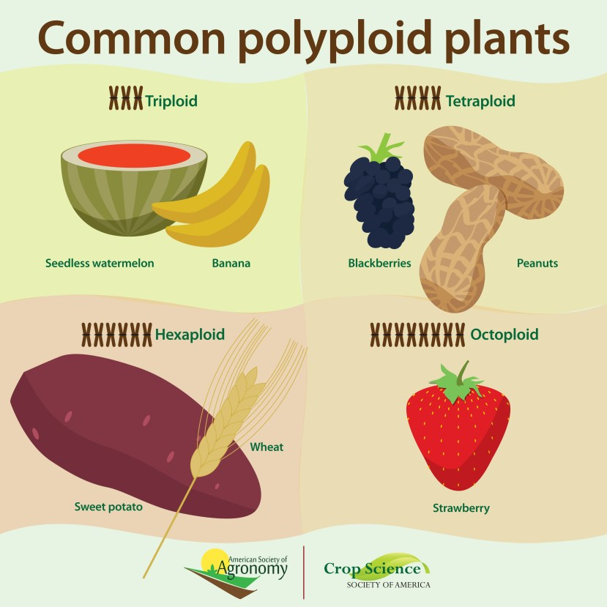
Genome cocktails and ploidies
https://sustainable-secure-food-blog.com/2019/05/07/polyploidy-or-how-do-we-get-seedless-fruit/
Pelé A, Rousseau-Gueutin M and Chèvre A-M (2018) Speciation Success of Polyploid Plants Closely Relates to the Regulation of Meiotic Recombination. Front. Plant Sci. 9:907. doi: 10.3389/fpls.2018.00907

Slide 3
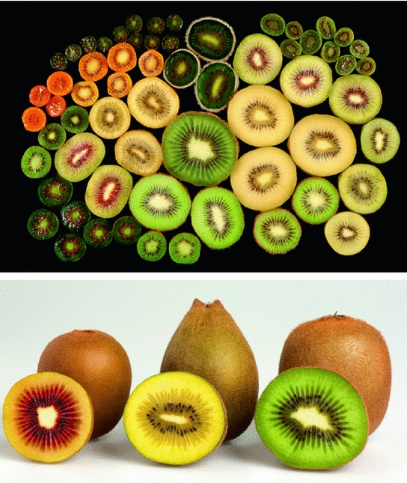

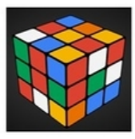
Actinidia
Ploidy stair in the genus: 2x,4x,6x,8x, 10x
Dioecy
High heterozygosity
29 Chromosomes/ Linkage groups
Kiwifruit- Outcrossing polyploid
Commercial -Actinidia chinensis 2x, 4x, 6x

Slide 4
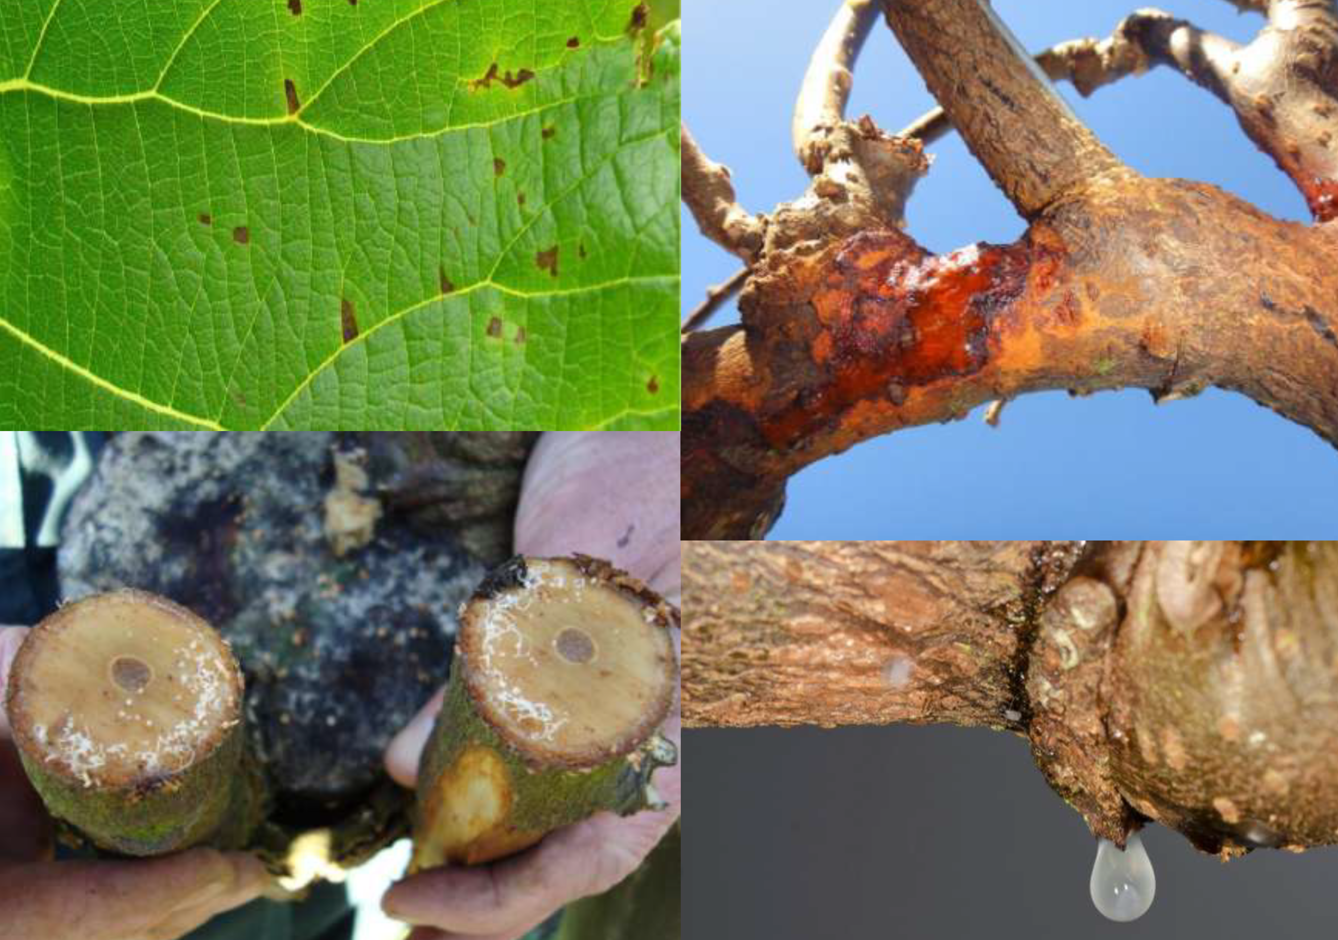
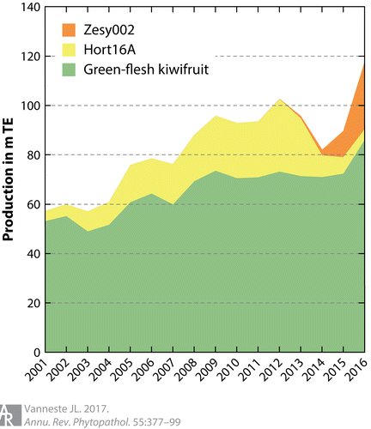
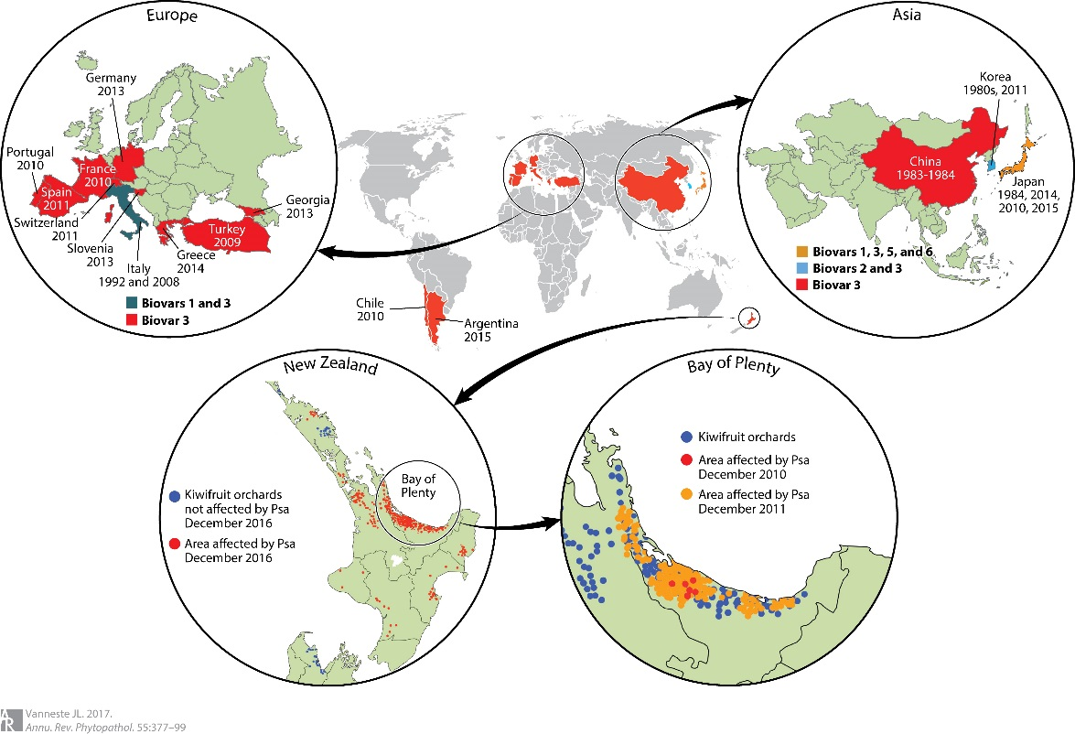
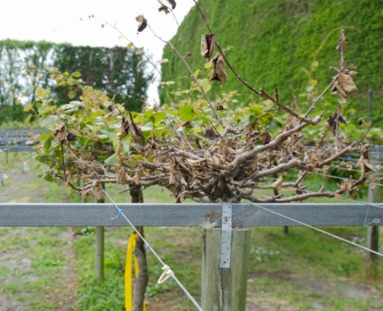
Psa biovar 3 disease –a global challenge for kiwifruit
Disease responses due to Psa Biovar 3 infection
Economic impact
1. Actinidia chinensis 2x….> 4x
2. Psa-resistant males selected

Slide 5
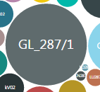
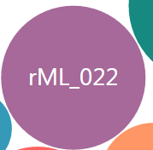
Scheme for mapping Psa resistance in tetraploid (4x) kiwfruit
2x
4x
Biallelic SNPs
Hort16A x P1
Yellow x P2
0
1
2
3
4
Pop. Size = 230
Replicated 10x (1yr)
Planted at TePuke
Phenotyping 2017-2019
Pop. Size = 230
Replicated 10x (1 yr)
Planted at TePuke and KK
Phenotyping 2018-2020
aaaa
Aaaa
AAaa
AAAa
AAAA
5 different marker dosages in tetraploid

Slide 6
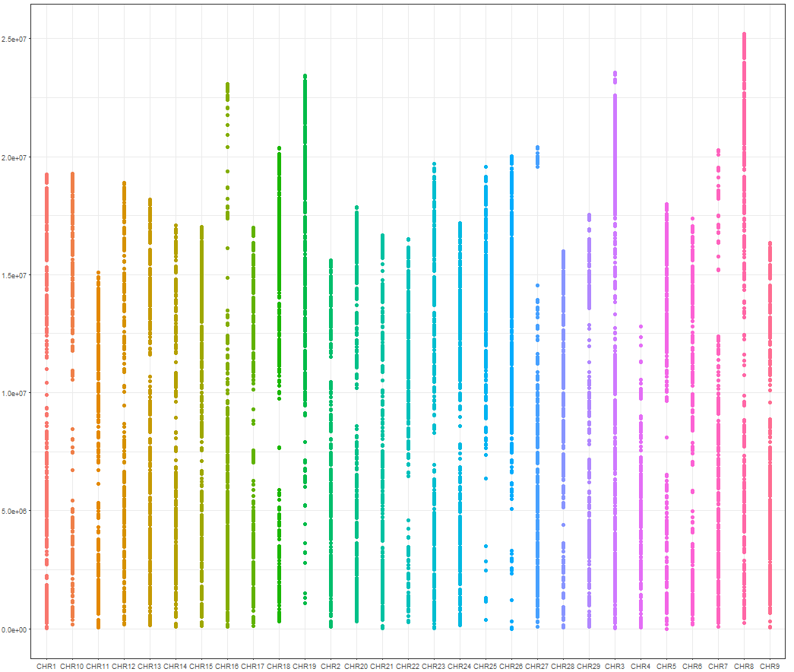
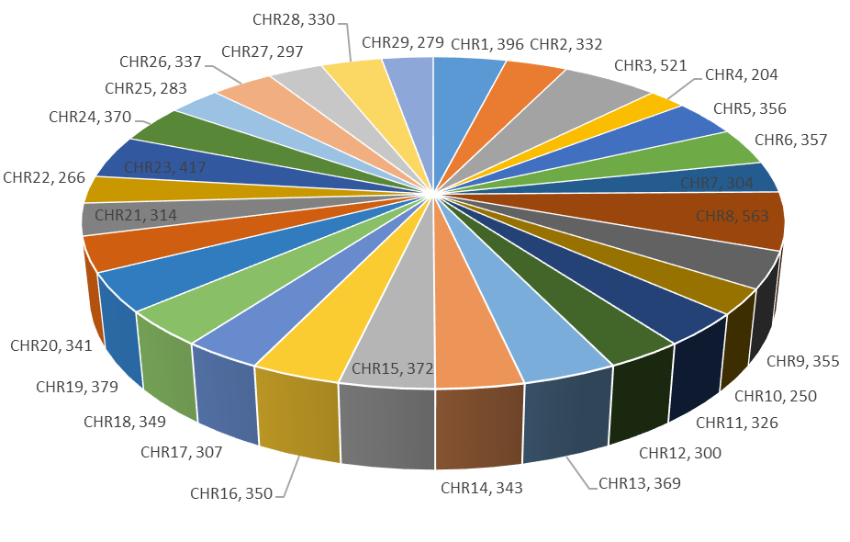
Capture Sequencing using 10K baits at Rapid G
Exome-120 bp
basepairs
Mean and median depth of 120x and 111x across baits, respectively.
Within this dataset, a total of 725,175 raw SNP variants detected
Chromosomes

Slide 7
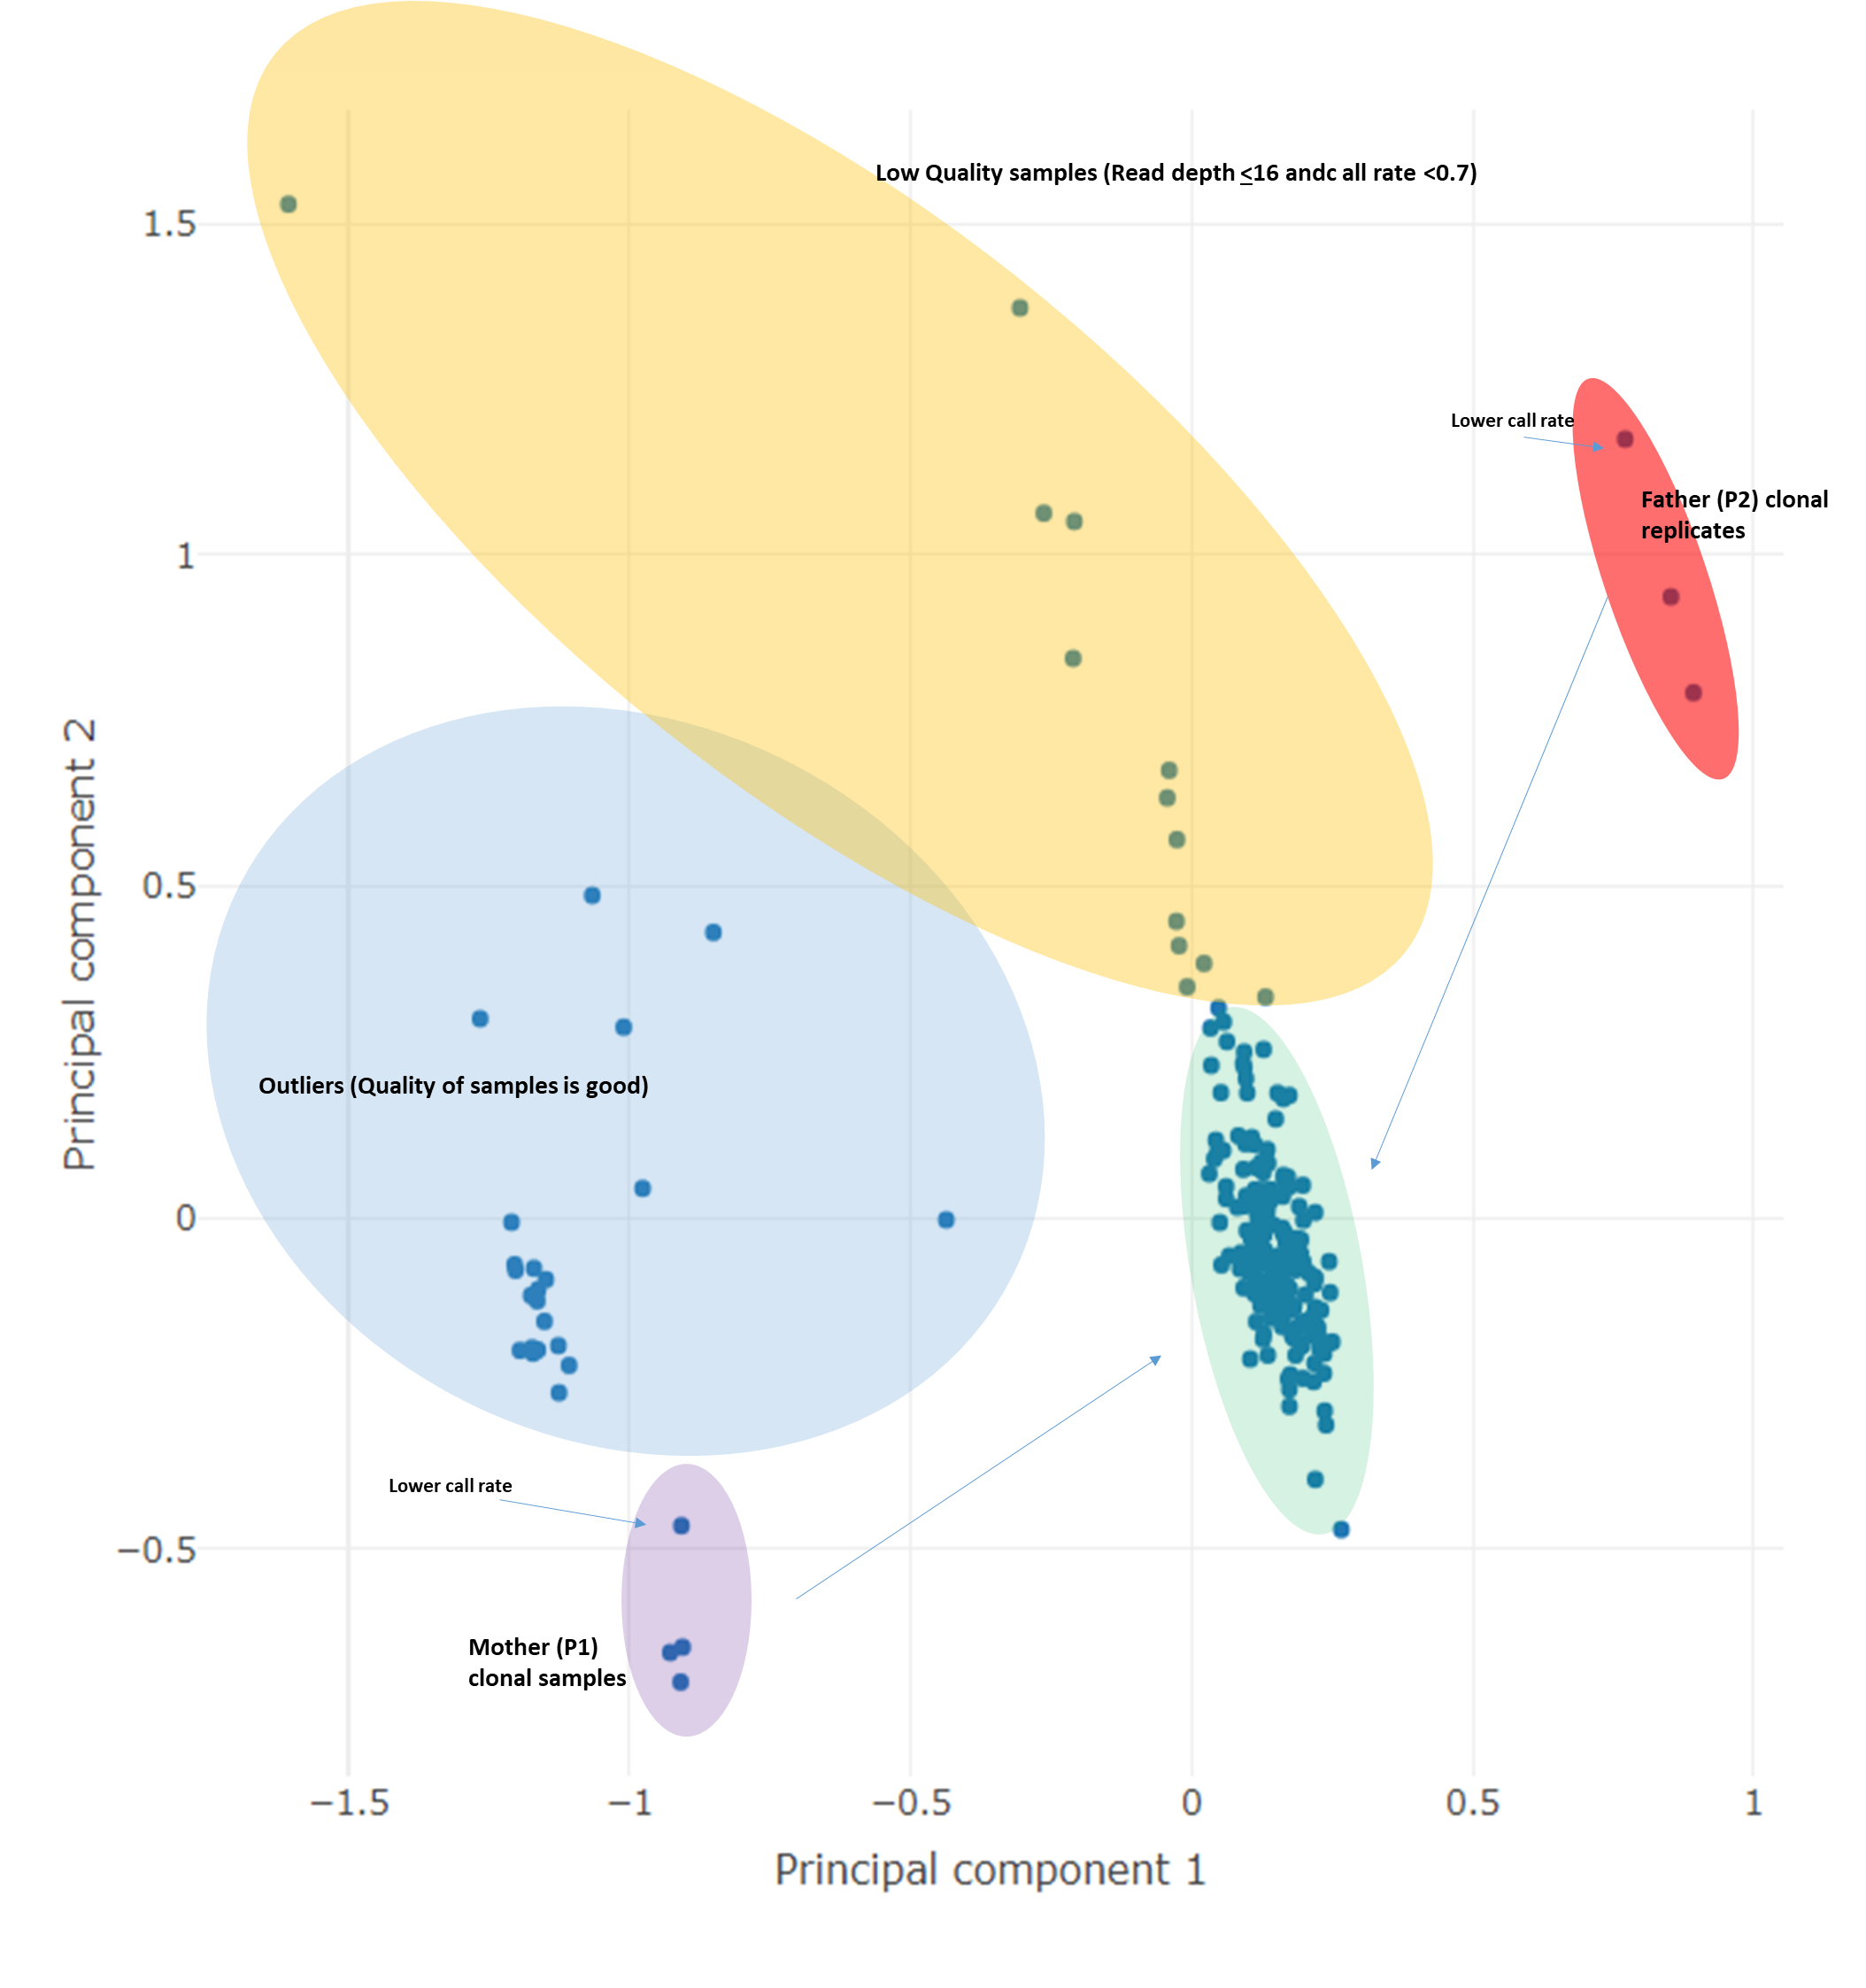
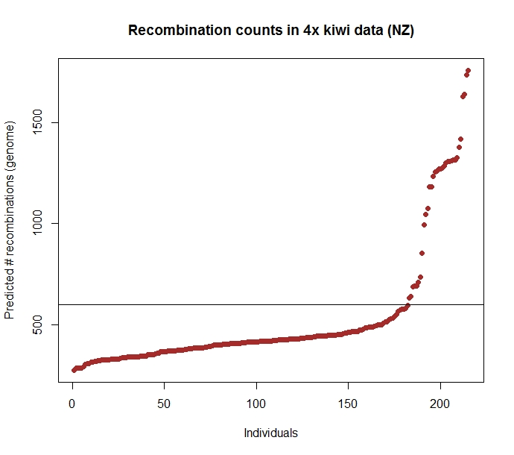
Estimates for self-relatedness in the population - outliers
polymapR
188 true hybrids with high-quality sequence data for variant selection
KGD

Slide 8
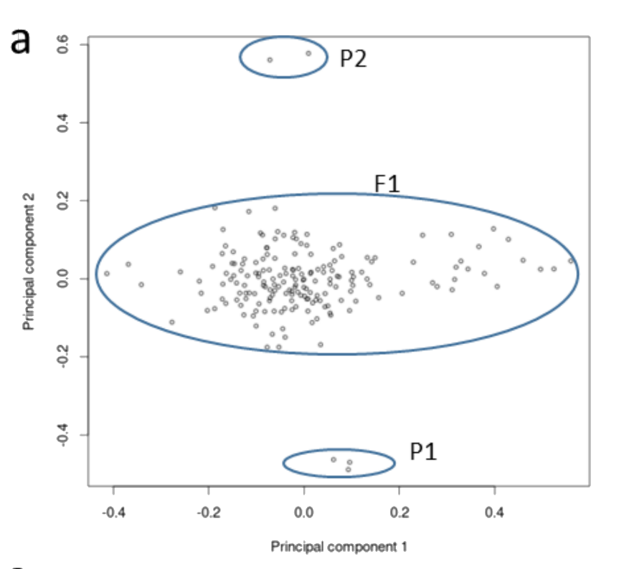


Allele frequencies and dosage estimates
Frequency peaks of
heterozygous alleles/haplotypes
(1/2, 3/4 and 1/4)
Frequency peaks of homozygous alleles/haplotypes (0/0 and 1/1)
AAAA and AAAa
AAAA, AAAa and AAaa
AAAA , AAAa, and AAaa
biases or over-dispersion for this particular SNP and hence qualifies for removal

Slide 9
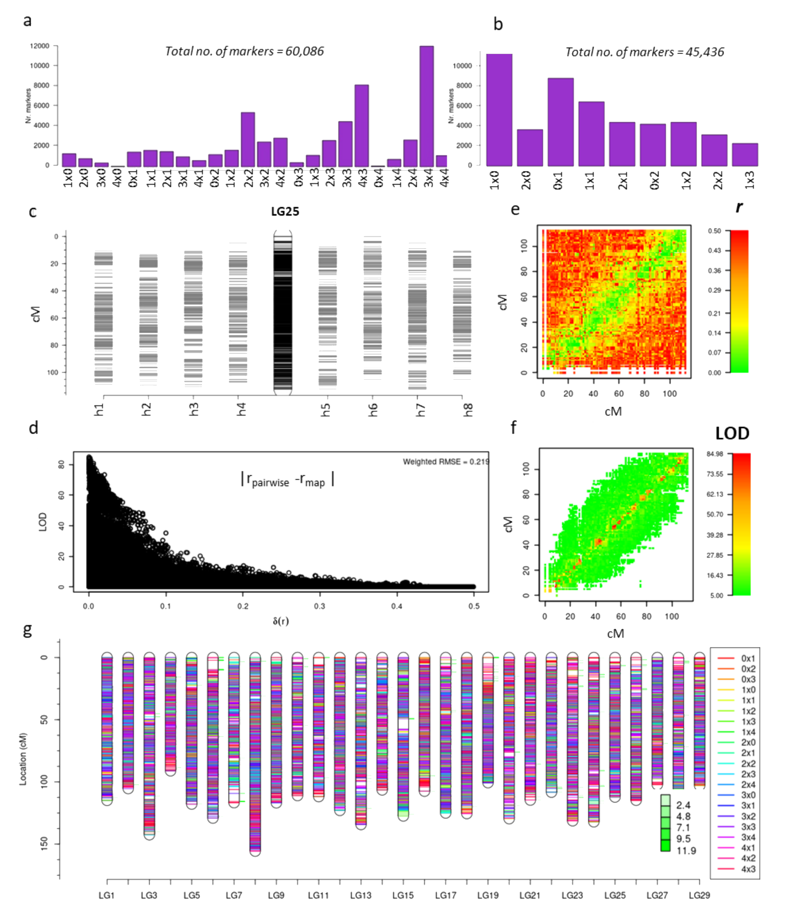
Biallelic markers and types
Subsequent filtering of SNPs using Updog for a range of quality metrics, such as allele bias, over-dispersion and sequencing error rate, resulted in 60,006 usable bi-allelic markers representing 24 different marker types
After applying standard quality checks (including skewness, missing values at a threshold of 0.1 and duplication in individuals and markers) in polymapR
re-coded to 9
For example, a marker which segregates as ‘0 × 1’ will segregate similarly to a marker with a segregation type of ‘3 × 4’

Slide 10
Linkage maps
Initial construction of the expected 116 homologues (29 chromosomes × 4 homologues) was achieved using
- 19,563 homologue-specific simplex × nulliplex
4215 duplex × nulliplex
4035 simplex × simplex …….Finally, more complex allelic segregation types, such as
  simplex × triplex (1514),
  simplex × duplex (4663) and
  duplex × duplex (953) markers were added to improve the marker density of the maps and calculate the phase of each homologue.
A total of 39,322 markers were assigned across the 29 LGs, making this one of the highly dense linkage maps published for a polyploid species

Slide 11

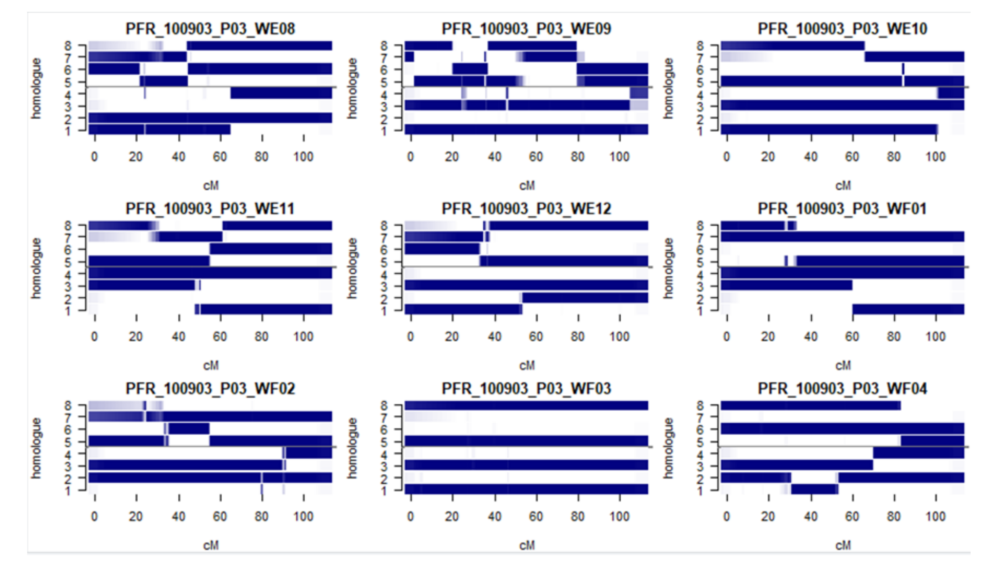

Map checks
Marker distribution across homogloues
IBDs (identity-by-descent)
Estimates of recombination frequencies and LODs associated

Slide 12
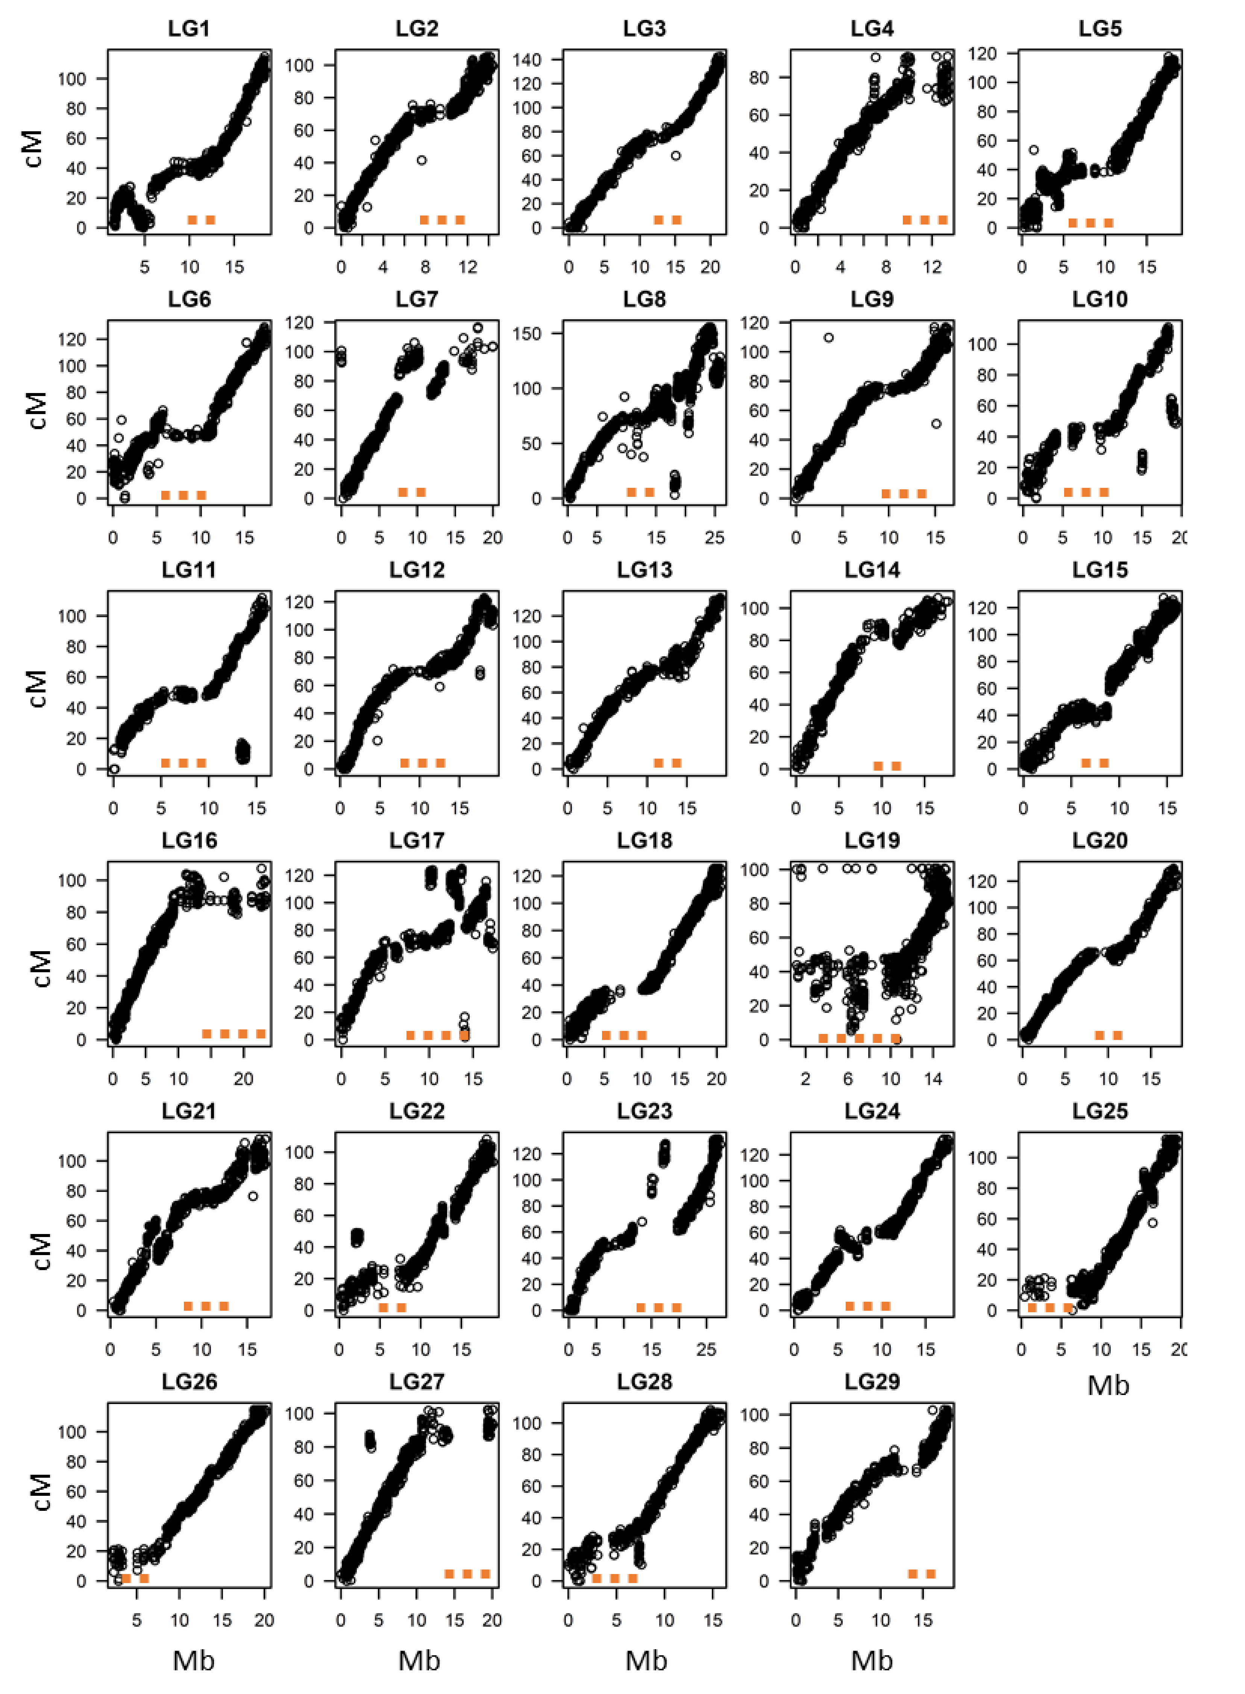
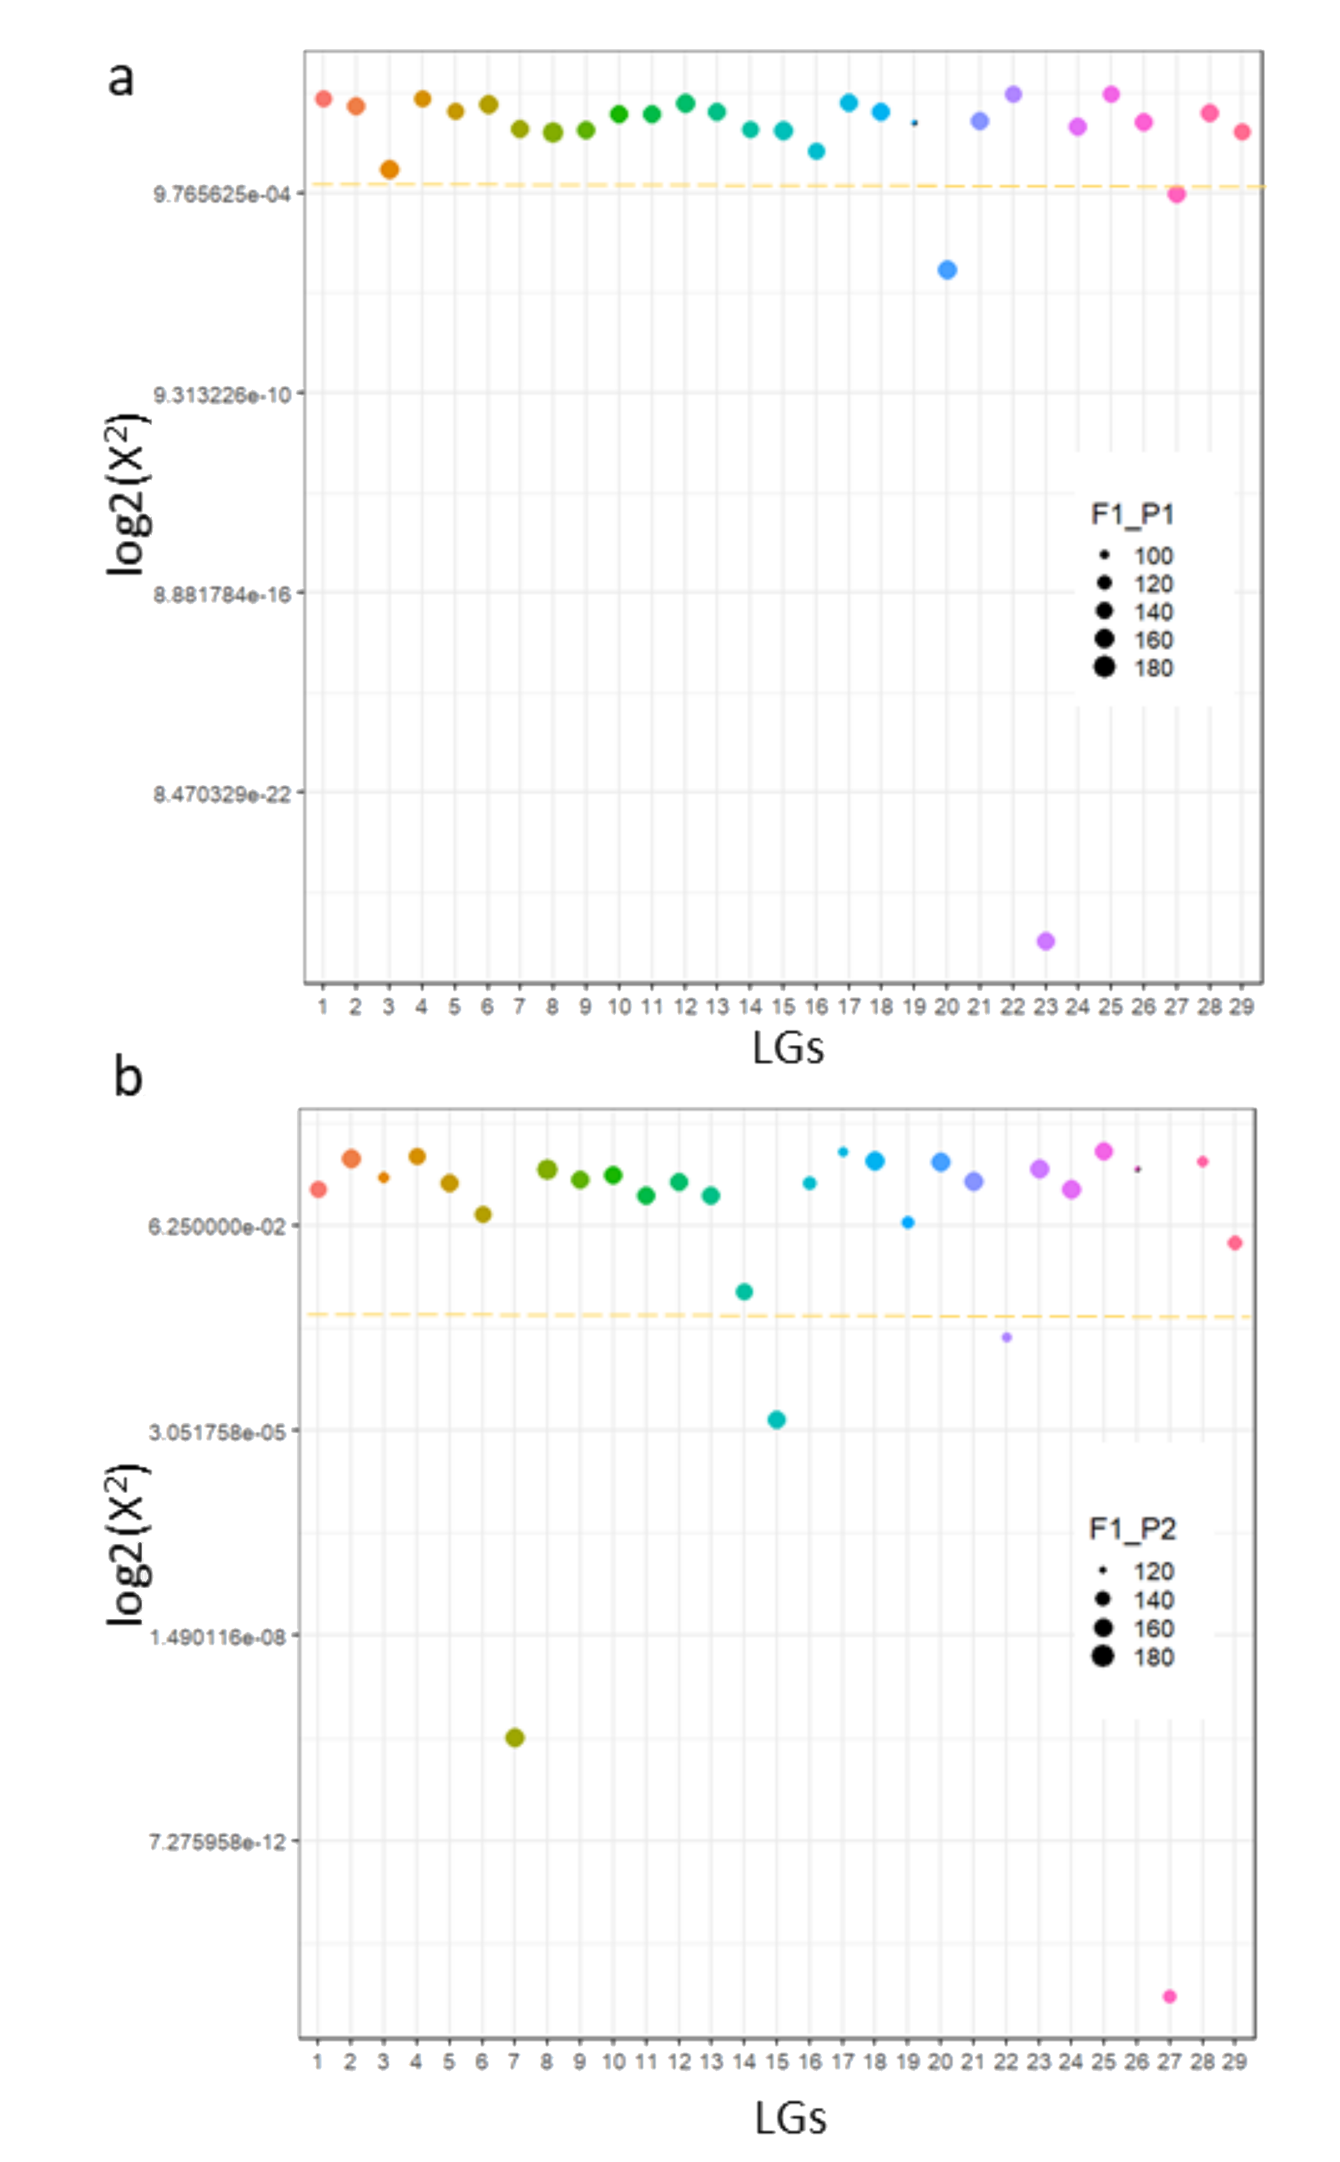
Synteny between the physical and the genetic maps and quantification of chromosomal pairing
polysomic
preferntial
Pairing is calculated by X² values generated by polyqtlR for each LG in each parent, with an arbitrary threshold of X² < 0.001 set as indicative of preferential pairing. This is represented by the yellow dotted line and LGs above it are considered to show polysomic inheritance whereas LGs below it are likely to be disomic.

Slide 13
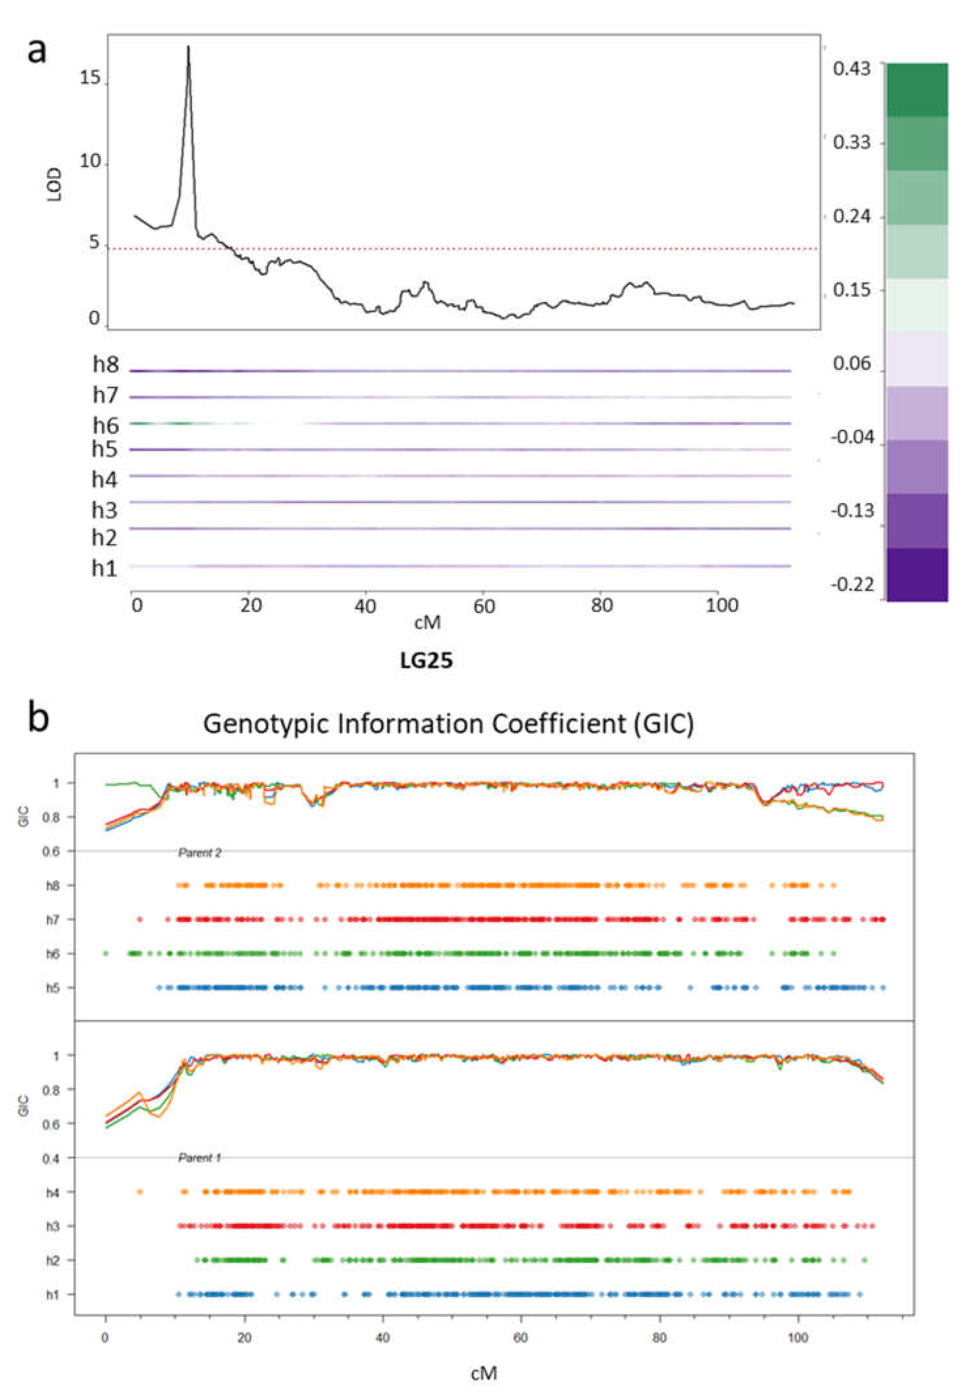
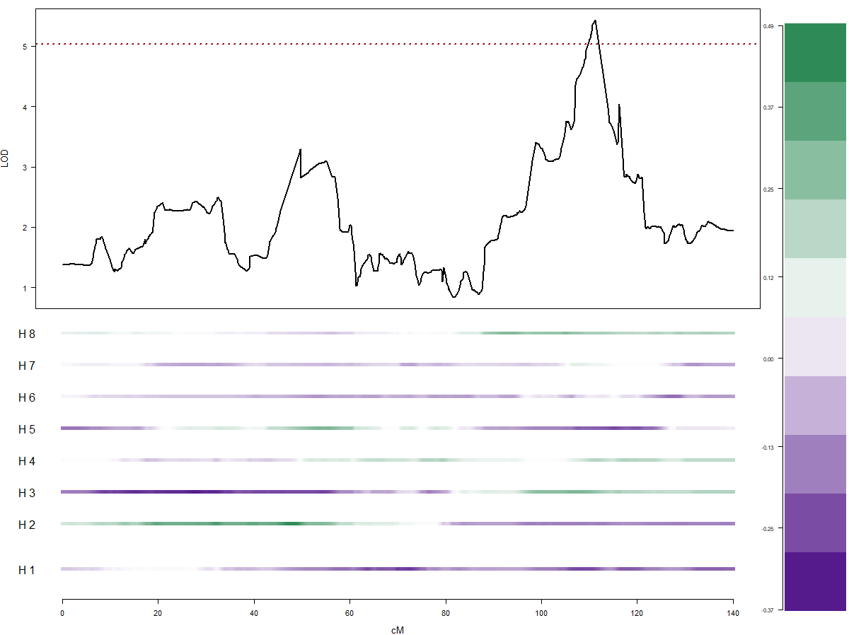
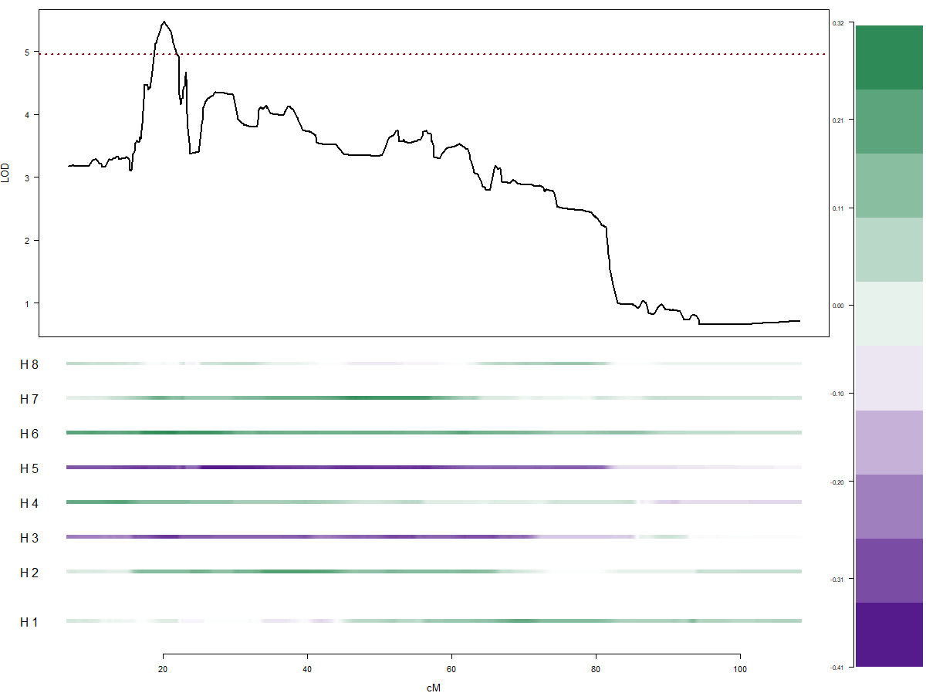
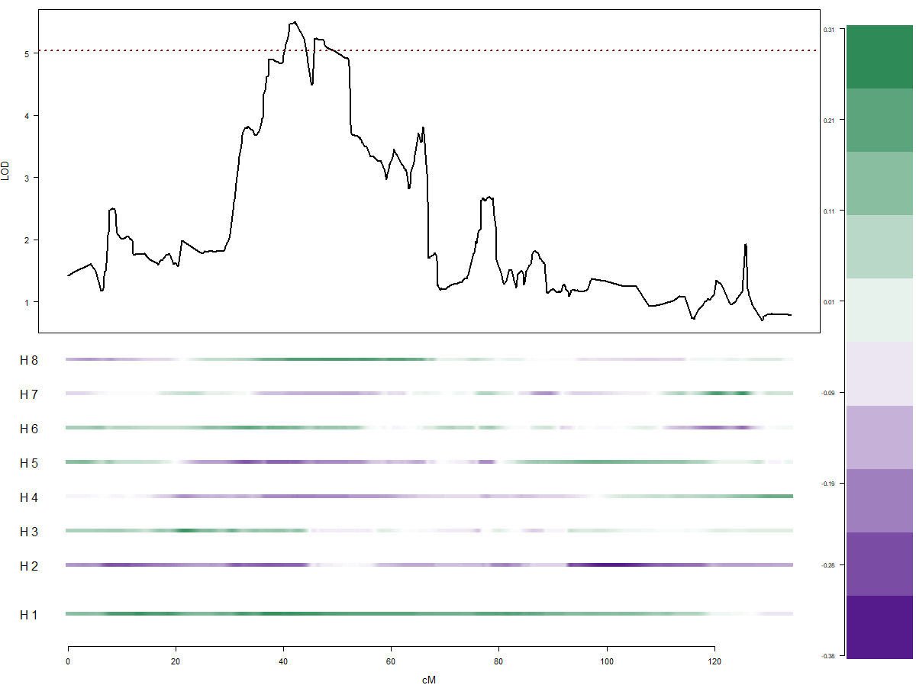
QTL mapping for sex (mendelian) and flowering (polygenic)
Sex
Early Flowering
LG3
LG22
LG13

Slide 14
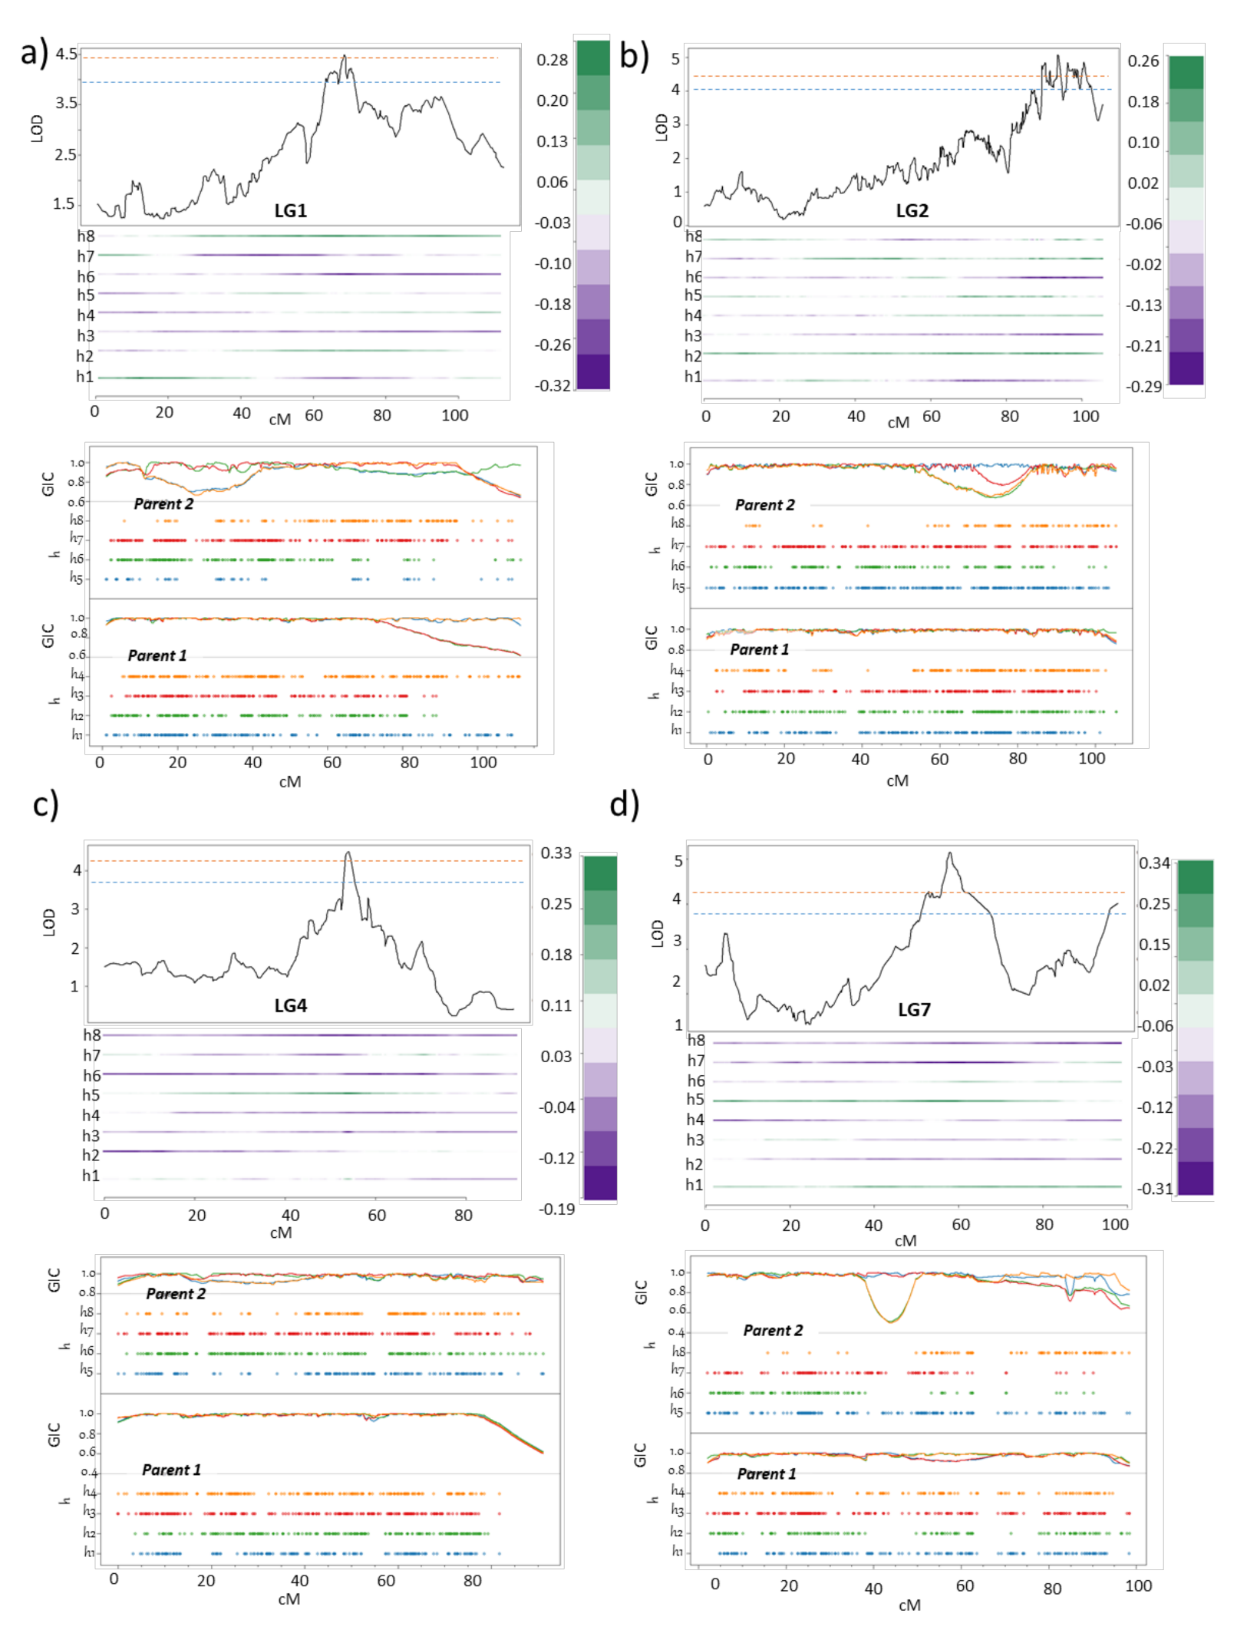
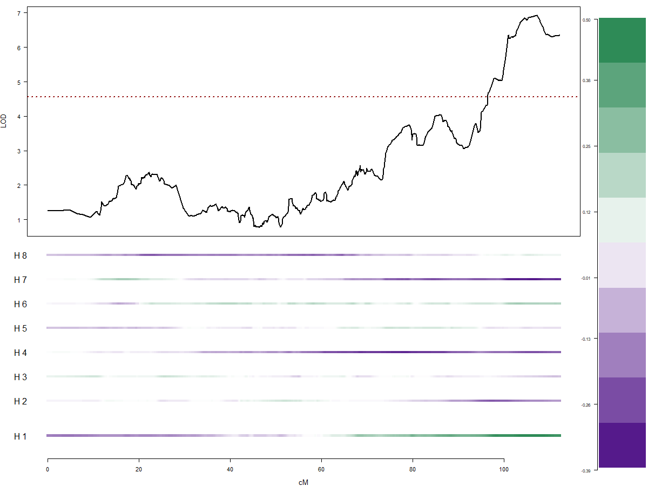
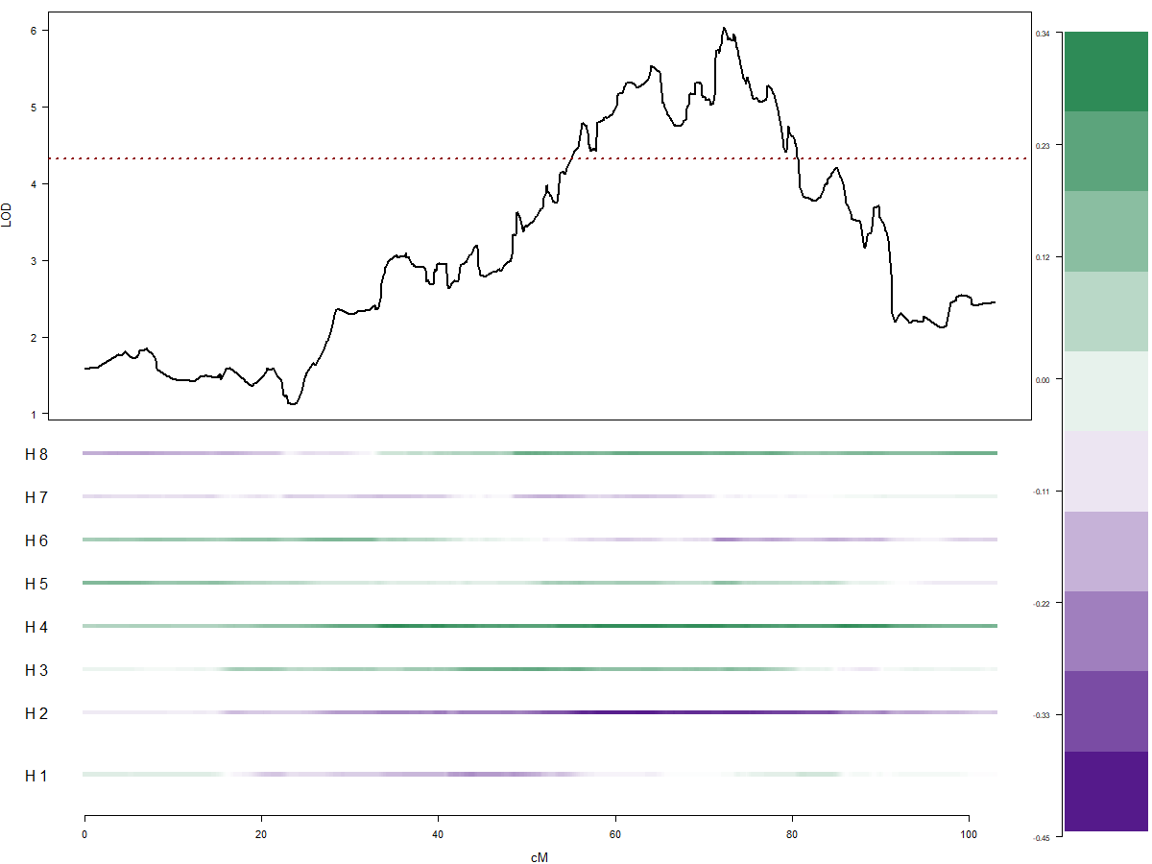
QTL mapping for Psa tolerance (polygenic)
Field Psa tolerance
Stab- tissue specific Psa tolerance
LG25
LG29
To determine if the field QTLs act in combination in delivering quantitative resistance we next calculated the percentage variance explained combined, to assess the additive effect of all four QTLs in combination. The 4-QTL model (Q1(LG1)_Q2(LG2)_Q3(LG4)_Q4(LG7)) indicated a total PVE of 34. We suggest that the four QTLs act in combination in the progeny to provide a more robust QR against Psa in the field.

Slide 15
The next maze- application in breeding programmes
Polygenic trait-Multiple genes can have variable effects (additive or negative).
Being an outcrossing tetraploid species brings two major challenges- allelic variation due to polyploidy and multiple allelic combination from various genes could have different effects.
Lack of power to detect QTLs that have small effects on highly polygenic traits.
Difficulties in incorporating epistatic, environmental and complex phenotypic trait interactions into QTL mapping strategies
Being an outcrossing species, genetic markers found to be associated with the trait from linkage analysis and QTL mapping in backcrosses, will need to be tested in outcrosses to validate effects due to allelic variation in different populations.

Slide 16
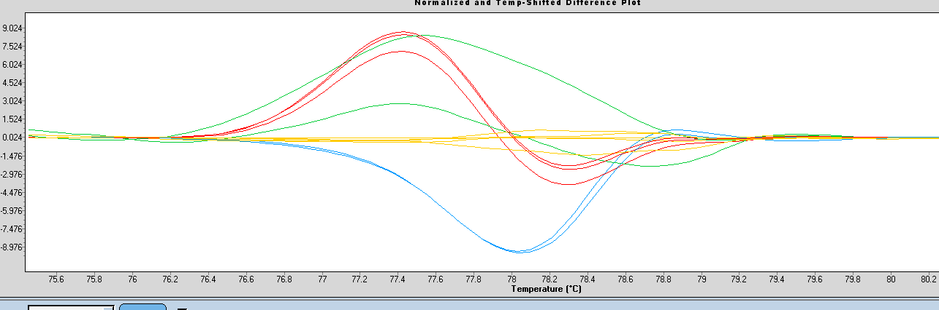
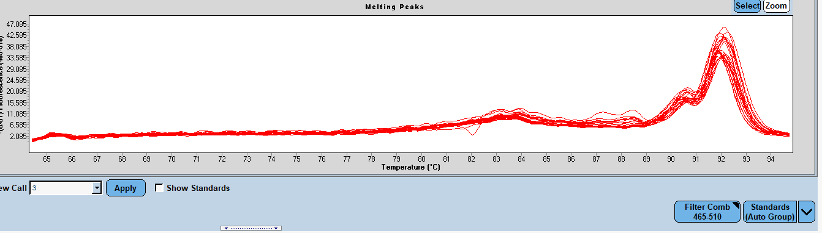
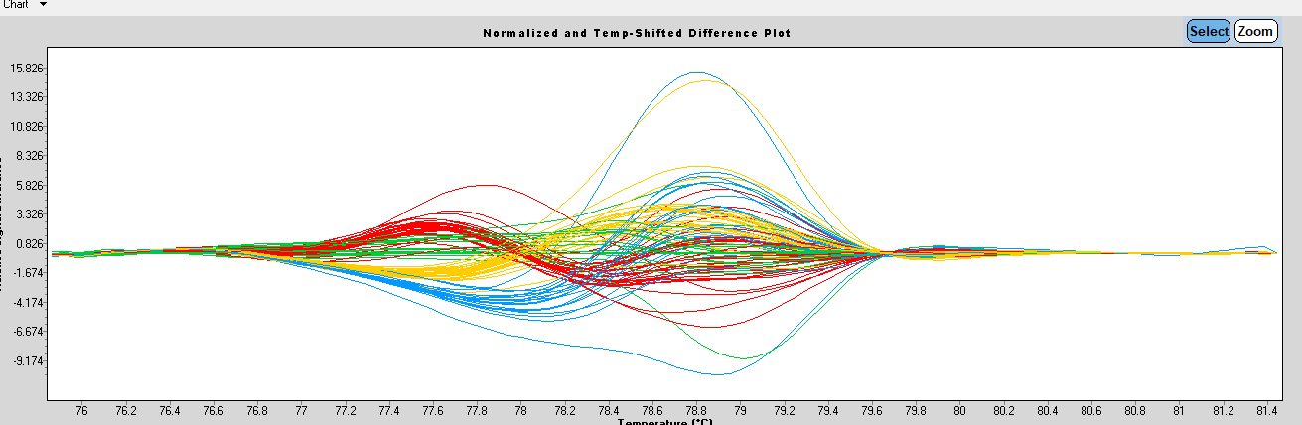
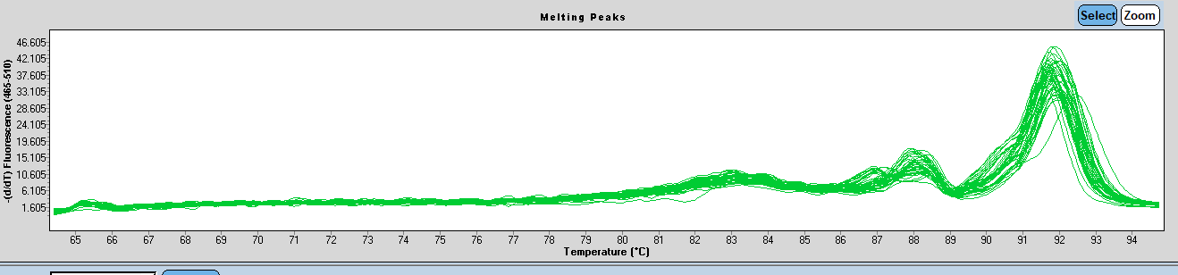
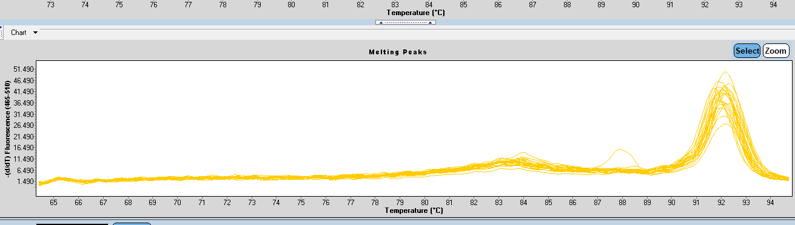
Using Captureseq data developed -SNP markers at QTLs
Chr 1 (Gene Acc00962/ Position 15,052,859 -15,053,019 bp)
Chr2 (Gene Acc02448/ Position 13,387,212 -13,387,334 bp)

Slide 17
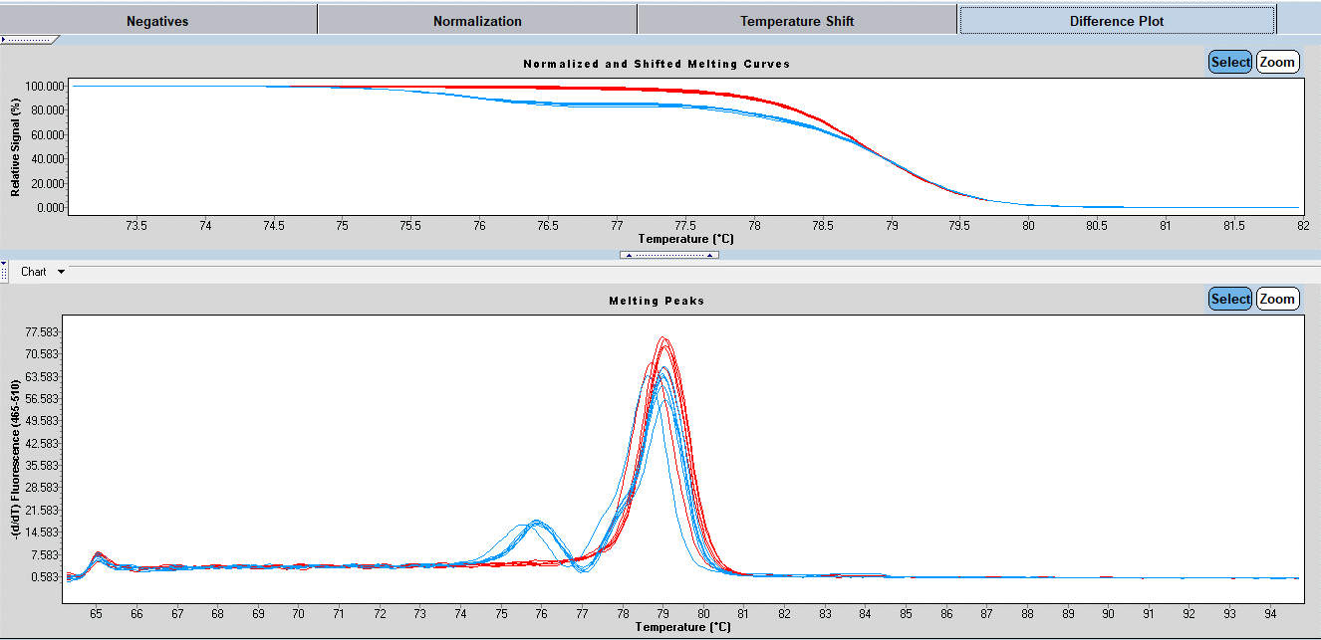
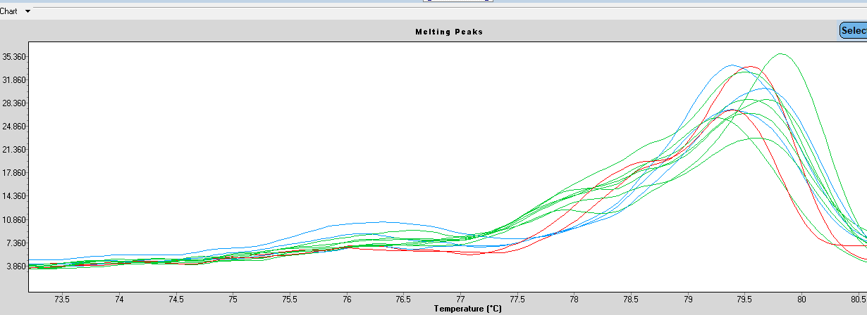
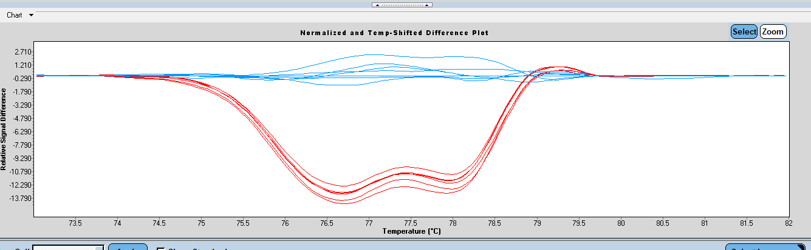
Using Captureseq data developed -SNP markers at QTLs
Chr4 (Gene Acc04887/ Position 5,916,952 -5,917,052 bp)
Chr7 (Gene Acc07789/ Position 6,784,163 -6,784,243 bp)

Slide 18
Allelic combination (pair and tri-wise) and associated phenotypes
Discalimer: All allelic combinations do not represent same number of F1 individuals

Slide 19
Allelic combination and corresponding % population showing better mean Psa tolerance
Pair-wise | Genotypes for corresponding Mean of Psa means under threshold | % of total population
Chr1_2 | 29 | 18.1
Chr1_4 | 28 | 17.5
Chr1_7 | 68 | 42.5
Chr2_4 | 52 | 32.5
Chr2_7 | 17 | 10.6
Chr4_7 | 53 | 33.1
Tri-wise | Genotypes for corresponding Mean of Psa means under threshold | % of total population
Chr_1_2_4 | 62 | 38.75
Chr_1_2_7 | 53 | 33.1
Chr_1_4_7 | 61 | 38.1
Chr_2_4_7 | 56 | 35

Slide 20
Allelic combination (tetra-wise) and associated phenotypes
Tetra-wise | Genotypes for corresponding Mean of Psa means under threshold | % of total population
Chr_1_2_4_7 | 79 | 49.3
Due to more than 60 allelic combinations, the genotypes segregates into smaller clusters of allelic combinations, with not more than 9 genotypes max in a cluster. We therefore run into another problem -“ enough representability of genotype classes problem” . We need higher numbers for each allelic combination to validate the effect ~100- 500

Slide 21
Outcome and next....
Our data led towards mapping some crucial traits for a commercially important fruit crop, which is now helping us to study other key traits in Actinidia polyploids in the breeding programme.
Dearth in the literature around marker assisted selection in outcrossing tetraploid species for polygenic traits and our work indicates that there is a strong limitation in validating the genetic origins of complex traits in genome cocktails.
Nevertheless there are other ways emerging to look into such a complexity.
  Boyle EA, Li YI, Pritchard JK. An Expanded View of Complex Traits: From Polygenic to Omnigenic. Cell. 2017;169(7):1177-1186. doi:10.1016/j.cell.2017.05.038

Slide 22

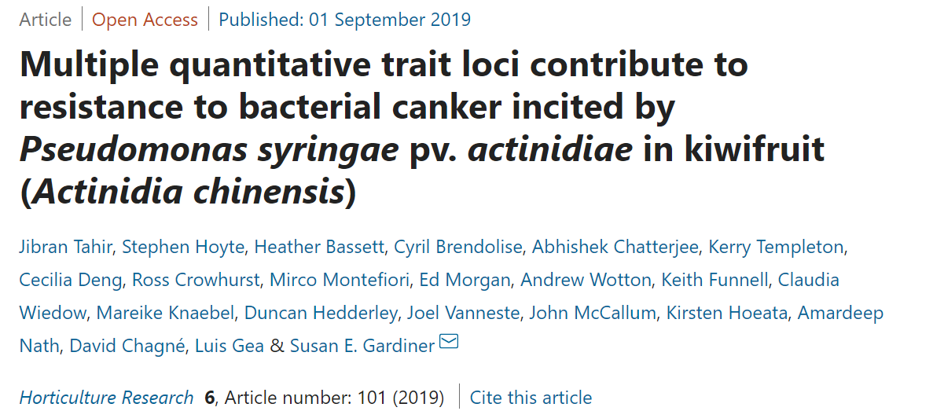
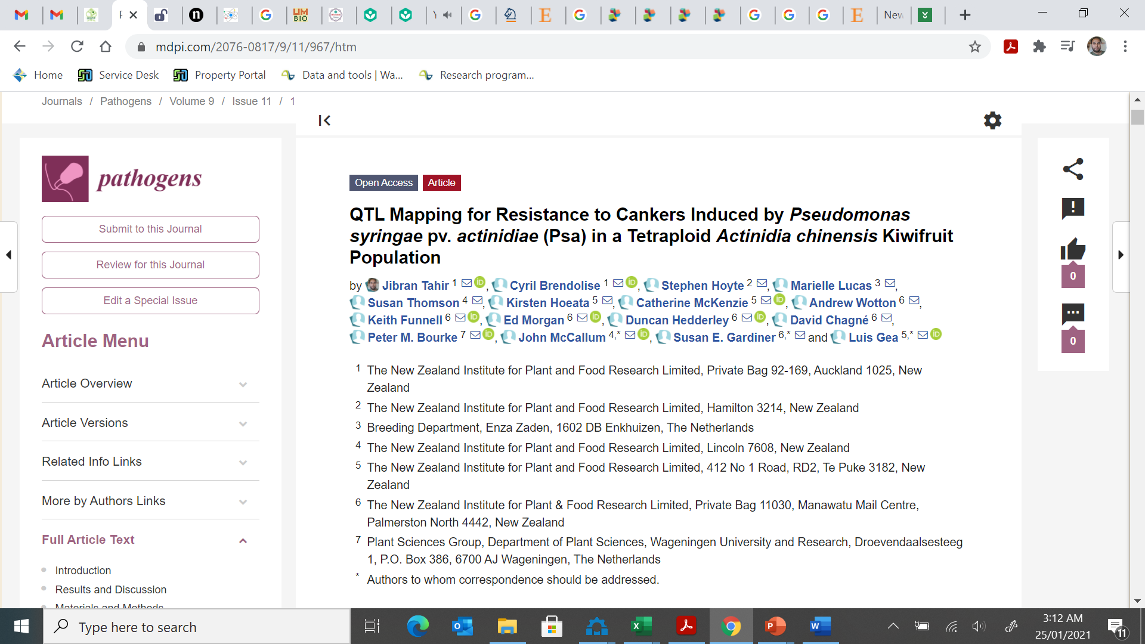
Acknowledgements
Key authors: Susan Thomson, John McCallum, Cyril Brendolise, Luis Gea, David Chagné, Susan E. Gardiner
Peter Bourke (Wageningen University and Research /polymapR, polyqtlR)
David Gerard, American University, Washington (UpDog software for dosage estimates)
Brian J. Knaus, Oregon State University (vcfR package).
Post-doctorate
fellowship
Plant and Food Research (Vine Characterisation Programme, Kiwifruit Royalty Investment Programmes) WUR (Novel genetic and genomic tools for polyploid crops,

