Slide 1


Tools for Genomics-Assisted Breeding of Polyploids: Development of a Community Resource

Slide 2
Introduction: Tools for Genomics-Assisted Breeding in Polyploids
David Byrne
  Professor
  Basye Endowed Chair in Rose Genetics
  Rosa and Prunus Breeding
Texas A&M University
  Horticultural Sciences
  College Station, TX
Toolsforpolyploids@tamu.edu
This project is funded by USDA NIFA Specialty Crop Research Initiative Award # 2020-51181-32156 (09/01/20 - 08/31/24)

Slide 3









OBJECTIVE 1
Develop computational tools for genomics-assisted breeding in polyploid crops
Enhanced methods for genome-wide association studies
Linkage and QTL analysis in multi-parent populations
Polyploid haplotype assembly from short reads
OBJECTIVE 2
Validate computational tools in public breeding programs
Allele dosage assignment
Genome-wide association
Linkage and QTL analysis
Genomic selection
Sequence-based haplotyping
Research and Development
Use and Validation
OBJECTIVE 3
Train polyploid crop breeders to use and validate computational tools
Documentation for computational tools
Workshops and short-courses for polyploid crop breeders
Polyploid Breeding Community Resource website
Training and Outreach
Polyploid Crops Community of Stakeholders
This project is funded by USDA NIFA Specialty Crop Research Initiative Award # 2020-51181-32156 (09/01/20 - 08/31/24)

Slide 4












Project Members

Slide 5























Other Collaborators
Neuhouse Farms
Woolf Roses L.L.C.

Slide 6
Who is the Polyploid Crop Community?

Slide 7
Age of Participants: Most in 20s and 30s
Equally distributed between female and male
Notes:
2021 – 64% under 40
2020 – 69% under 40

Slide 8
Participants in Training Workshop

Slide 9
Location of Participants
2021 – 45% International, 2022 – 55% international

Slide 10
Participant Expertise Represented

Slide 11
Crops Represented

Slide 12
Ploidy Levels Represented
Frequently work on multiple ploidy levels

Slide 13
Use of software?

Slide 14
Software Familiarity
2021 – average of 10% familiar with the software
2022 - Average of 21% familiar with the software

Slide 15
Use of Genomics-Assisted Breeding
Is it increasing?

Slide 16
Molecular marker use – Parental selection

Slide 17
Molecular marker use – Seedling selection

Slide 18
Molecular marker use – Genomic selection

Slide 19
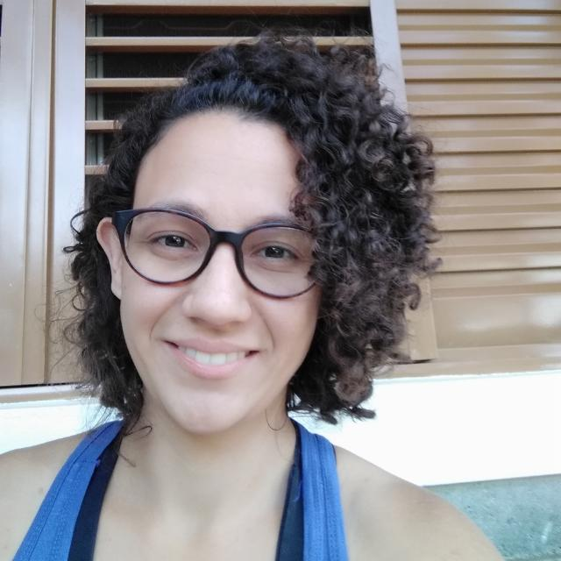
Computation Sessions
December 7th, 14th, and 21st
Consultants
  Maria Caraza-Harter
  Gabriel Gesteira
  Jeekin Lau
  Cristiane Taniguti
Question and Answers
  Slack channel
  Software installation

Slide 20
Tools for Polyploids Training Workshop
Elements
Major Training Presentations
  Software Updates (13th)
    Mapping and QTL software
    Comparison of software
  New Software (14th)
    Simulation Tools
    Haplotype Assembly
    Genomic Selection
  Office Hours
User Interactions
  Oral presntations (9)
  Poster presentations (16)
  Increase networking within the polyploid breeding community

Slide 21


Workshop Agenda – January 13th
Introduction
  David Byrne - Introduction
  Dorrie Main, Delany Baum – Polyploid Community Resource website
Software Updates
  Peter Bourke – polymapR/polyqtlR
  Marcelo Mollinari – MAPpoly/QTLpoly
  Jeff Endelman – GWASpoly
  Jeekin Lau – Software comparisons
Office Hours
  Breakout rooms
This project is funded by USDA NIFA Specialty Crop Research Initiative Award # 2020-51181-32156 (09/01/20 - 08/31/24)

Slide 22
Workshop Agenda – January 13th
User presentations
Author | Title
Jibran Tahir et al. | Genetic Maze for polygenic traits in heterozygous polyploid kiwifruit populations
Paterne Agre et al. | Identification of QTLs controlling resistance to anthracnose disease in water yam
Cris Taniguti | Reads2Map: Practical and reproducible workflows to build linkage maps from sequencing data
Alejandro Thérèse Navarro et al. | Smooth Descent: a ploidy-agnostic algorithm to improve linkage mapping in the presence of genotyping errors
Mason Chizk et al. | Novel genomic resources enable association mapping in tetraploid blackberry
Notes:
Tahir New Zealand
Agre – Nigeria, IITA
Taniguti – TAMU
Navarro – Wageningen
Chizk – U Ark

Slide 23
Workshop Agenda – January 13th
Poster presentations
Breakout Room | Author | Title
#4 | Simon Fraher et al. | QTL analysis of the “Tanzania” x “Beauregard” sweetpotato mapping population for resistance to Meloidogyne enterolobii
#5 | Jose Guillermo Chacon et al. | Octoploid strawberry linkage map from reduced representation sequencing SNP markers
#6 | Jeewan Pandey et al. | Genomic prediction for yield and processing traits in the tetraploid potato
#7 | Ao Jiao et al. | Exploring the genetic control of potato tuber dormancy
#8 | Ira Herniter and Nicholi Vorsa | Development of genomic resources for cultivated blueberry
#9 | Beatriz Tome Gouveia et al. | Improving zoysiagrass for drought tolerance across the southern USA
#10 | Sanjeev Gautam et al. | Genome-wide association study on potato tuber defects under heat stress
#11 | Christopher Benson et al. | Sequenced genomes of allotetraploid Poa annua and its diploid progenitors provide insight into the evaluation and breeding of versatile polyploid
Notes:
Tahir New Zealand
Agre – Nigeria, IITA
Taniguti – TAMU
Navarro – Wageningen
Chizk – U Ark

Slide 24
Workshop Agenda – January 13th
Poster presentations
Breakout Room | Author | Title
#12 | Tessa Hochhaus et al. | Development of a genotyping by sequencing pipeline in tetraploid rose
#13 | Jeekin Lau et al. | Identifying a rose germplasm panel to attain optimal SNP array genotype calling of small samples of genotyped individuals
#14 | Liesl Bower-Jernigan et al. | Unusual dalliances within the polyploid Chrysanthemum species complex
#15 | Haramrit Gill et al. | Quantitative trait loci associated with flower color transition phenotype in tetraploid roses
#16 | Michael Miller et al. | Predicting length to width ratio, roundness, and compactness in potatoes
#17 | Lindsay Clark et al. | Multiploidy support in polyRAD
#18 | Cesar Medina et al. | Increasing the prediction accuracy in genomic selection of complex traits using WGBLUP
#19 | Felipe Bitencourt Martins et al. | A semi-automated SNP-based approach for contaminant identification in biparental polyploid populations of tropical forage grasses
Notes:
Tahir New Zealand
Agre – Nigeria, IITA
Taniguti – TAMU
Navarro – Wageningen
Chizk – U Ark

Slide 25


Workshop Agenda – January 14th
Software talks
  Roeland Voorrips – Simulation Tools
  Tim Millar – Haplotype Assembly
  Jeff Endelman – Stagewise
  Jeff Endelman– Genomic Selection: Potato
  Patricio Muñoz – Genomic Selection: Blueberry
Question and Answers
  Breakout rooms
This project is funded by USDA NIFA Specialty Crop Research Initiative Award # 2020-51181-32156 (09/01/20 - 08/31/24)

Slide 26
Workshop Agenda – January 13th
User presentations
Author | Title
Ranjana Bhattacharjee et al. | Harnessing the promising fruits of genomics-assisted breeding for yam improvement
Olivia Angelin-Bonnet et al. | Investigating genotype-phenotype relationships for tuber bruising in autotetraploid potatoes
Nweze Peter et al. | Evaluation of Musa accessions indigenous to Benin republic for resistance to black sigatoka disease
João Vitor Nomura et al. | Genome-wide association for drought tolerance in potato
Notes:
Tahir New Zealand
Agre – Nigeria, IITA
Taniguti – TAMU
Navarro – Wageningen
Chizk – U Ark

Slide 27
Tools for Genomics-Assisted Breeding of Polyploids: Development of a Community Resource

