Slide 1



Development of a Genotyping by Sequencing Pipeline in Tetraploid Roses (Rosa sp.)
Tessa Hochhaus*, Cristiane H. Taniguti, Jeekin Lau, Patricia E. Klein, David H. Byrne, and Oscar Riera-Lizarazu
Department of Horticultural Sciences, Texas A&M University, College Station, TX 77843-2133, USA

Slide 2
Introduction
Roses are highly heterozygous and most commonly diploids, triploids, and tetraploids. Genotyping by sequencing (GBS) has been performed in diploid rose populations, however, it has not been done in populations with higher ploidy because of their increased complexity (autopolyploidy). This complexity is due to the greater number of genotypic classes and the difficulty in accurately calling allele dosage. GBS uses restriction enzymes to reduce genome complexity and adapter barcodes to allow the pooling of multiple samples to increase sequencing efficiency and lower the sample cost. In this study, we are optimizing a GBS protocol for tetraploid roses.
Objectives
Targeting for 50X sequencing read depth and testing the impact of various read depths on SNP marker quality and quantity
Create linkage map with adequate marker quality with a read depth of 50x.

Slide 3




Materials
  Three Tetraploid Populations
    ‘Morden Blush’ x ‘George Vancouver’
    Stormy Weather x Brite Eyes
    Brite Eyes x My Girl
  GBS Protocol:
    NgoMIV restriction enzyme
    12-bp barcode adapters
    72 samples per pool
    7 pools total
‘George
Vancouver’
‘Morden
Blush’
Stormy Weather
‘Orafantanov’
My Girl
‘BAIgirl’
Brite Eyes
‘RADbrite’

Slide 4
Methods
GBS Workflow
1. Quantify DNA
2. Normalize
3. Digest with Restriction Enzyme
4. Add Adapters and Ligase
5. Pool Samples
6. Sonication
7. Clean up and size selection
8. PCR
9. Sequence Using
Illumina NovaSeq
10. SNP Marker discovery and Genetic Mapping

Slide 5
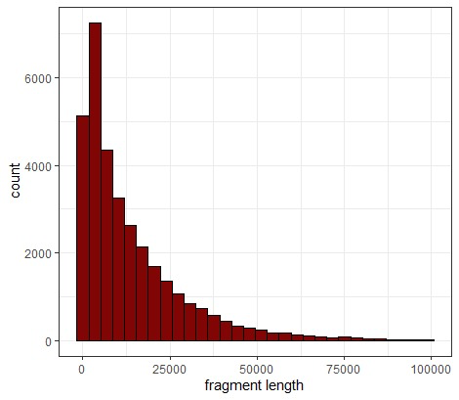
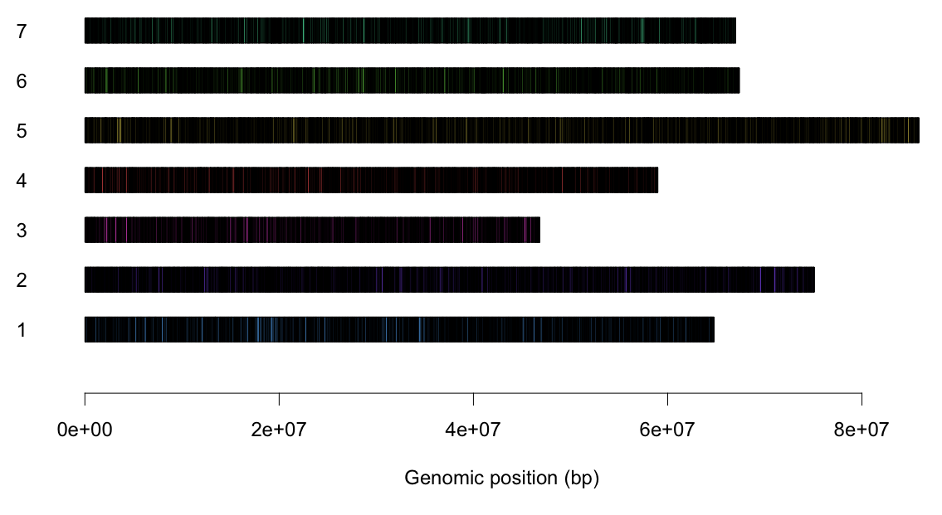
Results: In silico
Distribution of NgoMIV Cut Sites
Frequency of Fragment Size
# fragments: 36,108 Reference Genome: Rosa chinensis Whole Genome v1.0 ^{[2]}
In silico analysis: ddRADseqTools
Notes:
Figure 1: (A) In silico analysis, illustrating number of cut sites indicated by black lines in each chromosome (left) Frequency of fragment sizes after enzyme activity (right).

Slide 6
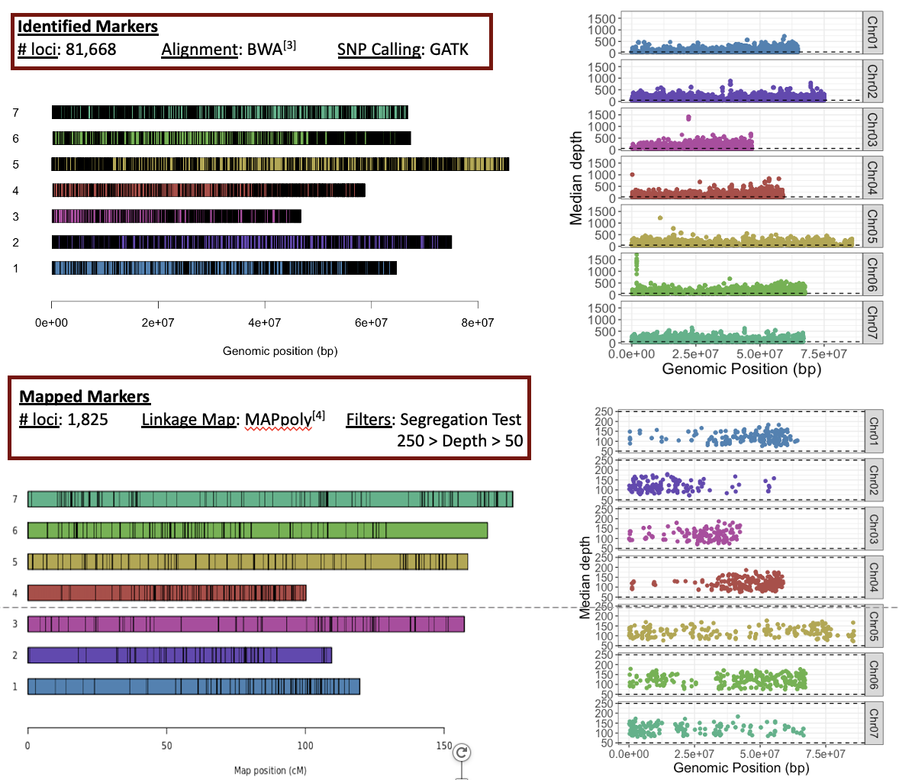
Results: Empirical
Number of Loci
Median Read Depth
Linkage Map Statistics
Total | Value
Map length (cM) | 1007.11
Markers/cM | 1.92
Total Markers | 1825
Max Gap | 16.99
Notes:
B) Illustrates number of identified markers indicated by black lines (left). (C) Illustrates number of mapped markers indicated by black lines (left). (Right side of B and C) Sum of read depth of all individuals for each marker. B and C are based GBS data from the ’Morden Blush’ x ‘George Vancouver’ population.
Figure 2: Misclassification error rate (MER), and correlation of the ‘updog^{’[1]} oracle estimation for increasing read depth, compared with the true genotype.
Table 1: Built linkage map descriptive statistics

Slide 7
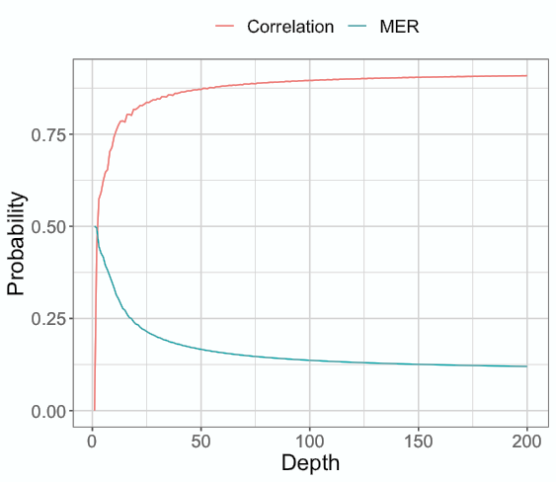
Results: updog oracle analysis

Slide 8
Conclusion
Based on our GBS protocol:
We can accurately create linkage maps with 50-250x read depth.
Mean depths below 50x decrease the correlation between the estimated and the true genotype exponentially.

Slide 9
Acknowledgments
This work is funded in part by the Robert E. Basye Endowment in Rose Genetics, Dept. of Horticultural Sciences, Texas A&M Univ., and the USDA’s National Institute of Food and Agriculture (NIFA) Specialty Crop Research Initiative (SCRI) project ‘‘Tools for Genomics-Assisted Breeding in Polyploids: Development of a Community Resource’’ (Award No. 2020-51181-32156)

