Slide 1
QTL analysis of the ‘Tanzania’ x ‘Beauregard’ sweetpotato mapping population for resistance to Meloidogyne enterolobii
Simon Fraher*1, Tanner Schwarz2, Bonny Oloka3, Ken Pecota1, Chris Heim1, Adrienne Gorny2, and G. Craig Yencho 1
1Department of Horticultural Science, North Carolina State University, Raleigh, NC 27695
2Department of Entomology and Plant Pathology, North Carolina State University, Raleigh, NC 27695
3Root Crops Program, National Agricultural Research Organization, Entebbe, Uganda

Slide 2
Introduction
Meloidogyne enterolobii (M.e.), the guava root-knot nematode, is a significant pest of sweetpotato (Ipomoea batatas) and other crops, weeds, and ornamentals.
Since 2018, M.e. has been under interior quarantine in North Carolina, which grows approximately 67% of US sweetpotatoes – worth $375m in 2020 (USDA NASS).
Orange-fleshed moist sweetpotatoes (OFSP) are the US market preference. There is no resistance in modern OFSP breeding germplasm, and resistance to M.e. will likely come from exotic landraces or specialty cultivars.
It is prohibitively expensive to bio-assay resistance to M.e.
This project is funded by USDA NIFA Specialty Crop Research Initiative Award # 2020-51181-32156 (09/01/20 - 08/31/24)
Additional funding from the SweetGAINS funded by the Bill and Melinda Gates Foundation Opportunity OPP1213329,
The NC Agricultural Foundation, Inc., and the NC Crop Improvement Association and NC Foundation Seed Producers, Inc.

Slide 3
Materials and Methods
Germplasm
The biparental mapping population ‘Tanzania’ x ‘Beauregard’ (TB) consisting of 246 individuals was used for this study. Progenies were replicated twice.
Check lines included susceptible (‘Beauregard’, ‘Covington’) and resistant lines (‘Jewel’, ‘Tanzania’) as both positive (inoculated) and negative (un-inoculated) controls. Positive controls were replicated four times and negatives twice.
Nematodes
A M. enterolobii isolate from a soy/sweetpotato rotational field in Johnston County, NC was inoculated at a rate of 10,000 eggs per sweetpotato plant at 14-days post-planting (6” terra cotta pots, 1:1 ratio sand to clean field soil, greenhouse conditions, 25-28ºC with no supplemental lighting.)
Evaluations
60 days post-inoculation, a modified NaOCl-based egg extraction protocol by Hussey & Barker (1973) was used.
M.e. eggs were quantified two ways: manual counting at various dilutions, and visual gall ratings by percent of total root volume with galls (i.e. 1 galled root in 100 was 1% galling).
Reproductive factor (RF) was scored as total eggs per sample / initial inoculum (10,000 eggs).
Data Analysis
Genotyping was performed using GBSpoly (Wadl et al. 2018) and genomic DNA library preparation was done at the NCSU Genomic Sciences Laboratory.
GBSpoly reads were aligned with the I. trifida reference genome (Wu et al. 2018).
QTL analysis was performed using the R package QTLpoly (v. 0.2.1) (Pereira et al. 2020), which used a fixed-effect interval mapping approach to associate variance components with QTL.

Slide 4
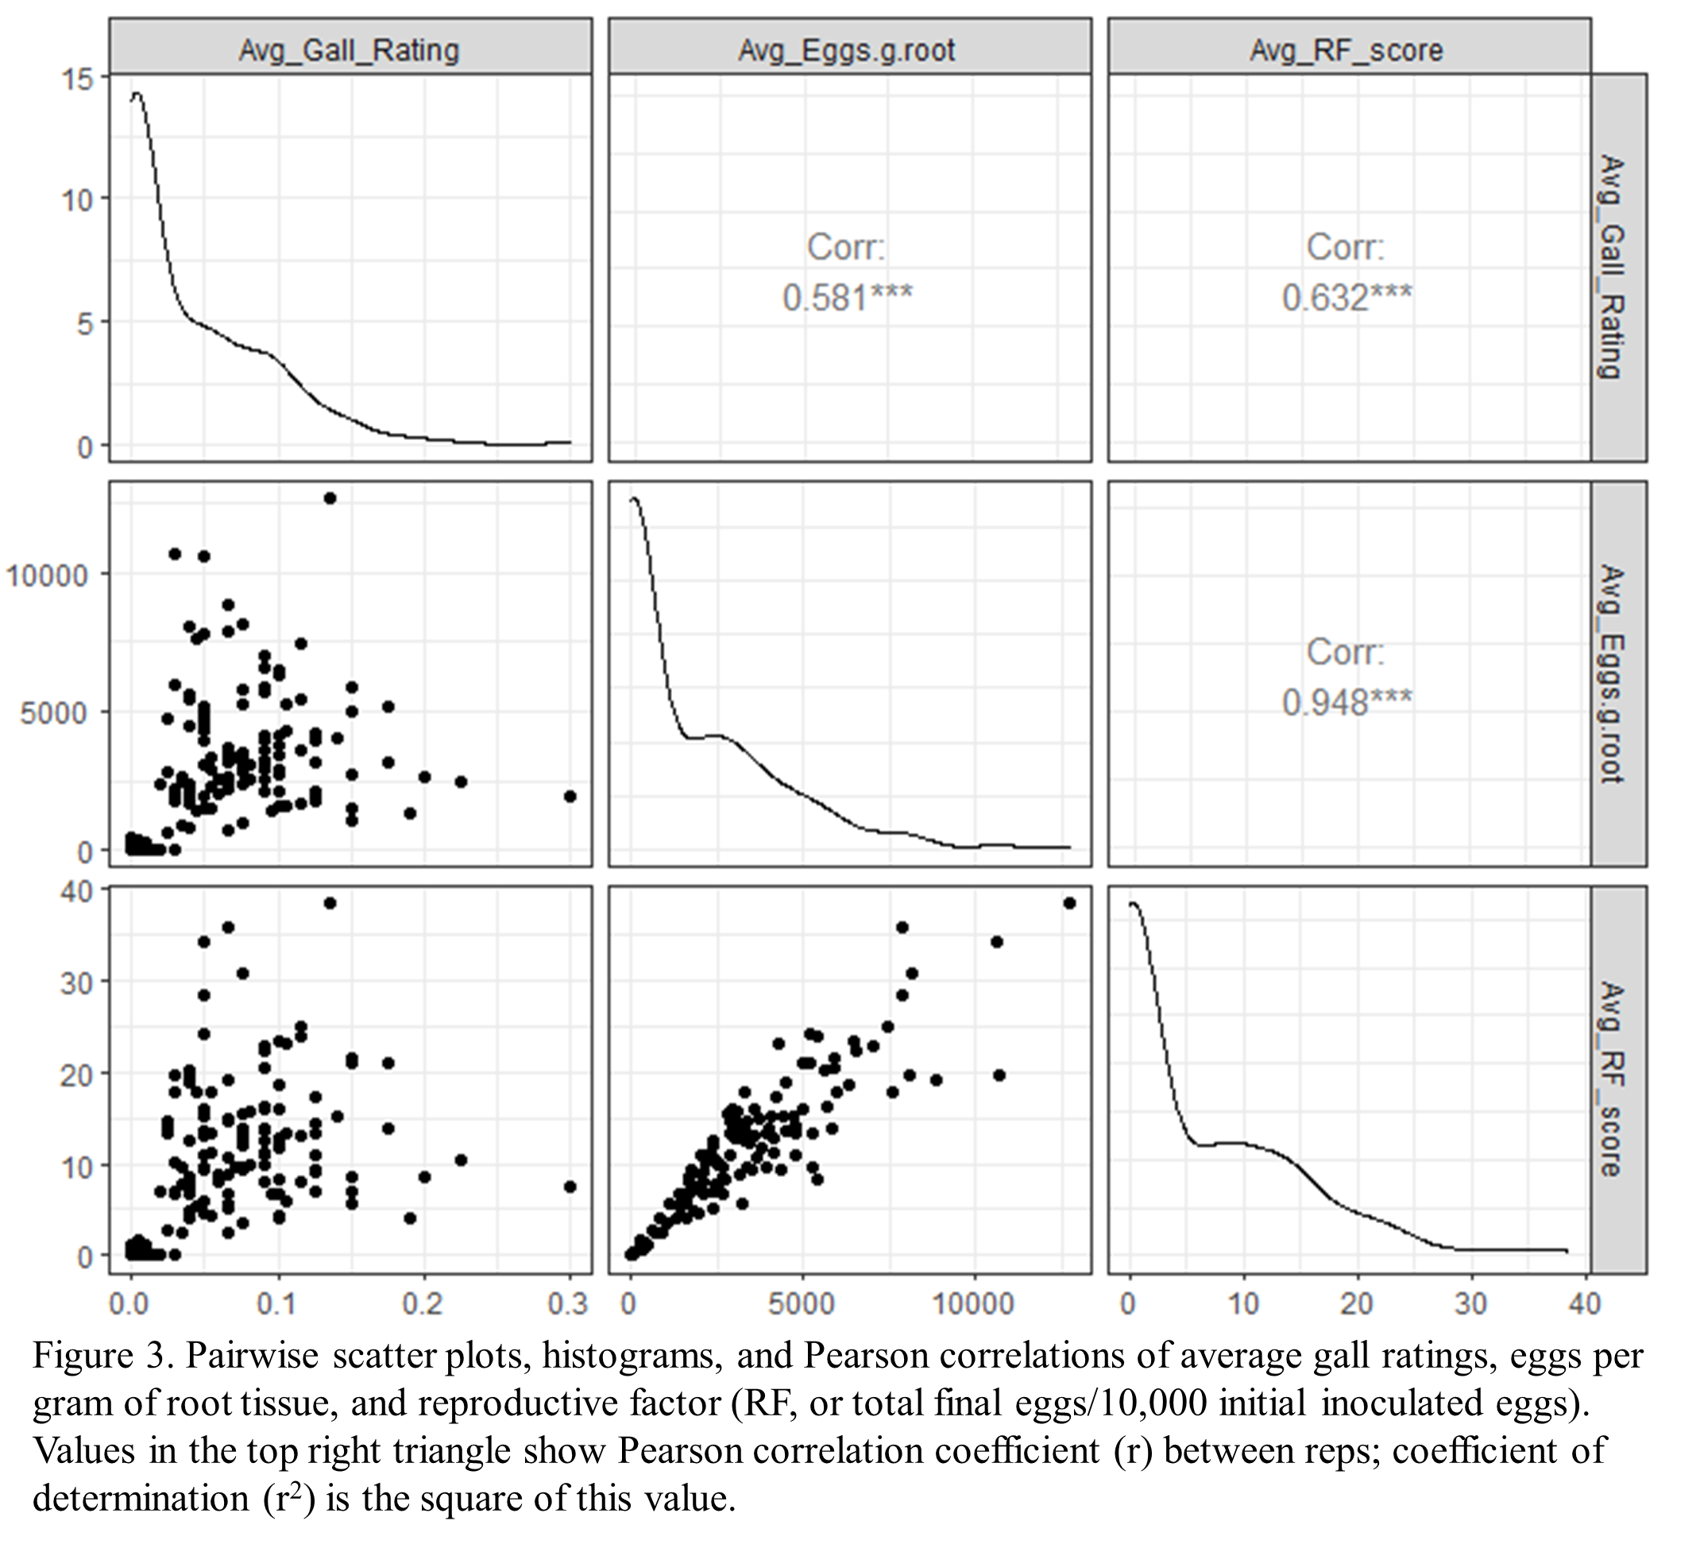
Results
Resistance to M.e. is highly heritable in TB, occurring at RF<0.5 in approximately half the population.
Egg counts and RF scores were strongly correlated within TB (Fig. 2, r² = .90, P<.001).
Gall rating was poorly correlated with eggs/g root within TB (Fig. 2, r² = .34, P<.001). Samples may have galls and no eggs, or high egg counts and few or no galls. Galls may indicate general susceptibility, but RF or egg counts are stringent measures of resistance to M.e. for breeders.

Slide 5
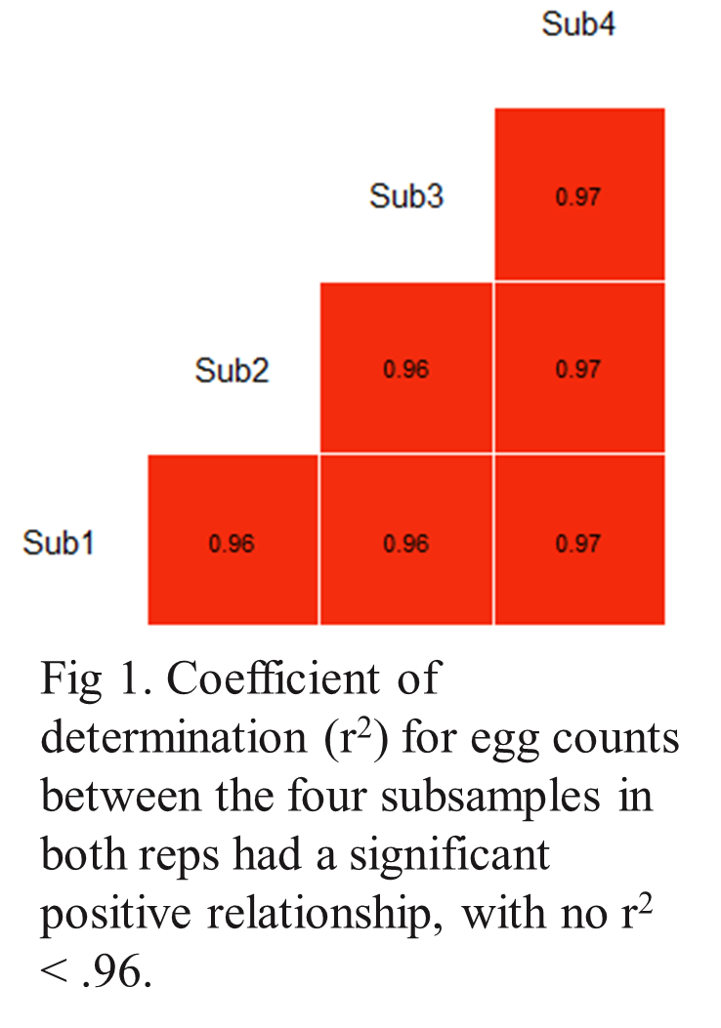
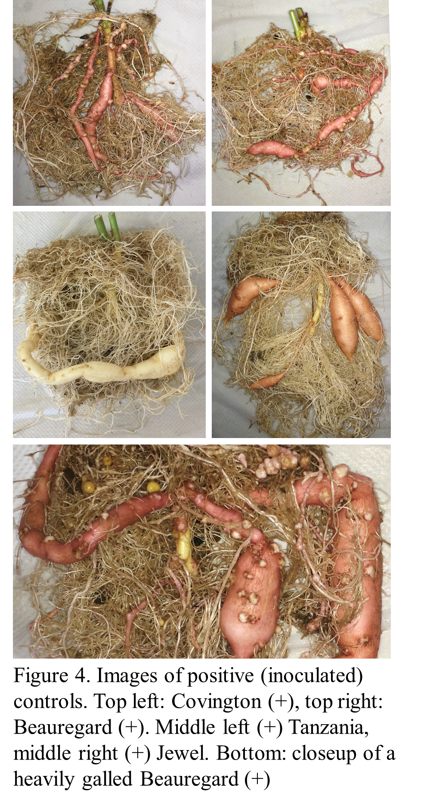
Results
Correlations within rep (between subsamples) were strong (r²>0.96 for all pairwise egg counts).
Correlations between the two reps for reproductive factor (r² = .29, P<.001), and for eggs/g root (r² = .25, P<.001)

Slide 6
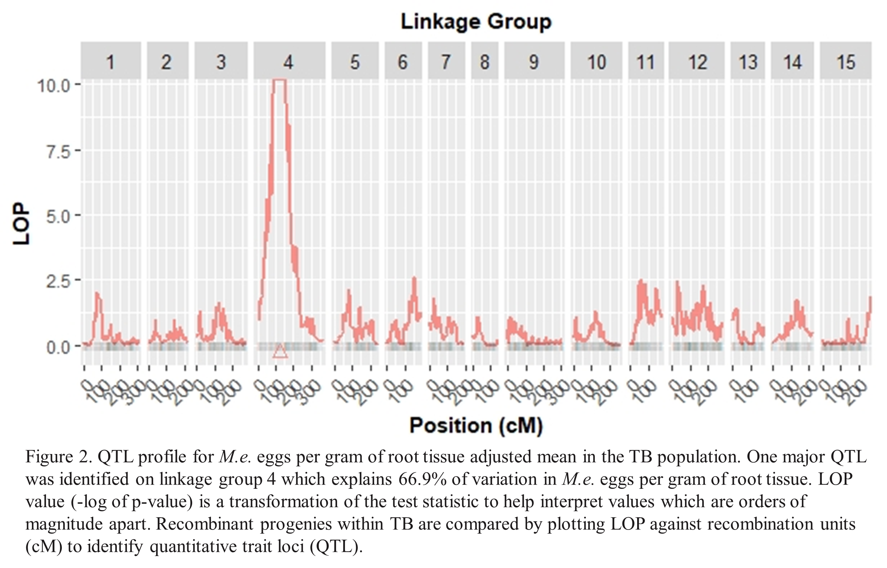

Slide 7
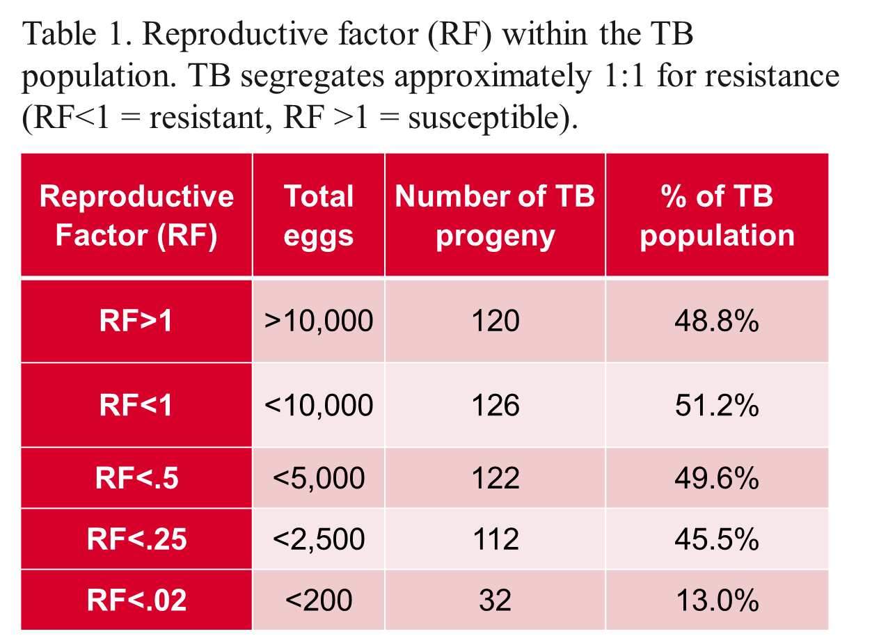
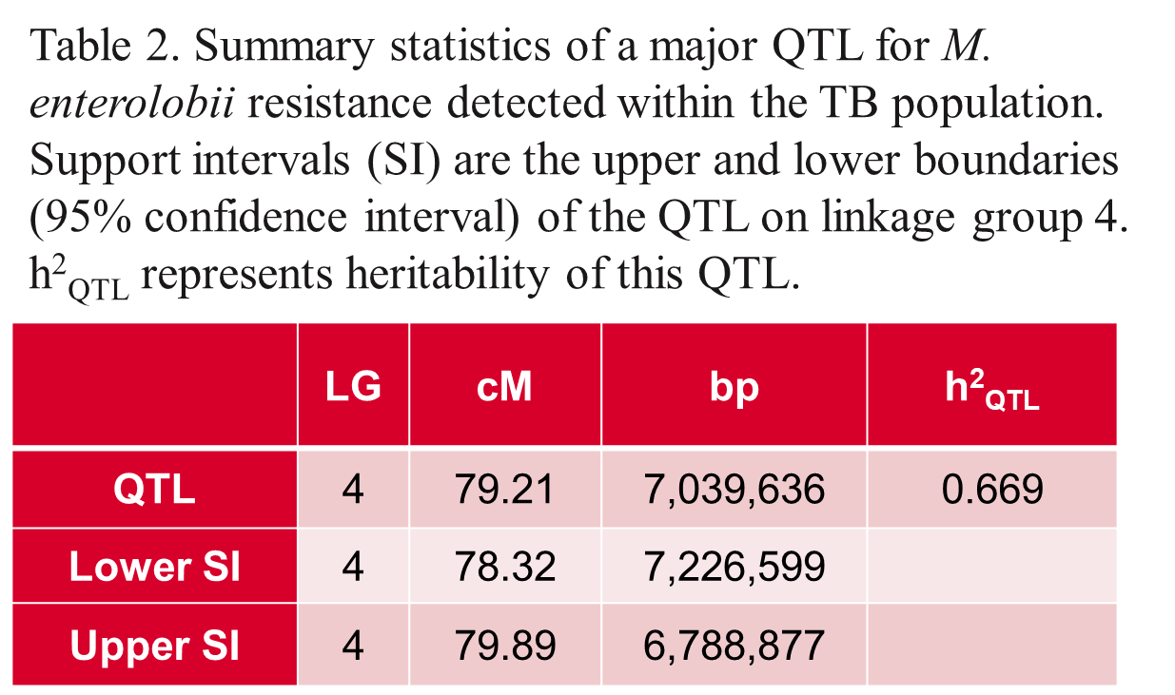

Slide 8
Conclusions and Future Research
A 1:1 segregation pattern suggests a simplex dominant trait controls M.e. resistance in the TB population. This is likely conferred by parent ‘Tanzania’, though it may be a missing allele in ‘Beauregard’.
Oloka et al. (2021) used this same approach to discover a major QTL on LG 7 explaining 58.3% of variation for M. incognita (M.i.) resistance, another root knot nematode of worldwide economic importance.
Using the I. trifida reference genome and WGS data for ‘Tanzania’ and ‘Beauregard’, we have identified 2,444 simplex or pentaplex biallelic markers within these QTL on LG 4 and 7 which may be KASP-compatible.
Known resistant and susceptible lines from the greater germplasm (as well as select TB lines) have been genotyped by LGC BioSearch Technologies at peak-flanking positions, and preliminary data supports multiple markers which predict resistant/susceptible with 90-100% accuracy for both M.e. and M.i.
Implementing KASP-based assays in breeding for Meloidogyne resistance would represent the first usage of marker-assisted selection in sweetpotato.

Slide 9
Acknowledgments
We would like to thank Guilherme Pereira, Marcello Mollinari, C. Robin Buell and her team at UGA, and Victor Amankwaah for all their collaborations and contributions. Additional thanks to Sharon Williamson. A special thanks to the NC Crop Improvement Association, the NC Agriculture and Dairy Foundation and the Bill and Melinda Gates Foundation SweetGAINS project for funding the research.
Contact: Simon Fraher: SPFraher@ncsu.edu

Slide 10
References
Hussey, R. S., & Barker, K. R. (1973). Comparison of methods of collecting inocula of Meloidogyne spp., including a new technique. Plant Disease Reporter.
USDA/NASS. (2020). Vegetables 2019 Summary. USDA NASS.
da Silva Pereira, G., Gemenet, D. C., Mollinari, M., Olukolu, B. A., Wood, J. C., Diaz, F., Mosquera, V., Gruneberg, W. J., Khan, A., Buell, C. R., Yencho, G. C., & Zeng, Z.-B. (2020). Multiple QTL Mapping in Autopolyploids: A Random-Effect Model Approach with Application in a Hexaploid Sweetpotato Full-Sib Population. Genetics, 215(3), 579–595.
Wadl, P. A., Olukolu, B. A., Branham, S. E., Jarret, R. L., Yencho, G. C., & Jackson, D. M. (2018). Genetic Diversity and Population Structure of the USDA Sweetpotato (Ipomoea batatas) Germplasm Collections Using GBSpoly. Frontiers in Plant Science, 9, 1166.
Wu, S., Lau, K. H., Cao, Q., Hamilton, J. P., Sun, H., Zhou, C., Eserman, L., Gemenet, D. C., Olukolu, B. A., Wang, H., Crisovan, E., Godden, G. T., Jiao, C., Wang, X., Kitavi, M., Manrique-Carpintero, N., Vaillancourt, B., Wiegert-Rininger, K., Yang, X., … Fei, Z. (2018). Genome sequences of two diploid wild relatives of cultivated sweetpotato reveal targets for genetic improvement. Nature Communications, 9(1), 4580.

Slide 11
Abstract
Due to its highly heterozygous hexaploid nature, sweetpotato (I. batatas) lags behind other crops in terms of genomic tools. New tools and strategies have afforded opportunities to associate sequence data with phenotypic data though QTL analysis, especially the publication of a diploid reference genome for I. trifida in 2018, and open-source software packages like QTLpoly and MAPpoly. QTL analysis is expected to be instrumental in accelerating breeding in this crop, notably for nematode resistance and nutritional factors.
We analysed the progeny of the sweetpotato biparental mapping population ‘Tanzania’ x ‘Beauregard’ (TB) representing 250 genotypes (including 4 check lines) for resistance to the emergent plant parasitic nematode, Meloidogyne enterolobii (M.e.). Parent ‘Tanzania’ is highly resistant, and parent ‘Beauregard’ is highly susceptible. Bioassays showed clear bimodal segregation for resistance, suggesting a simplex major allele conferring resistance. Using the R package QTLpoly and the I. trifida reference genome, we discovered a major QTL peak at base pair 7,039,636 (79.21cM) of linkage group 4 of I. batatas associated with resistance to M.e. This analysis suggests variability in M.e. resistance within the TB population can largely be ascribed to genetic differences amongst the progenies (h² =66.9%). Next steps will search for flanking markers associated with these genotypes and attempt to identify markers which can be screened in the seedling stage, reducing the need for costly and laborious bioassays with this quarantined pest.

