Slide 1
Bayesian micro-haplotype assembly in autopolyploids
Tim Millar^{1,2}, Susan Thomson¹, John McCallum¹, Phil Wilcox^{2,3}, Mik Black^{2,3}

Slide 2
DISCLAIMER
The New Zealand Institute for Plant and Food Research Limited does not give any prediction, warranty or assurance in relation to the accuracy of or fitness for any particular use or application of, any information or scientific or other result contained in this report. Neither The New Zealand Institute for Plant and Food Research Limited nor any of its employees, students, contractors, subcontractors or agents shall be liable for any cost (including legal costs), claim, liability, loss, damage, injury or the like, which may be suffered or incurred as a direct or indirect result of the reliance by any person on any information contained in this report.
LIMITED PROTECTION
This report may be reproduced in full, but not in part, without the prior written permission of The New Zealand Institute for Plant and Food Research Limited. To request permission to reproduce the report in part, write to: The Science Publication Office, The New Zealand Institute for Plant and Food Research Limited – Postal Address: Private Bag 92169, Victoria Street West, Auckland 1142, New Zealand; Email: SPO-Team@plantandfood.co.nz.
CONFIDENTIALITY
This report contains valuable information in relation to the Programme programme that is confidential to the business of The New Zealand Institute for Plant and Food Research Limited and Client. This report is provided solely for the purpose of advising on the progress of the Programme programme, and the information it contains should be treated as “Confidential Information” in accordance with The New Zealand Institute for Plant and Food Research Limited’s Agreement with Client.
COPYRIGHT
© COPYRIGHT (2020) The New Zealand Institute for Plant and Food Research Limited. All Rights Reserved. No part of this report may be reproduced, stored in a retrieval system, transmitted, reported, or copied in any form or by any means electronic, mechanical or otherwise, without the prior written permission of the of The New Zealand Institute for Plant and Food Research Limited. Information contained in this report is confidential and is not to be disclosed in any form to any party without the prior approval in writing of The New Zealand Institute for Plant and Food Research Limited. To request permission, write to: The Science Publication Office, The New Zealand Institute for Plant and Food Research Limited – Postal Address: Private Bag 92169, Victoria Street West, Auckland 1142, New Zealand; Email: SPO-Team@plantandfood.co.nz.

Slide 3
Overview
Motivation
Theory
Software overview
Future research

Slide 4
Genotyping platforms
Cost
Throughput
Data/sample
$20NZD/sample
Few ->many esp sex
~ 0.0001% of genome
SSRs - 9PVR set
Flex-seq – 3300 multiplex PCR amplicons
$20USD/sample
2021: 5000
~ 0.1% of genome
Capture-seq – 10000 regions
$70USD/sample
2021: 1000
~ 0.25% of genome
Whole Genome Sequencing
~$1000NZD/sample
>1 & <100
Gigabases

Slide 5
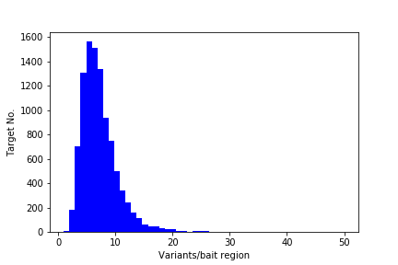
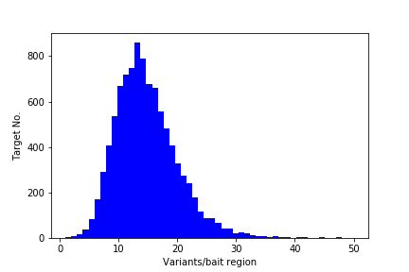
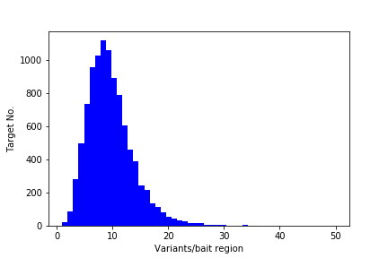
Variant density
AF > 0.01
AF > 0.01
AF > 0.01
2x Cohort
N=288
Variants=161719 (0.93)
4x Cohort
N=136
Variants =361742 (0.86)
6x Cohort
N=66
Variants =238262 (0.91)

Slide 9
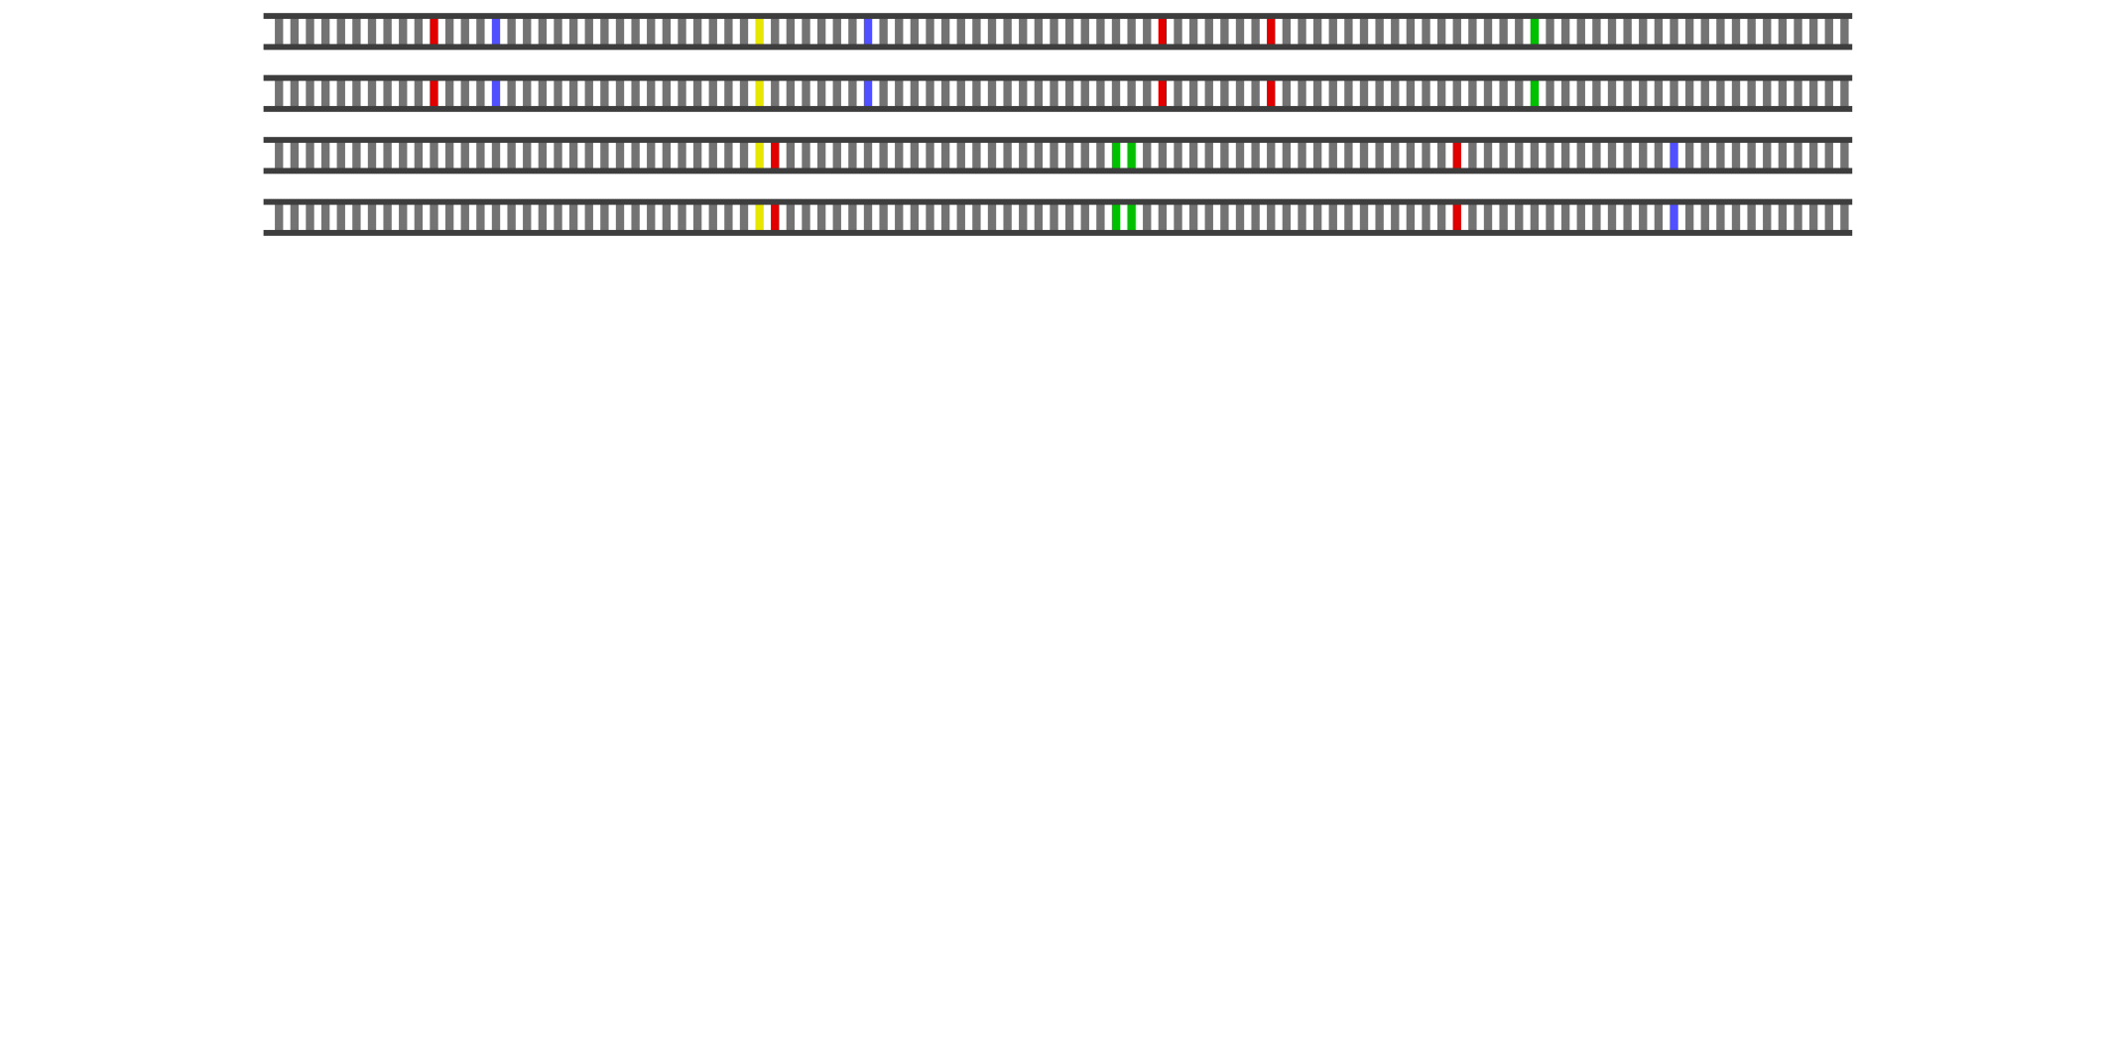
Motivation

Slide 10
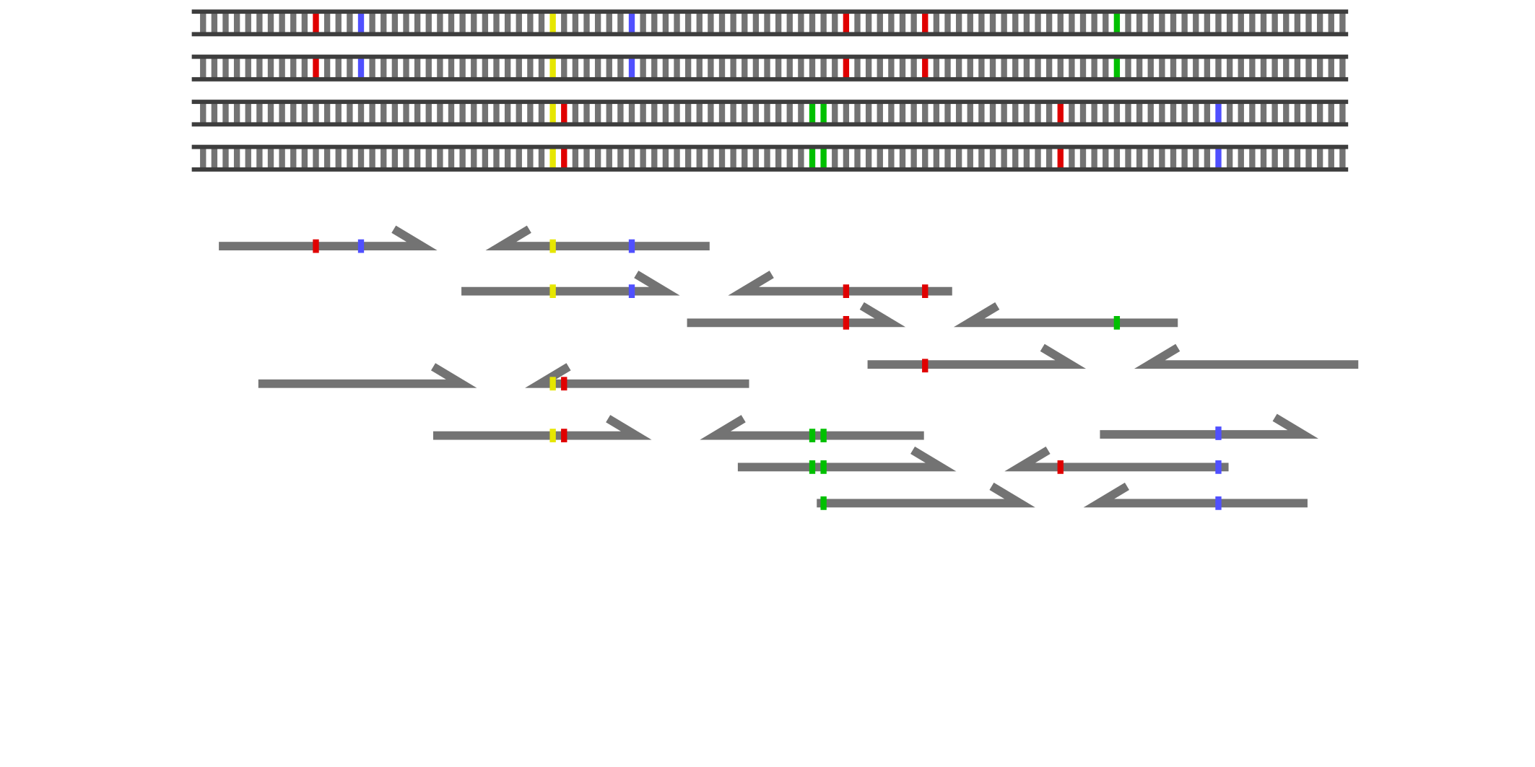
Motivation

Slide 11
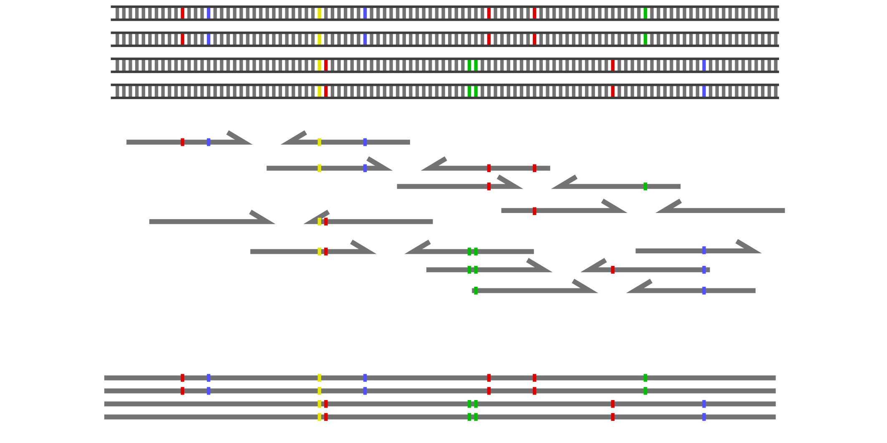
Motivation

Slide 12
Motivation

Slide 13
Motivation

Slide 14
Motivation

Slide 15
Aims
Develop a tool for micro-haplotype assembly in autopolyploids
Generate markers for statistical genetics
Suitable for a range of sequencing platforms
Suitable for complex populations under selection

Slide 16
Theory

Slide 17
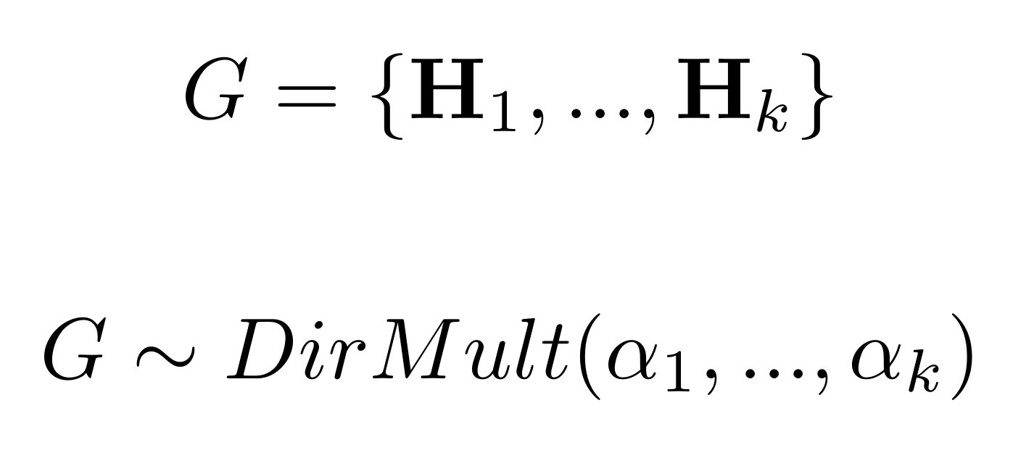
Prior distribution
A genotype G is treated as a multiset of k haplotypes where k is the ploidy.
We then use a Dirichlet-multinomial distribution for the prior distribution of genotypes.
This lets us incorporate both the expected inbreeding coefficient and allele frequencies into the prior distribution.

Slide 18
Likelihood function
The probability of a read R being drawn from a genotype G is the mean of probabilities that it matches each haplotype H present in that genotype (accounting for error).
The likelihood P(R|G) is then the joint probability that all reads in the set R are drawn from genotype G.

Slide 19
Haplotype assembly

Slide 20
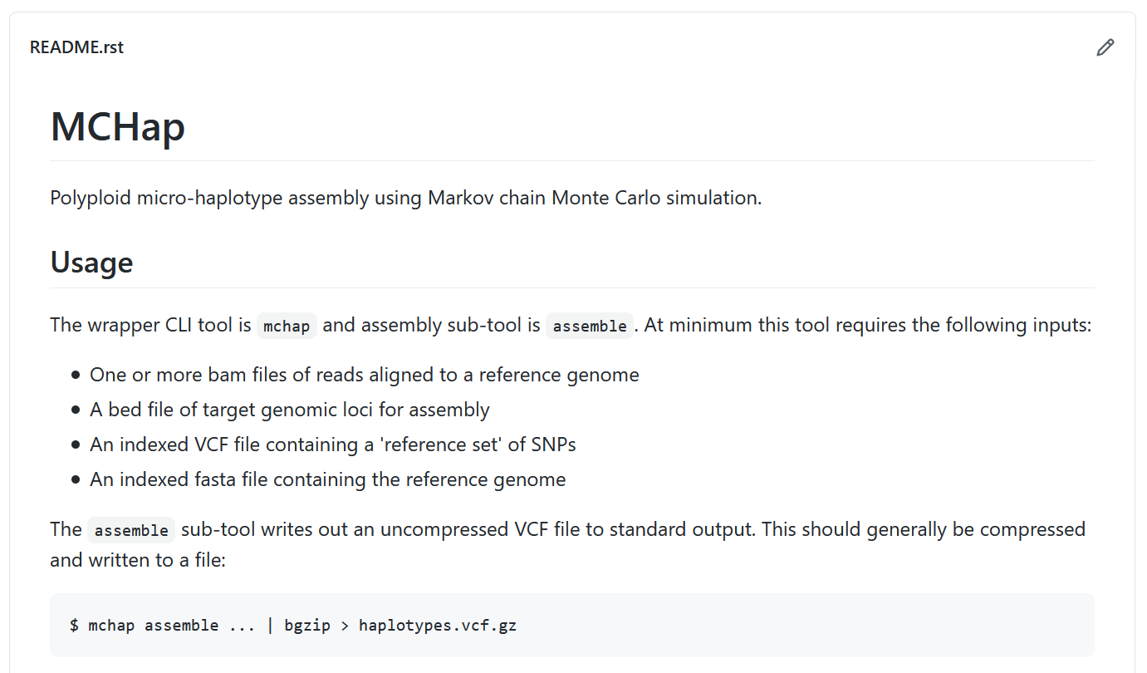

Slide 21
Example
MCHap applied to a tetraploid potato bi-parental cross.
Run mchap assemble for de novo assembly in individuals
Inspect at VCF output
Run mchap call to recall genotypes using the population-wide haplotypes

Slide 22
Example: De novo assembly

Slide 23
Example: De novo assembly

Slide 24
Example: VCF output

Slide 25
Example: VCF output

Slide 26
Example: Using known haplotypes
Use a reference set of haplotypes
Reduces parameter space
Can improve genotype calls

Slide 27
VCF metadata

Slide 28
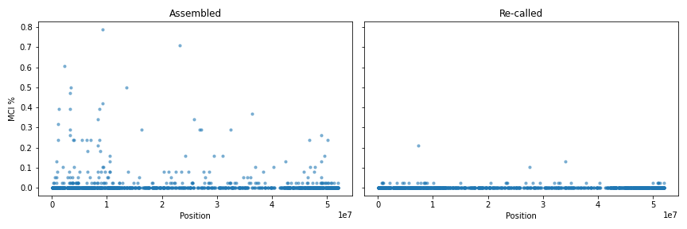
VCF metadata
MCI: Markov Chain Incongruence
0 = No incongruence between replicate chains
1 = Incongruence between chains (at configurable level of probability)
2 = Incongruence between chains with a total number of unique alleles exceeding ploidy

Slide 29
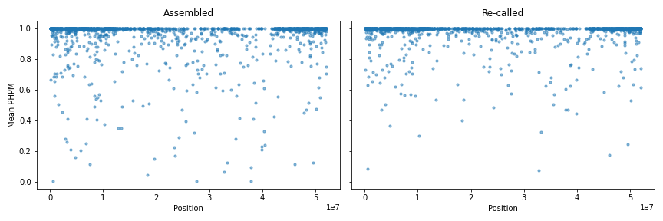
VCF metadata
PHPM: PHenotype Posterior Mode probability
Genotype mode = [0, 0, 1, 2]
“allelic phenotype” mode = [0, 1, 2] = [0, 0, 1, 2] + [0, 1, 1, 2] + [0, 1, 2, 2]

Slide 30
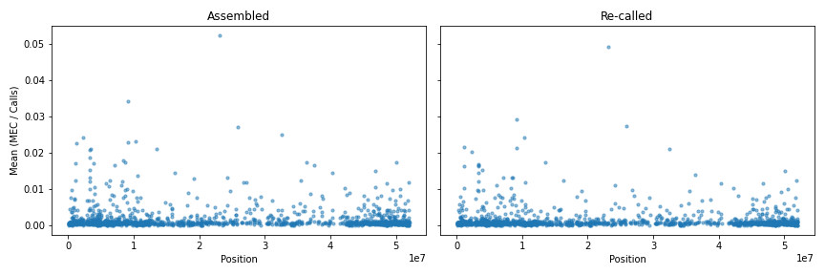
VCF metadata
MEC: Minimum Error Correction
Number of corrections required for all reads to match haplotypes

Slide 31
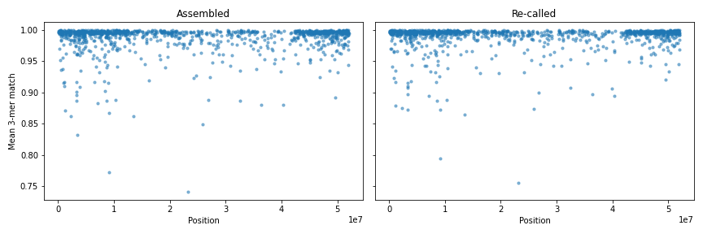
VCF metadata
KMERCOV: K-mer Coverage
Proportion of reads matching haplotypes

Slide 32
MCHap features
Assemble haplotypes are re-call known haplotypes
Any ploidy up to 20x
Use of inbreeding prior
Parallel-tempering
Can output full posterior distributions (can produce huge VCF!)
Good performance for MCMC (core components use the Numba JIT compiler)
Parallel processing of target loci
Standard bioinformatics formats: VCF, BAM, BED, Fasta

Slide 33
Future work
Documentation
Prior for allele frequencies
Posterior allele frequencies
Improve sampling for deep amplicon sequencing
Make use of pedigree data?

Slide 34
Acknowledgements
SCRI Tools for Polyploids!
PFR internal funding from KRIP (Kiwifruit Royalty Investment Programme)
Supervisors & Advisors: John McCallum, Susan Thomson, Phil Wilcox and Mik Black
Kiwifruit Breeders: Amardeep Nath, Luis Gea, Liz Popowski
Marker Development: Mareike Knaebel, Adrian Grande, Emily Koot, Sarah Moss, Elena Hilario, Ross Crowhurst
And the rest: David Chagne, Samantha Baldwin, Rodelyn Jaksons, and many more

Slide 35
Thank you
tim.millar@plantandfood.co.nz

