Slide 1
Genomic Selection in Potato
Jeffrey Endelman
January 14, 2022
Funding from USDA NIFA Award #2020-51181-32156

Slide 2
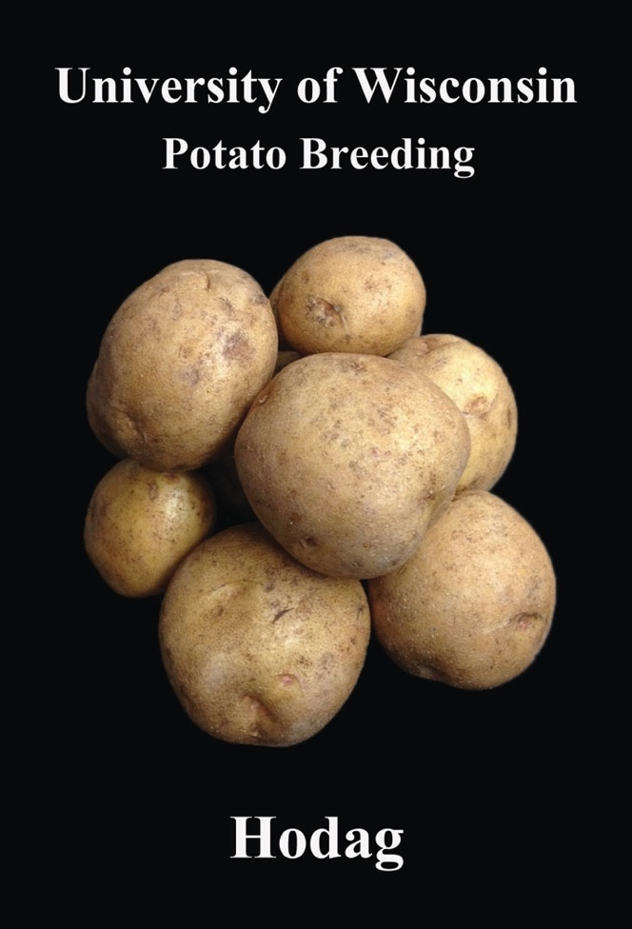
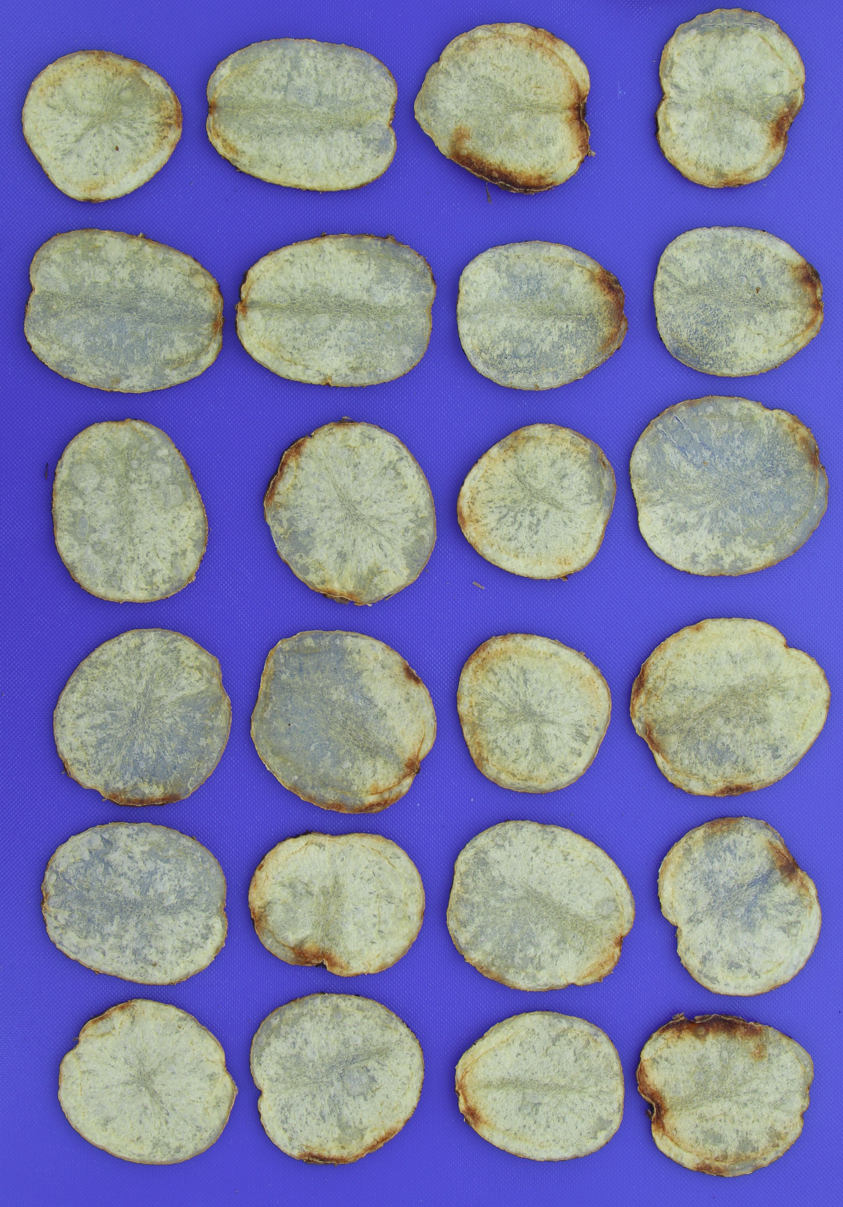
Year | Stage | Number Varieties
0 | Crossing + Seedlings | 20,000
1 | Single Plant Selection | 15,000
2 | Clone Selection | 750
3 | Preliminary Yield Trial | 150
4 | Regional Yield Trial | 15
5–6 | National Yield Trial | 5–10
7–9 | Foundation Seed Production | 1–2
10 | Variety Release | 0–1

Slide 3
Building a Training Pop
Year | Stage | Number Varieties
0 | Crossing + Seedlings | 20,000
1 | Single Plant Selection | 15,000
2 | Clone Selection | 750
3 | Preliminary Yield Trial | 150
4 | Regional Yield Trial | 15
5–6 | National Yield Trial | 5–10
7–9 | Foundation Seed Production | 1–2
10 | Variety Release | 0–1
In 2015 we began genotyping all clones in preliminary yield trial (PYT) with 10K potato SNP array
Also genotyped clones from other programs entered in the national trial, for which WI is one location
TP size

Slide 4
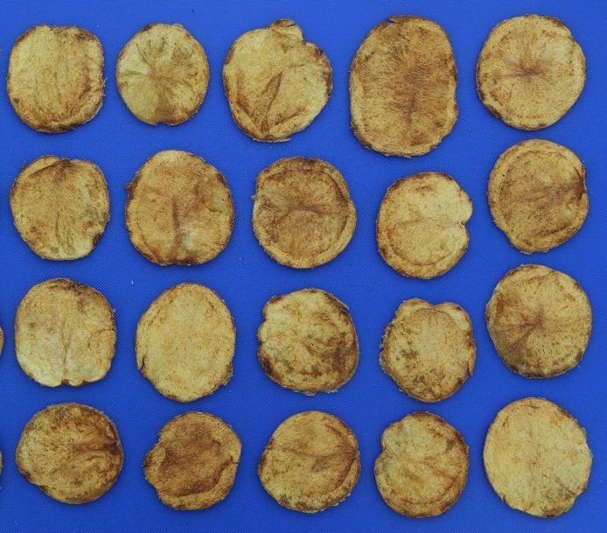
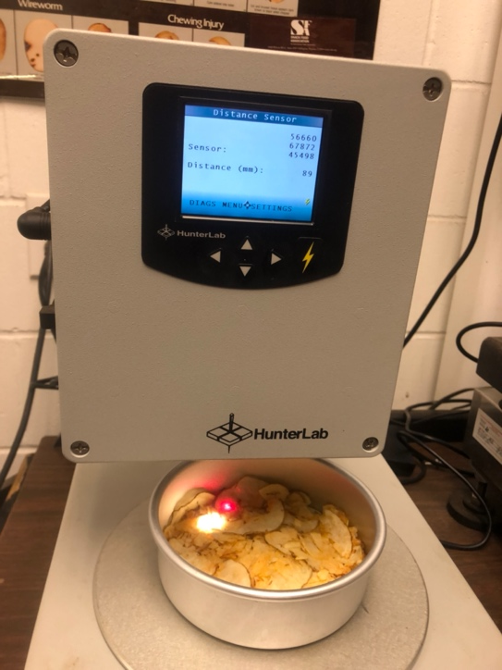
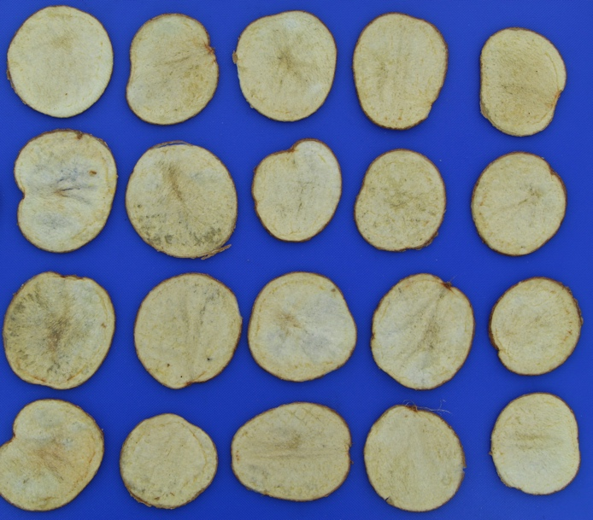
Traits
Total yield
Specific gravity (dry matter)
Fry color
Vine maturity
Other traits are recorded (e.g., tuber appearance, hollow heart, scab) but not yet used for GS
L = 45.0
L = 67.5

Slide 5
Year | Stage | Number Varieties
0 | Crossing + Seedlings | 20,000
1 | Single Plant Selection | 15,000
2 | Clone Selection | 750
3 | Preliminary Yield Trial | 150
4 | Regional Yield Trial | 15
5–6 | National Yield Trial | 5–10
7–9 | Foundation Seed Production | 1–2
10 | Variety Release | 0–1
Starting in 2018, PYT clones were also considered as parental candidates (genome-wide MAS)
Genomic Selection: 4 years
Traditionally: 6-10 years

Slide 6

Selection Accuracy
For all four traits, the reliability of genome-wide MAS exceeded phenotypic selection h² by $≈$0.3
 | h² (PS) | r² (MAS) | r² (MBS)
Yield | 0.30 | 0.64 | 0.52
Dry Matter | 0.46 | 0.74 | 0.60
Fry Color | 0.34 | 0.67 | 0.56
Vine Maturity | 0.33 | 0.66 | 0.56

Slide 7
Multi-Trait Index
For clone selection, the use of independent culling is appropriate because all criteria are needed for commercial adoption
But for parent selection, a multi-trait index is recommended
For uncorrelated traits, independent predictions can be combined without issue
But for correlated traits, a multi-trait BLUP analysis is recommended

Slide 8
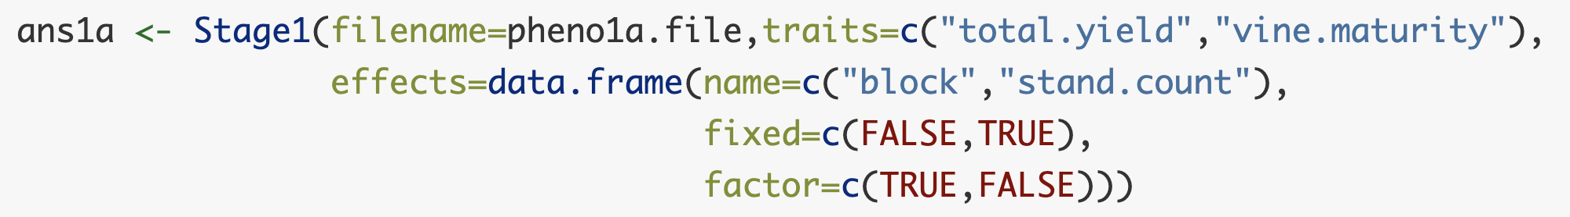
Vignette 3. Multiple traits, homogeneous GxE
Multiple traits listed in Stage1
Syntax for Stage2 is unchanged

Slide 9
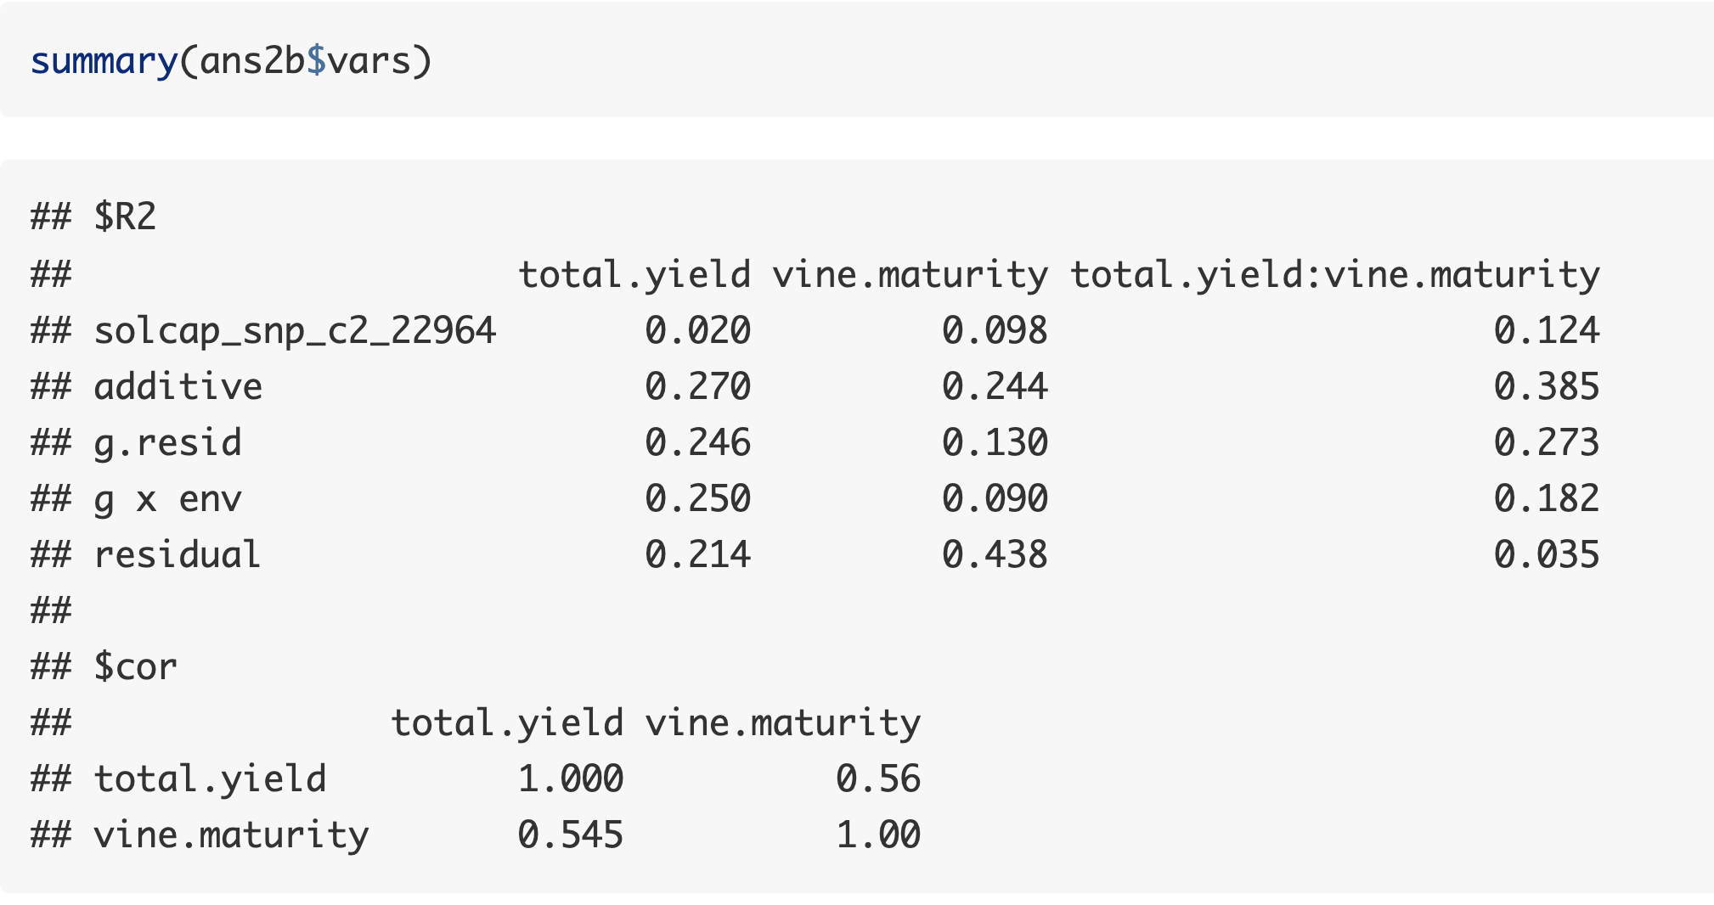
Stage2 output includes partitioning of covariance

Slide 10
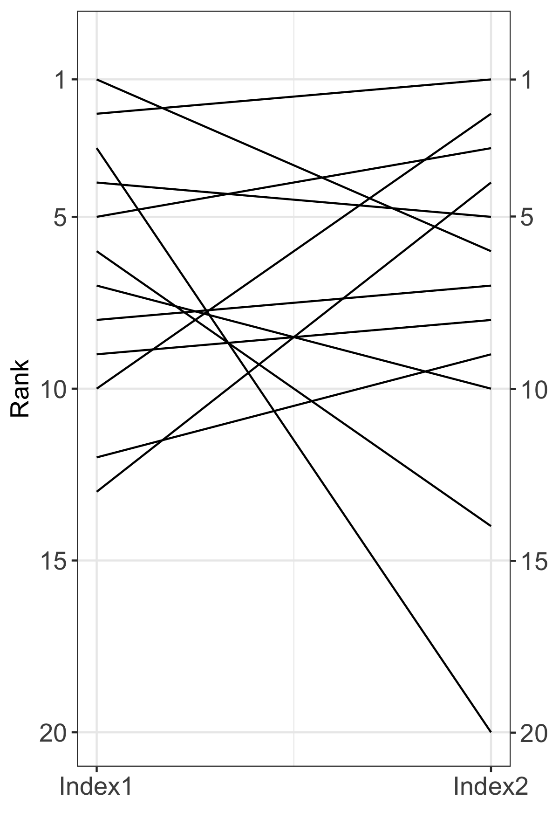
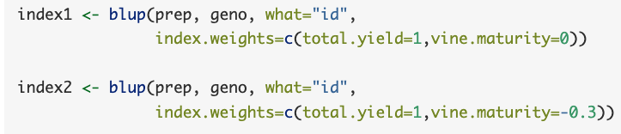
Goal: Select for higher yield without selection for later maturity
Some high-yielding genotypes dropped in rank after introducing penalty for maturity,
While others remained highly ranked.

Slide 11
Going Faster
Marker-based selection (MBS) implies phenotypes are not available for the sel. candidates
  Lower accuracy than MAS but allows for shorter breeding cycle
 | h² (PS) | r² (MAS) | r² (MBS)
Yield | 0.30 | 0.64 | 0.52
Dry Matter | 0.46 | 0.74 | 0.60
Fry Color | 0.34 | 0.67 | 0.56
Vine Maturity | 0.33 | 0.66 | 0.56

Slide 12
Accuracy vs. Cycle Time
Even though shorter breeding cycles have lower accuracy, they often achieve greater genetic gain per unit time
Does not mean faster is always better
  Complex interplay of genetics, economics, and logistics
For potato, simulation results suggest a 3-year cycle would lead to greater gain, but SNP array too expensive to fully realize
  Collaborated with EiB and CIP to identify 2K SNPs from the array with genome-wide coverage and high MAF
  DArTag = Targeted amplicon sequencing

Slide 13
Going Faster
Year | Stage | Number Varieties
0 | Crossing + Seedlings | 20,000
1 | Single Plant Selection | 15,000
2 | Clone Selection | 750
3 | Preliminary Yield Trial | 150
4 | Regional Yield Trial | 15
5–6 | National Yield Trial | 5–10
2022–
GS with 3 yr cycle
GS with SNP array (4 yr cycle)
Traditionally: 6-10 years

Slide 14
Combining Low & High-Density Markers
The merge_impute function in R package polyBreedR (available at https://github.com/jendelman) uses BLUP to impute from low to high density arrays
  Not designed for GBS data (better to use EM algorithm in rrBLUP package)
If phased parental genotypes are available, can also use PolyOrigin (only 4x species)

Slide 15
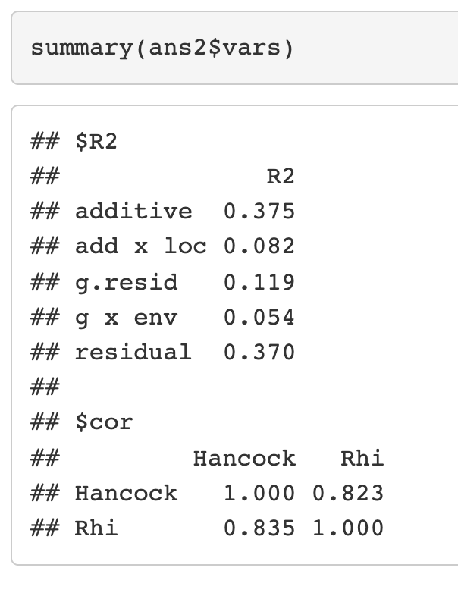
Year 2 Specific Gravity (Dry Matter)
Specific gravity is measured in Year 2 but at a different location (our seed farm), which is not as representative of commercial environments as Year 3 trial
Strategy: Use Year 2 data as correlated location, with zero weight in the selection index

Slide 16
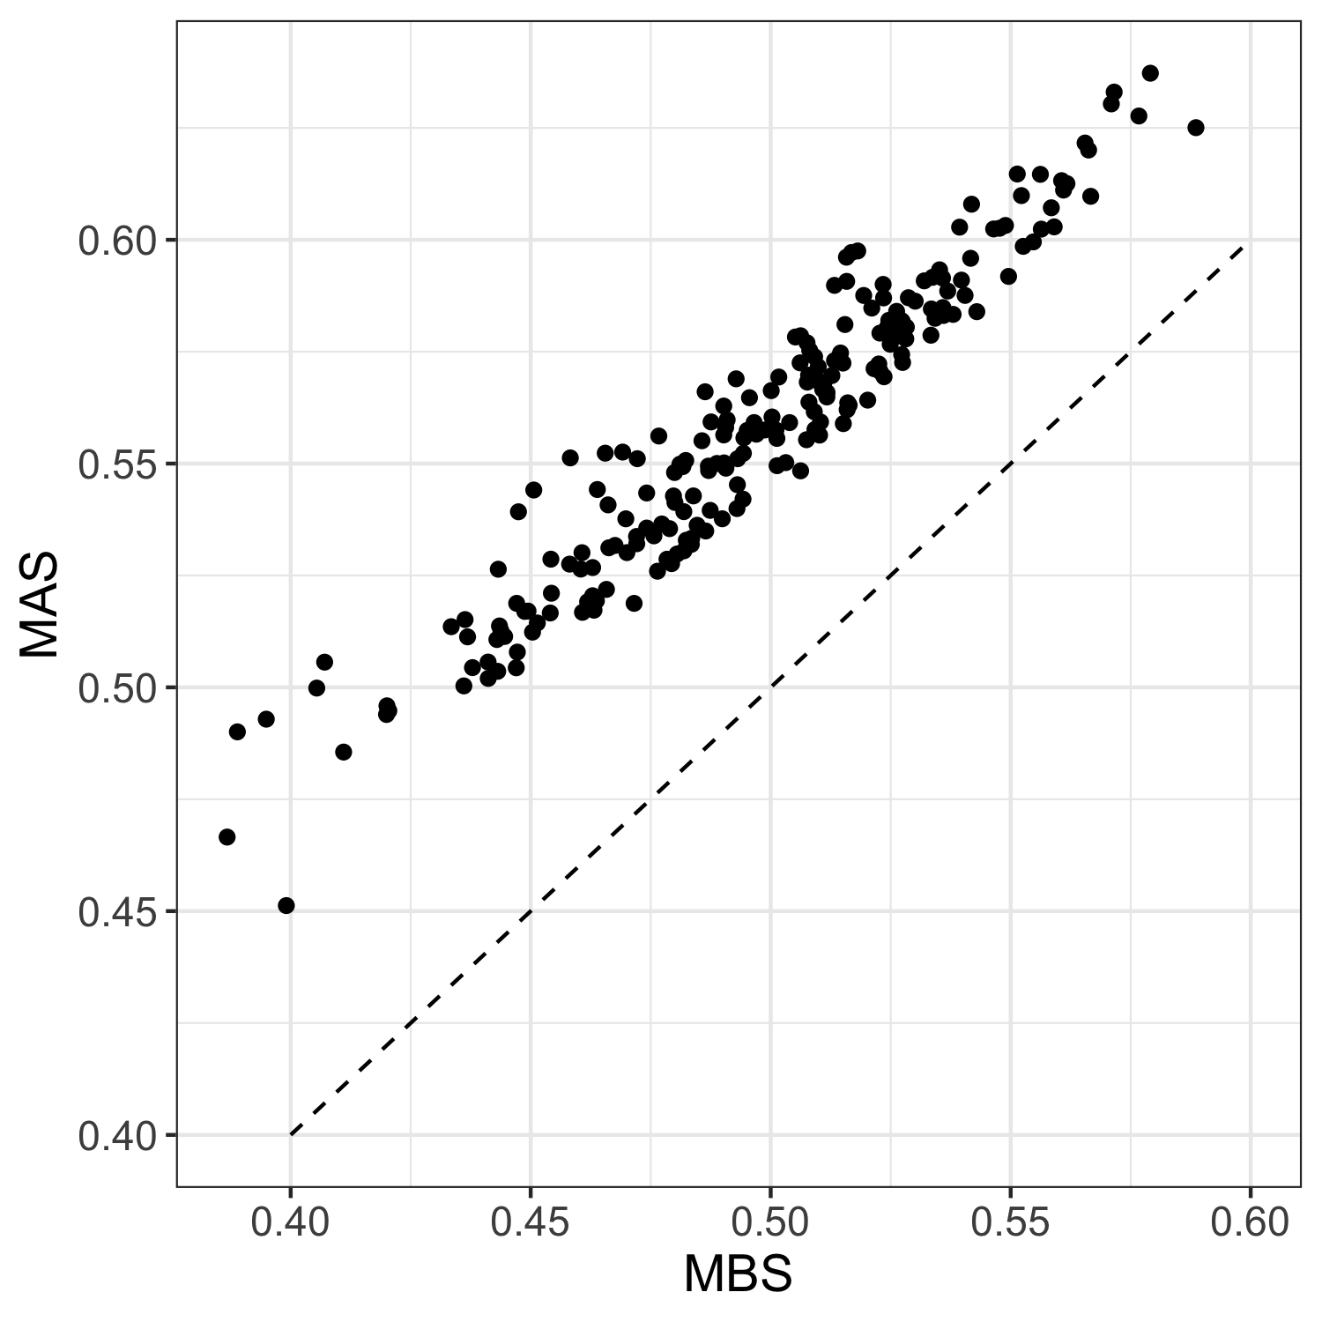
Year 2 Specific Gravity (Dry Matter)
Specific gravity is measured in Year 2 but at a different location (our seed farm), which is not as representative of commercial environments as Year 3 trial
Strategy: Use Year 2 data as correlated location, with zero weight in the selection index

Slide 17
Selection for Long-Term Gain
Selection on breeding value only maximizes genetic gain for one generation
  Genetic diversity is not considered
  Best individuals are likely to be closely related
Need to balance short- vs. long-term gain
  Strong selection can lead to the loss of beneficial alleles that may be present in individuals with lower fitness
Traditional approach to this problem in animal breeding is called optimum contribution selection

Slide 18
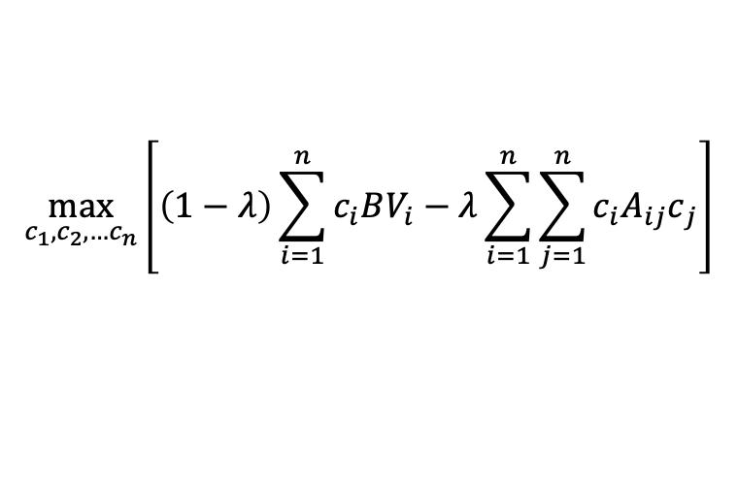
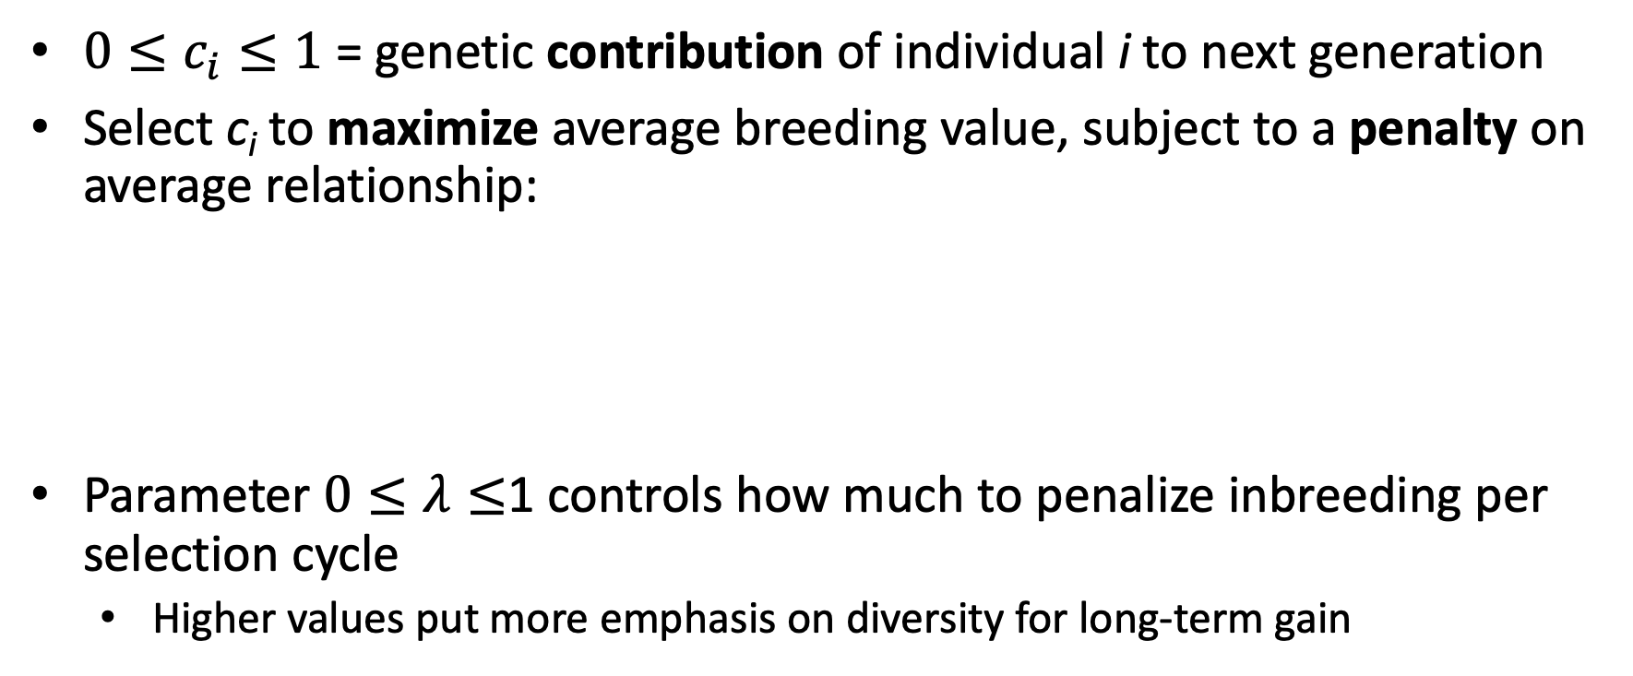
Optimum Contribution Selection (OCS)
$0≤c_{i}≤1$ = genetic contribution of individual i to next generation
Select c_{i} to maximize average breeding value, subject to a penalty on average relationship:
Parameter $0≤λ≤$1 controls how much to penalize inbreeding per selection cycle
  Higher values put more emphasis on diversity for long-term gain
$$\max_{c_{1},c_{2},…c_{n}}\left[\left(1−λ\right)\sum_{i=1}^{n}{c_{i}BV_{i}}−λ\sum_{i=1}^{n}{\sum_{j=1}^{n}{c_{i}{A_{ij}c}_{j}}}\right]$$

Slide 19


$$λ=0$$
Equivalently, can specify tradeoff based on angle of the “optimal frontier” = penalty degrees
$$λ=1$$

Slide 20
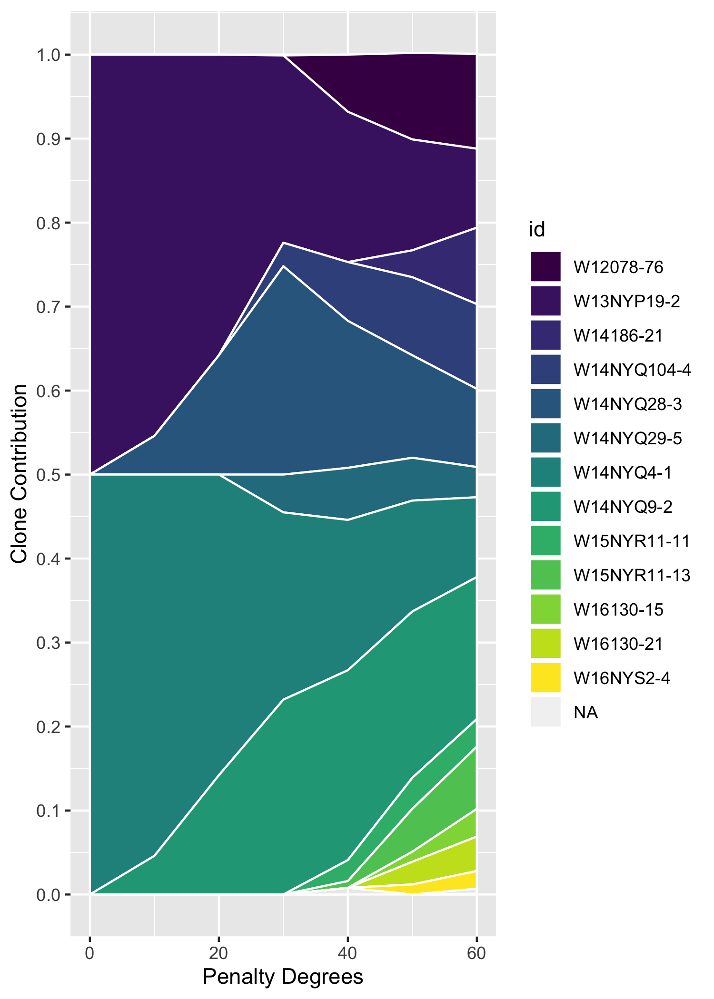
Clone Contribution
At 0º, only one cross is selected, with the highest average breeding value
As penalty increases, more crosses are selected

Slide 21
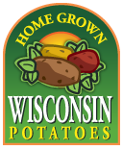


Acknowledgments
Software development funded by USDA Hatch and NIFA Award 2020-51181-32156 (Tools for Genomics-Assisted Breeding in Polyploids)
Vignette data collected with support from the USDA and potato industry

