Slide 1
Genomic Selection in Polyploids
Jeffrey Endelman
January 14, 2022
Funding from USDA NIFA Award #2020-51181-32156

Slide 2
Genomic Prediction vs. Selection
Prediction: statistical analysis and computation
  Similar across plants, animals, and humans
  Additive, Genotypic, and Hybrid predictions are possible
Selection: effective use of predictions in breeding
  Varies between species
  Involves complex, resource allocation problems

Slide 3

Genotypic Value
The genotypic value of a plant variety is the average phenotypic value over some population of environments
  Environment = location x year x management
  aka clonal value because measurement of clonal replicates (sexual or asexual) is implied
$$y=g+E+gE+e$$
Phenotype
Residual
Genotypic Value
Environment
Effect
Genotype x Environment Interaction

Slide 4


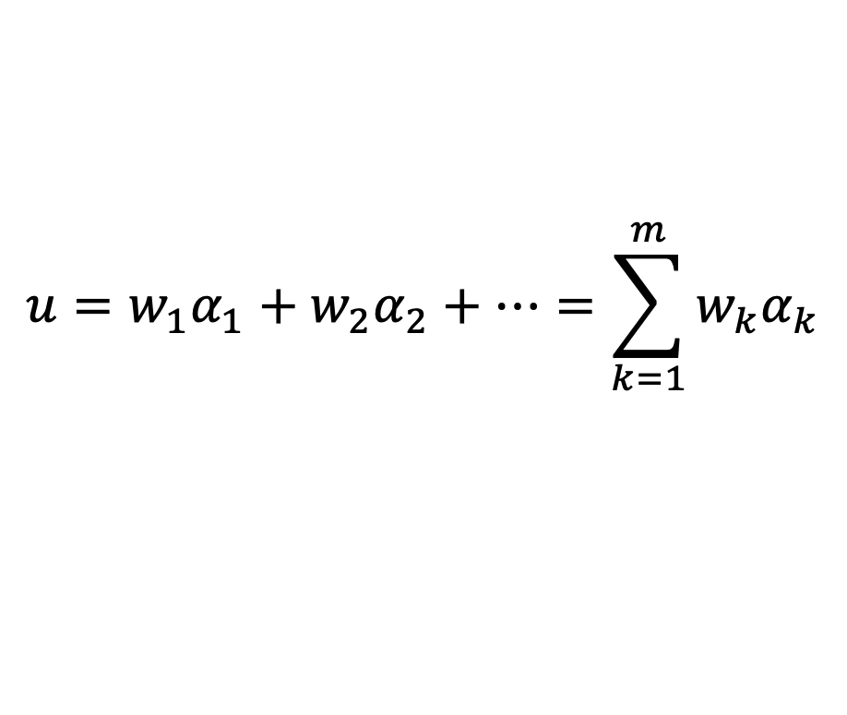
Breeding Value
Genotypic value is best predictor of clone performance BUT not progeny performance, aka breeding value
Under random mating, breeding value $≈$ additive value, defined by regression of genotypic value on allele dosage
For bi-allelic QTL:
$$g=u+r$$
$$u=w_{1}α_{1}+w_{2}α_{2}+…=\sum_{k=1}^{m}{w_{k}α_{k}}$$
Genotypic Value
Additive Value
Non-Additive
Value
Allele dosage at QTL 1
Additive effect at QTL 1

Slide 5
Additive Effect Example
Late
Early

Slide 6
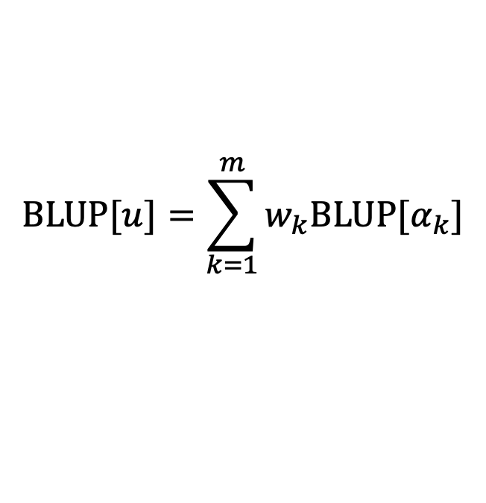
RR-BLUP
Since we do not know all QTL, in practice, additive values estimated by regression on genome-wide markers
With so many predictors, ordinary regression does not work
  Treat additive marker effects as random, predict by BLUP
BLUP is special case of method known as ridge regression (RR)
  Hence, often called RR-BLUP in the literature
$$BLUP[u]=\sum_{k=1}^{m}{w_{k}{BLUP[α}_{k}]}$$
Predicted Additive Value

Slide 7

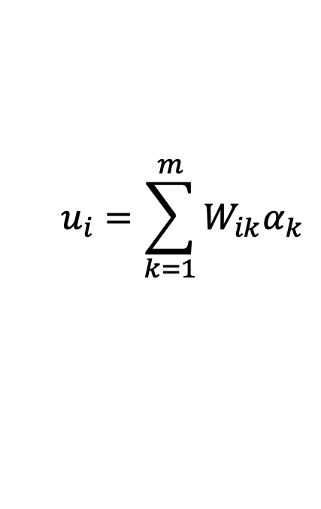
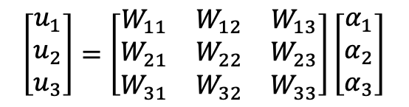
G-BLUP
Instead of treating markers as predictors, can predict additive values directly as multivariate normal effects, with covariance proportional to genomic relationship matrix G
$$u_{i}=\sum_{k=1}^{m}{W_{ik}α_{k}}$$
$$\left[\begin{matrix}u_{1} \\ u_{2} \\ u_{3}\end{matrix}\right]=\left[\begin{matrix}W_{11} & W_{12} & W_{13} \\ W_{21} & W_{22} & W_{23} \\ W_{31} & W_{32} & W_{33}\end{matrix}\right]\left[\begin{matrix}α_{1} \\ α_{2} \\ α_{3}\end{matrix}\right]$$
$$u=Wα$$
Matrix of marker dosages
Additive Value of clone i
Allele dosage for clone i at marker k
Vector of additive values
Vector of marker effects

Slide 8


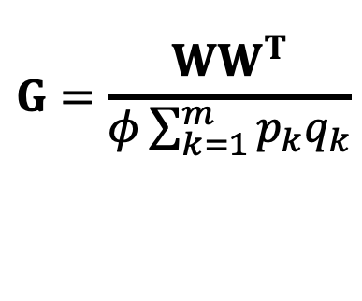
G-BLUP
Instead of treating markers as predictors, can predict additive values directly as multivariate normal effects, with covariance proportional to genomic relationship matrix G
Formula for computing G from markers
$$u=Wα$$
$$G=\frac{WW^{T}}{φ\sum_{k=1}^{m}{p_{k}q_{k}}}$$
$$cov\left[u\right]=WW^{T}σ_{α}^{2}=Gσ_{u}^{2}$$
Variance of marker effects
Variance of additive values
ploidy

Slide 9
G vs A matrix
N = 570 potato clones
Relationship matrix from pedigree (A) is based on probability IBD, so values are all non-negative
G matrix based on correlation as a measure of similarity, so values can be pos. or neg.
Unlike A, G accounts for Mendelian sampling and LD in founders
  Can predict within biparental families

Slide 10
RR-BLUP = G-BLUP
G-BLUP framework more accurately reflects the “real” nature of genomic prediction
  Marker effects from BLUP include relationship information
Genomic prediction relies on two kinds of genetic information
Marker-QTL LD
Marker-Estimated Relationship
Simulation experiments by Habier et al. (2007, 2013) illuminated important differences

Slide 11
Glossary
Training population (TP): the genotypes (clones) and environments used to make predictions
  Does not require “extra” phenotyping – use breeding program data
Validation population (VP): the group being predicted, aka selection candidates
Prediction accuracy (r): correlation between predicted and true value
Common misconception is that TP and VP need to be different
  When VP is within the TP = genome-wide marker-assisted selection
  Including phenotype data for sel. candidates improves prediction accuracy

Slide 12
Estimating Accuracy
Theoretical estimate from BLUP, more commonly reported as r² and called reliability.
Cross-validation: sample correlation between predicted and observed values
Both methods have strengths and weaknesses:
#1 assumes the model is correct, #2 does not
#2 requires good estimates of the true value, #1 does not

Slide 13
Two kinds of genetic information
 | Accuracy due to LD | Accuracy due to Relationship
Population Size (N) |  |  | Relationship generates more accuracy than LD at small N
Number of generations between TP and VP

Slide 14
Two-way Classification
Environments
 | In TP | Not in TP
In TP | Easy | Harder
Not in TP | Harder | Hardest
Key principle:
Predictions for more distantly related individuals and/or environments are less accurate
Genotypes

Slide 15
Predicting progeny of A x B with different TPs
Maize DH families
Riedelsheimer et al. (2013)
TP
AxB (full-sibs)
AxC and BxD (half-sibs through both parents)
Prediction accuracy
AxC or BxD (half-sibs through one parent)
CxD (no close relatives)
Training population size

Slide 16
Clark et al. 2012
Animal breeding dataset
Average G with all individuals in the TP
Average G for top 10 closest relatives in the TP

Slide 17
Two-Stage Analysis of
Multi-Environment Trials
More flexibility for environment-specific models (spatial variation, experimental designs) than single-stage analysis
Stage 1: Compute BLUE for genotypes within environment
→ response variable in Stage 2
Stage 2: Compute BLUP for breeding values or marker effects across environments
Including var-cov matrix for Stage 1 BLUEs in Stage 2 makes the analysis fully efficient (Damesa et al. 2017)
Developed R package StageWise to facilitate adoption by plant breeders

Slide 18
StageWise https://github.com/jendelman
Three vignettes
Single trait, homogeneous GxE
Singe trait, heterogeneous GxE
Multiple traits, homogeneous GxE

Slide 19
Stage1
compute BLUEs
& var-cov matrix
Marker Effects
GWAS
“marker”
Stage2
estimate variance components (ASReml-R)
blup_prep
mask BLUEs (optional) &
invert var-cov mat
blup
“id”
Breeding Values
Genotypic Values
Reliability
read_geno
compute G matrix

Slide 20
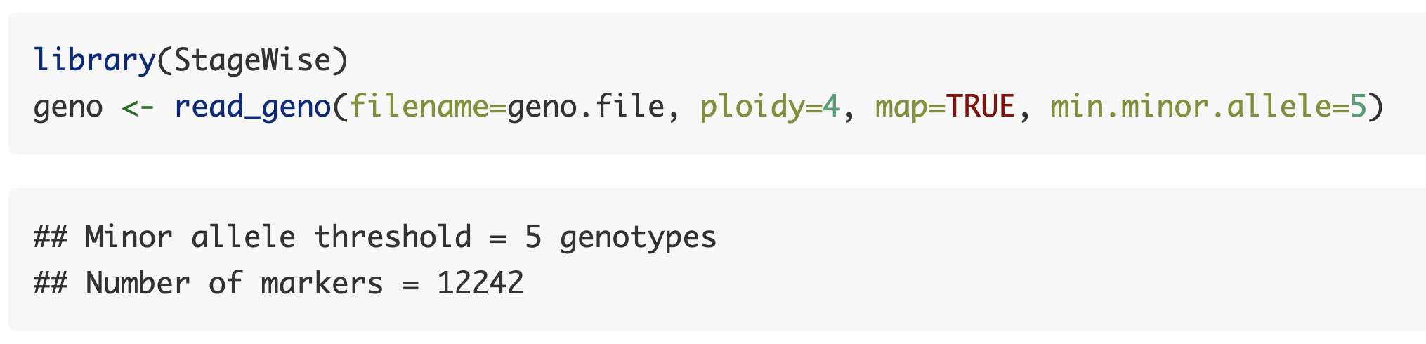
Vignette 1. Potato Breeding Example
6 years at one location
950 clones
12K markers (SNP array)

Slide 21
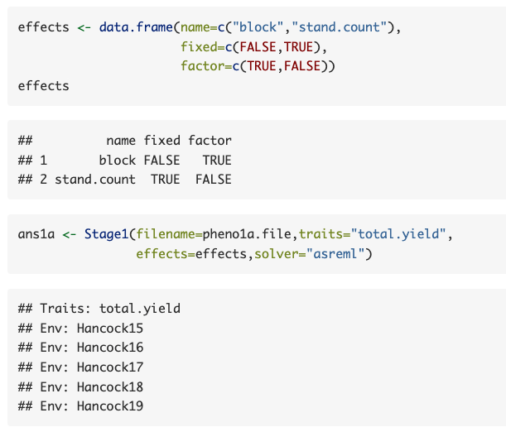

Slide 22
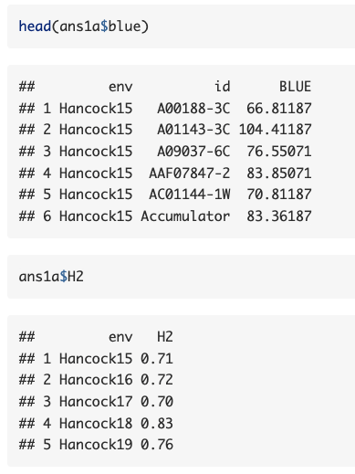
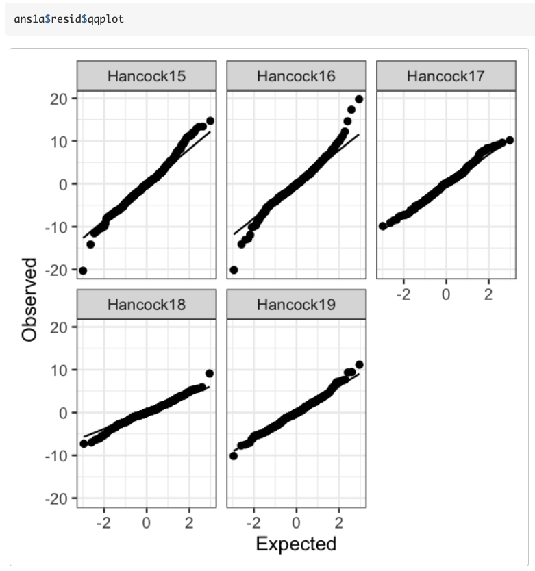

Slide 23
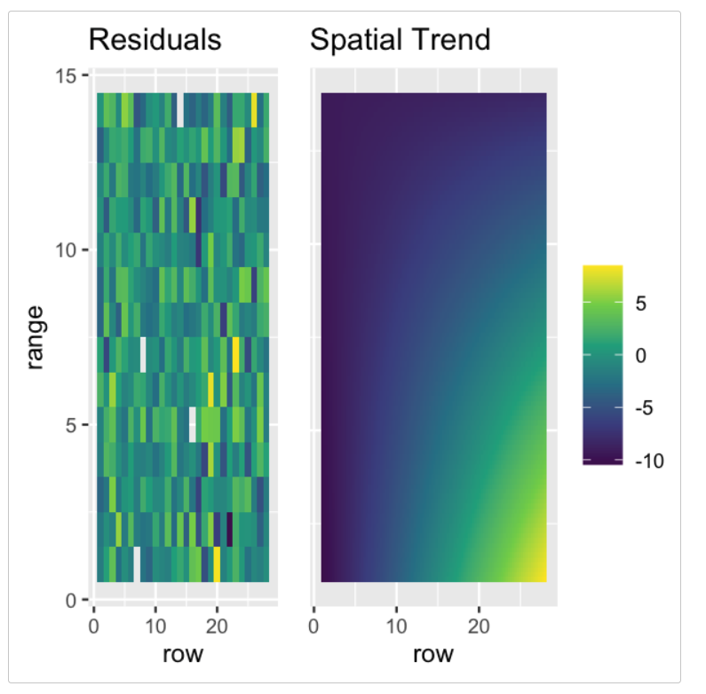
StageWise can also use the R/SpATS package in Stage1, to model spatial variation with 2D splines

Slide 24

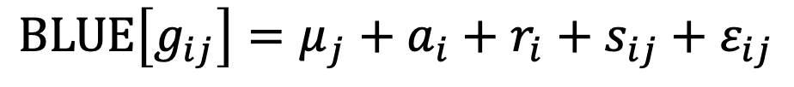



Stage 2 Model (homogeneous GxE)
Additive value
for genotype i
Residual genetic value
for genotype i
$$a\sim N\left(0,Gσ_{a}^{2}\right)$$
$$r\sim N\left(0,Iσ_{r}^{2}\right)$$
Stage 1 BLUE for
genotype i in env j
$$BLUE\left[g_{ij}\right]=μ_{j}+a_{i}+r_{i}+s_{ij}+ε_{ij}$$
GxE (model residual)
$$ε_{ij}\sim N\left(0,σ_{GE}^{2}\right)$$
Main effect for env j
Stage 1 error
(var parameters fixed)
$$s\sim N\left(0,⊕Ω_{k}\right)$$
k

Slide 25
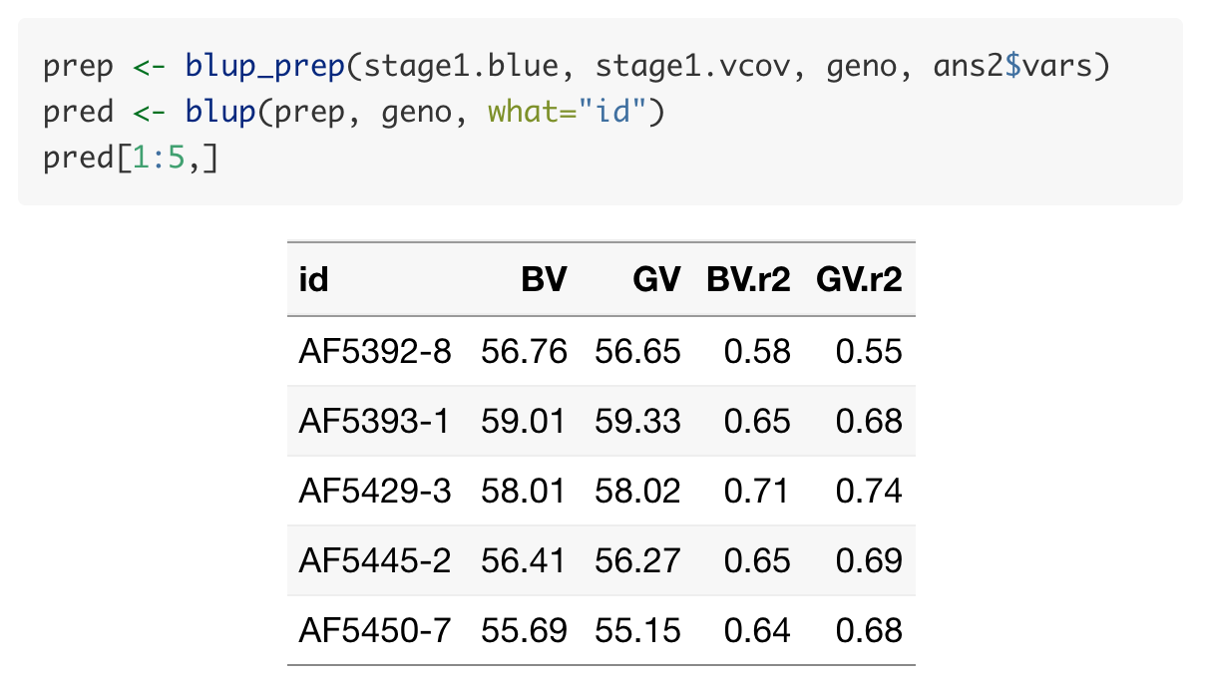
BV = Breeding (additive) value
GV = Genotypic value
r² = Reliability (squared correlation)

Slide 26
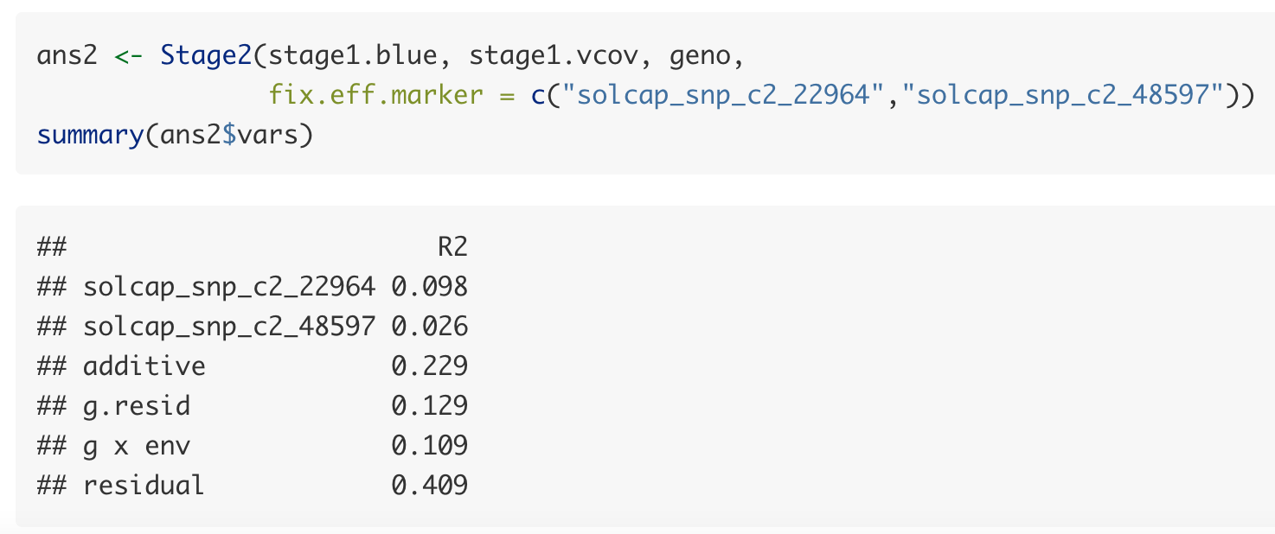
Fixed Effect Markers
Markers linked to major QTL can be included in Stage2 as fixed effects

Slide 27
Sparse Testing
Genomic selection also creates new possibilities for experimental design
Sparse Testing: Highly unbalanced design with respect to genotype
  Alleles are replicated even when genotypes (clones) are not
Multi-location phenotyping is possible at an earlier stage of variety development, even before enough seed is available to test in all locations

Slide 28
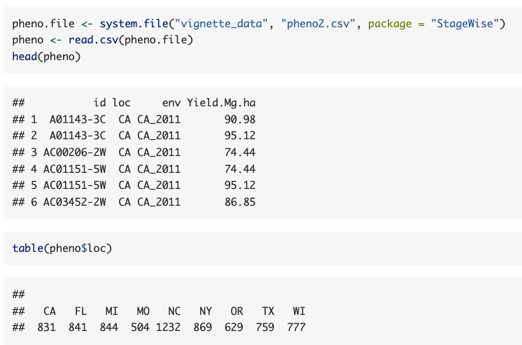
Vignette 2. Single trait, heterogeneous GxE

Slide 29
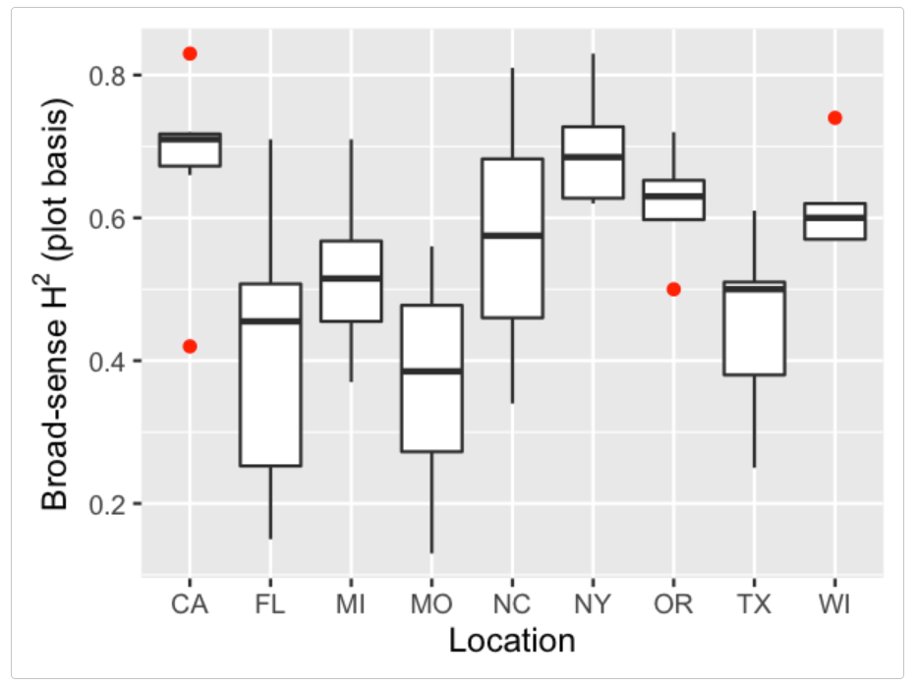

Slide 30
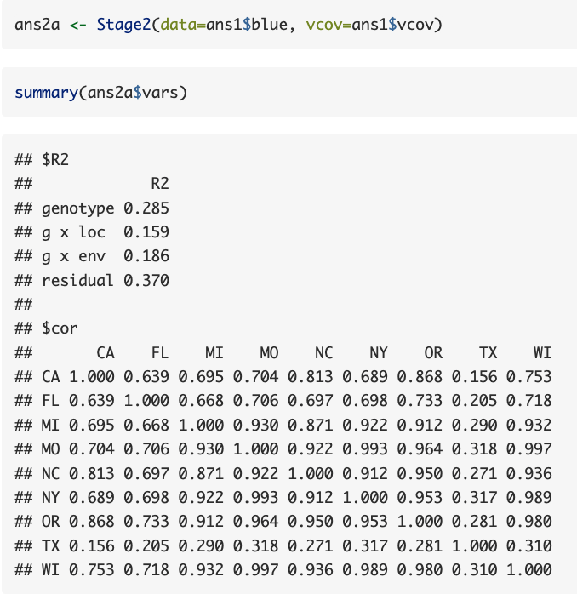
Sparse Covariance Model
StageWise uses two latent factors to model genetic covariance between locations
Enough complexity for a typical breeding program but may be insufficient for cross-program analysis (i.e., diverse locations)

Slide 31
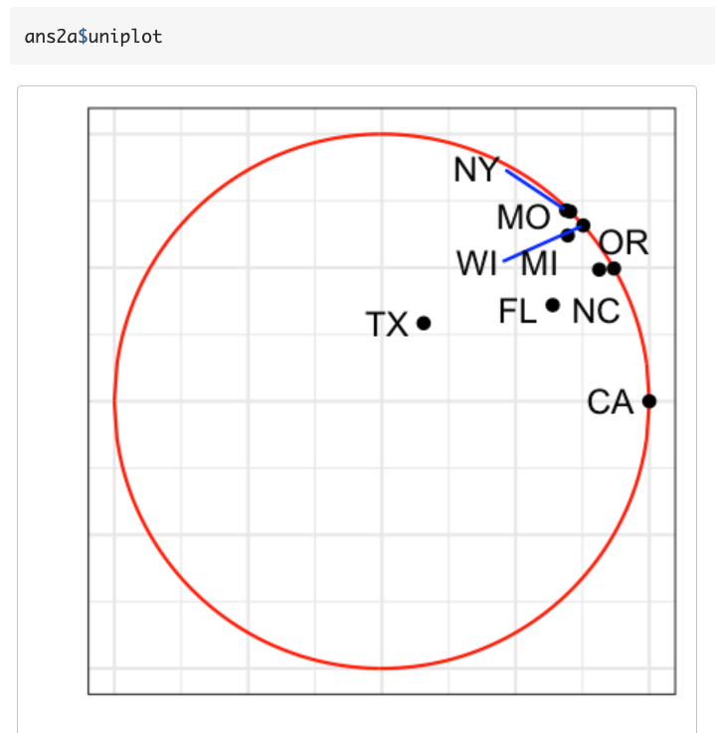
Visualize results with a uniplot (Cullis et al. 2010)
(radius)² = prop. var. explained by latent factors
cos(angle) = genetic correlation due to latent factors

Slide 32
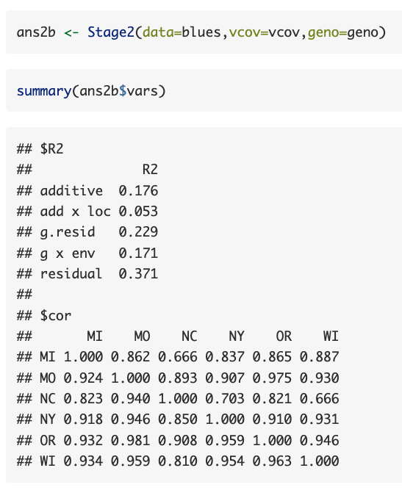
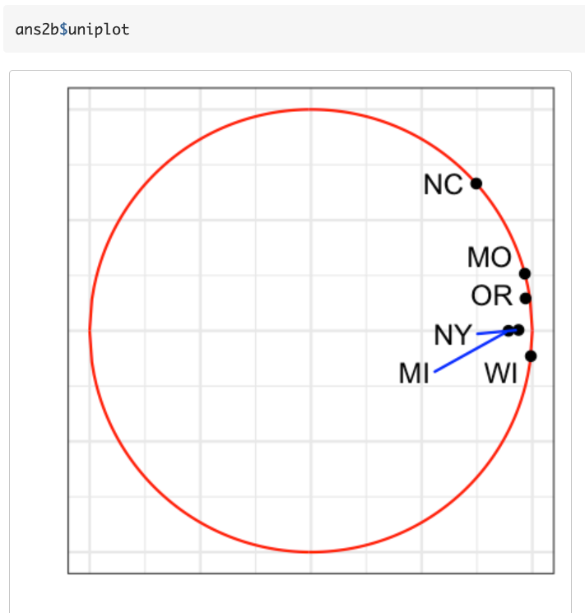
Additive correlation
Total genetic correlation

Slide 33
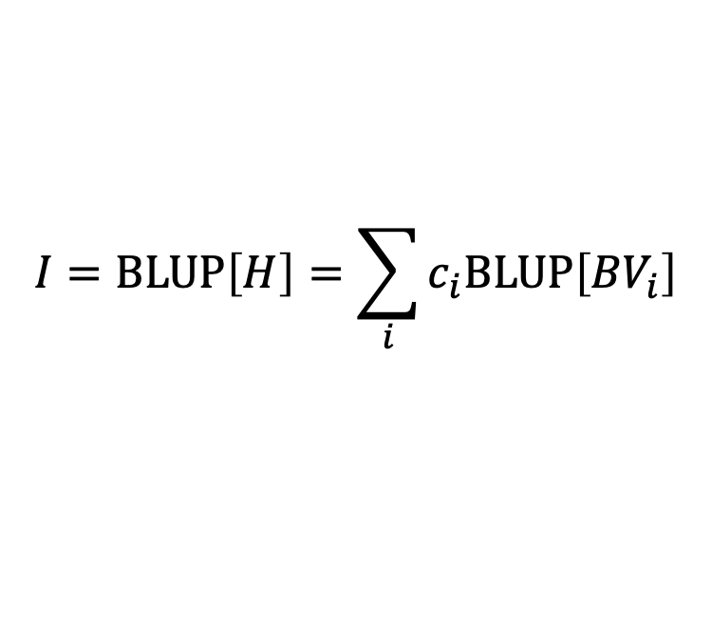
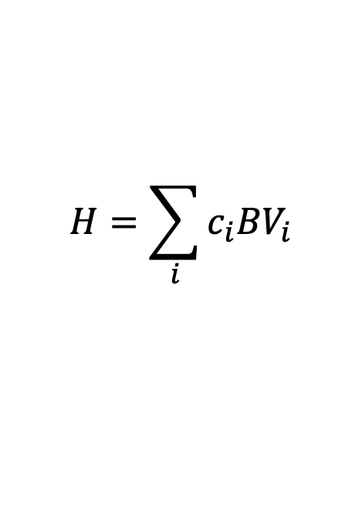
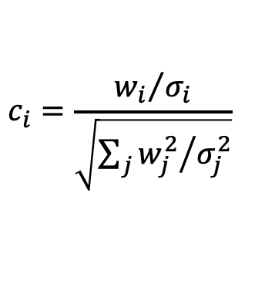
Selection Indices
StageWise makes it easy to use the optimal index!
Under multivariate analysis, coefficients for BLUPs = coefficients for true values
$$H=\sum_{i}{c_{i}{BV}_{i}}$$
Genetic Merit:
$$I=BLUP\left[H\right]=\sum_{i}{c_{i}BLUP\left[{BV}_{i}\right]}$$
Selection Index:
Index weights (w_{i}) are interpreted for standardized traits and rescaled to get coefficients with unit norm:
$$c_{i}=\frac{{w_{i}}/{σ_{i}}}{\sqrt{\sum_{j}{{w_{j}^{2}}/{σ_{j}^{2}}}}}$$

Slide 34
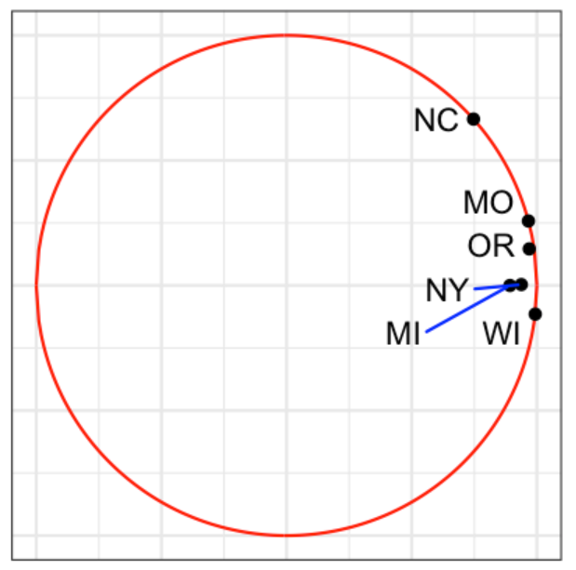
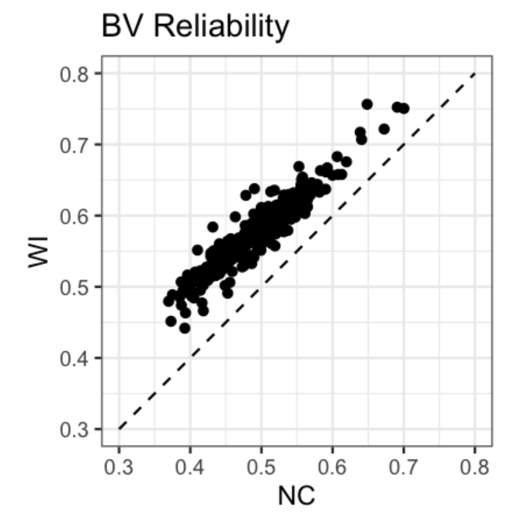
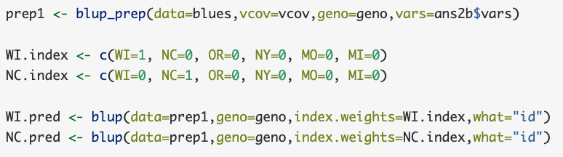
Vignette 2. Single trait, heterogeneous GxE
Compare reliability for WI vs NC:
WI is higher because higher correlation with other locs

Slide 35



Acknowledgments
Software development funded by USDA Hatch and NIFA Award 2020-51181-32156 (Tools for Genomics-Assisted Breeding in Polyploids)
Vignette data collected with support from the USDA and potato industry

