Slide 1
New Software Features for GWAS in Polyploids
Jeffrey Endelman
January 13, 2022

Slide 2
GWASpoly R package https://github.com/jendelman/GWASpoly
Several software updates in the past year
LOCO method for kinship matrix
fit.QTL function to estimate partial R² with multiple QTL
VCF2dosage to generate GWASpoly input file from VCF file

Slide 3
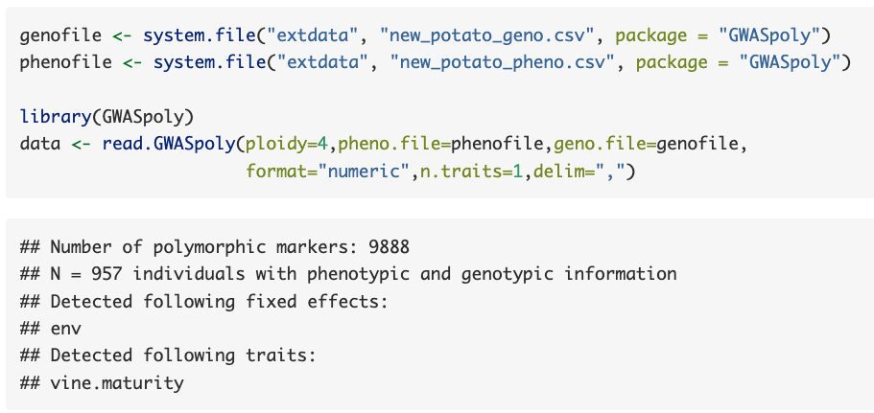
Vignette Example

Slide 4
Marker Curation
GWAS relies on LD between markers and QTL
  Markers can only have high LD with QTL at similar allele frequency
But statistical power is low for rare alleles (i.e., low MAF)
Thus, removing markers with low MAF can reduce the computational burden and threshold due to multiple testing

Slide 5

Marker Curation
set.params allows marker curation based on MAF or maximum genotype frequency
  Latter is more general and appropriate for non-additive models
  If neither MAF or geno.freq is specified, the software now uses geno.freq = 1 – 5/N as default

Slide 6

LOCO = Leave One Chromosome Out
In the traditional K model (Yu et al. 2006), the marker effect is present as both fixed and random effect
Listgarten et al. (2012) showed this duplication leads to slight reduction in statistical power
One efficient fix is to compute a separate genomic relationship matrix for each chromosome, which excludes all markers from that chromosome (Yang et al. 2014)

Slide 7
Original
LOCO
Higher scores at significant QTL with LOCO but also slightly higher inflation across whole genome

Slide 8
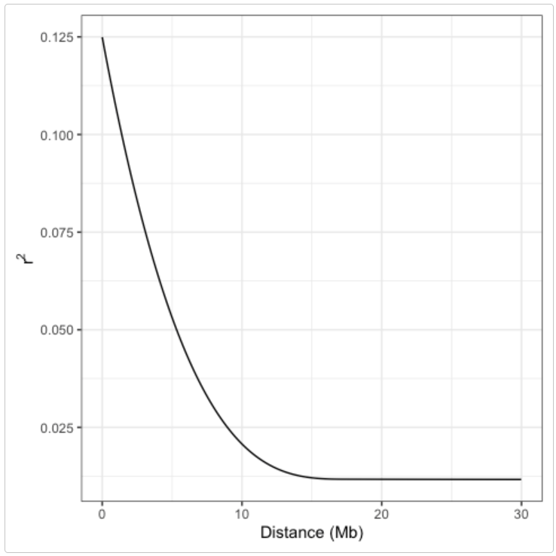
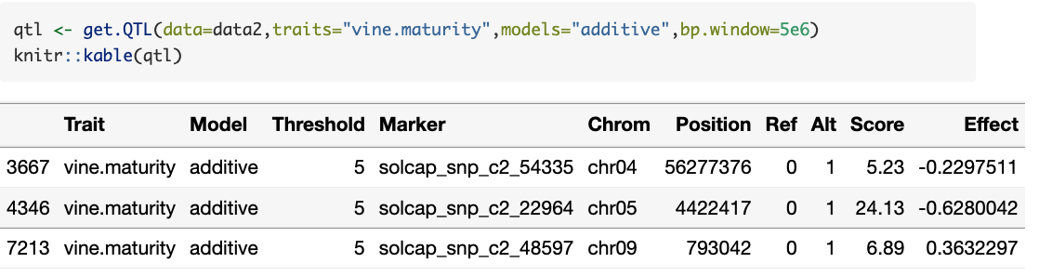

LD.plot creates figure of $\left\langle r^{2}\right\rangle$ vs. distance
Can help with QTL delineation
Use with bp.window in get.QTL to prune list of significant markers

Slide 9
fit.QTL
New function to report partial R² in multiple QTL models
  Based on likelihood ratio under backward elimination
fit.QTL(data, trait, qtl, fixed)
Data frame with marker name and model (e.g., additive, dominant)
Optional data frame with effect name and type (factor or numeric)

Slide 10
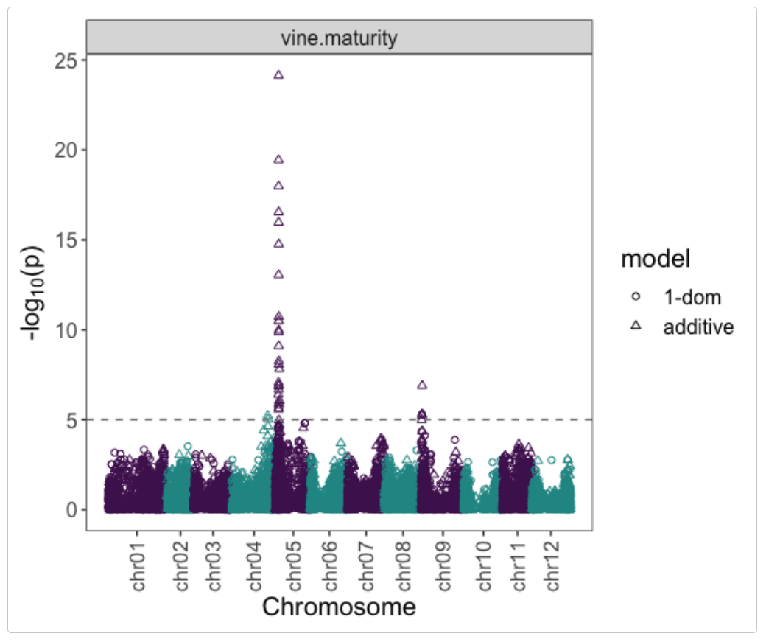
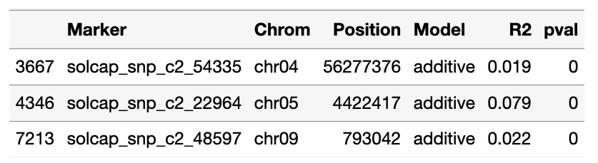

Slide 11
VCF (Variant Call Format)
Common format for genotyping-by-sequencing data
New function, VCF2dosage, will convert to GWASpoly input format
At present, two FORMAT fields available for extracting genotypes
GT = posterior maximum, e.g. 0/0/1/1
DS = posterior mean

Slide 12
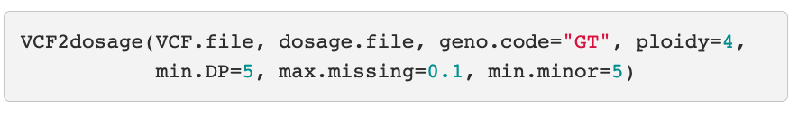
min.DP: minimum sample depth
max.missing: maximum proportion of missing data per marker
min.minor: minimum number of samples with the minor allele

Slide 13
Example
GBS of tetraploid rose F1 population (O. Riera-Lizarazu, TAMU)
Over 80K variants in VCF file → 45K exported for GWASpoly

Slide 14
Multi-Environment GWAS
Ideally, GWAS dataset should span multiple environments to ensure QTL are robust
GWASpoly can include cofactors to model environment or other fixed effects
  But too limited for complex experimental designs or spatial variation specific to environments
More complex data commonly analyzed in two stages
Stage 1: Analyze each environment (i.e., location x year) separately, with genotype as fixed effect
Stage 2: GWAS with genotype BLUEs as the response variable

Slide 15
Two-Stage Analysis
BLUEs from Stage 1 can have different standard errors
  Unbalanced experimental designs
  Differences in plot H²
Best analysis propagates the uncertainty from Stage 1 into Stage 2 (Damesa et al. 2017)
Now available for GWAS with R package StageWise

Slide 16
StageWise R package https://github.com/jendelman/StageWise
Three vignettes
Single trait, homogeneous GxE
Singe trait, heterogeneous GxE
Multiple traits, homogeneous GxE

Slide 17
Stage1
compute BLUEs
& var-cov matrix
Marker Effects
GWAS
“marker”
Stage2
estimate variance components (ASReml-R)
blup_prep
mask BLUEs (optional) &
invert var-cov mat
blup
“id”
Breeding Values
Genotypic Values
Reliability
read_geno
compute G matrix

Slide 18
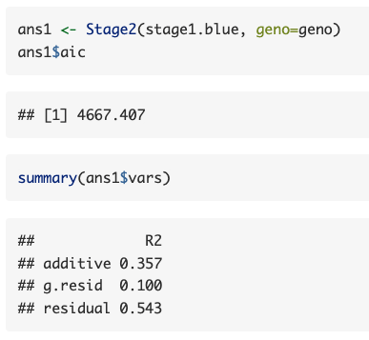
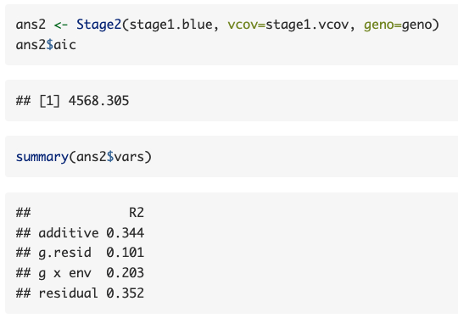
Without Stage 1 Errors
Fully Efficient Model
Including var-cov matrix of Stage 1 BLUEs lowers the AIC and
allows partitioning of GxE from plot error (“residual”)

Slide 19
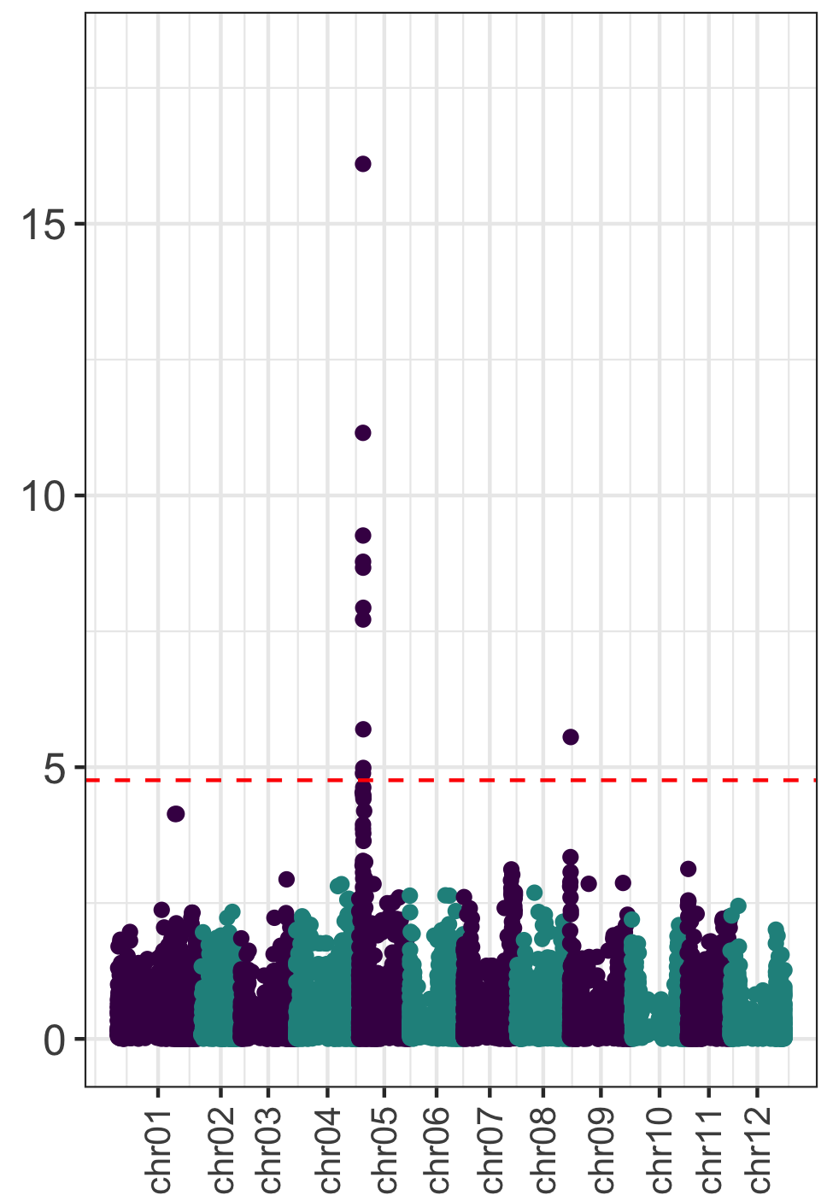
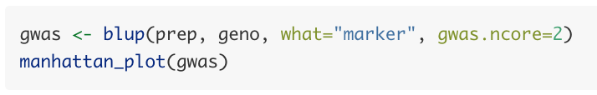
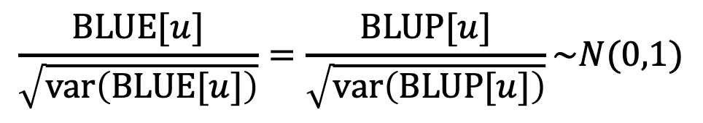
GWAS by BLUP
Exploits discovery that standardized marker effect (u) is invariant to modeling as fixed or random (Bernal Rubio et al. 2016)
Potato Vine Maturity
$$\frac{BLUE[u]}{\sqrt{var\left(BLUE[u]\right)}}=\frac{BLUP[u]}{\sqrt{var\left(BLUP[u]\right)}}\sim N(0,1)$$
-log₁₀p

Slide 20
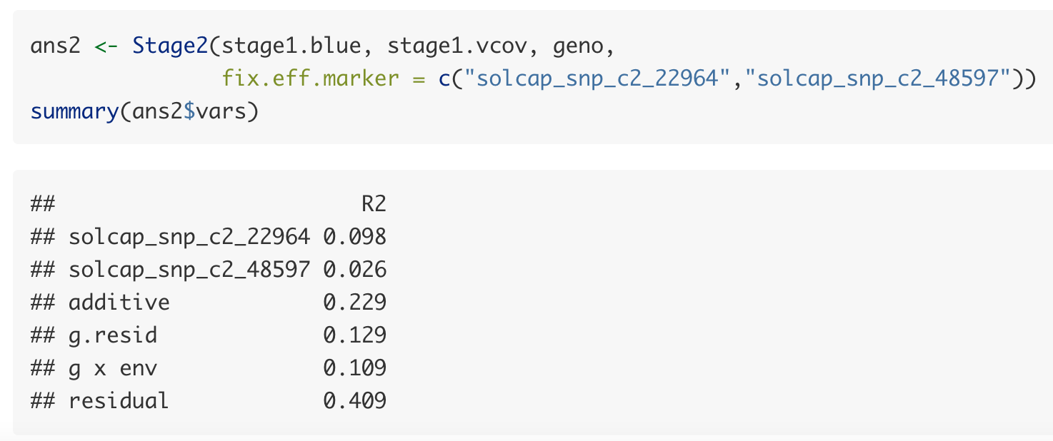
Fixed Effect Markers
Markers linked to major QTL can be included in Stage2 as fixed effects

Slide 21
Summary
StageWise makes the most efficient use of data for two-stage analysis but was not designed to be a “full-service” GWAS package
  Only additive QTL model
  Only one method to calculate detection threshold
Both packages can estimate partial R²
  GWASpoly uses “exact” ML method
  StageWise uses approximate method to partition variance across multiple fixed and random effects
Plans for 2022: multi-allelic markers, mixed ploidy panels

