Slide 1
Tools for Genomics-Assisted Breeding in Polyploids Workshop
Polyploids Community Website Resource
www.polyploids.org
Dorrie Main
Tools for Polyploids Workshop, January 13-15, 2021 (Virtual)

Slide 2
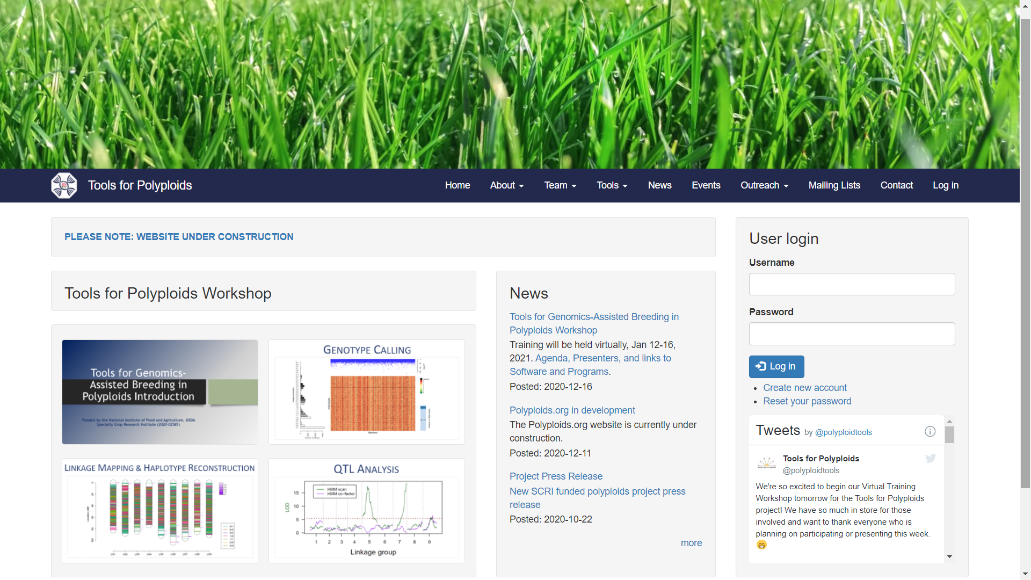
POLYPLOIDS.ORG

Slide 3
POLYPLOIDS.ORG

Slide 4
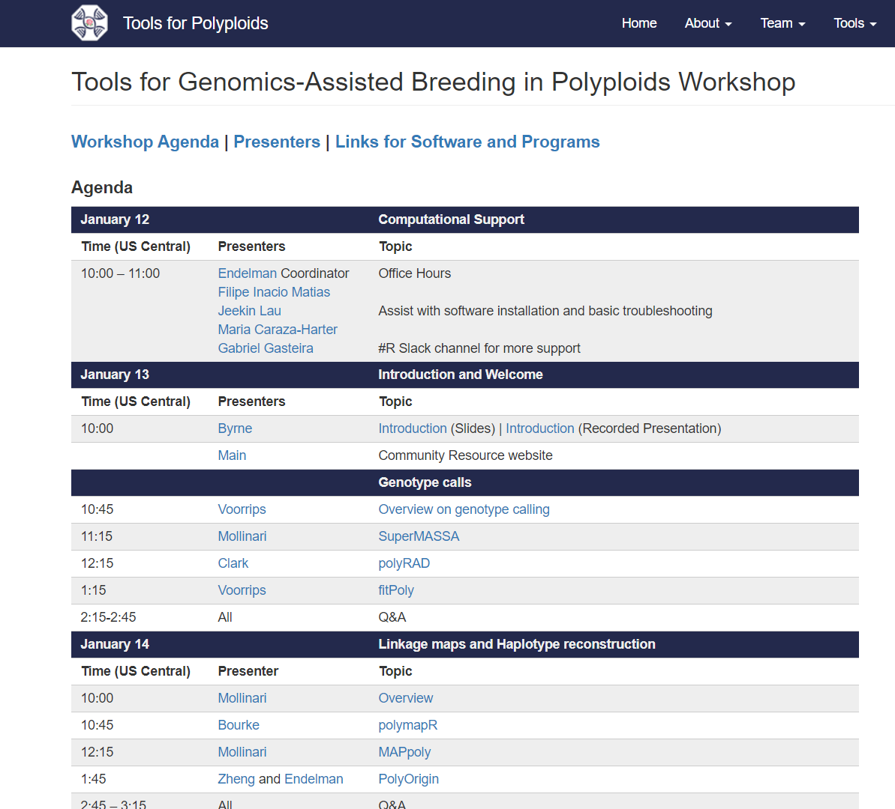

Slide 5
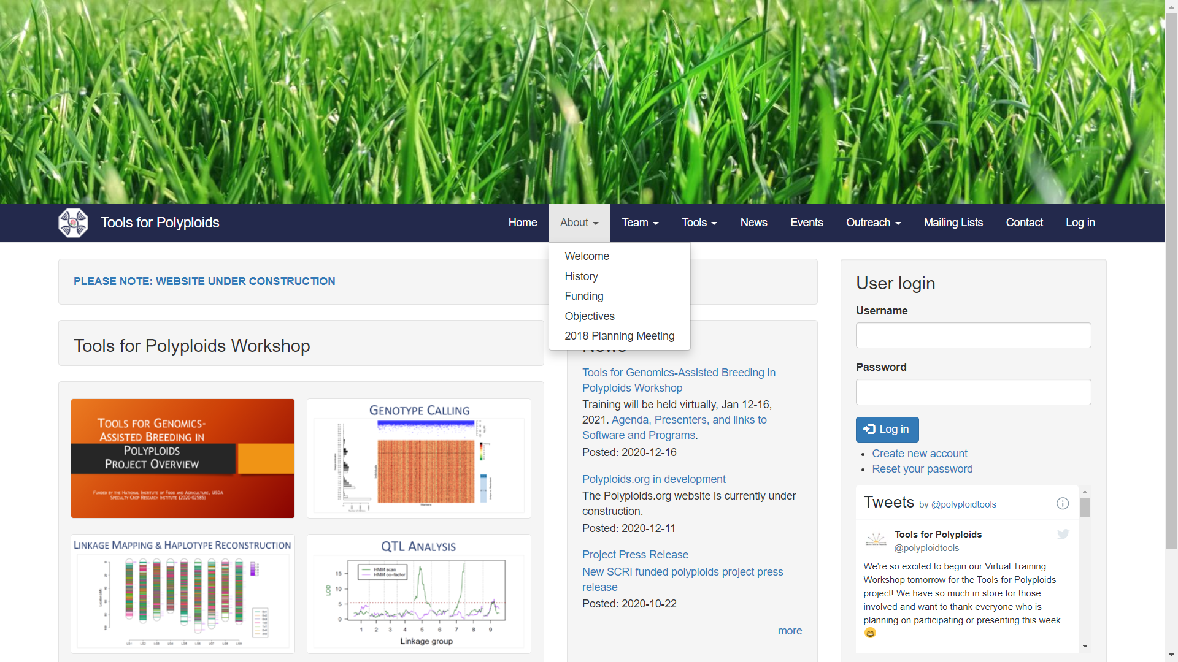

Slide 6
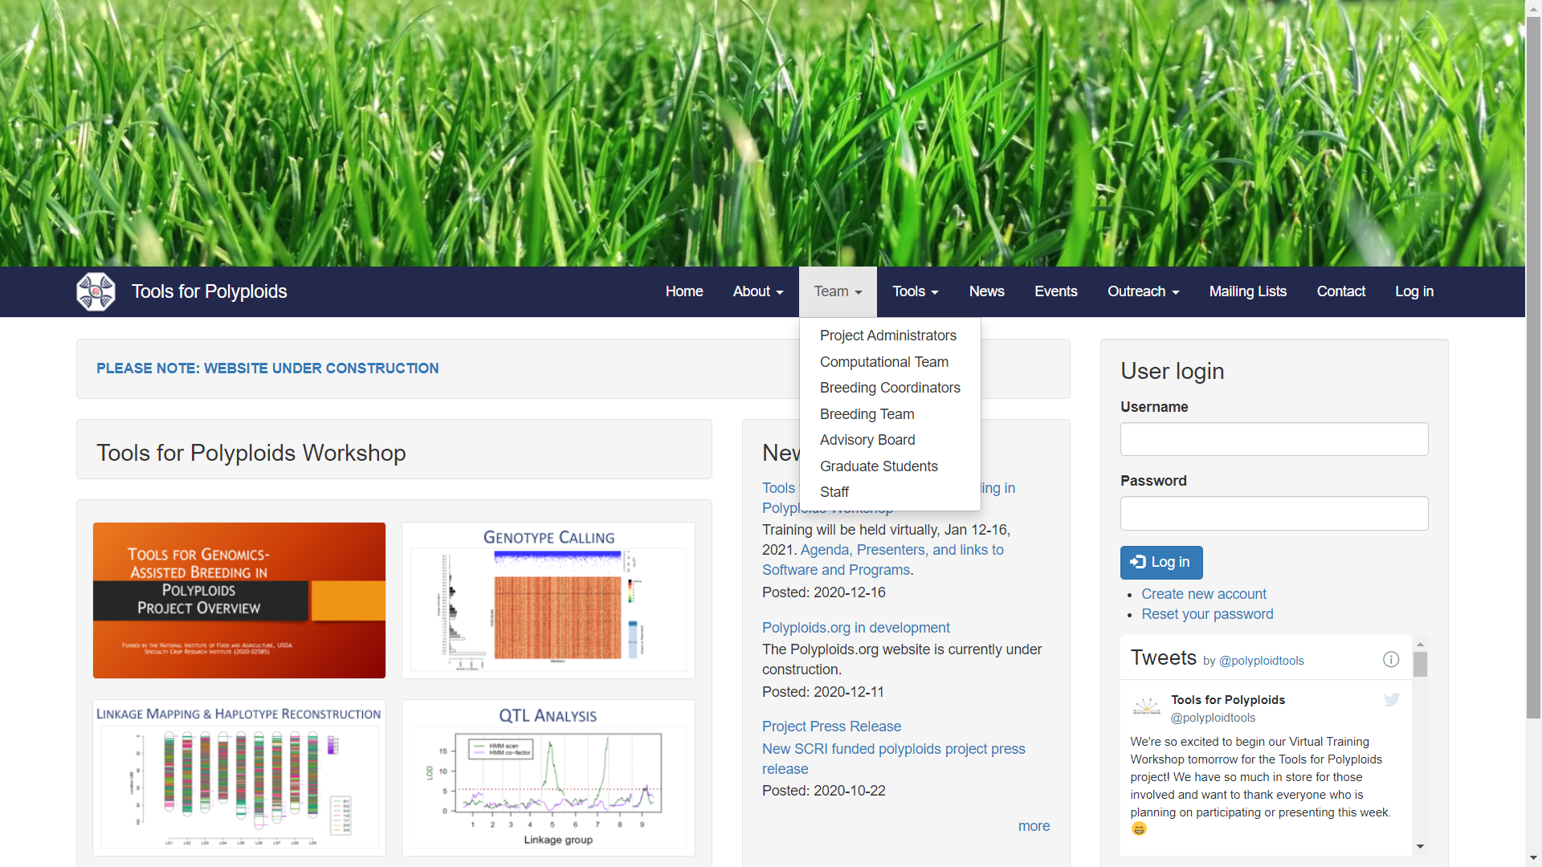

Slide 7
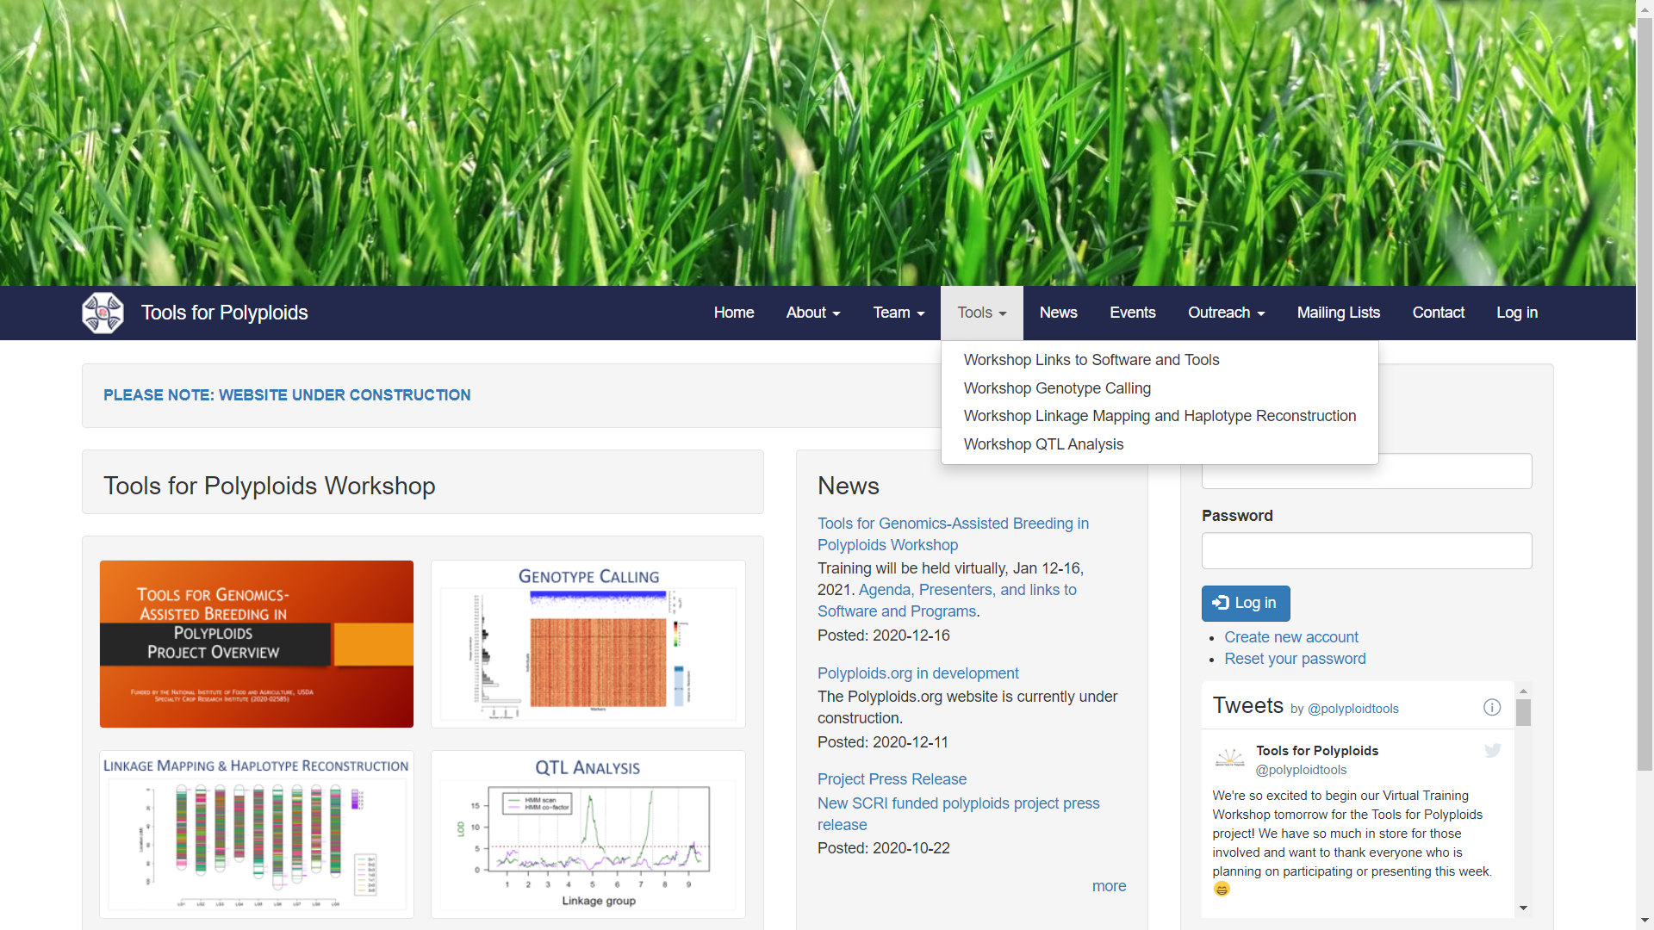

Slide 8
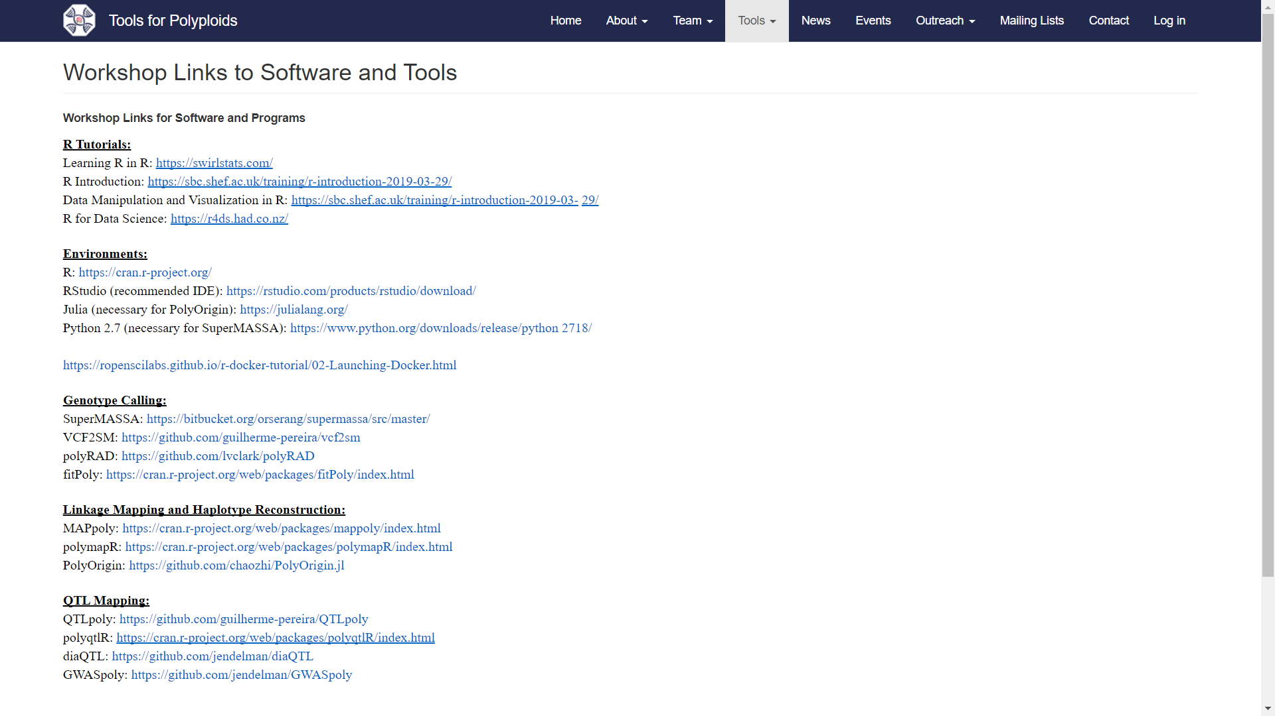

Slide 9
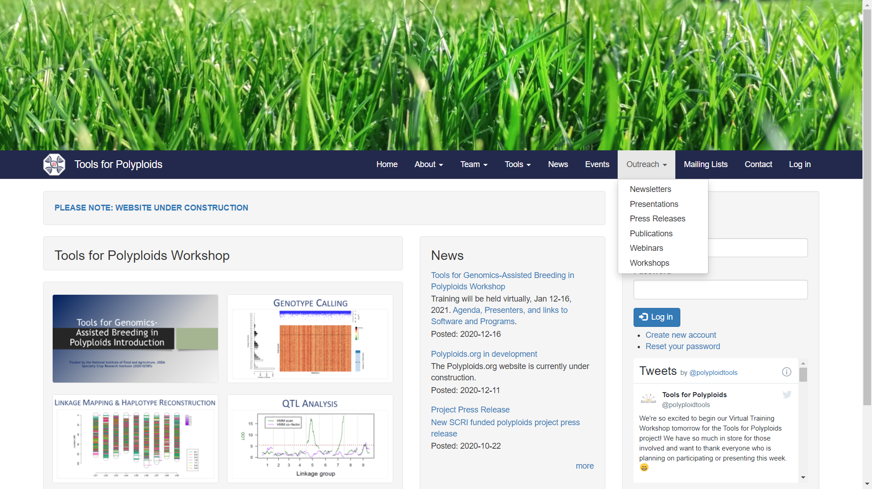

Slide 10
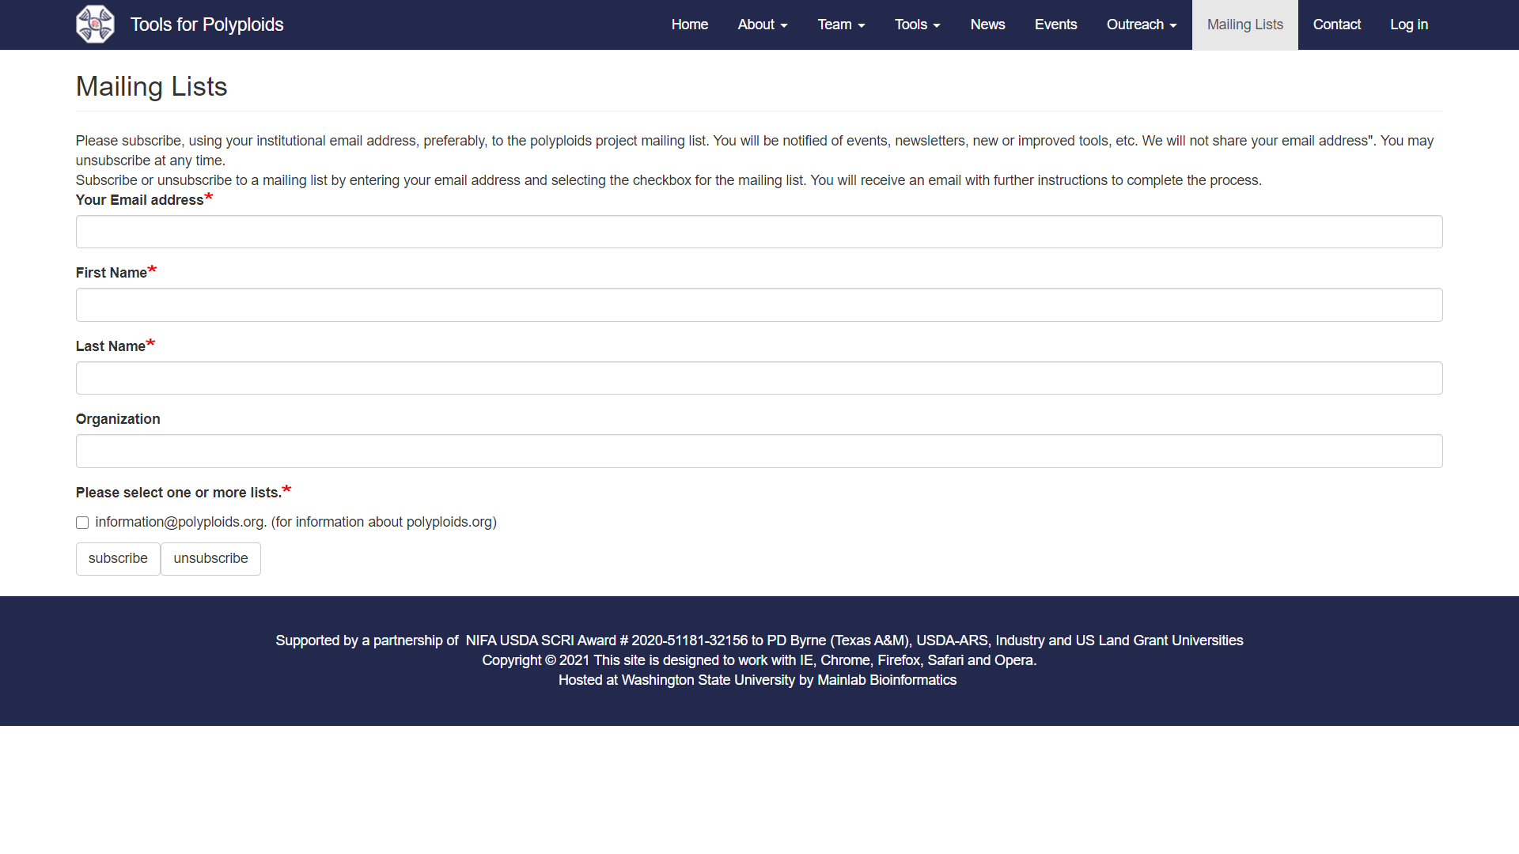
Please join the project Mailing List

Slide 11
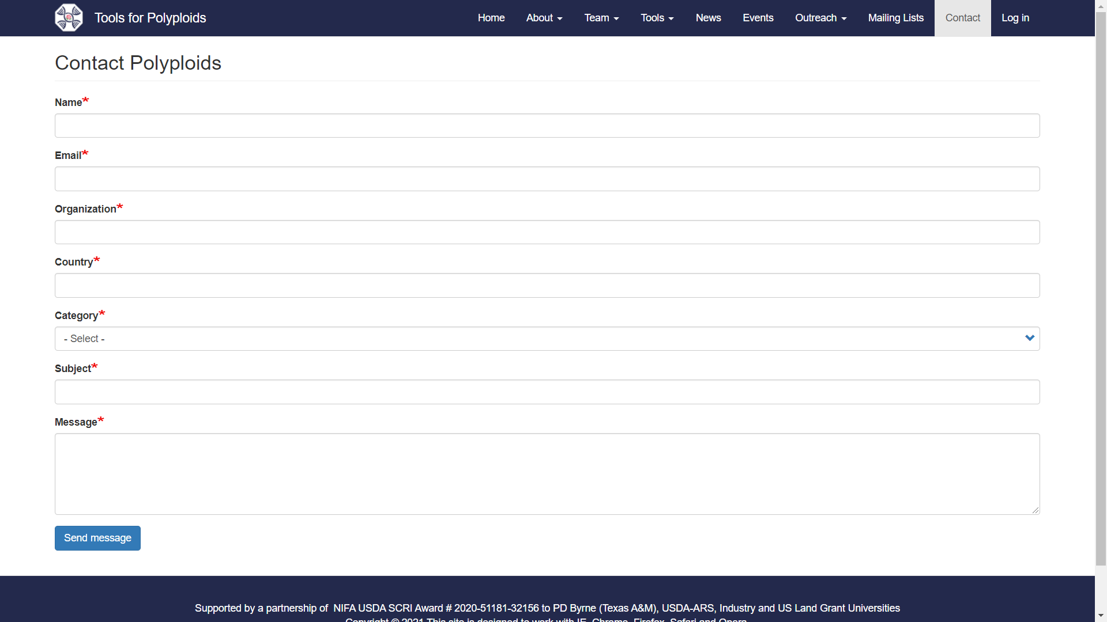
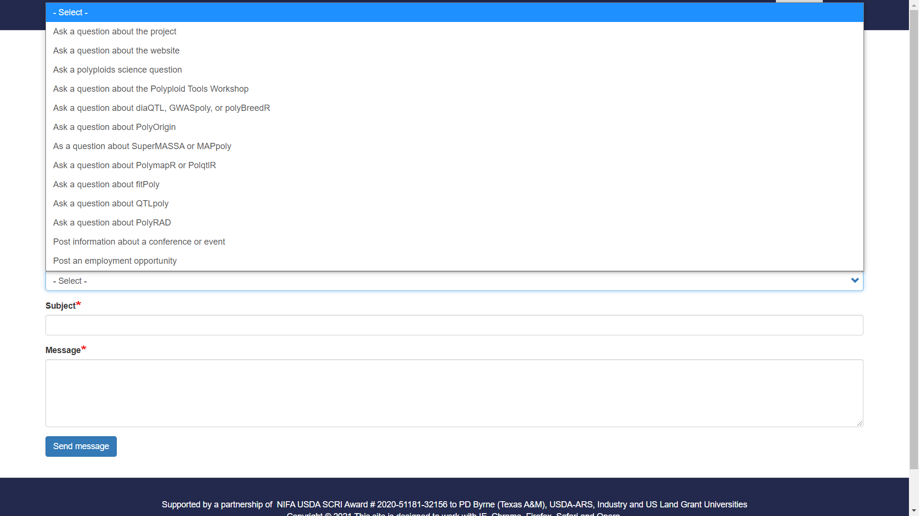
Please contact us using the contact mailing form and select the most relevant category for your question

Slide 12
POLYPLOIDS.ORG

