Slide 1
Overview of Dosage Calling
Roeland Voorrips, 13 January, 2021

Slide 2
What is dosage
Genotyping principles
From raw data to dosage calling
fitPoly: a dosage calling package

Slide 3
What is dosage?
SNP
...CAATTGTCGAAACTAT....
...CAATTGTCGCAACTAT....
...CAATTGTCGAAACTAT....
...CAATTGTCGAAACTAT....
Dosage: the count of one allele at one marker (position) in one individual
We consider only markers with 2 alleles
SNP = Single Nucleotide Polymorphism : mostly 2 alleles, three or (max) 4 are possible
the dosage of the A allele is 3 the dosage of the C allele is 1
One allele is chosen to report the dosage

Slide 4
Dosage classes
For each marker (SNP) one allele is chosen as the dosage-counted allele
Often this is the “alternative” allele, as opposed to the “reference” allele
Dosage classes have names:
multiple heterozygous genotypes
Name | Dosage | Tetraploid | Hexaploid
nulliplex | 0 | XXXX | XXXXXX
simplex | 1 | XXXY | XXXXXY
duplex | 2 | XXYY | XXXXYY
triplex | 3 | XYYY | XXXYYY
quadruplex | 4 | YYYY | XXYYYY
(quinqueplex) | 5 |  | XYYYYY
(sexaplex) | 6 |  | YYYYYY

Slide 5
Some tetraploid examples
nulliplex (0 C)
duplex (2 C)
...CAATTGTCGAAACTAT....
...CAATTGTCGCAACTAT....
...CAATTGTCGAAACTAT....
...CAATTGTCGCAACTAT....
...CAATTGTCGAAACTAT....
...CAATTGTCGAAACTAT....
...CAATTGTCGAAACTAT....
...CAATTGTCGAAACTAT....
simplex (1 C)
...CAATTGTCGAAACTAT....
...CAATTGTCGAAACTAT....
...CAATTGTCGCAACTAT....
...CAATTGTCGAAACTAT....
...CAATTGTCGCAACTAT....
...CAATTGTCGAAACTAT....
...CAATTGTCGAAACTAT....
...CAATTGTCGCAACTAT....
...CAATTGTCGAAACTAT....
...CAATTGTCGAAACTAT....
...CAATTGTCGCAACTAT....
...CAATTGTCGCAACTAT....
...CAATTGTCGAAACTAT....
...CAATTGTCGAAACTAT....
...CAATTGTCGAAACTAT....
...CAATTGTCGCAACTAT....

Slide 6
Genotyping principles
Sequencing:
Align reads
Select all reads that overlap a SNP position
Count the number of reads with each allele
Genotyping array:
Each spot on array targets one SNP
DNA fragments with target SNP attach to spot (mixture of both SNP alleles)
Each allele is labelled with a different color
Fluorescence of both labels measured

Slide 7
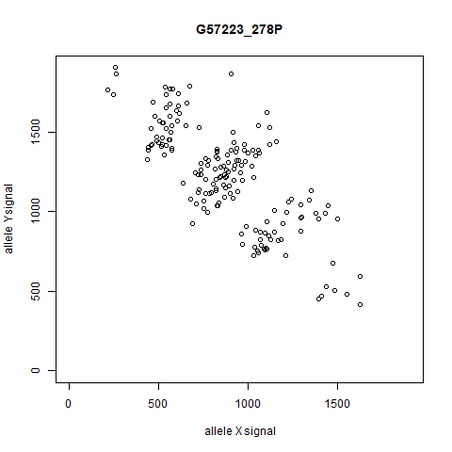
Genotyping data
YYYY quadruplex
XYYY triplex
XXYY duplex
XXXY simplex
XXXX nulliplex

Slide 8
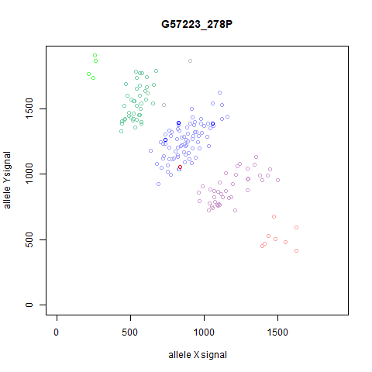
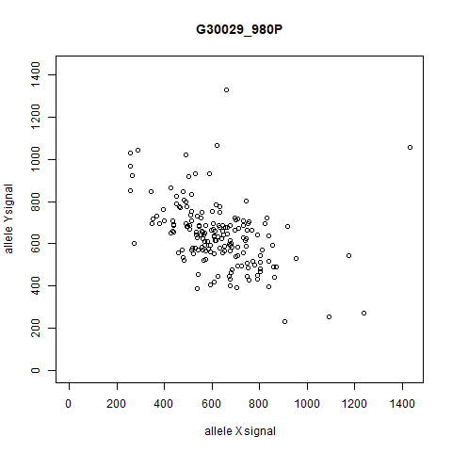
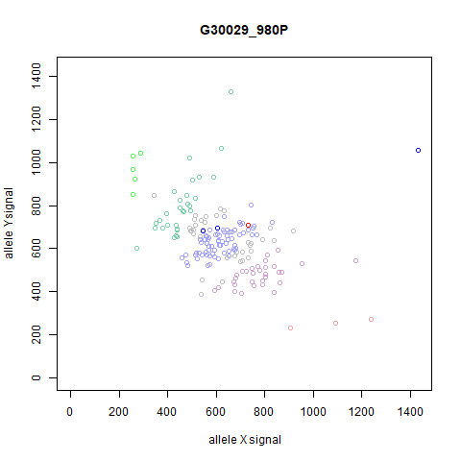
Genotyping: data and result

Slide 9
Dosage calling software
Most widely used packages for dosage calling
From array data:
fitPoly (fitTetra): Voorrips et al, 2011, 2019
SuperMASSA: Serang et al, 2012
ClusterCall: Schmitz Carley et al, 2017
From sequencing data:
updog: Gerard et al, 2018
polyRAD: Clark et al, 2019

Slide 10
fitPoly
Array data
Any ploidy, all samples same ploidy
Multiple populations, each with different genotype frequency expectations (HW, F1)
Deviating samples (wild relatives, other ploidy) can be genotyped without affecting the model
Operates on signal ratios: ratio = Y / (X+Y)
Fits mixture models
Optimization through EM (Expectation-Maximization) algorithm

Slide 11
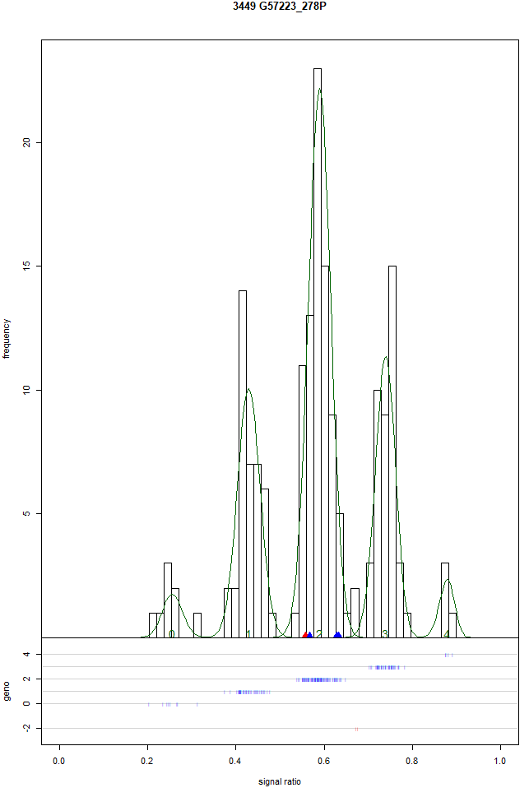
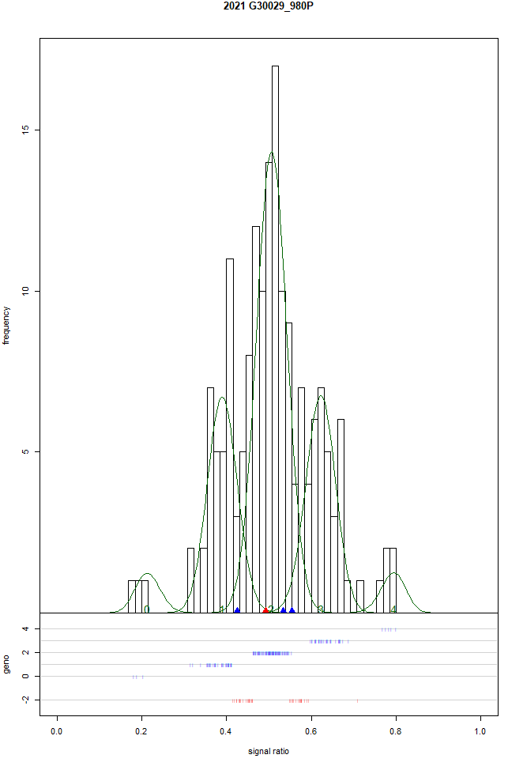
fitPoly – mixture model

Slide 12
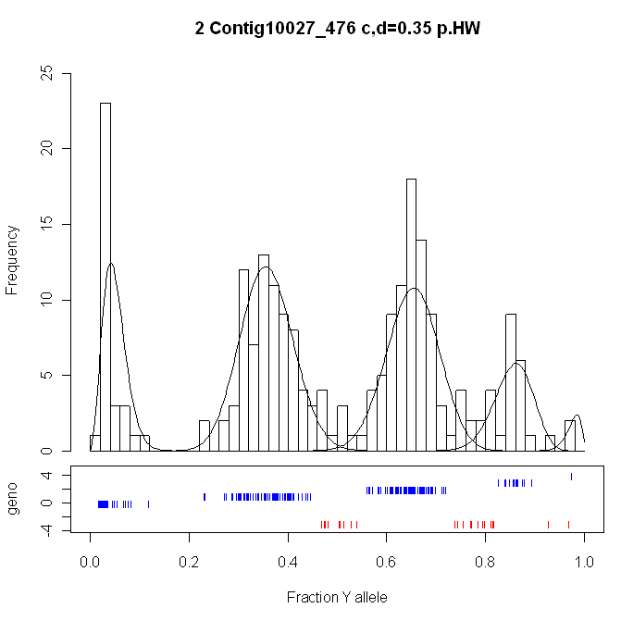
Dosage scoring: fitPoly
0
1
2
3
4
Peak probabilities:
P₀ | P₁ | P₂ | P₃ | P₄
0.00 | 1.00 | 0.00 | 0.00 | 0.00
0.00 | 0.00 | 0.23 | 0.77 | 0.00
Signal ratio = Y / (X+Y)

Slide 13
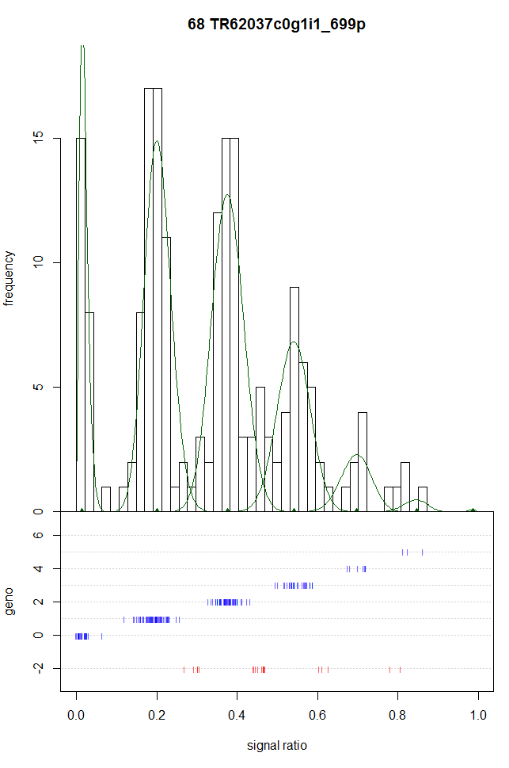
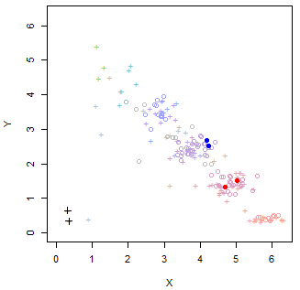
Hexaploid

Slide 14
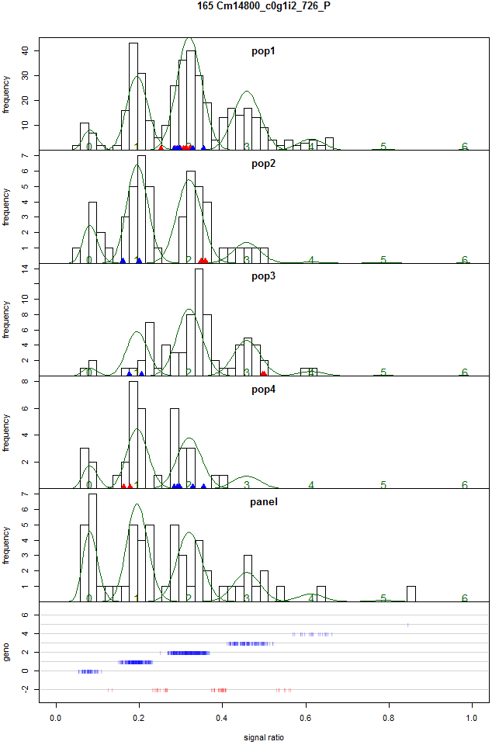
Multiple populations
Hexaploid (Chrysanthemum)
5 populations:
4 F1
1 panel (HW)

Slide 15
Summary
In diploids there is only one type of heterozygote, in polyploids there are multiple
these have different allele dosages
SNP allele dosages can be detected by sequencing or using SNP arrays
Raw data from sequencing (read counts) or arrays (signal intensities) must be converted to allele dosages
several software packages available

Slide 16
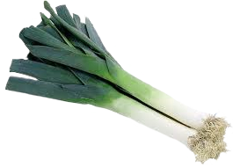
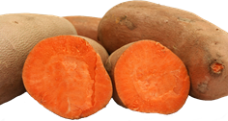
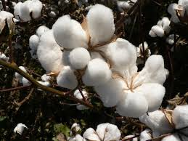
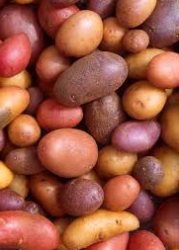
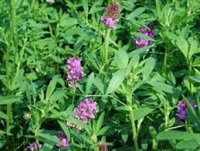
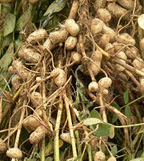
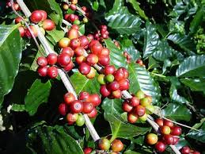
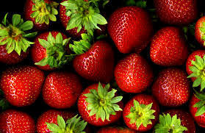
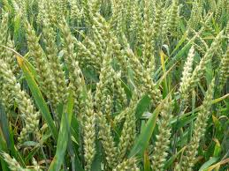
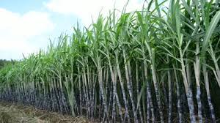
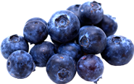
Questions ....?

